Slide 1
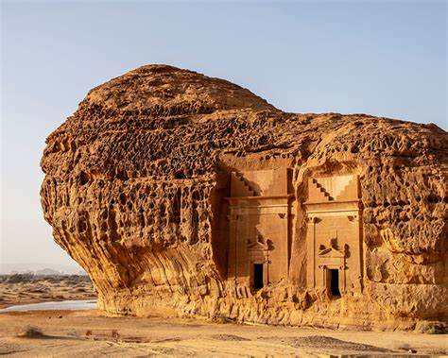
Reading P: 31
The Stones of al-ula

Slide 2
Objectives:
Read a text about the stones of AlUla
Answer questions about a text
Identify new words

Slide 3

Where is Al-Hijr?
write down everything you know about Al-Ula.

Slide 4
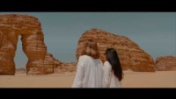


Slide 5
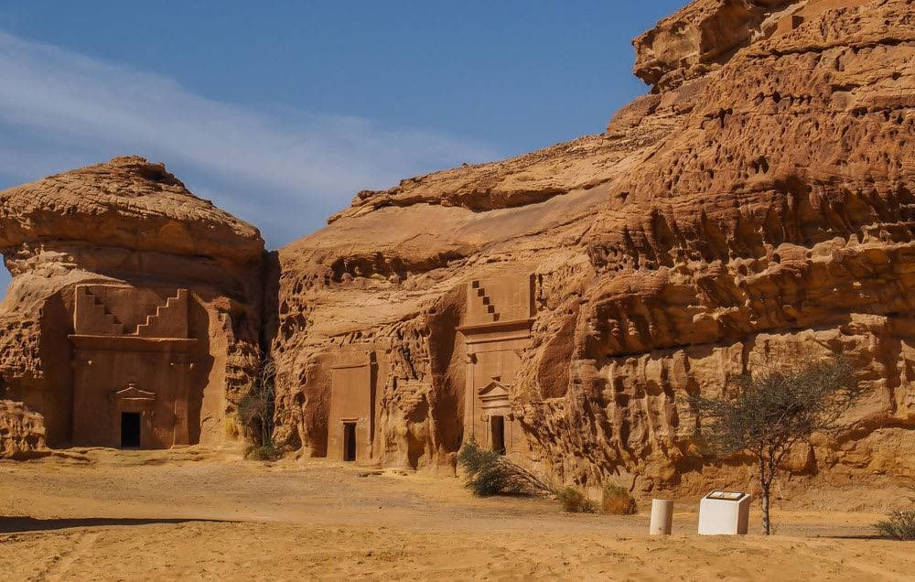
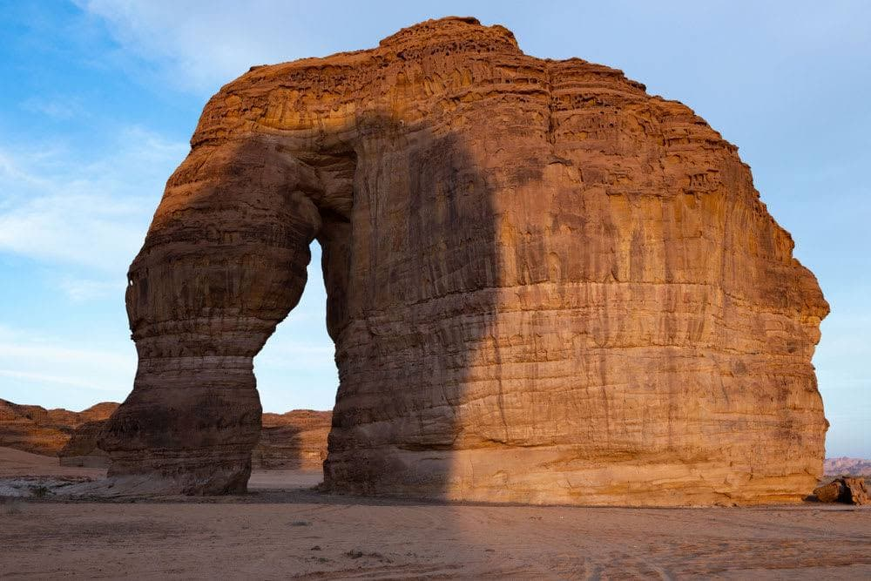
Al-ula
Mdaen Saleh
Elephant Stone

Slide 6
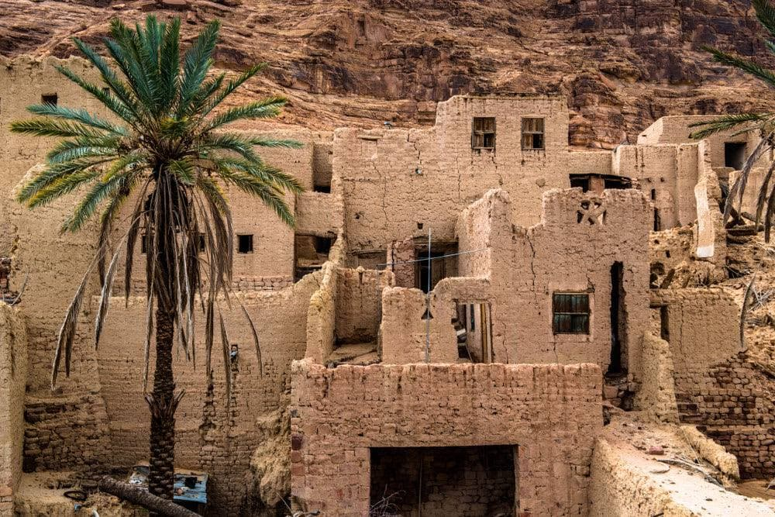
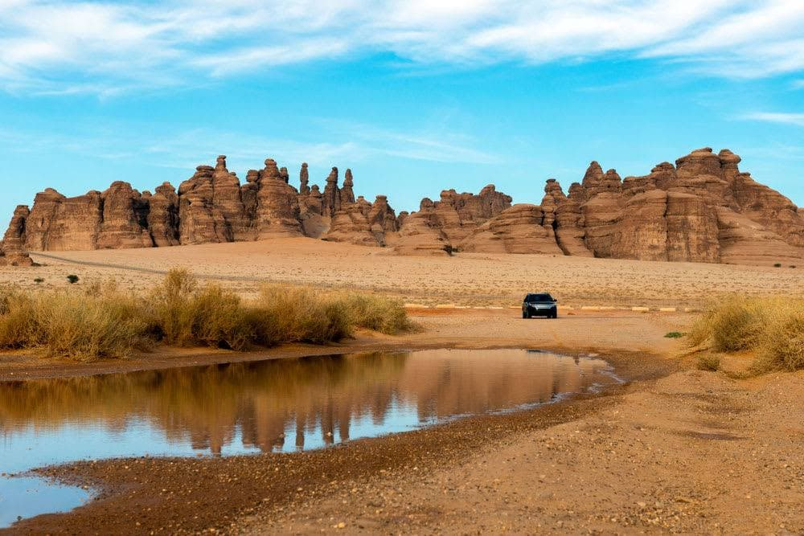
Old City
Al-Ula oasis

Slide 7
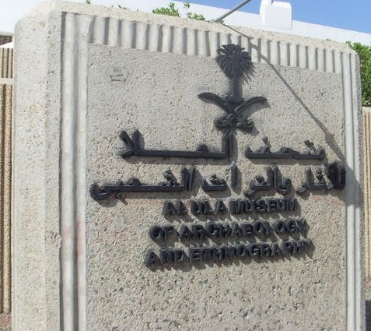
Museum

Slide 8
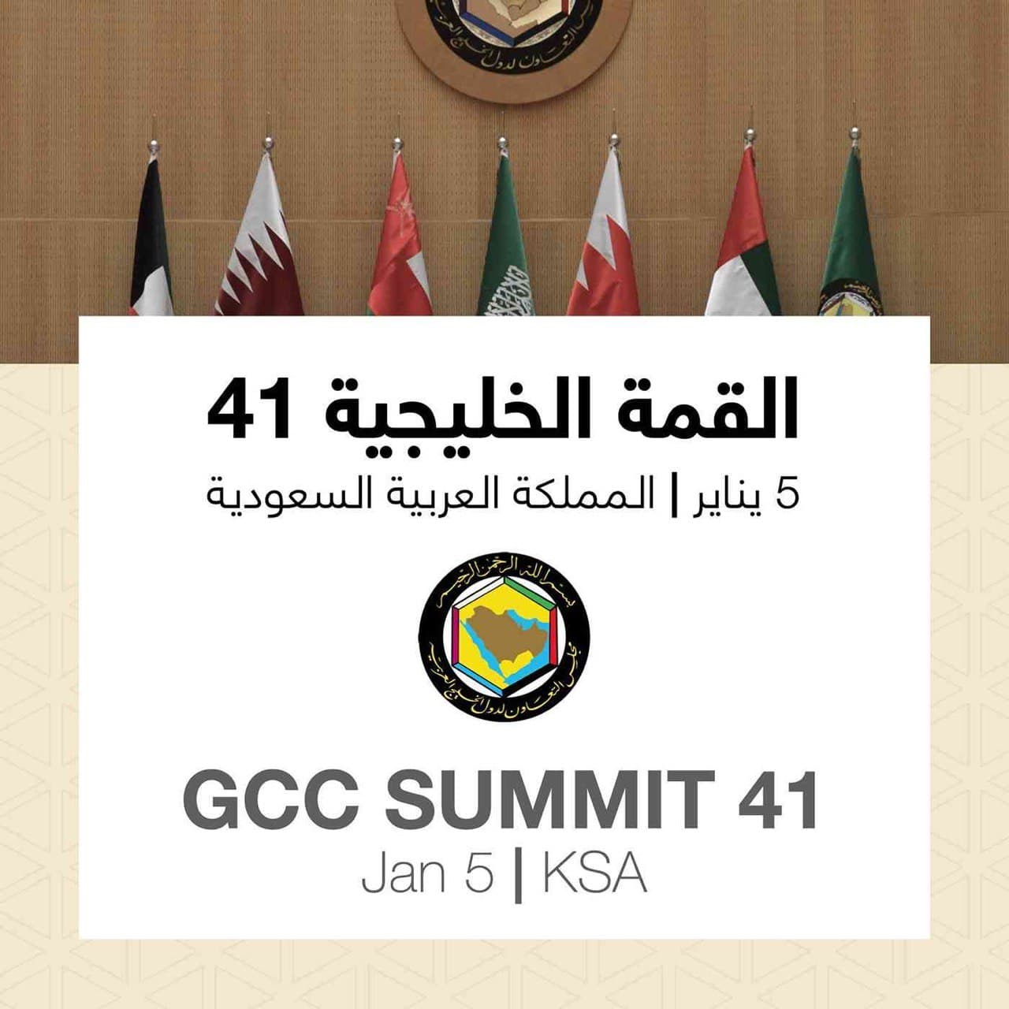
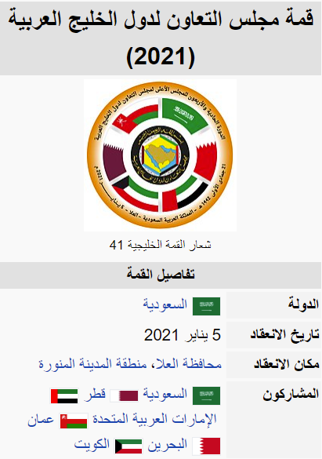
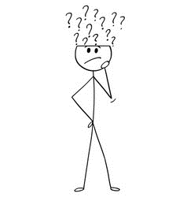
Where was the Arabic gulf summit 41 ?

Slide 9

Open your book page 31

Slide 10
Who is the email to?
What is the email about?
Who is the email from?

Slide 11
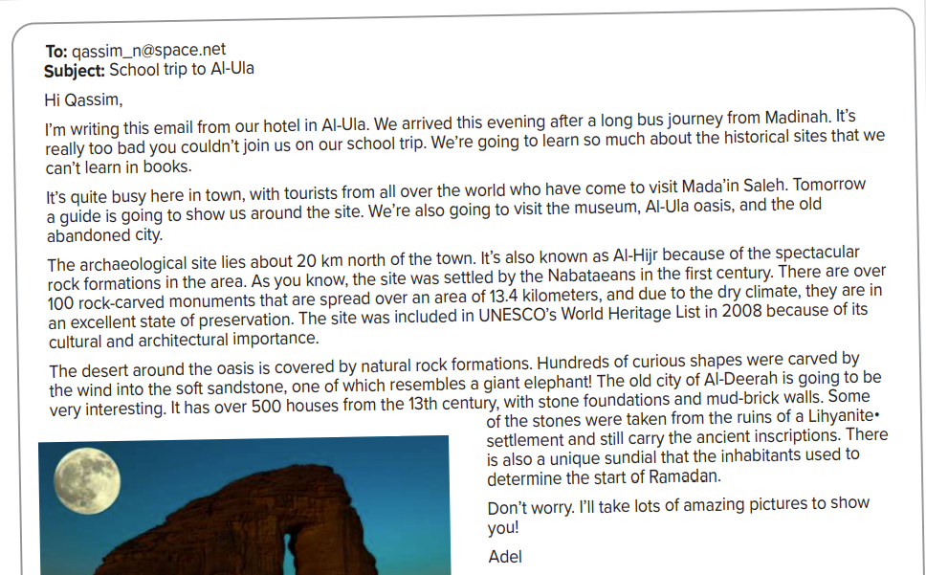


Slide 12
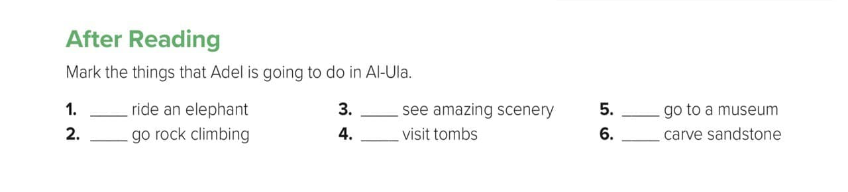

Slide 13

H.W
P:104

Slide 14
An Infographic

