Slide 1
Unit 3 Amazing Animals Form,Meaning & Function
Mega Goal 2.3
Done by : Entisar Al-Obaidallah

Slide 2
Lesson Objectives
Form
Add
01
02
Use
Apply
03
04
Correct sentences using adjectives
suffixes to form adjectives from verbs and nouns
all, both, neither and none to compare two or more things, places, animals or people
the rules to do the exercises correctly

Slide 3
Open
Student’s book pages
( 44 – 45 )

Slide 5
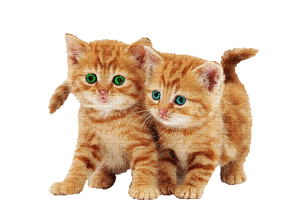
Adjectives:
We use adjectives to describe nouns( person , thing or place) .
Example :
Sport Car
Beautiful cats
Hot Coffee

Slide 6
Place adjectives in two positions in a sentence :
Position of Adjectives
Be
( am , is ,are, was & were)
Before a noun
After the verb Be
Red Apple
Apple is red
Note : We place adjective after (linking verbs) such as: become , feel , seem, get & sound

Slide 7
Before Noun
01
Structure : S + adjective + noun
Example :
It is a hot tea .
subject
adjective
noun

Slide 8
After the verb “ Be”
Structure : S + verb to be + adjective
02
Example :
Verb (be)
The tea is hot .
subject
adjective

Slide 9
Adjectives from Verbs & Nouns
➔A lot of adjectives are formed from verbs and nouns .
➔Many adjectives are formed by adding the following suffixes :
-y , -ful , -less , -ate , -al , -ive ,-ous , -ic , -ed or –ing .
noun
Example :
You won’t get much use out of that bag .
adjective
That bag is useless .

Slide 10
03
affectionate
cooperative
joyfully
loving
famous
healthy
beautiful
energetic
loyal

Slide 11
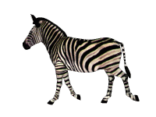
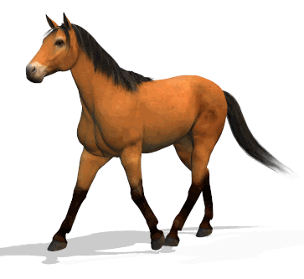

Slide 12
All / Both / Neither / None
Use
to compare two or more things, places, animals or people .
Example :
All tigers, cheetahs, leopards, and lions are big cats.
Both cheetahs and leopards are fast animals.
Neither tigers nor lions can be domesticated.
None of the big cats can be domesticated. They are all wild animals.

Slide 13
All
Refers to more than two people , things .
It is followed by a plural verb ..
It is used in affirmative sentences .
Example :
All the players are excited .
They are all friendly .
All tigers,lions and wolves are wild animals .

Slide 14
Both
It is used for two people, things, etc.
It is followed by a plural verb .
It is used in affirmative sentences .
Example :
Both iphone and Galaxy are smart phone .
Both Ali and Khaled have bikes.
They both live in Riyadh .
Both of them are friendly .

Slide 15
Neither
It is used for two people, things, etc.
It is followed by a singular or plural verb .(depends on the subject)
It is used in affirmative sentences and gives them a negative meaning. .
Example :
Neither Ali nor Ahmad likes football .
Neither he nor his friends came back .
Neither My father nor my brother knows him .

Slide 16
None:
It is used for more than two people, things, etc.
It is followed by a singular or plural verb .
It is used in affirmative sentences and gives them a negative meaning.
Example :
All my friends love chicken. None of them likes/like vegetables..
None of my friends speak / speaks English .
None of them has / have a smart phone .

Slide 17
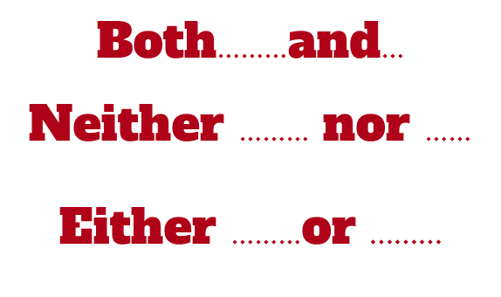
They are all paired or Double conjunctions .
They are used to link two words , phrases , or clauses of the same type .
They are used only in affirmative sentences

Slide 18
Both…and… :
It is used when something is true for two people, things, etc.
When combining the subjects of two sentences , the verb is always plural
It is used only in affirmative sentence.
Example :
Both Ali and Yasser have to comply with rules ..
Both Sara and Nora are my friends ..
My uncle has both a girl and a boy .
This house is both large and cozy .

Slide 19
Either………or
02
to talk about two possible ideas or choices .
The using of singular or plural verb depends on the subject that is closer to the verb .
Use
Either Ali or Saad has to give up their jobs.
Either Sara or Nora is my friends ..
Either my mother or my sister cooks dinner..
I left the book either on the table or the drawer.
I will drink either coffee or tea .
Example :

Slide 20
Neither……nor
Use
Used to talk about Negative or impossible ideas or choices .
The using of singular or plural verb depends on the subject that is closer to the verb .
Neither my father nor my mother went to university
Neither students nor teacher was at class..
Love is neither bought nor sold.
I likes neither milk nor cream cake.
Neither Fahad nor Khaled is my brother .
Example :

Slide 21
1-Both Prince Sultan and Majed Abdullah were born in Saudi Arabia
2-Both Prince Sultan and Majed Abdullah were famous
3-Both Prince Sultan and Majed Abdullah were on 1984 Olympics
4-Neither I nor my friend have heard about younger person to fly on
the space than Prince Sultan

Slide 22
Quick Chick
https://wordwall.net/ar/resource/12393180.
https://wordwall.net/ar/resource/12395221
https://wordwall.net/ar/resource/12396710

Slide 23
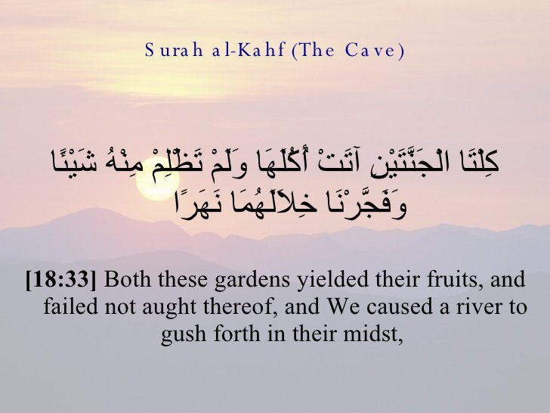
From The Holy Quran

Slide 24
Homework
Workbook page ( 110 ) , exercise ( N )

Slide 25
Thanks!

