Slide 1

Unit 5 Writing
SG4
Tr. Nora Khalid

Slide 2
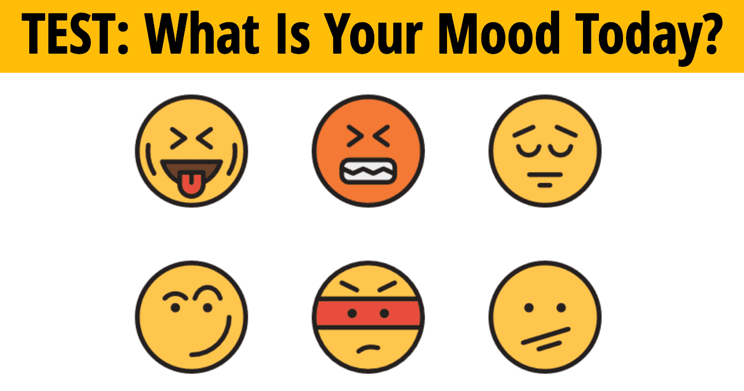

Slide 3

Objectives:
Write
about how the weather affects a person
Classify
adjectives that describe moods and those that describe the weather
Practice
The uses of “if” and “when”

Slide 4
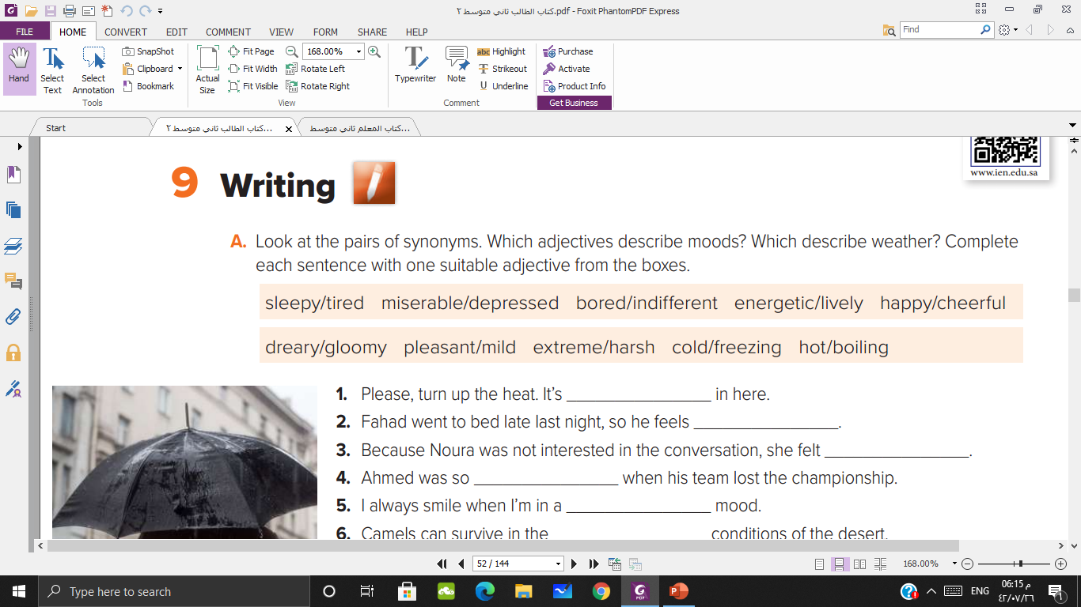


Slide 5
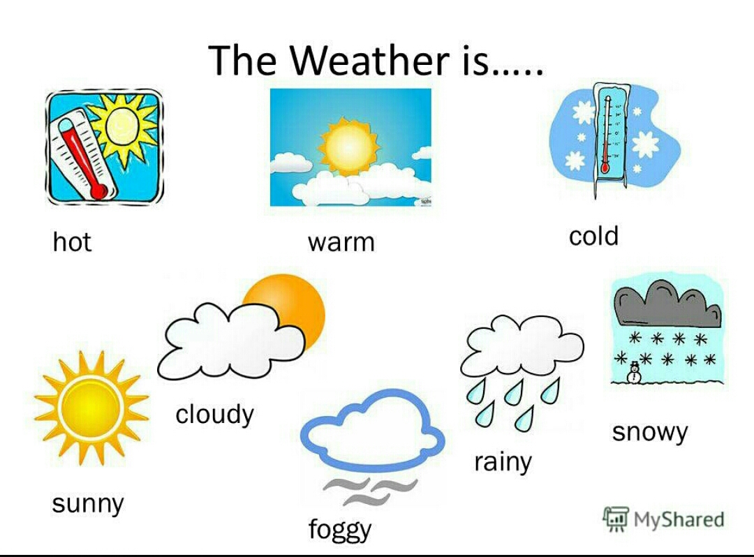

Slide 6

Find out the meaning of the new vocabulary

Slide 7
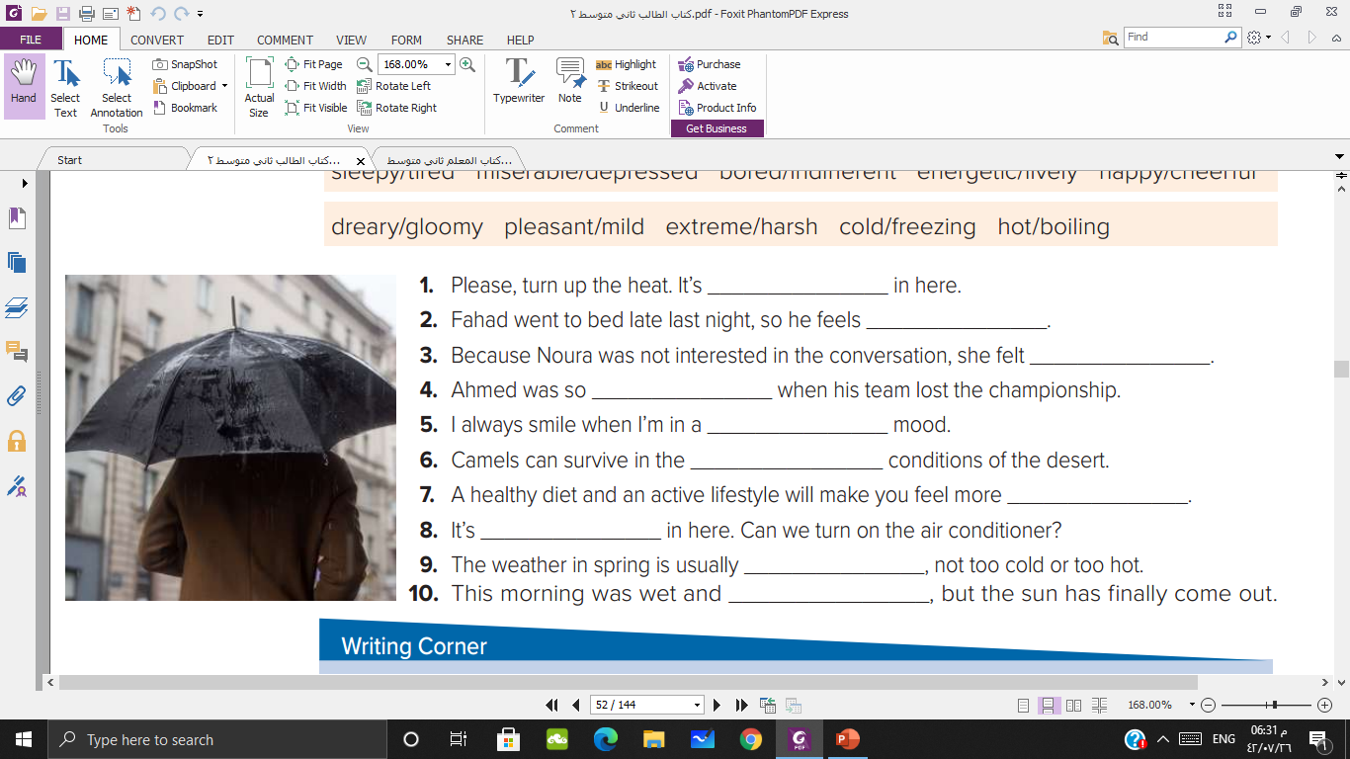
cold / freezing
sleepy / lazy
bored/indifferent
miserable/depressed
happy/cheerful
Extreme/harsh
energetic/lively
hot / boiling
pleasant / mild
deary / gloomy
Notes:
بهذه الشريحة يتم توضيح المحادثة وكيفية الحوار بين الطالبات ثم يكون التطبيق بالشريحة التي بعدها

Slide 8
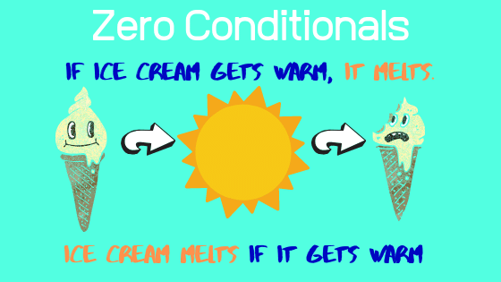

Slide 9
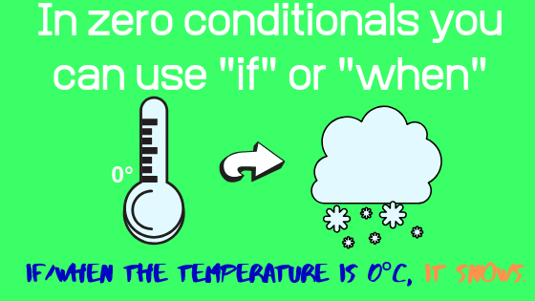

Slide 10
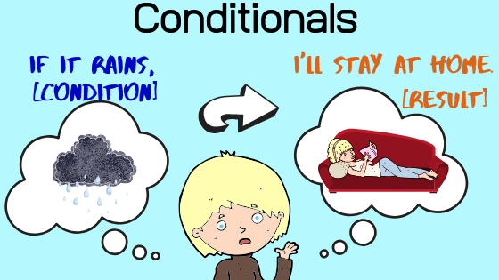

Slide 11
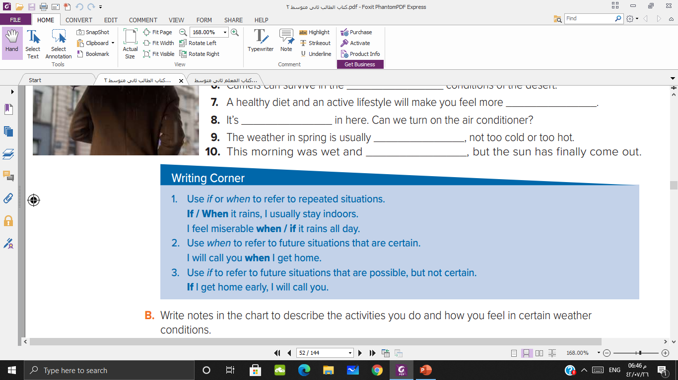

Slide 12

If it a pleasant day, ……..

Slide 13
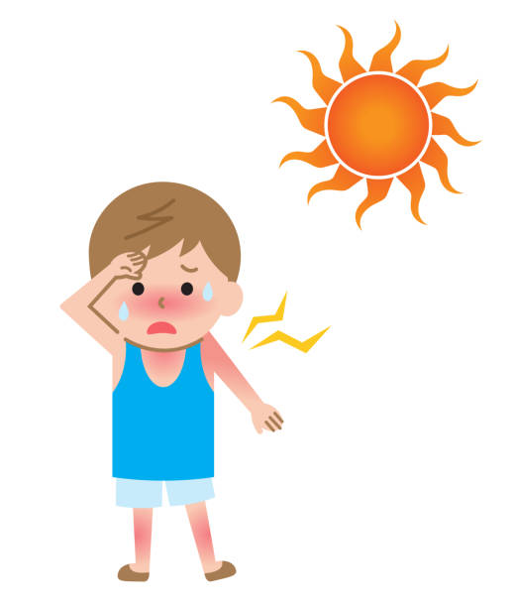
If the weather is boiling, ……..

Slide 14

I feel cheerful when, ……..

Slide 15
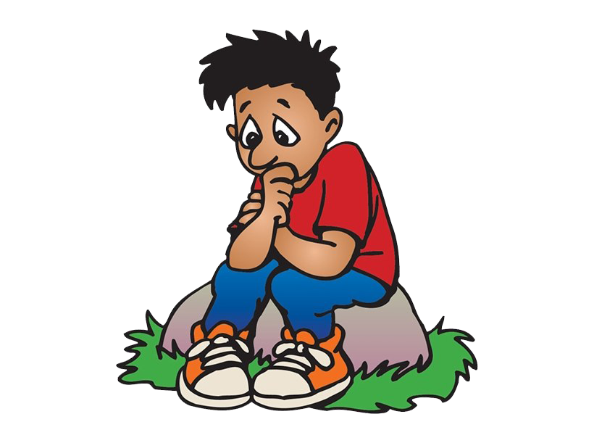
I feel depressed when, ……..

Slide 17

If I finish my homework early, ……..

Slide 18

If he misses the bus, ……..

Slide 19

My parents will be happy if, ……..

Slide 20
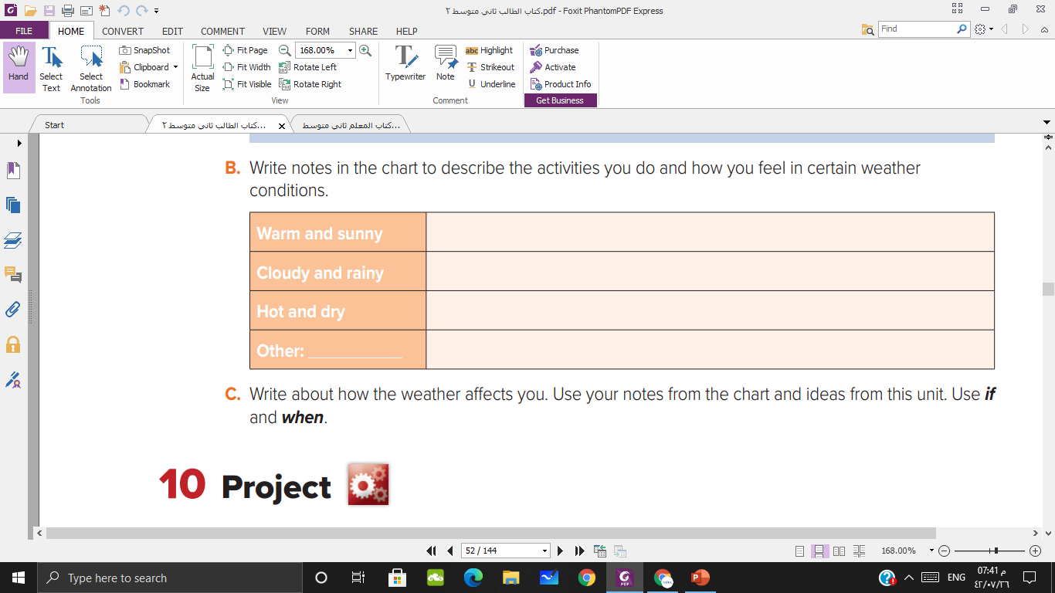







Slide 21
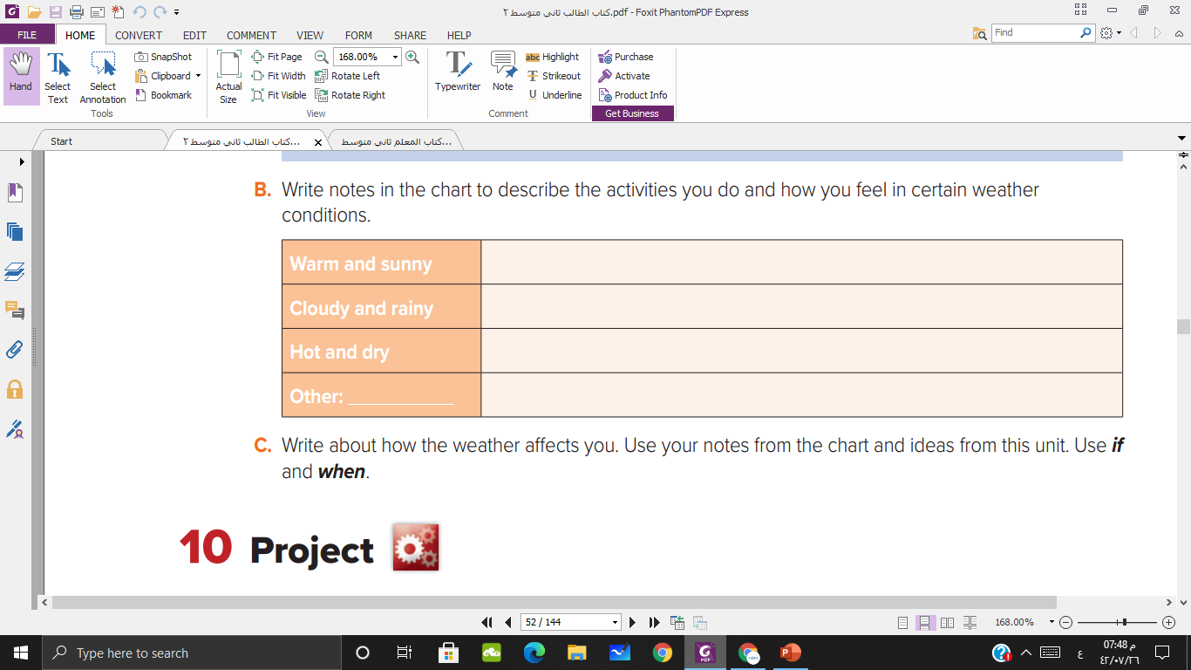
When it is warm and sunny, I feel energetic, and I go for a picnic with my family
If it cloudy and rainy, I feel relaxed and I stay at home
If it is hot and dry, I feel bored and I always go swimming

Slide 22
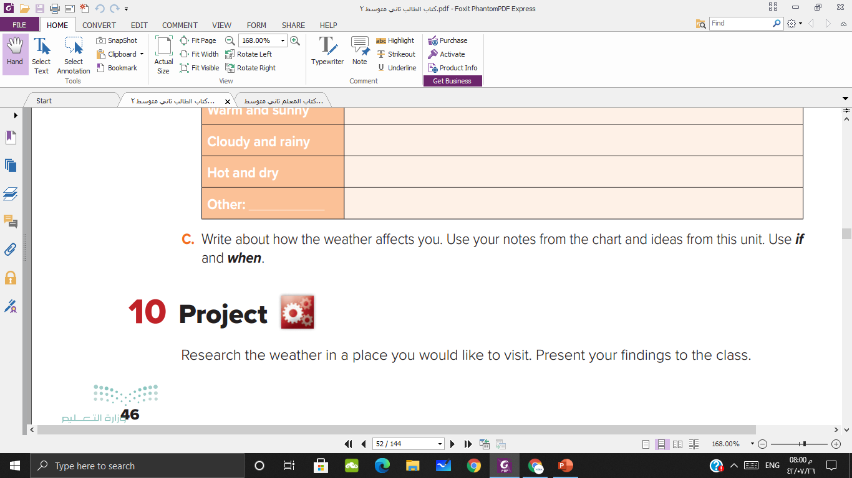


Slide 23


Slide 24

Thank you

