Slide 1

Unit 7
Today’s News
Part 3

Slide 2
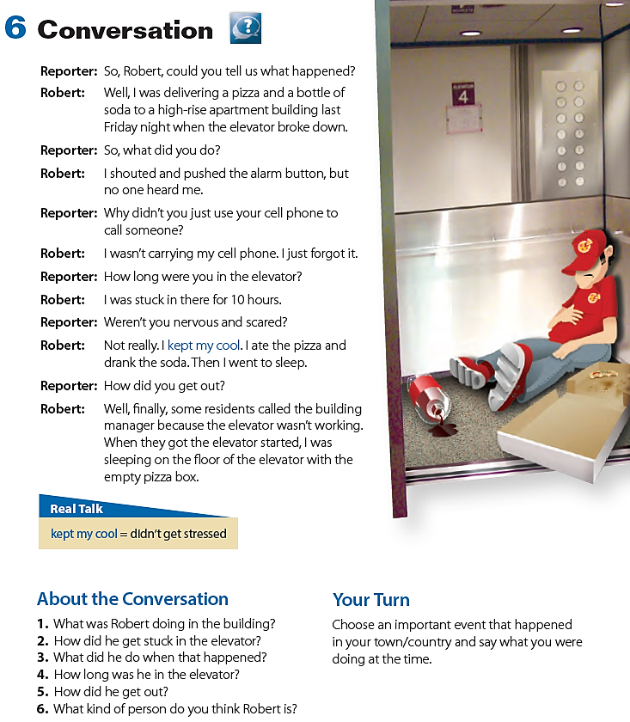

Q:3
Q:5
Robert was delivering a pizza.
He got stuck in the elevator because it broke down.
He was in the elevator for 10 hours.
He is a calm person who doesn’t get upset easily.

Slide 3
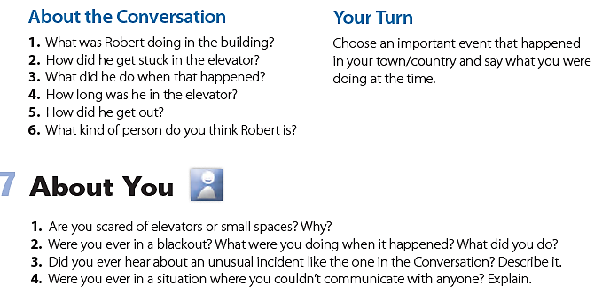

Slide 4
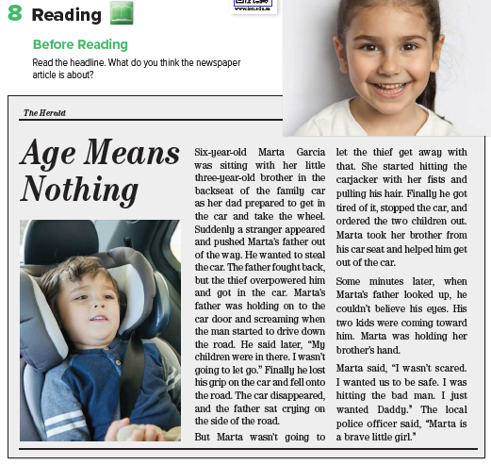
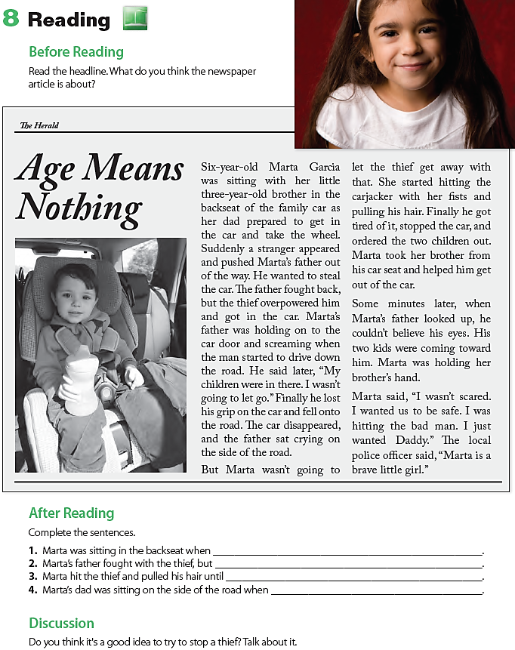
1-a stranger pushed her father out of the way, got in the car, and drove away
2-the thief overpowered him and got in the car
3-he stopped the car and ordered the children out
4-he saw his two children walking toward him

Slide 5
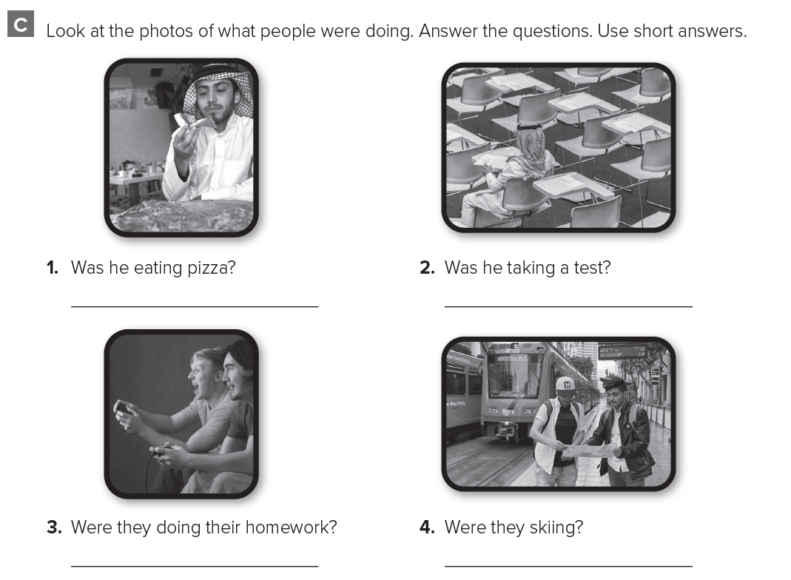
Yes , he was .
No , he wasn’t .
No , they weren’t .
Yes , they were .

Slide 6
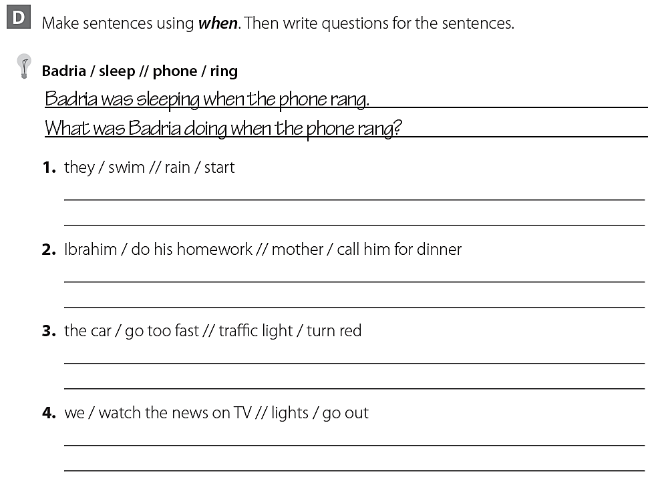
They were swimming when the rain started .
What were they doing when the rain started ?
Ibrahim was doing his homework when his mother called him for dinner .
What was Ibrahim doing when his mother called him ?
The car was going too fast when the traffic light turned red .
What was the car doing when the traffic light turned red ?
We were watching the news on TV when the lights went out .
What were you doing when the lights went out ?

