Slide 1

Unit 7 Reading p 61
Tr. Nora Khalid

Slide 2

Read
An article in newspaper
Answer
Some questions about the article

Slide 3


Slide 4
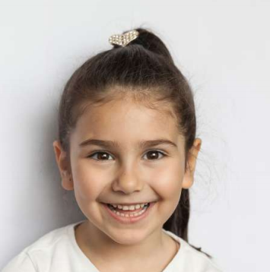

How old is the little girl in the picture?

Slide 5
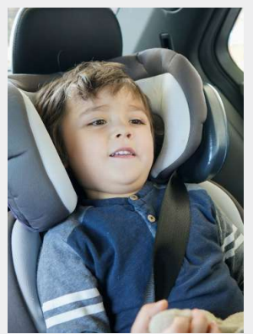
How old is the child in the car seat?

Slide 6
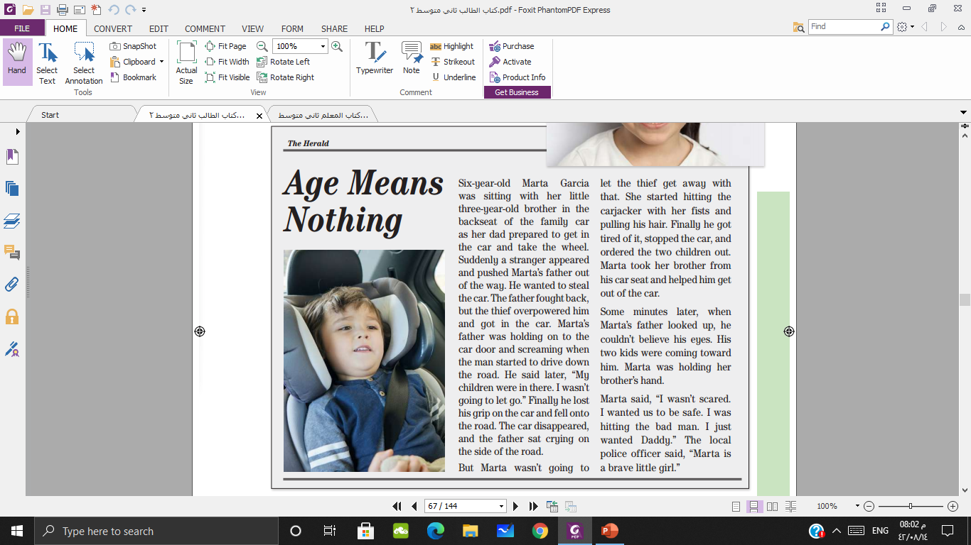
The headline
What do you think the newspaper article is about?

Slide 7
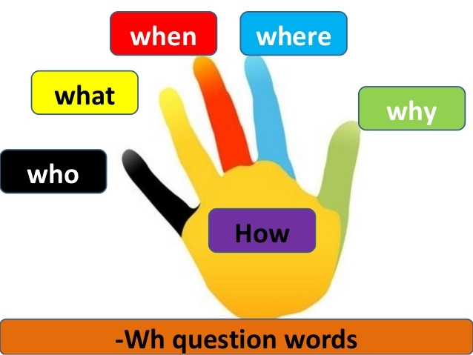

Slide 8


Slide 10

Six-years old Marta
One day
She wanted her daddy
She stopped a thief
In a car

Slide 11
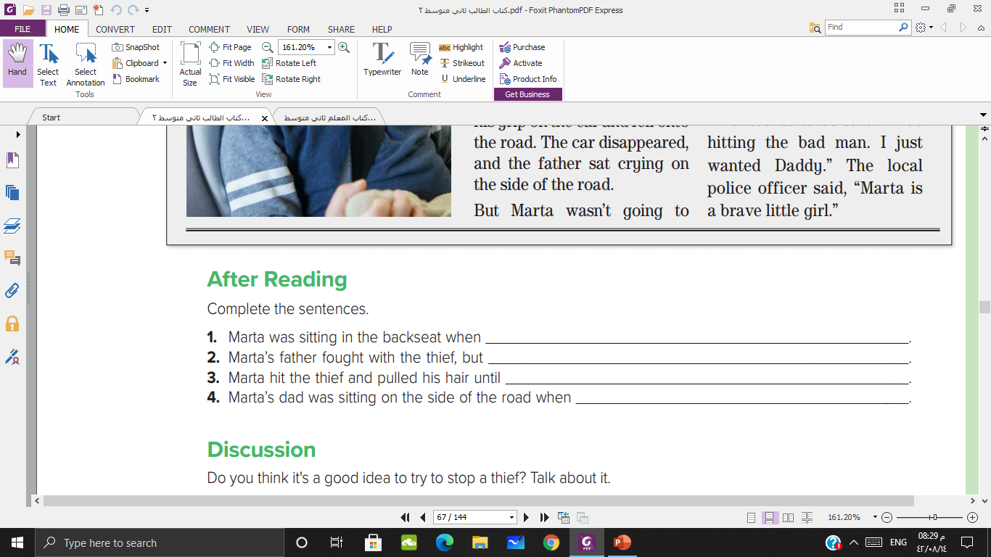

a stranger pushed her father out of the way, got in the car, and drove away
the thief overpowered him and got in the car
he stopped the car and ordered the children out
he saw his two children walking toward him

Slide 12


