Slide 1
U 2 It’s a bargain
Grammar

Slide 2
Use possessive adjectives and possessive pronouns.
Ask questions by using “whose”.
Differentiate between one and ones.
Use “too” correctly.
Listen to complete information in an ad.
Pronounce Linking adjacent sounds.

Slide 4
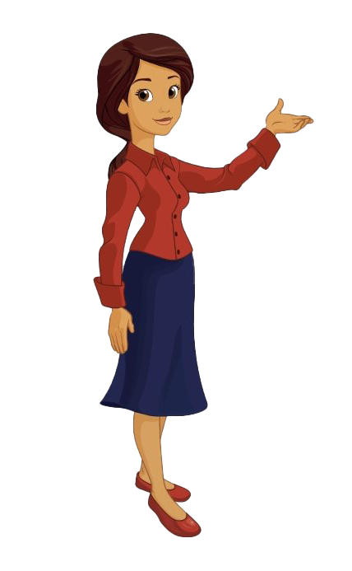
Do you remember my name?
My name is Nora

Slide 5
What’s is your name?
My name is ……

Slide 6
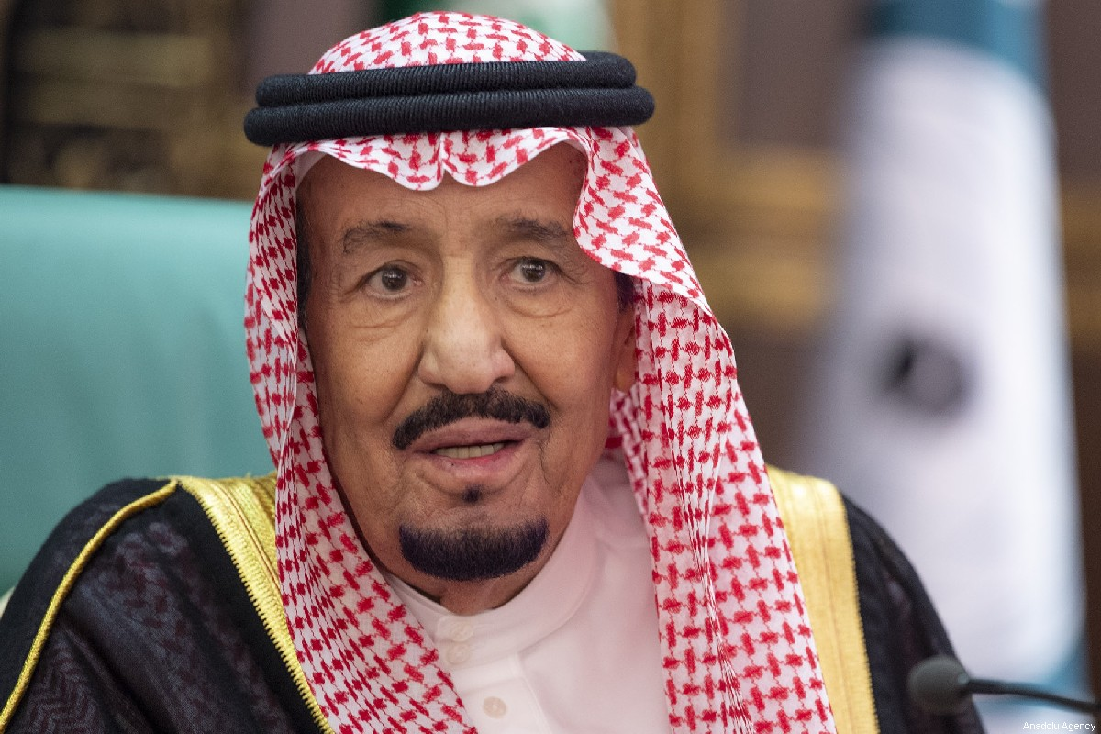
What is his name?
His name is King Salman

Slide 7
What is her name?
Her name is Reema Bent Bander

Slide 10
Bring me an item !

Slide 13
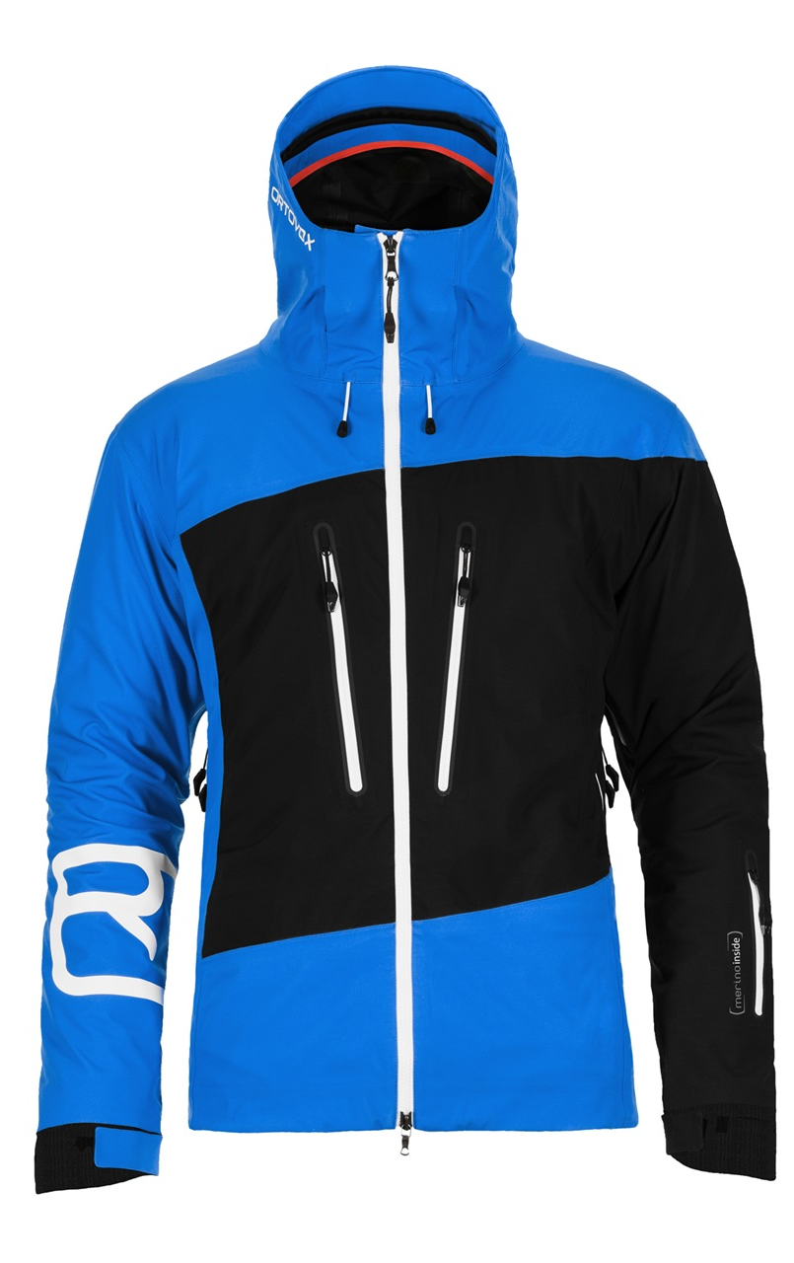
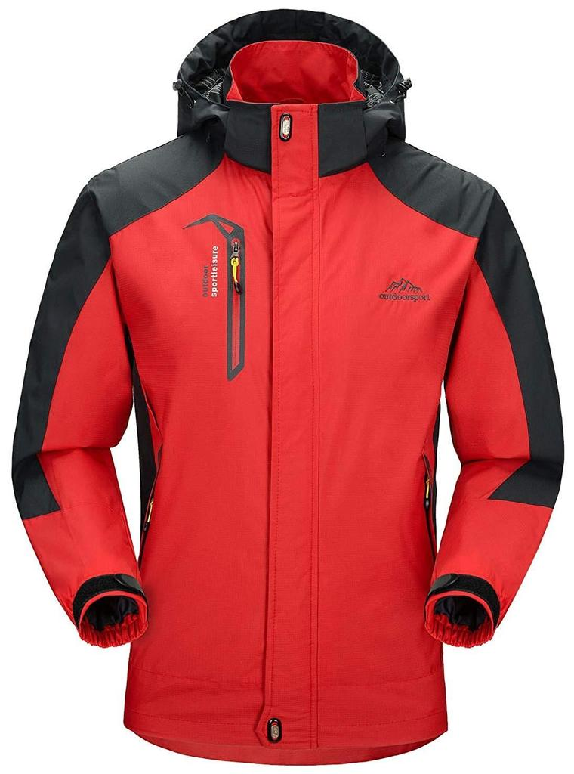
This jacket is too small
This jacket is too big

Slide 14
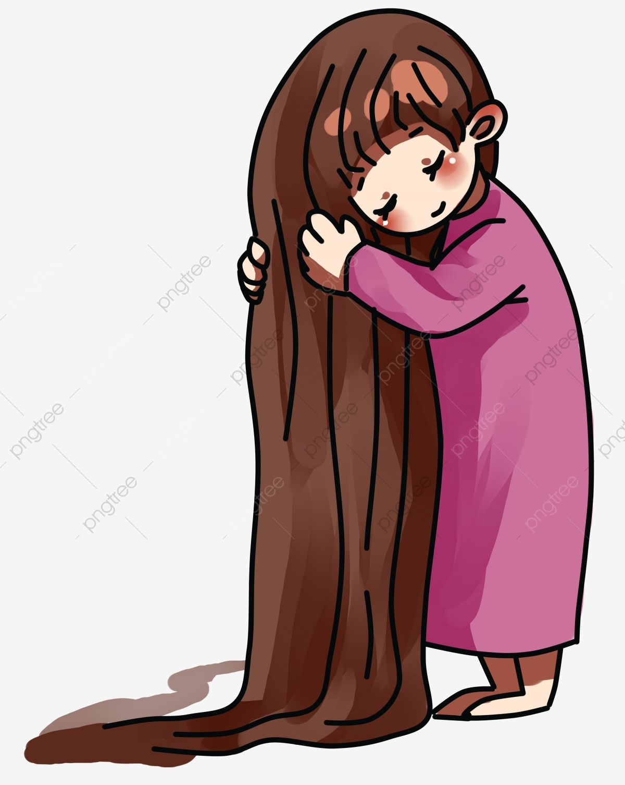
This hair is too long
This jacket is too short

Slide 15
Windbreaker
Necklace
Bag
Socks
Perfume

Slide 16
Whose bag is this?
Whose necklace is this?
Whose perfume is this?
Whose socks are these?

Slide 18
10
What do you think goes before a.m. and p.m.? (a number) Before a % sign? (a number)
After an adjective like special? (a noun) Do you think a plural noun or a singular noun goes after pair of? ( a plural noun)
9
20
sweaters
shirts
50
25
earrings
one
gift
One free

Slide 20
P 94-95

