Slide 1

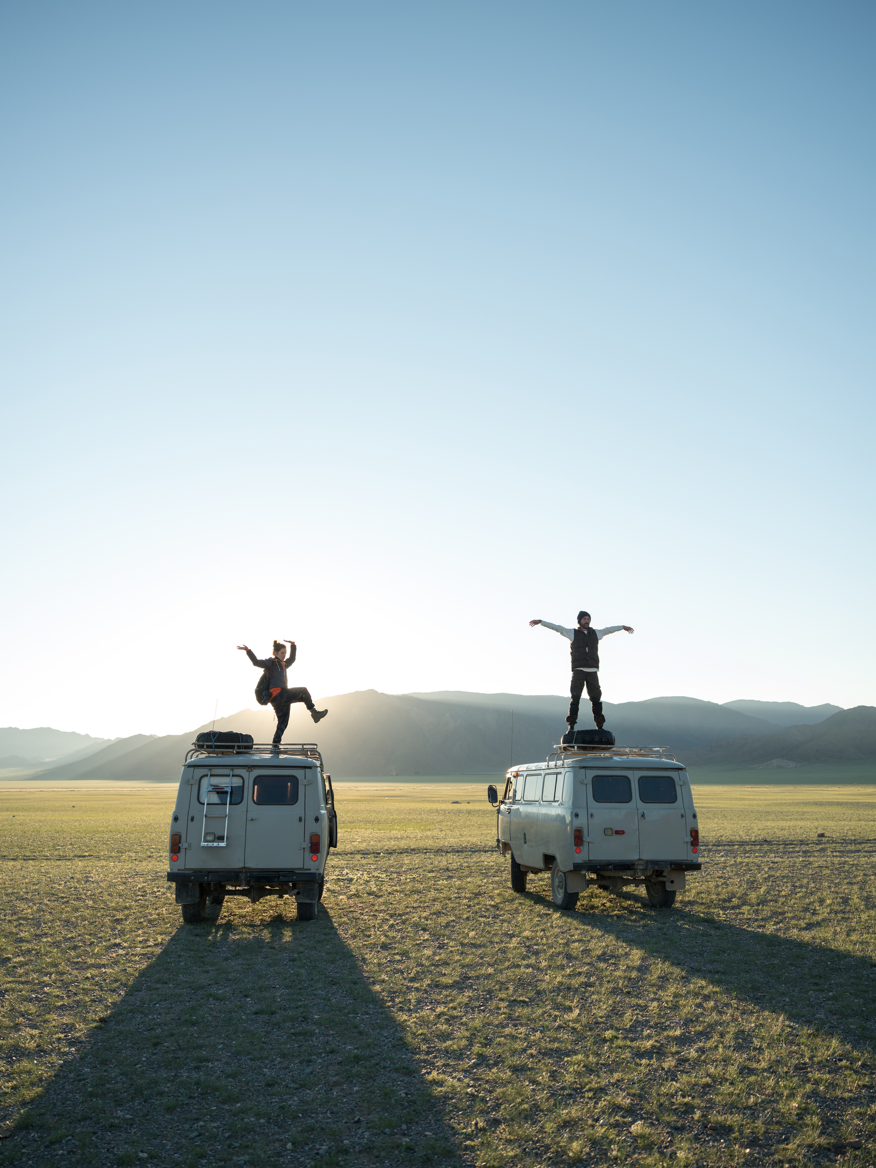

It's Going to Be Fun!
T. Sara Alaifan

Slide 2

By the end of the lesson
you will be able to:
- Match what you listen to with the corresponding part of the brochure in your book.
- Use “be going to” to talk about future plans.
- Make as many sentences as you can about places in your country and/or region of the world, using the adjectives in Quick Check A.
- Use the noun vacation correctly.
- Infer from the brochure all the adjectives.

Slide 3

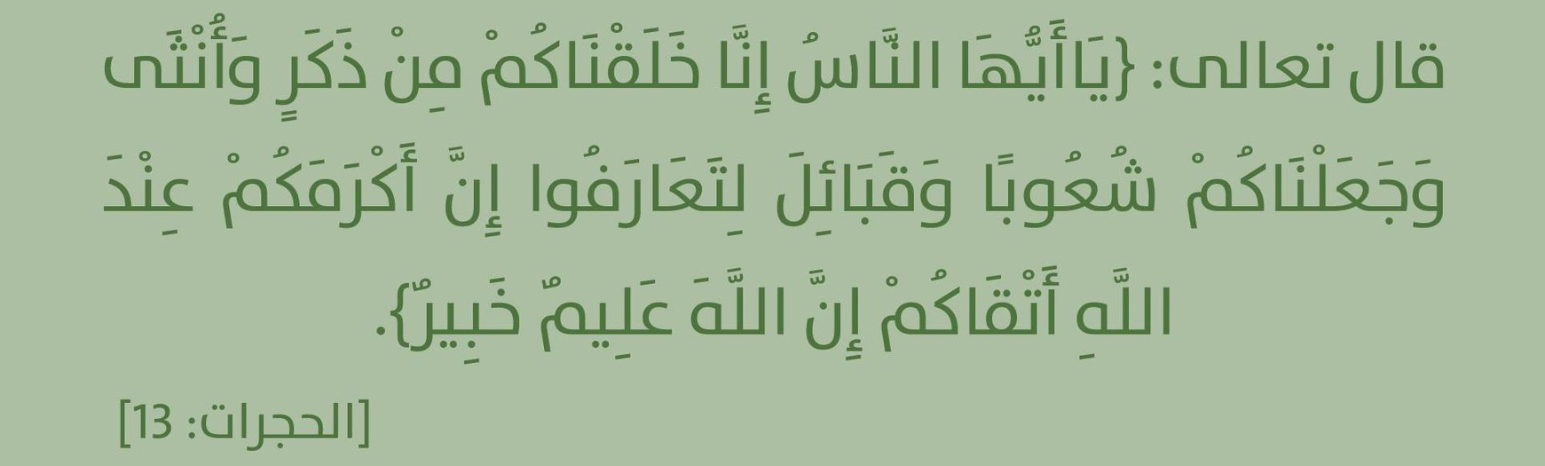
*Traveling is one of the most important ways that help people make new relationships with people from all over the world.

Slide 4

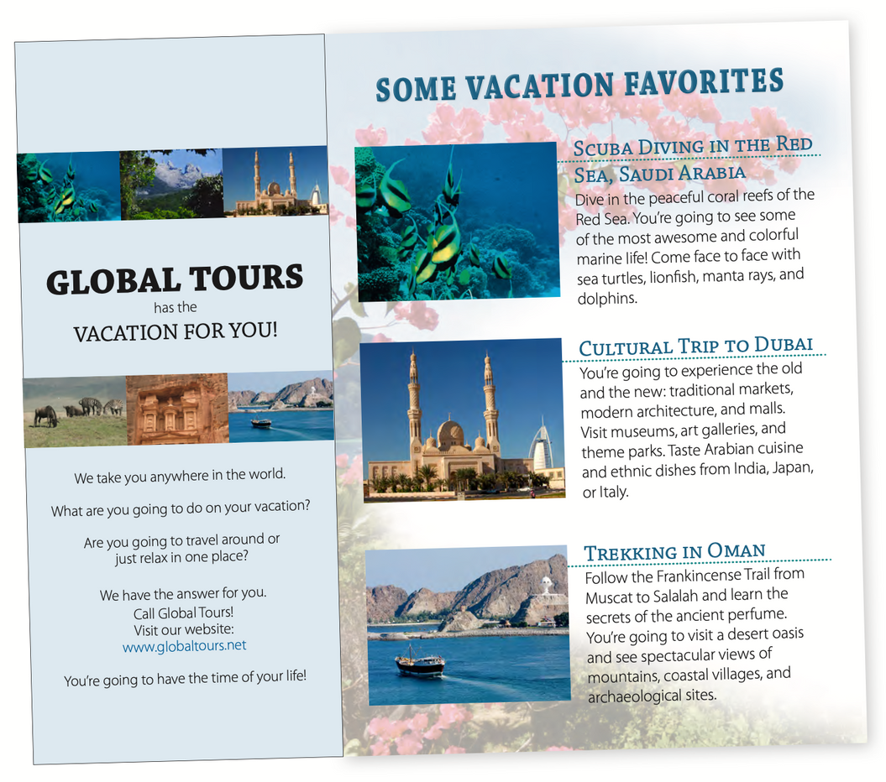
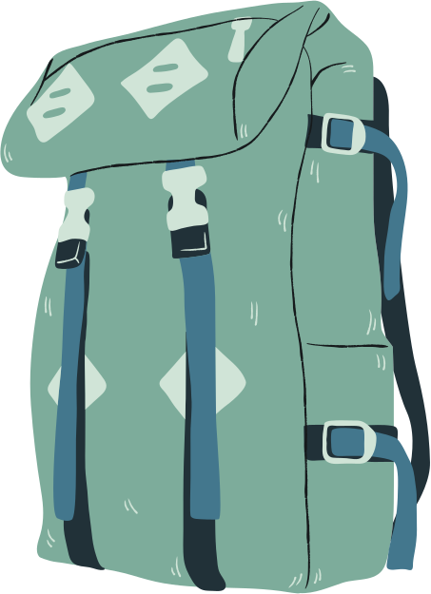
What is it?
vacation places
What is this brochure for?
What’s the name of the company on this brochure?
What does the first picture show?
What about the second picture?
What about the third picture?
Global Tours
marine life
A modern mosque
Frankincense Trail

Slide 5
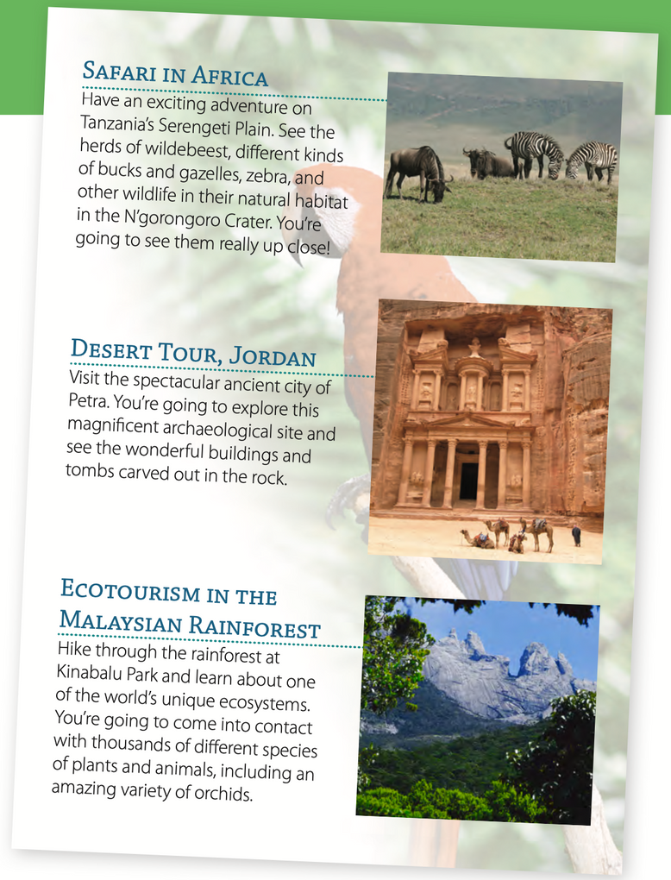
What is it?
What does the forth picture show?
What about the fifth picture?
What about the sixth picture?
Wildlife
Desert
Rainforest

Slide 6
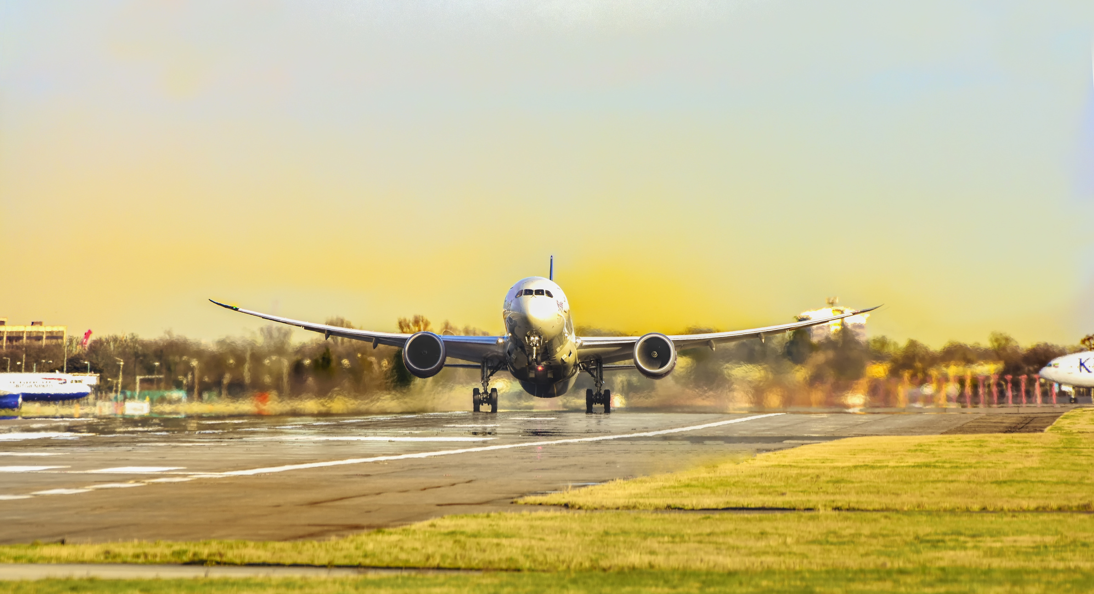



Which country should you visit if you want to see museums and modern architecture?
Dubai
How about if you want to follow an ancient trail?
Oman
Where can you go on a safari and see wildlife in their natural habitat?
Africa

Slide 7
What about if you want to go
scuba diving?
Saudi Arabia
How about if you want to visit archaeological sites like tombs?
Jordan
Which country is a good place to visit if you are interested in ecosystems?
Malaysia

Slide 8

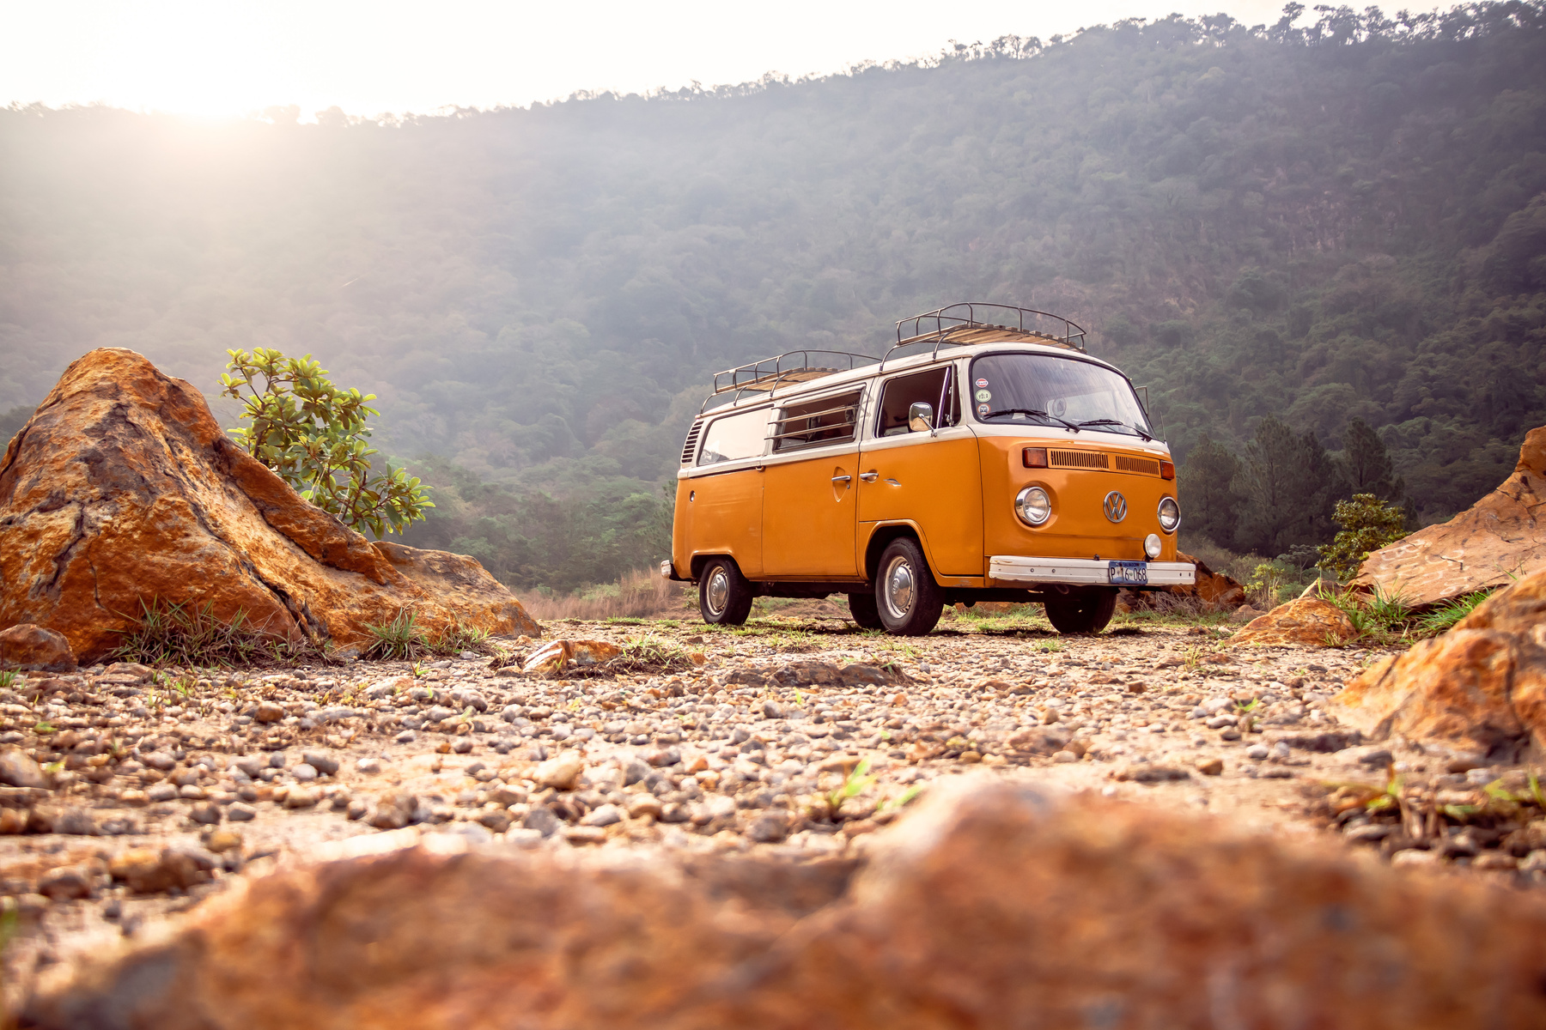



What kind of vacation do you prefer?
Discuss your choices with a partner.

Slide 9


IT'S TIME TO LISTEN!

Slide 10
Peaceful Popular
Safe Exciting/Thrilling
Inexpensive Adventurous
Unusual Luxurious
Quiet Exotic
Noisy Relaxing
LET'S EXPAND OUR VOCABULARY!

Slide 11

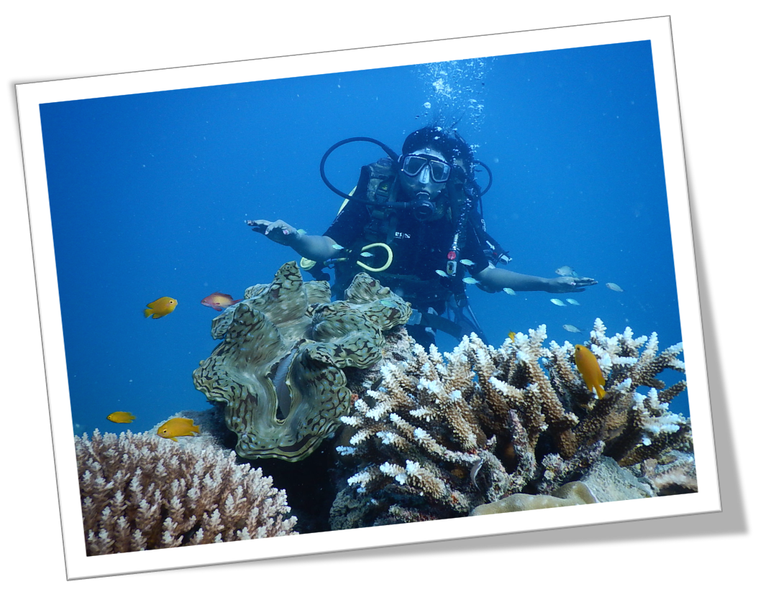
The scuba diving vacation in Saudi Arabia
is going to be thrilling
Use "is going to be" and the new adjectives to make sentences about future vacations.

Slide 12
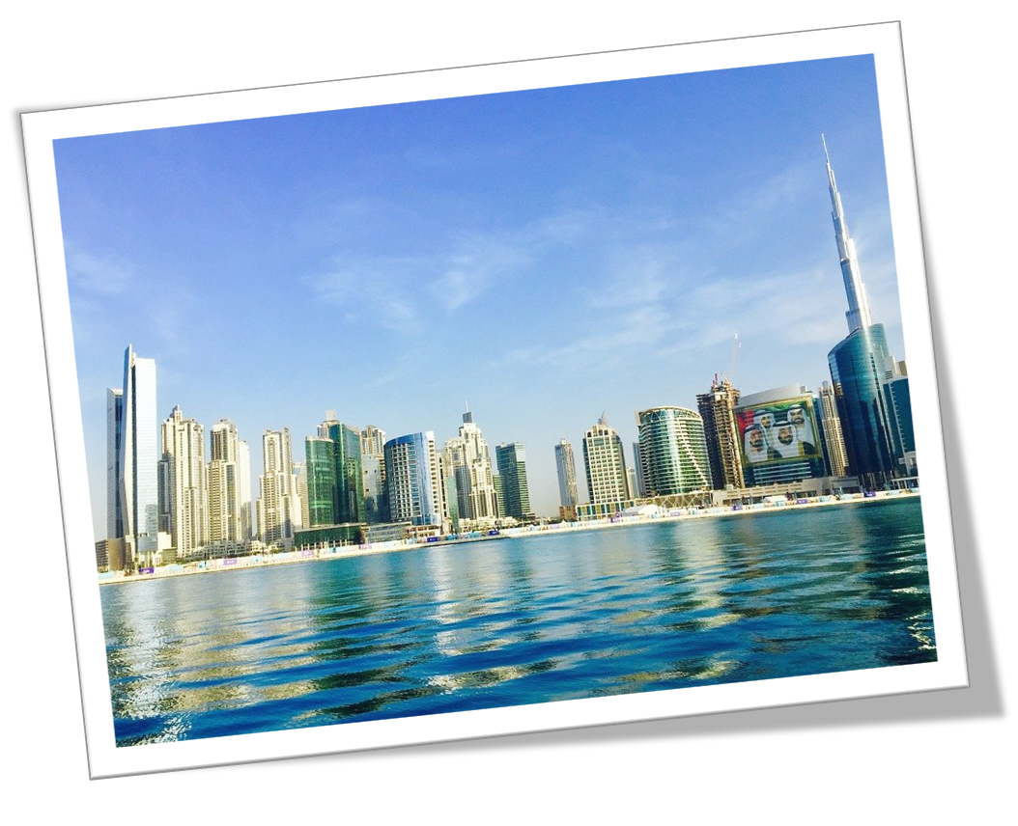
The visit to Dubai ....................…………….
Use "is going to be" and the new adjectives to make sentences about future vacations.

Slide 13
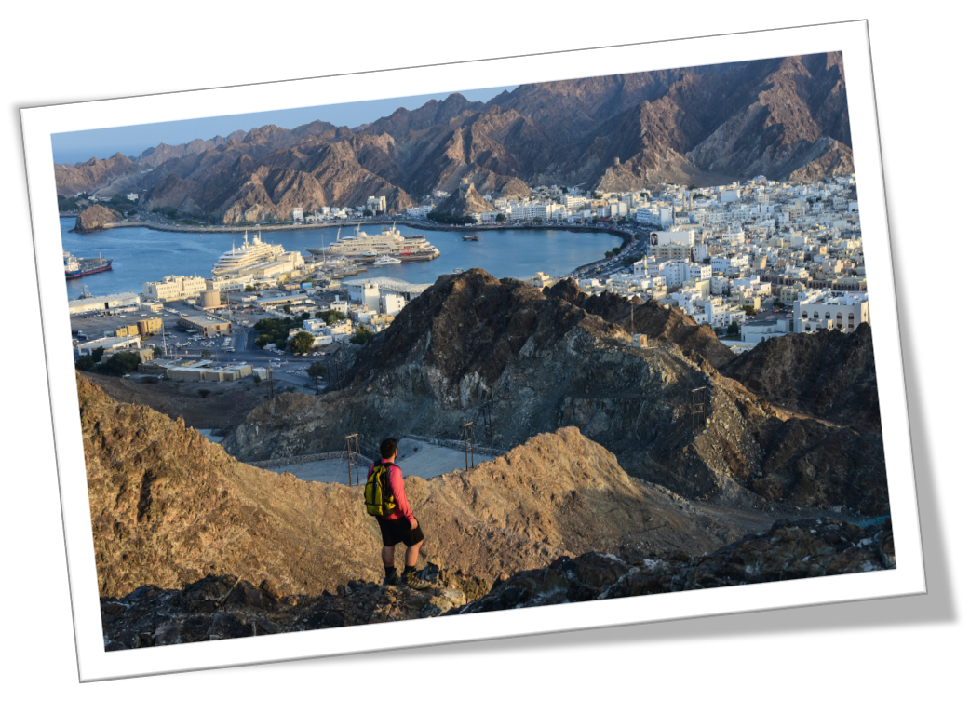
The trek in Oman ....................…………….....
Use "is going to be" and the new adjectives to make sentences about future vacations.

Slide 14
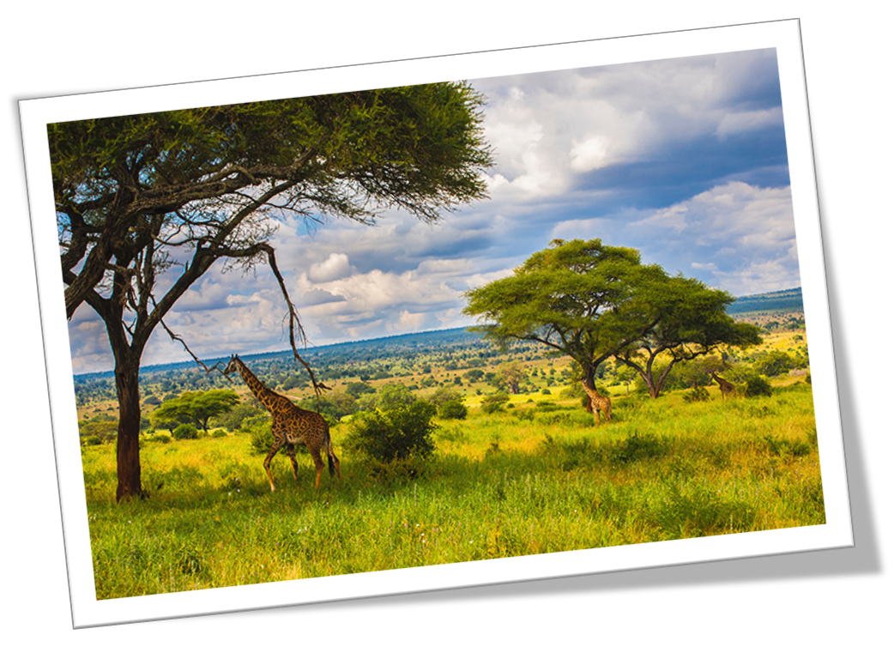
The safari in Tanzania ....................…………….
Use "is going to be" and the new adjectives to make sentences about future vacations.

Slide 15
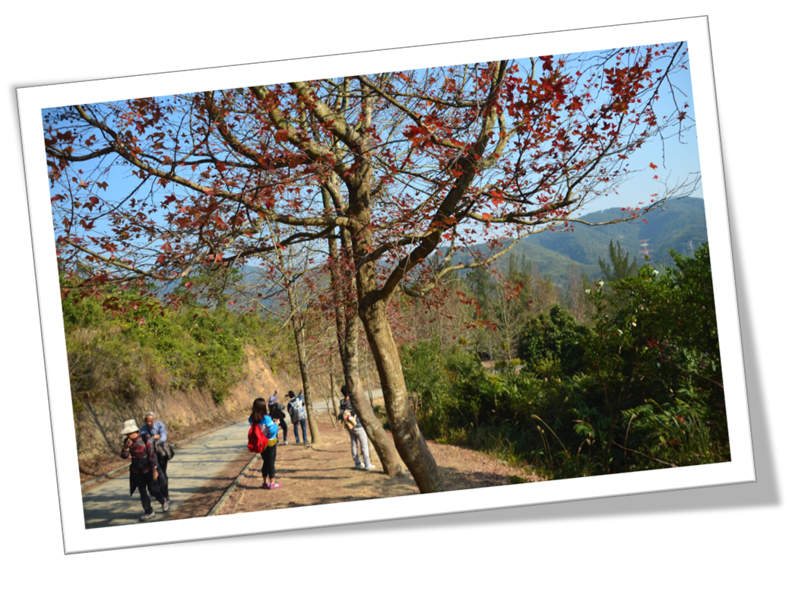
The hike in the Malaysia rainforest ....................…………….
Use "is going to be" and the new adjectives to make sentences about future vacations.

Slide 16
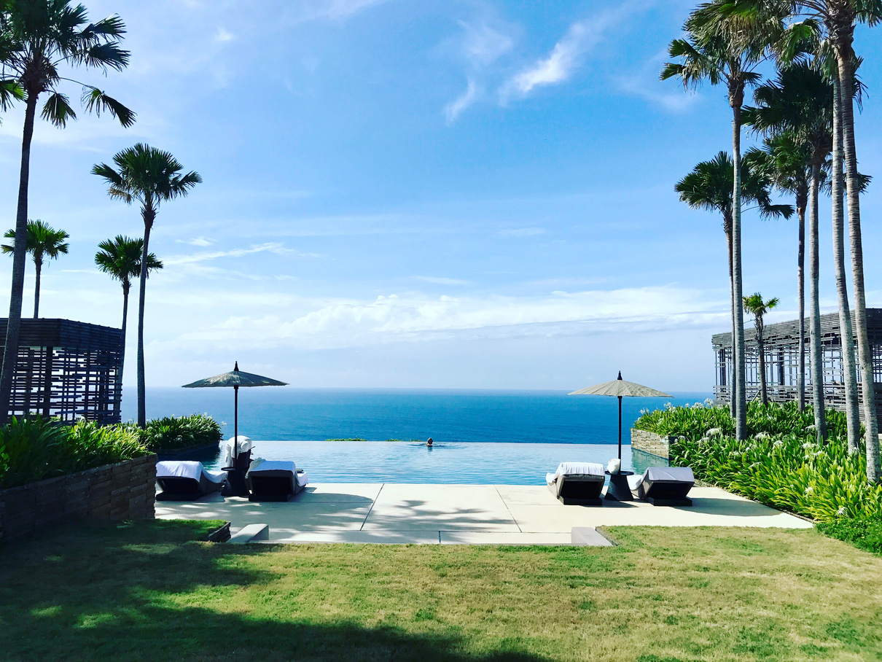

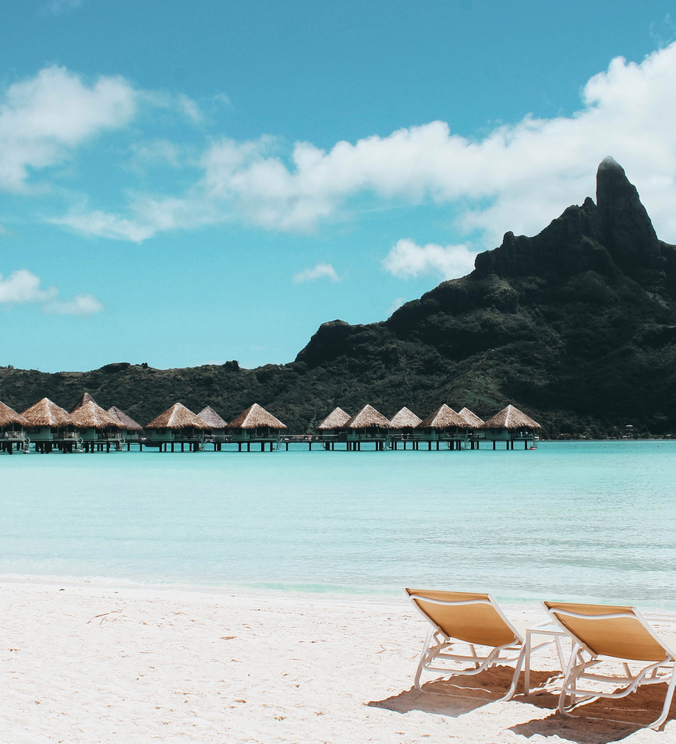

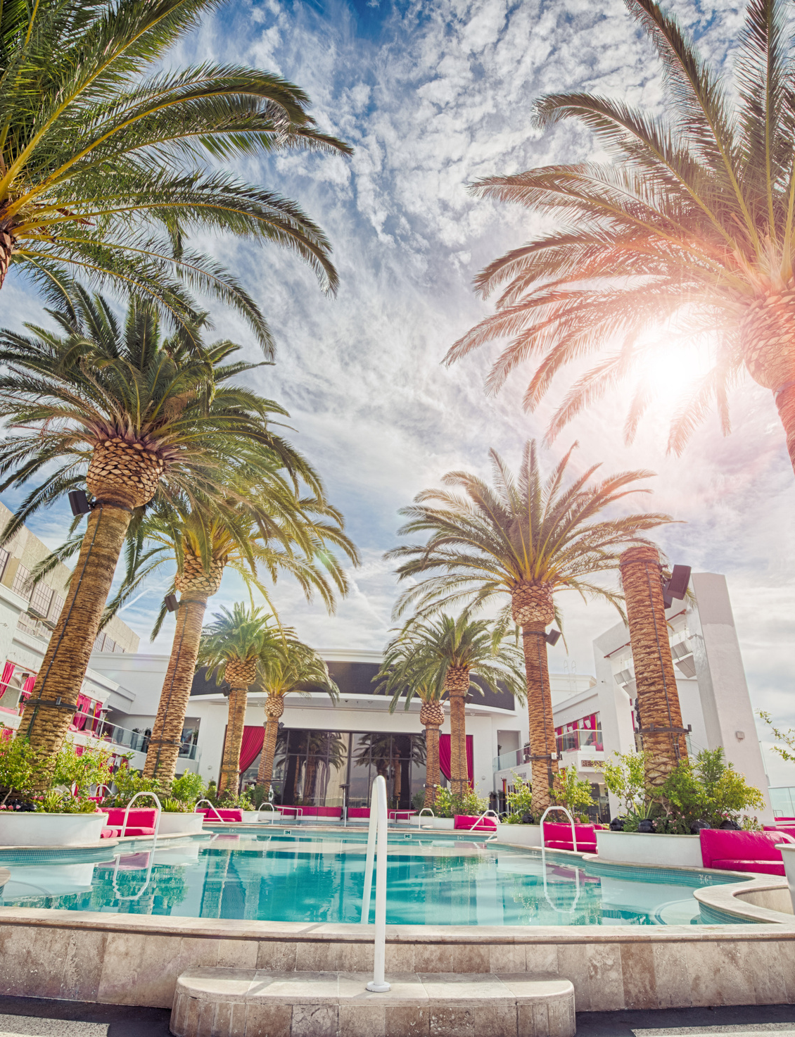

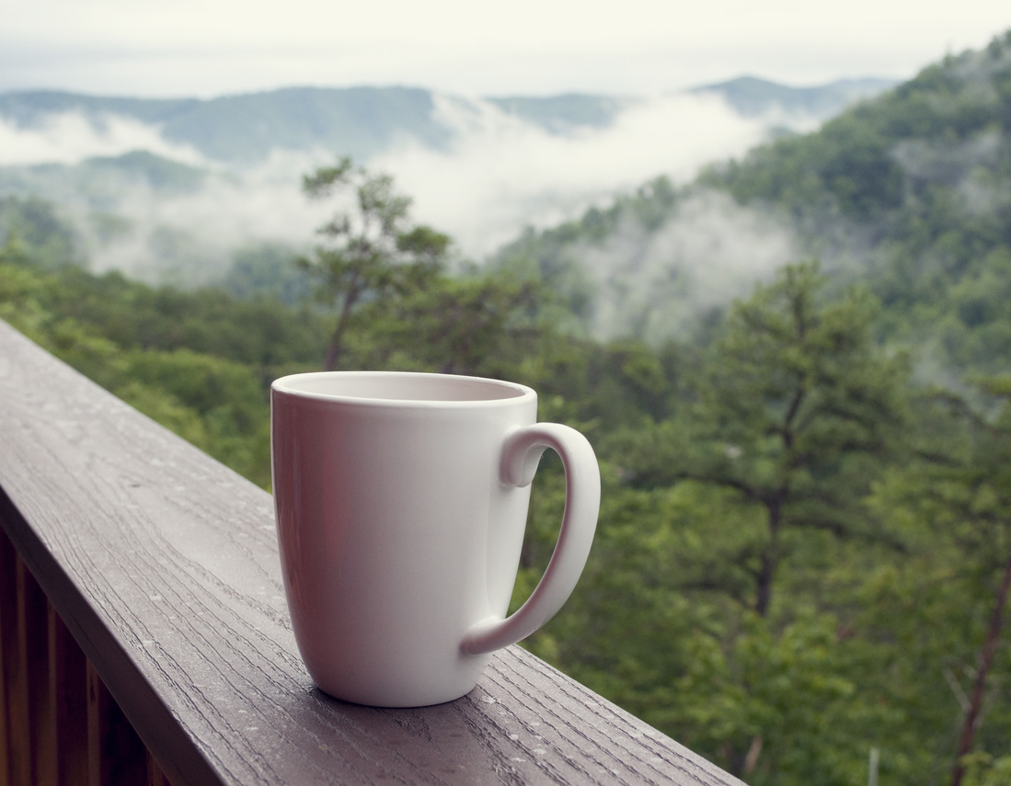

Vacation
With the noun vacation we use the verbs be on, go on, and take.
Bob’s on vacation.
I’m going to go on vacation next week. When are you going to take a vacation?

Slide 17
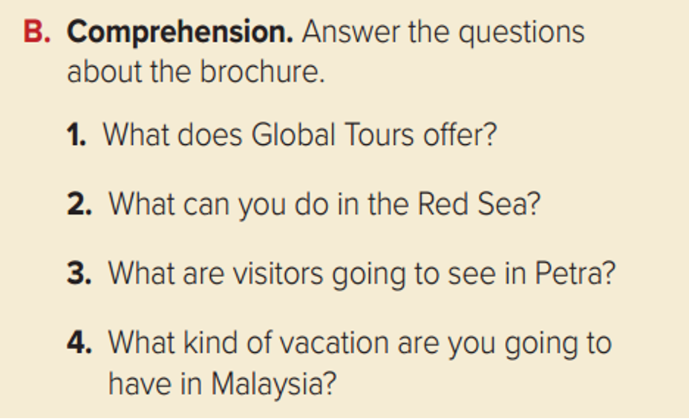

Answer then discuss your answer with your partner

Slide 18



write questions about the places (Dubai, Oman, Tanzania) for your classmates to answer.

Slide 19

work in pairs and make three sentences about places in their country and/or region of the
world, using the adjectives in Quick Check A.

Slide 20




Don't forget your homework
(page.101)

