Slide 1
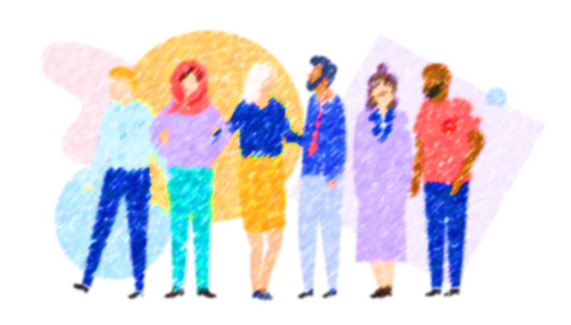
c
Culture
shock
By Asma Almjlad
S H O C K

Slide 2
objectives
Describe different culture habits
Use polite expressions

Slide 4
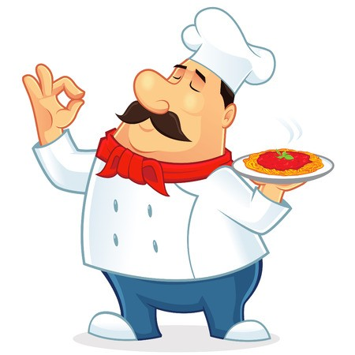
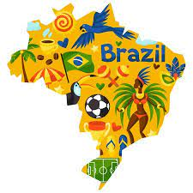
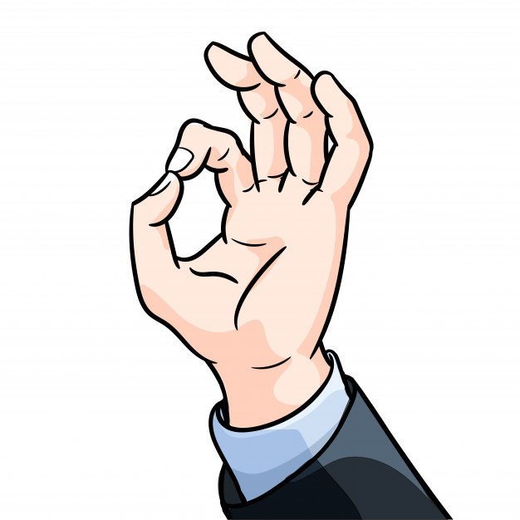
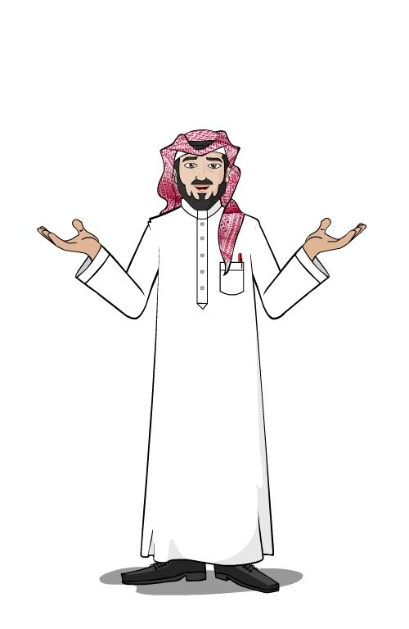
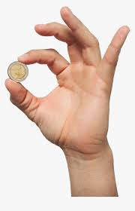
Some countries Delicious
What that means in your town ?
In American agree
In Japan money

Slide 5
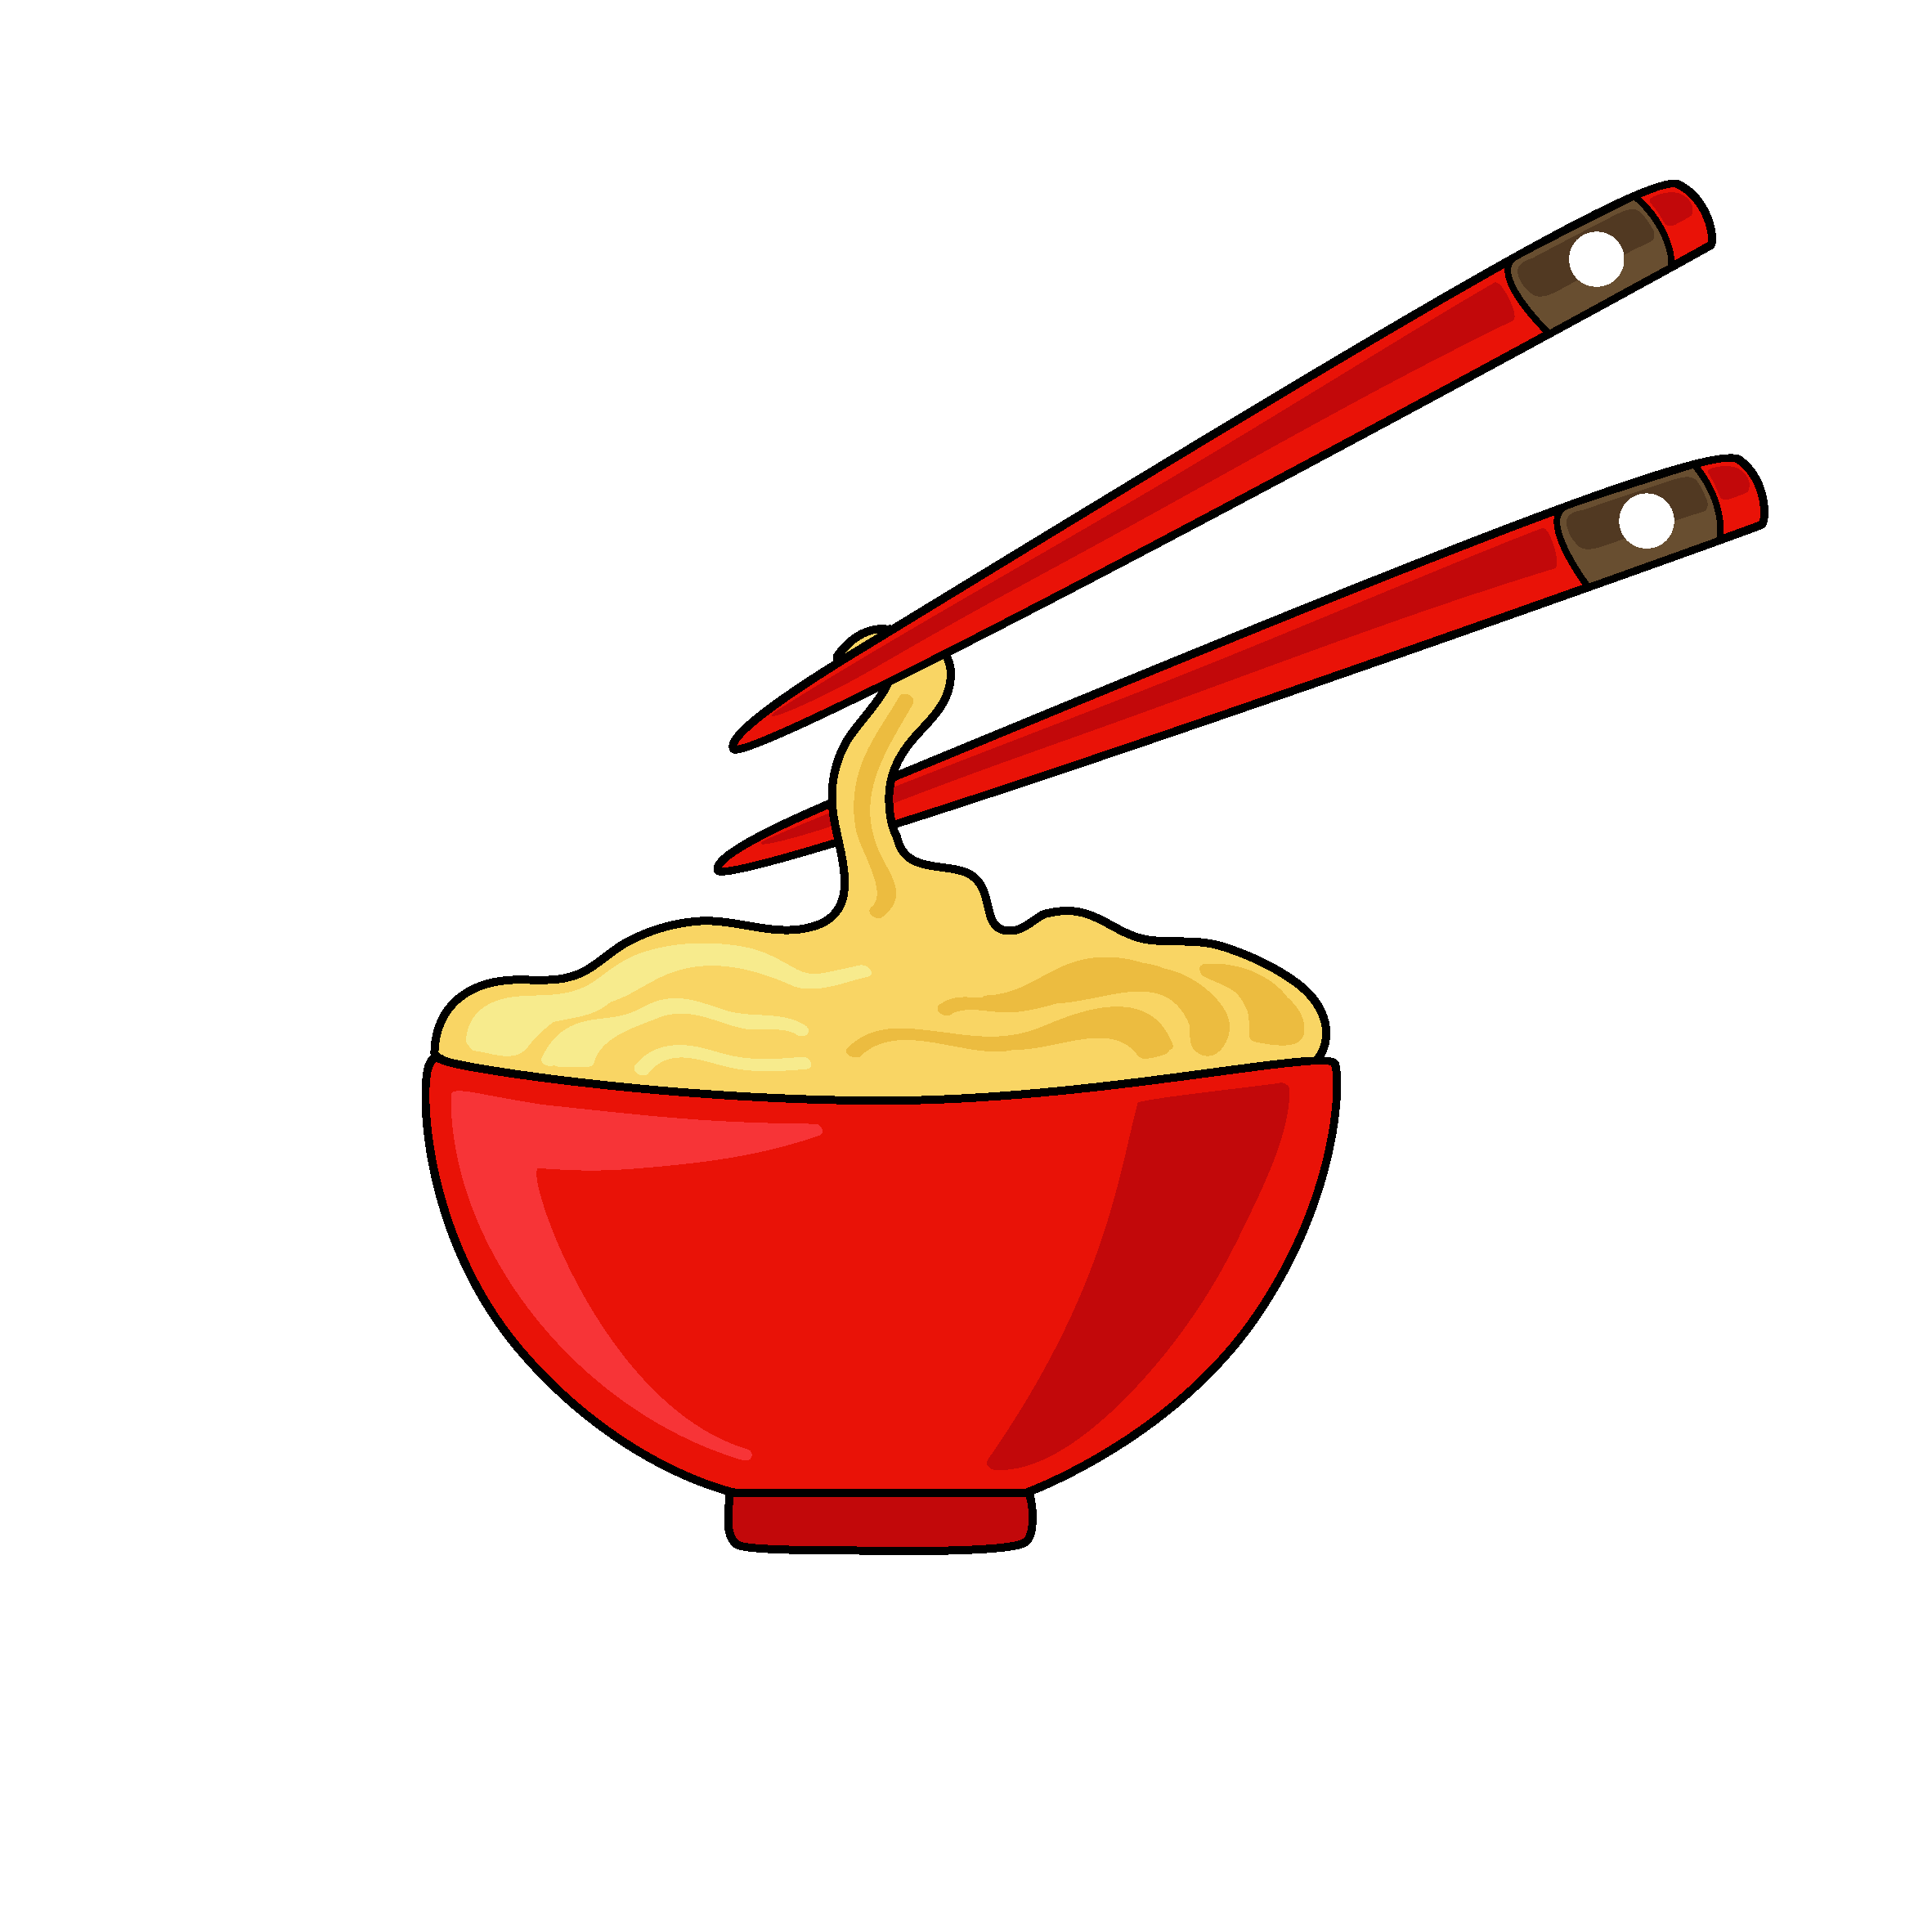
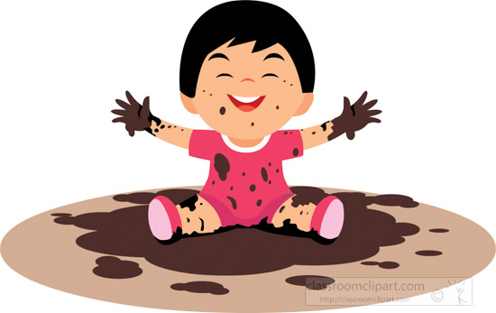
mud
Chopstick

Slide 6
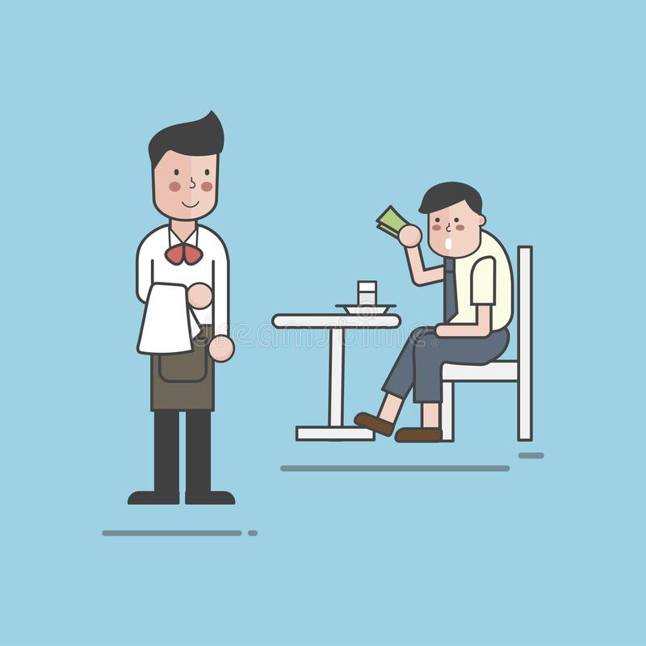
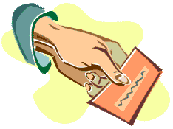
Business card
tip

Slide 7
@ 58 +59

Slide 8
in which country do you think people always talk about the weather?
In which countries do you think all university graduates have a title?
in which country is tipping not common?

Slide 9
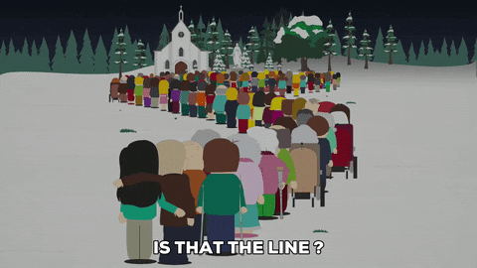
What do people in England usually do when they wait at bus stops?
What is the favorite topic of conversation with the British ?

Slide 10
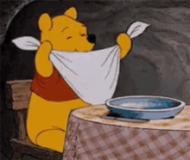
What are some Mediterranean countries?
What is the common custom in Mediterranean countries ?
People in these countries are common to take morning breaks ( T or F )

Slide 11
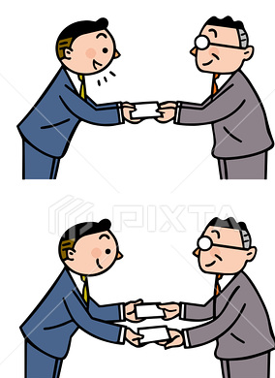
Where is the exchange of business cards or personal cards important?
Do you think it’s polite or impolite in Japan to talk about the cards?

Slide 12
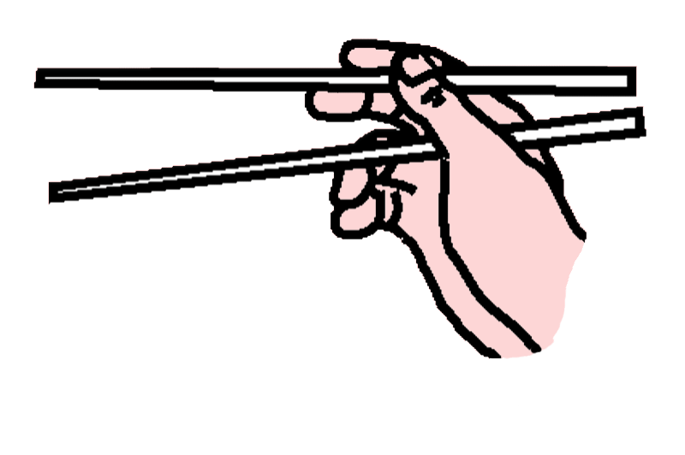
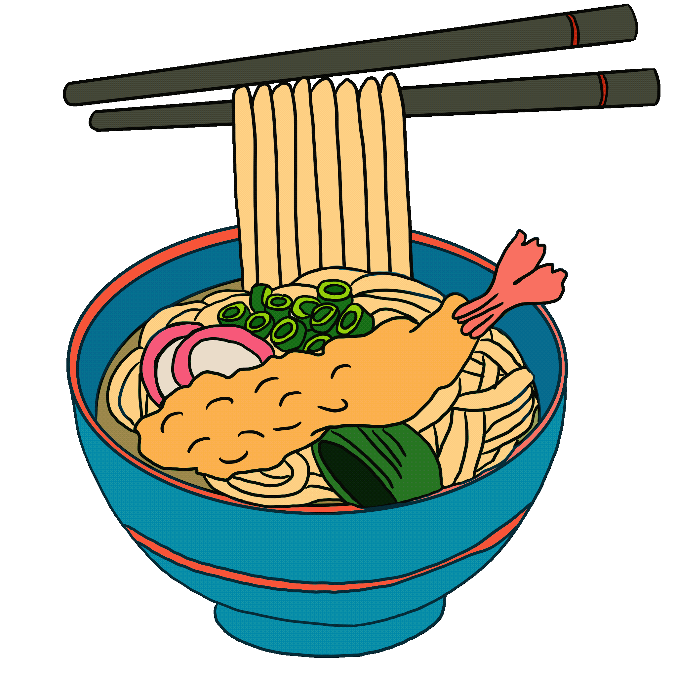
What do many Asian cultures use to eat with?
It’s polite to play with chopsticks ( T or F )

Slide 13
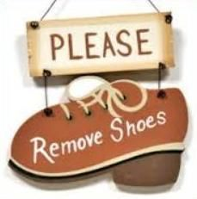
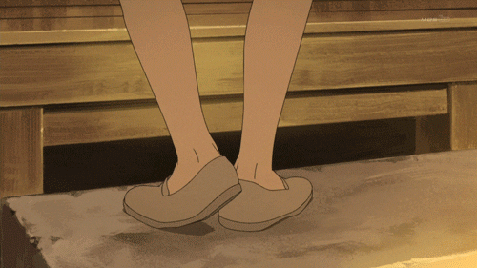
What is a custom they have in India?

Slide 14
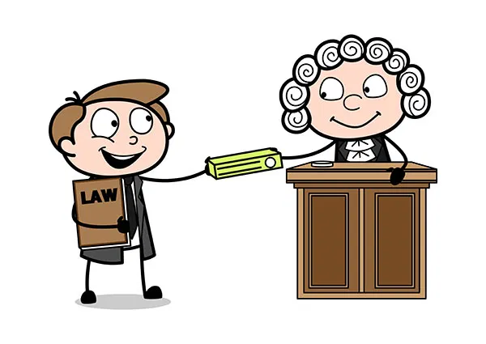
In which countries do you think all university graduates have a title?

Slide 15
When do cab drivers get angry in the United States?
The tip is usually 20% precent of your meal
(T or F)

Slide 16
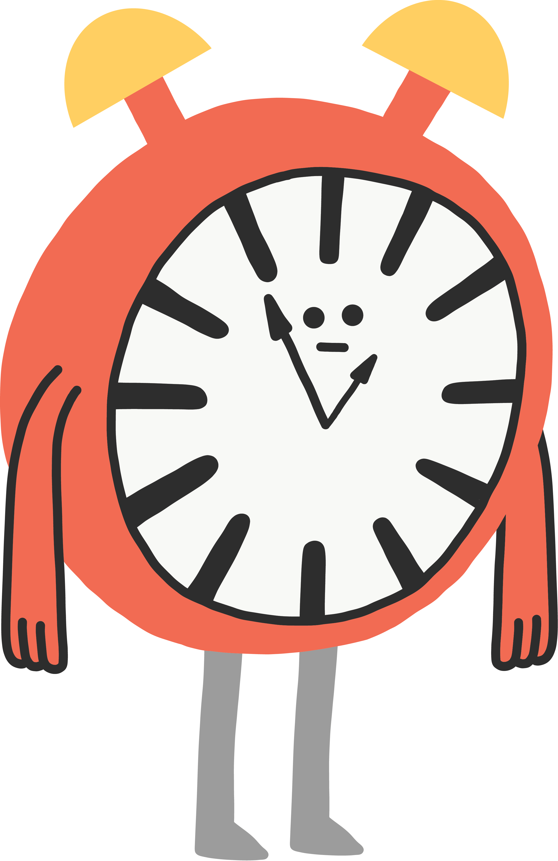
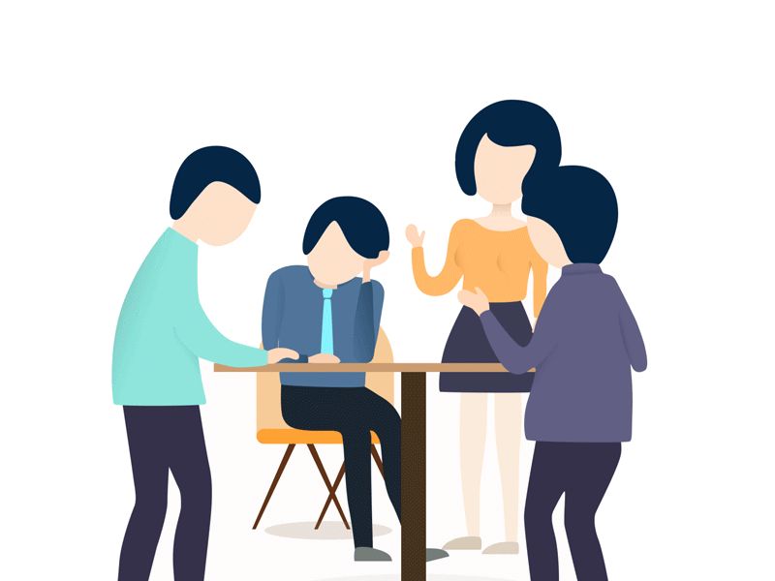
It is good idea to arrive early before meeting in Germany ( T or F )

Slide 17
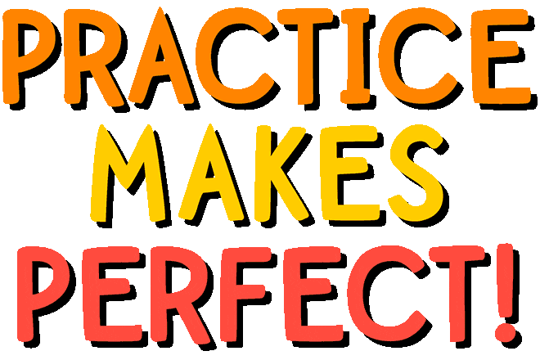

Slide 19
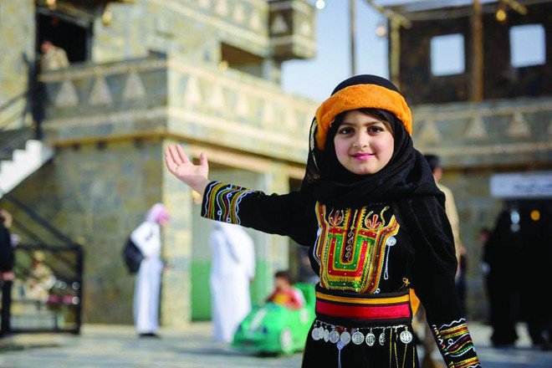
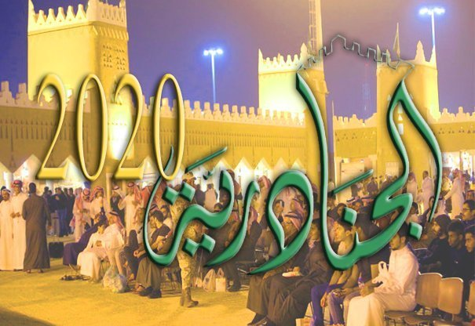
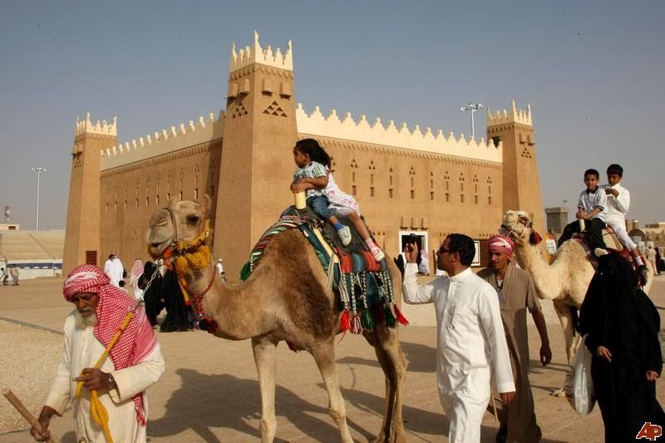
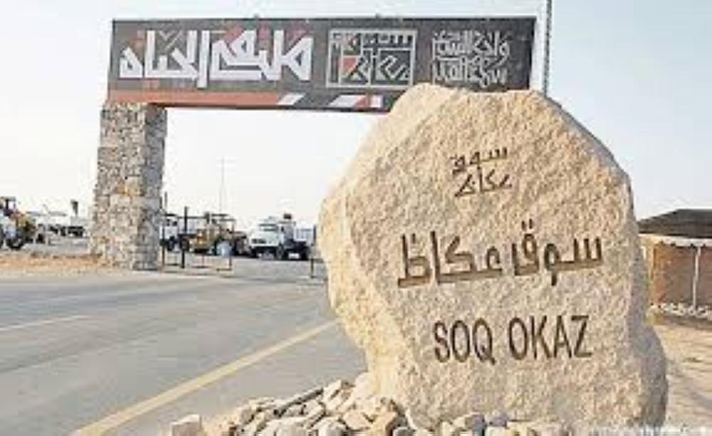
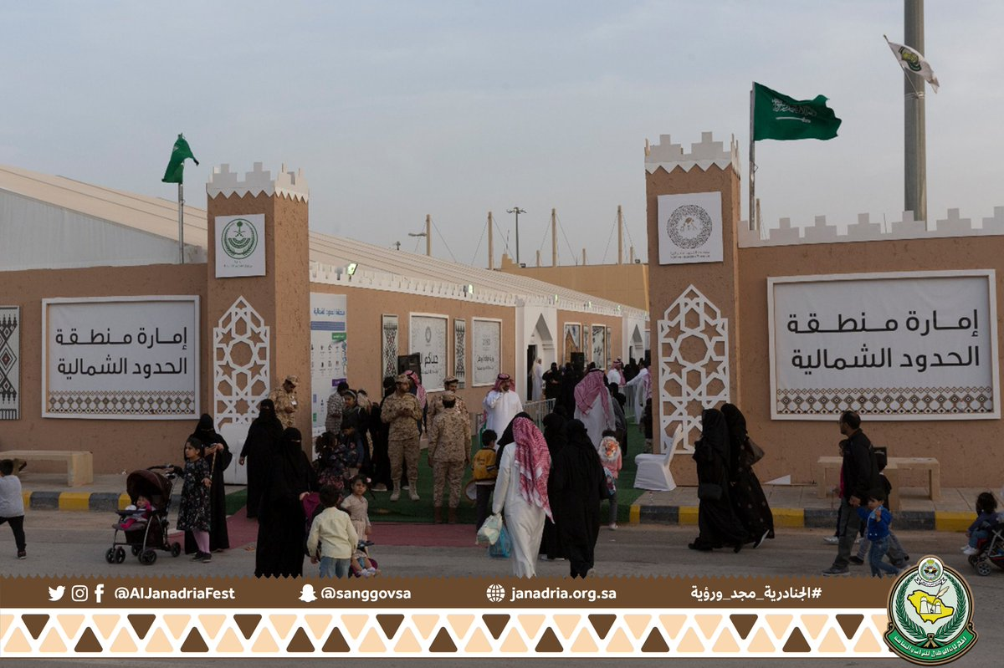
Which of the following customs are similar in your country?

Slide 20
In England, it’s customary to say…
In the United States, remember to make sure you…

Slide 21
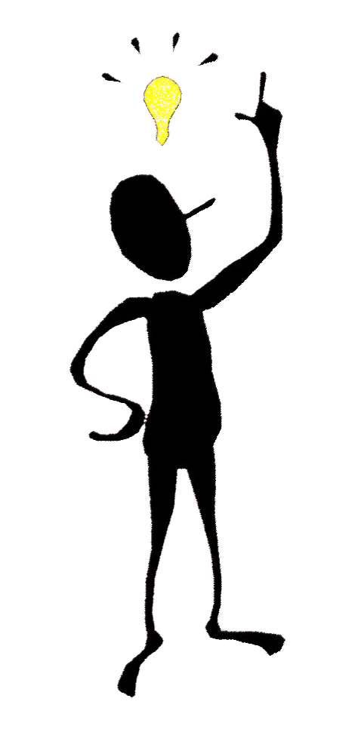
F
T
F
T
T
F

Slide 22
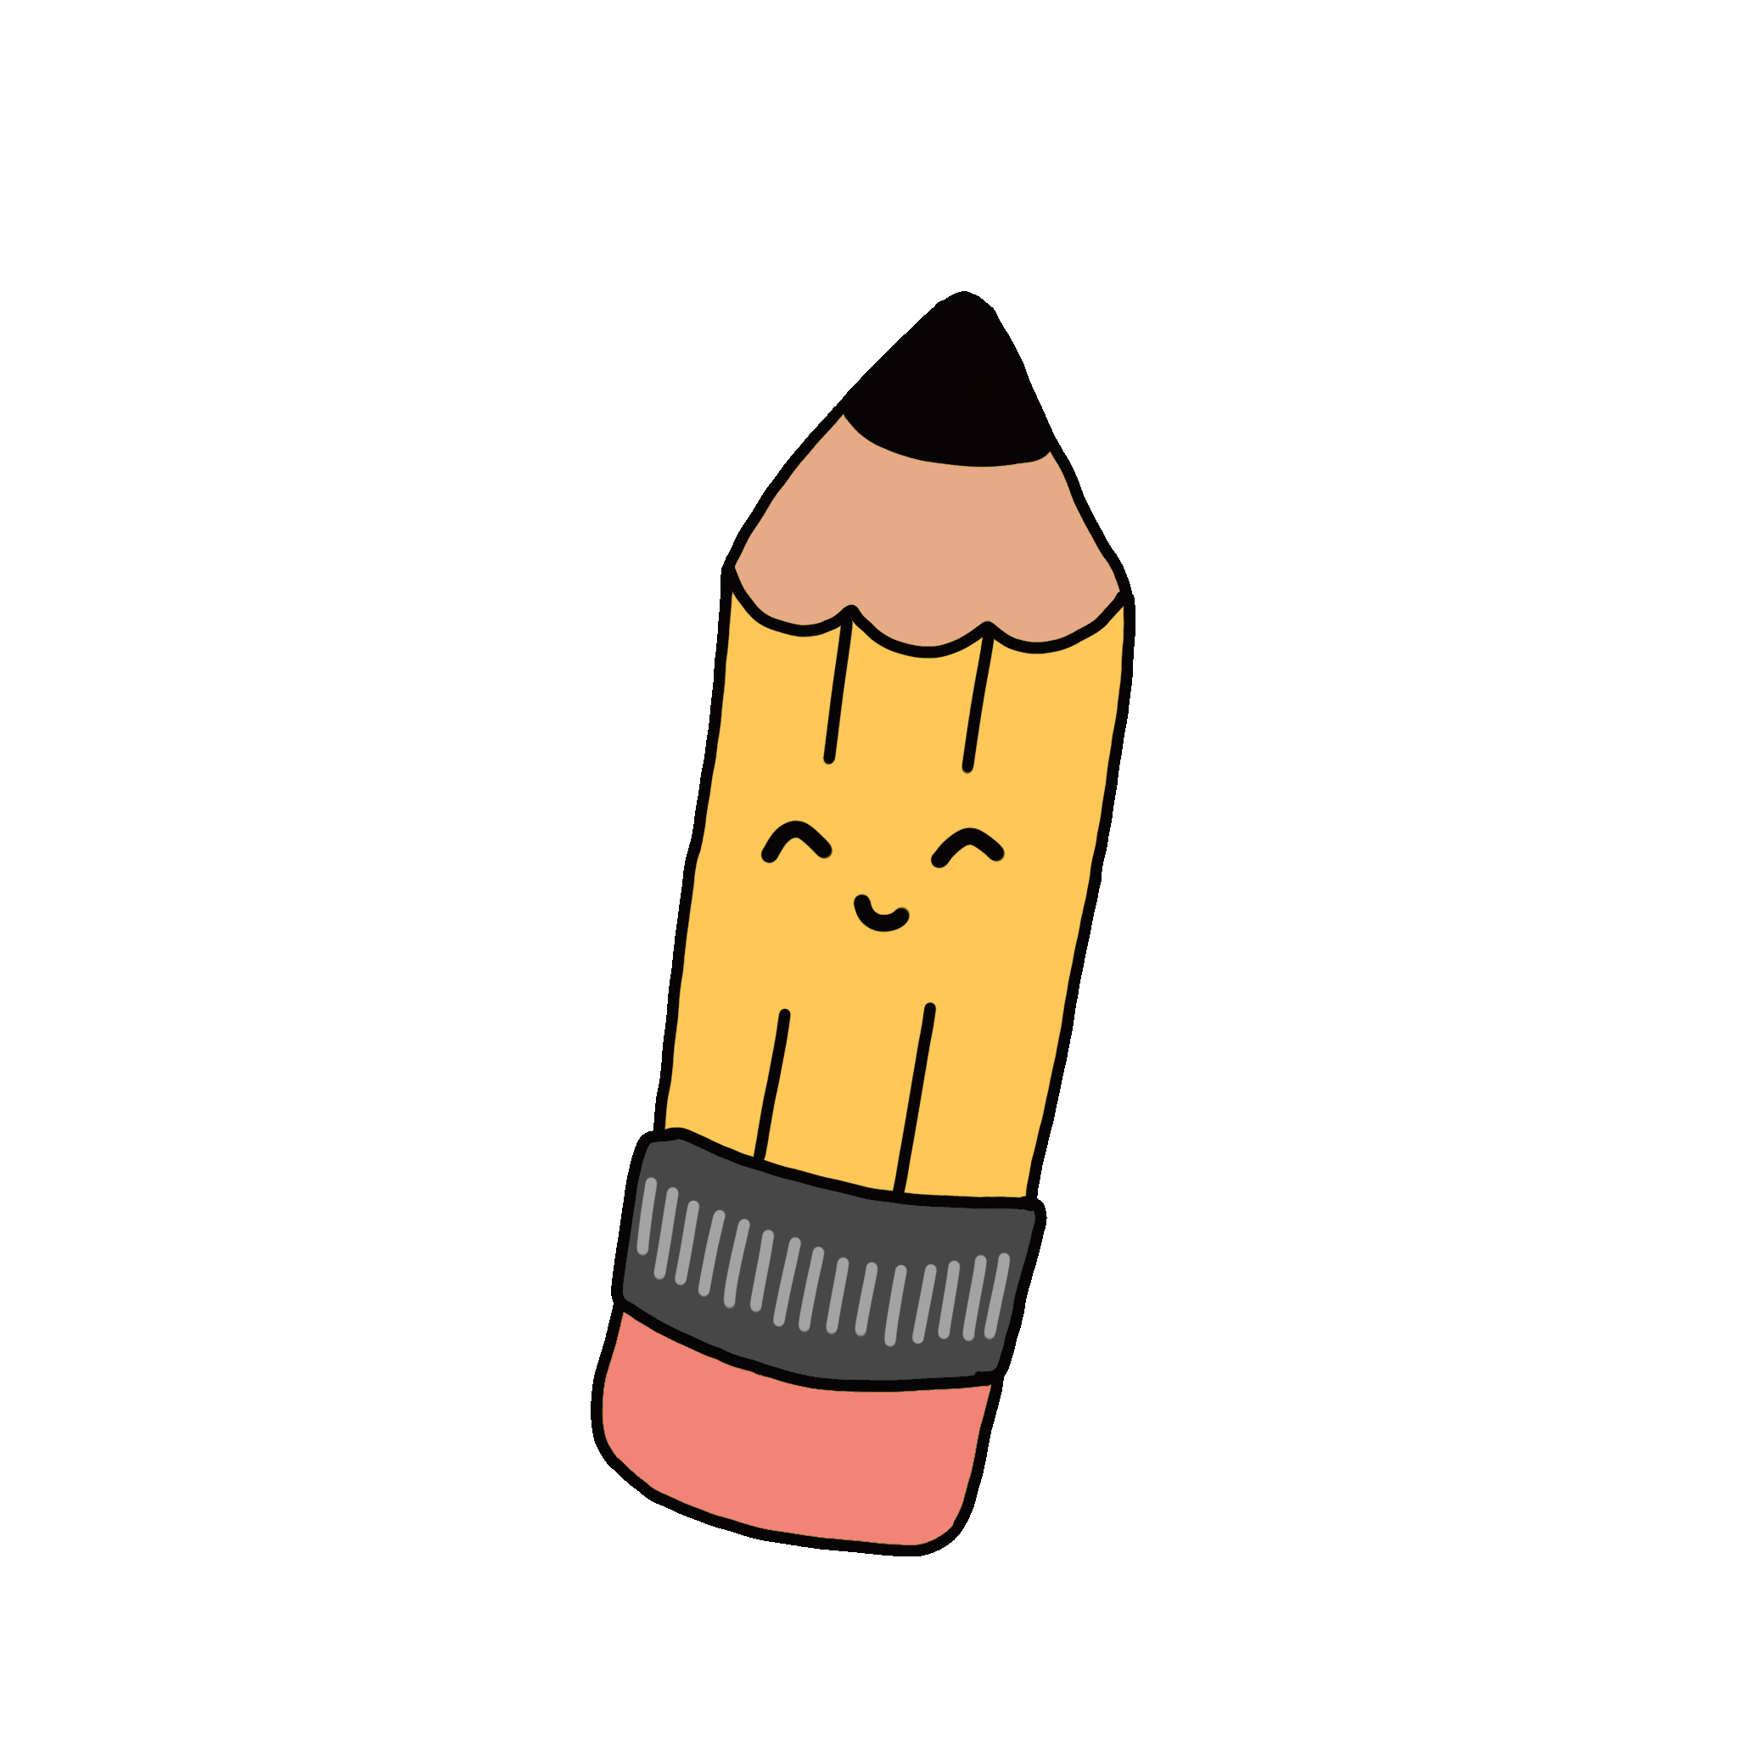

Slide 23
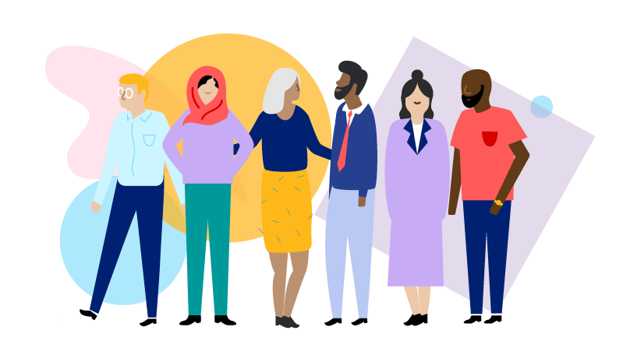

Slide 24
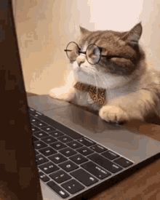

Slide 25
By Asma Almjld

