Slide 1

Unit 7 Grammar
SG 2
Tr. Nora Khalid

Slide 2

Use simple past of “be” in sentences and questions
Describe the life of a famous person depending on audio material
Use the verb “Born”
Pronounce “was/were”

Slide 3
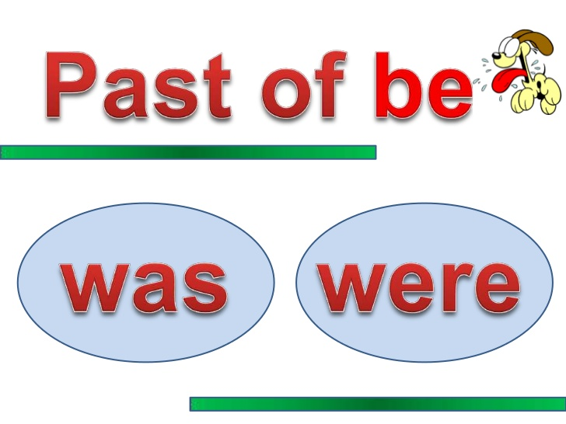

Slide 4
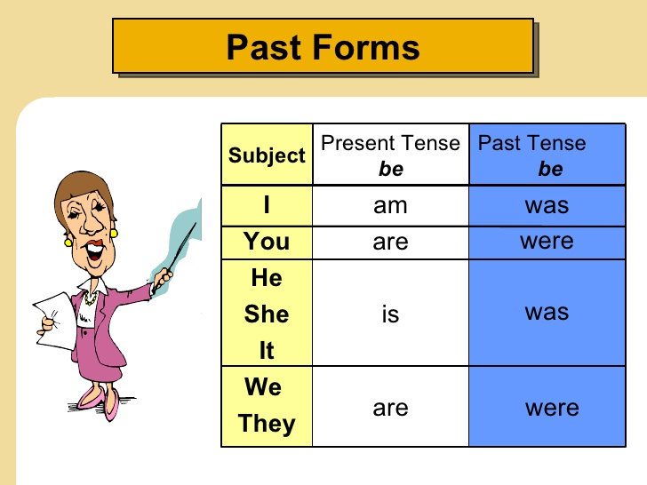

Slide 5
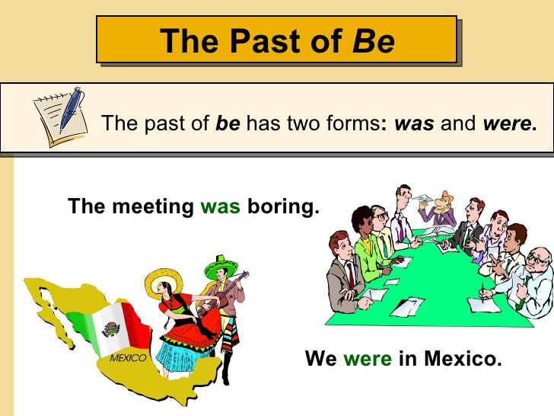

Slide 6
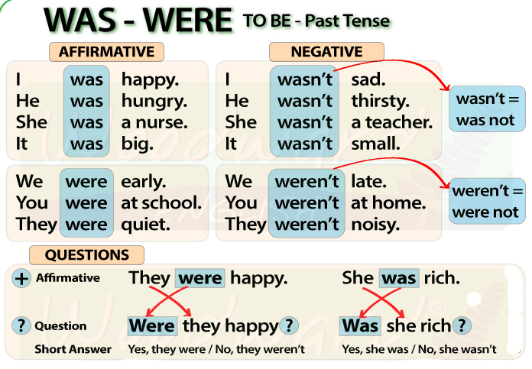

Slide 7
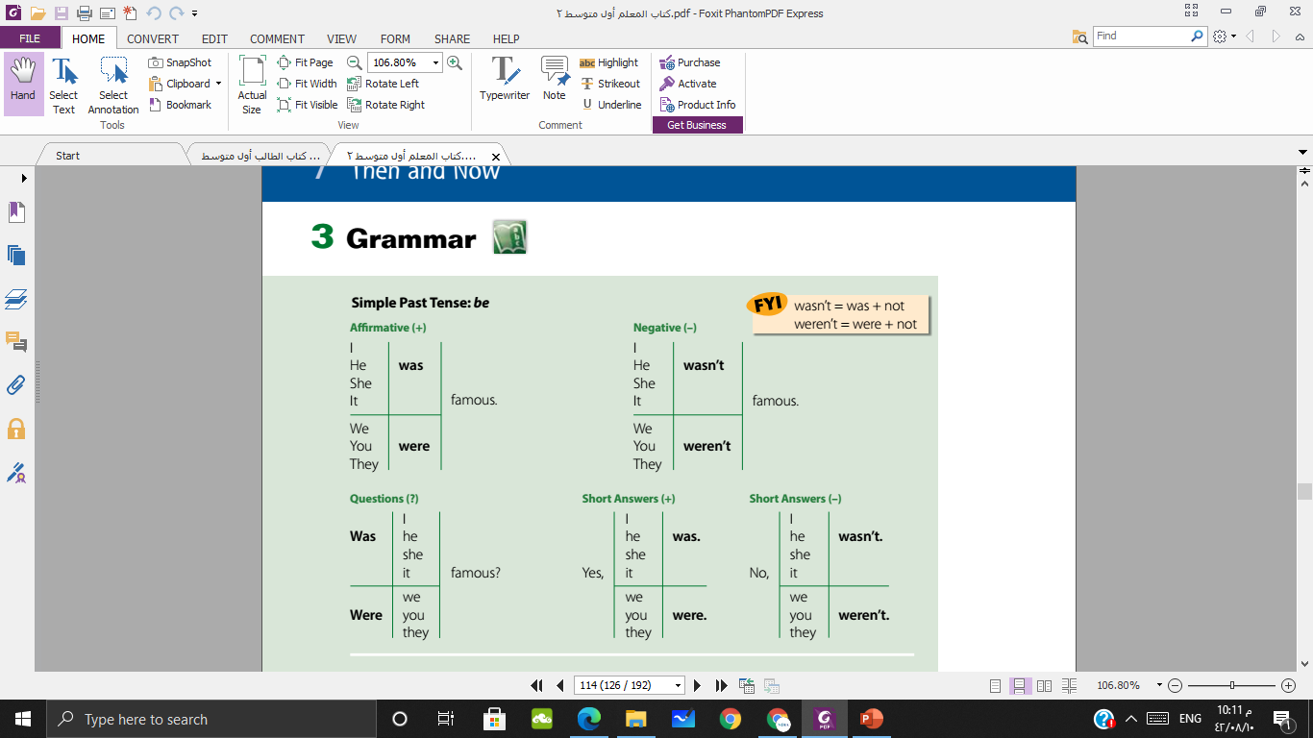

Slide 8

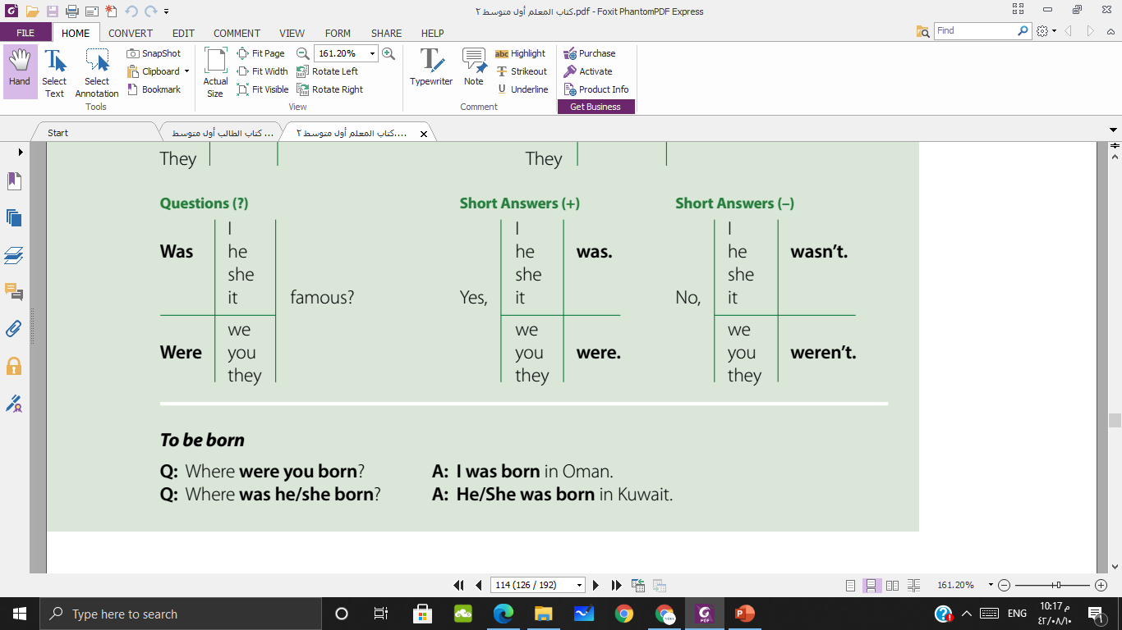

Slide 9
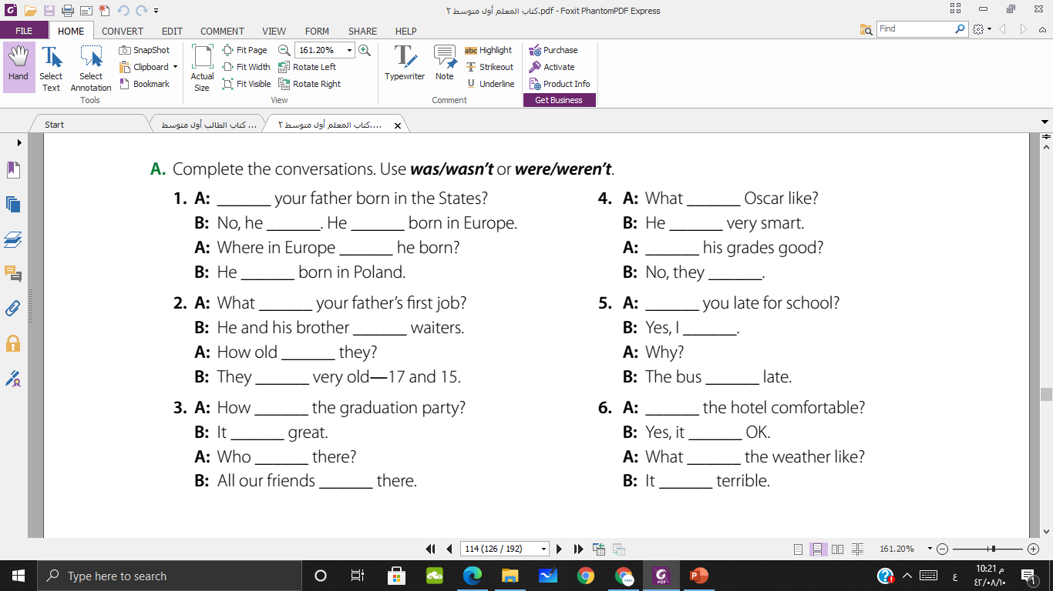
Where
was
was
was
was
was
Were
was
weren’t
was
Was
were
was
were
were
was
was
Was
was
was
was
was
were
was

Slide 10
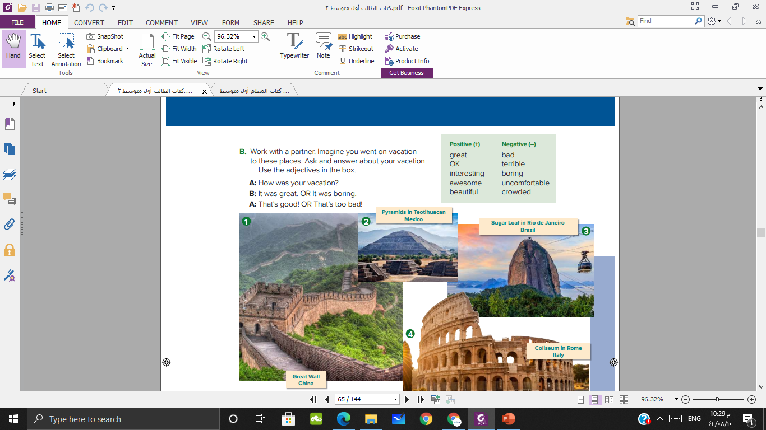


Slide 11
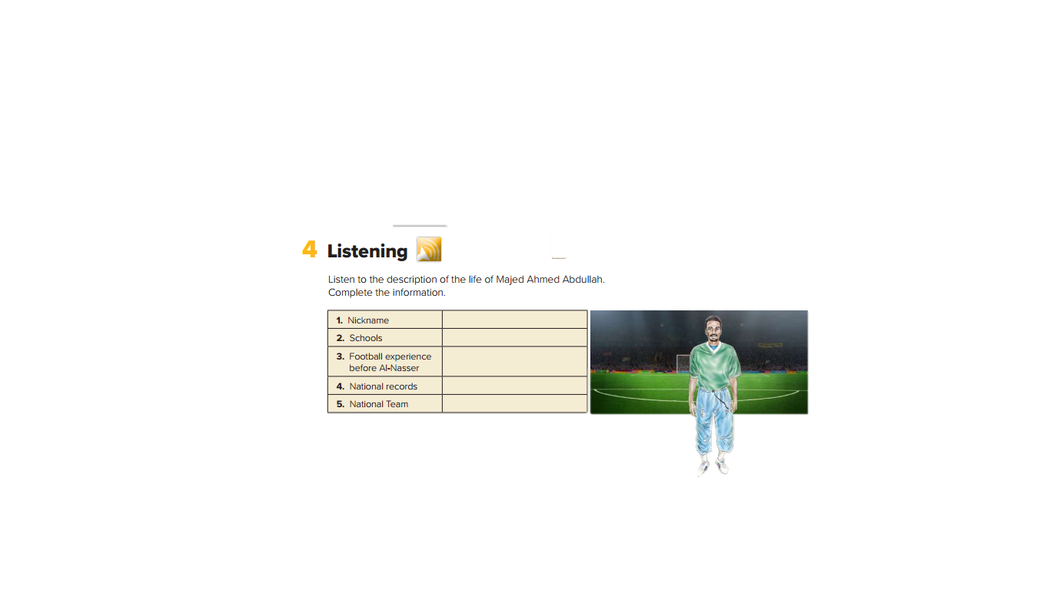

Arabian Pele’
Aljazeera elementary school – Almuwasta althaniah high school
goalkeeper for his school and neighborhood team, formed a team with his friends when he was in high school
Tow
Under 17 National Team in 1977, Senior National Team in 1978 for 16 years

Slide 12
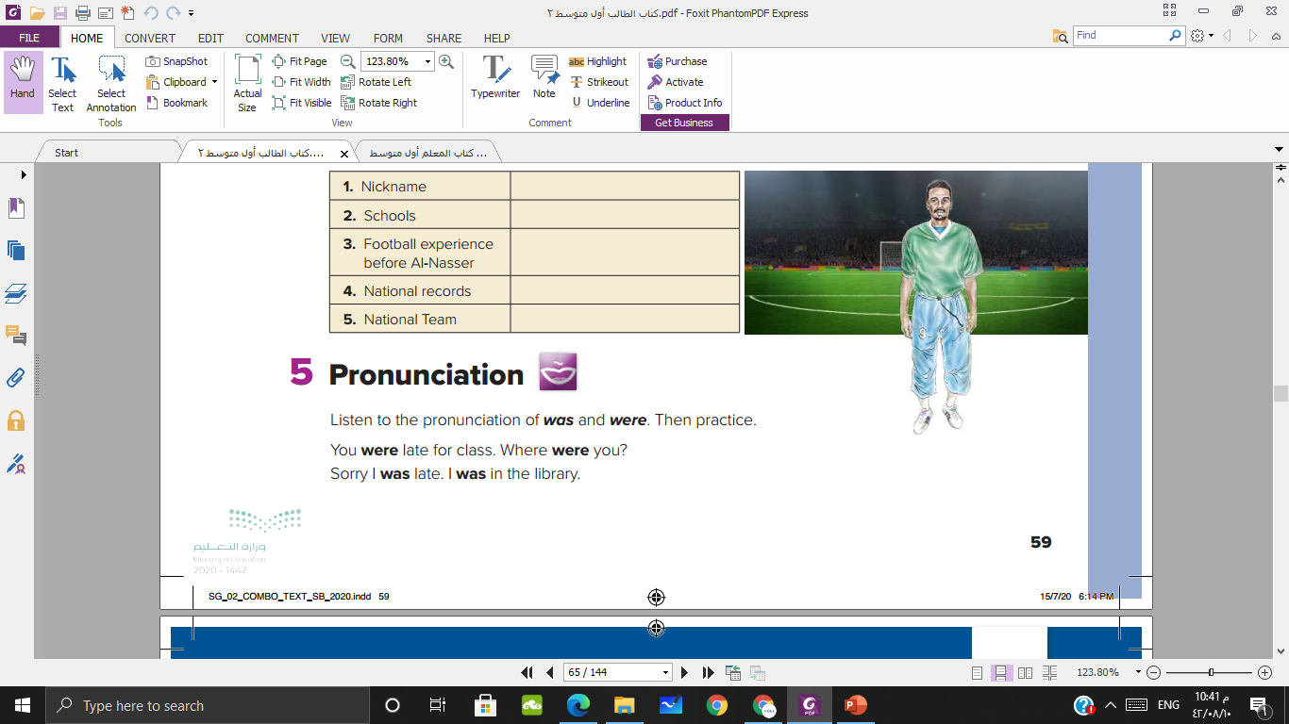

Slide 13

