Slide 1

Unit 7 Then and now p 56
Tr. Nora Khalid

Slide 2

Compare between past and present
Discuss and answer some questions

Slide 3
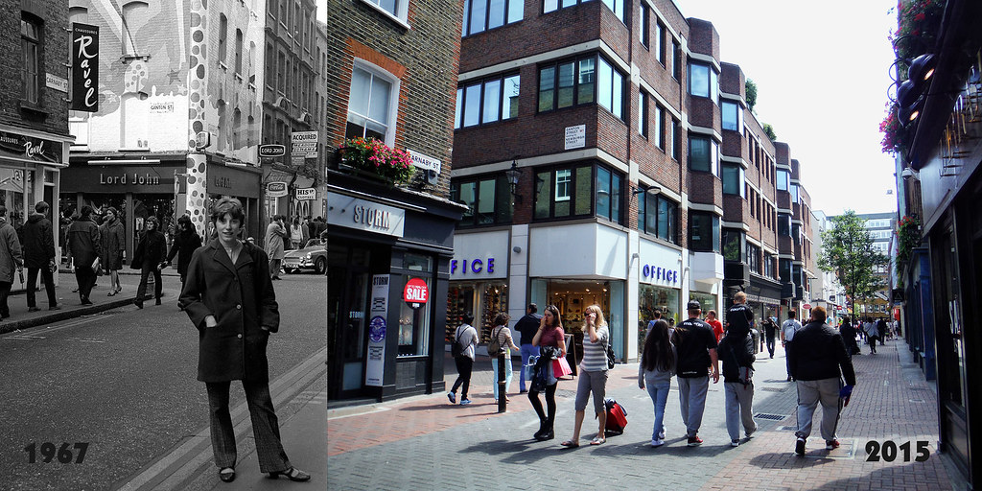

Then
Now

Slide 4
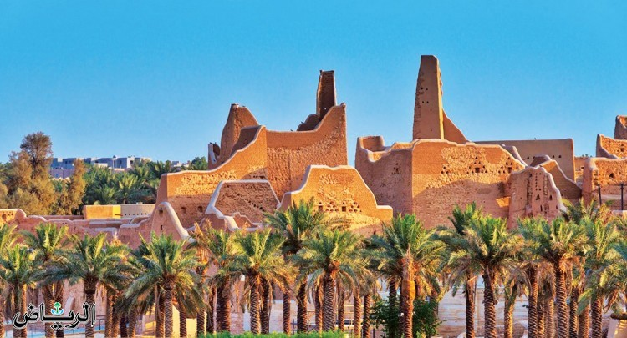
What can you see?
Ad-Dir’yah
Is it an old city or modern city?
What is the name of this city?

Slide 5
Ad-Dir’yah was the first capital of the Saudi Dynasty.
There were many palaces there.
Salwa palace was the largest palace.

Slide 6
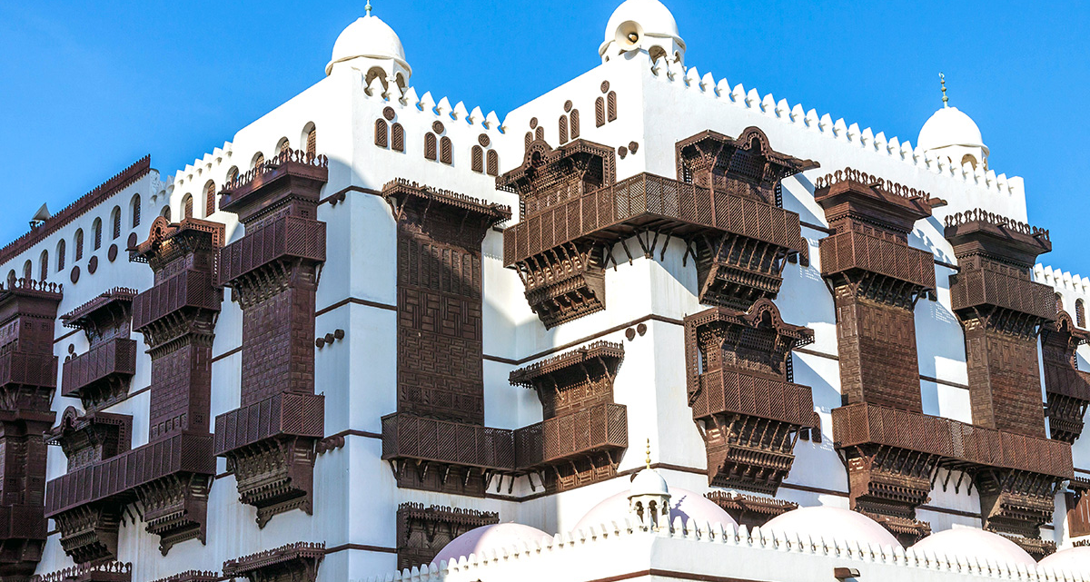
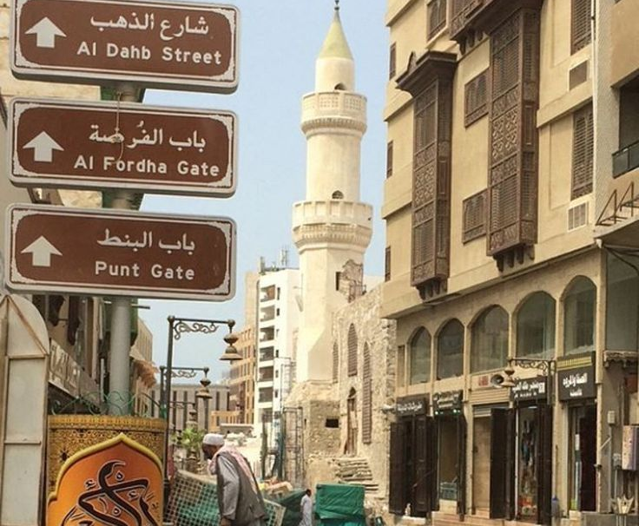
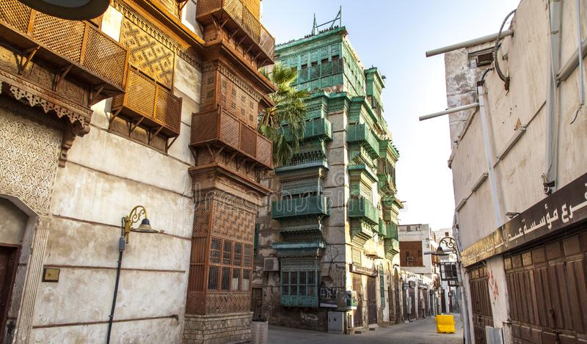
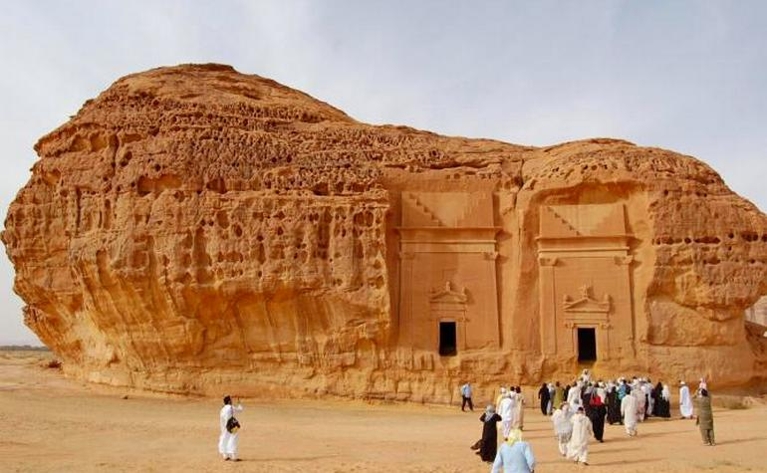
Name some historic cities.

Slide 7
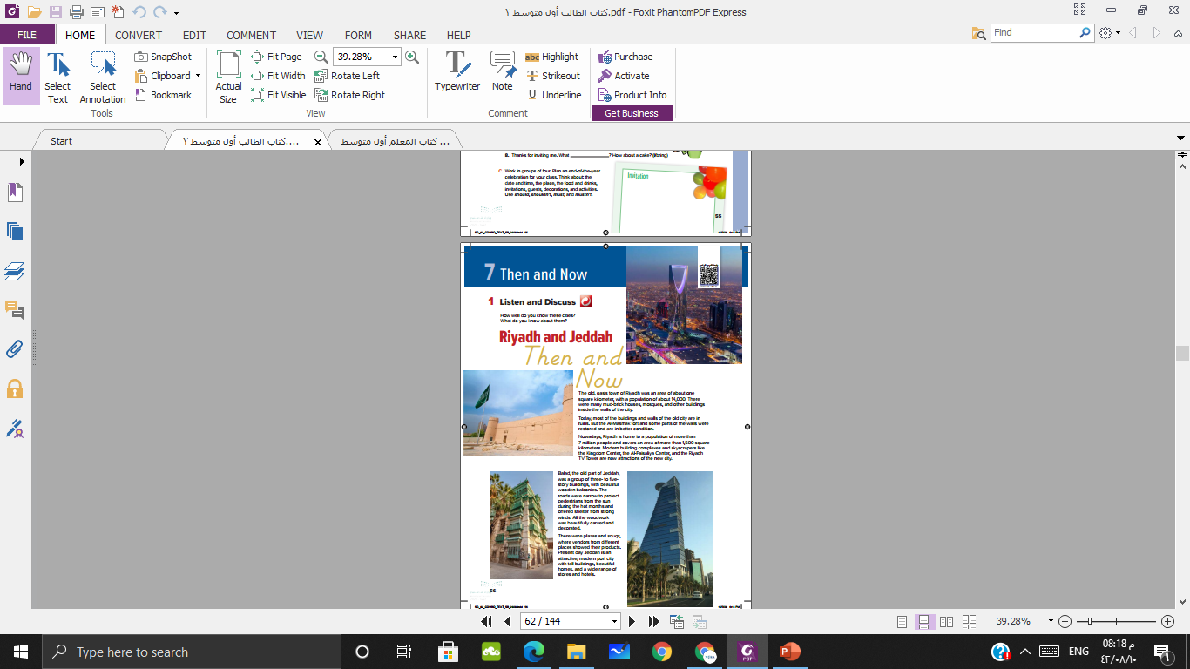
What do you see?
What do you know about them?

Slide 8

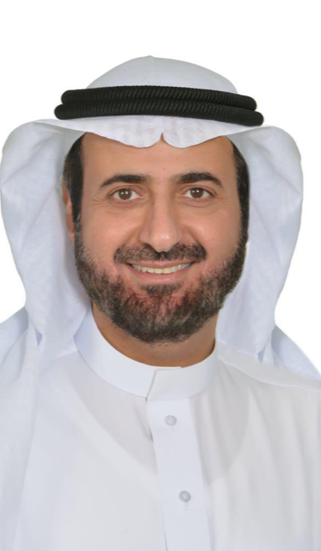
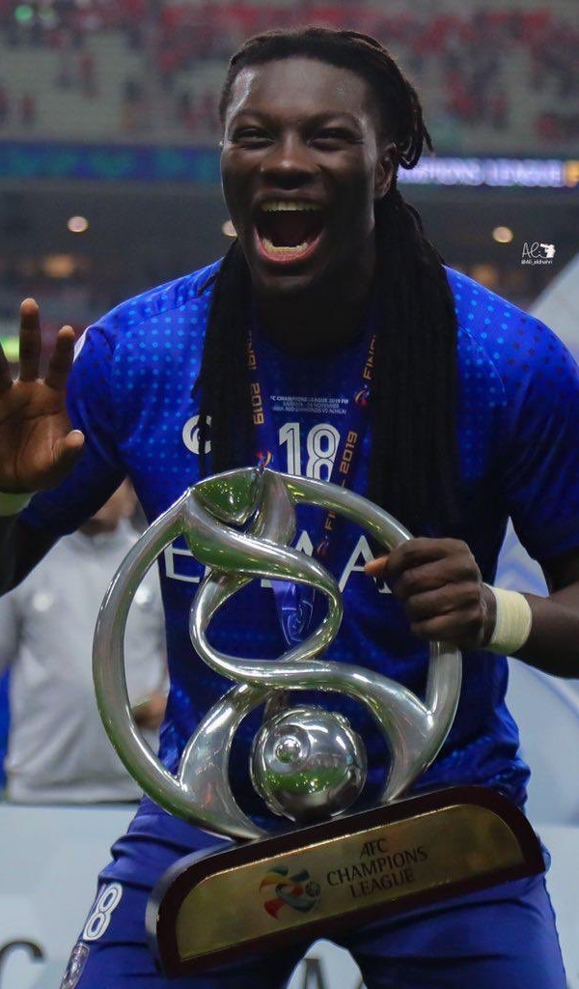
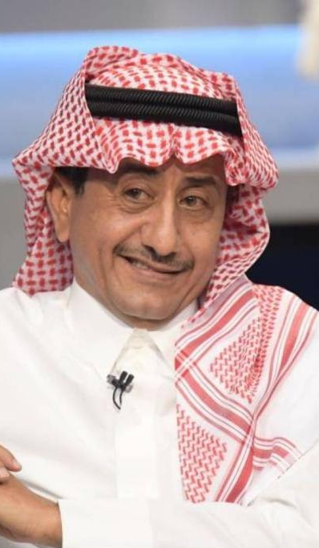
Do you know their names? Why

Slide 9
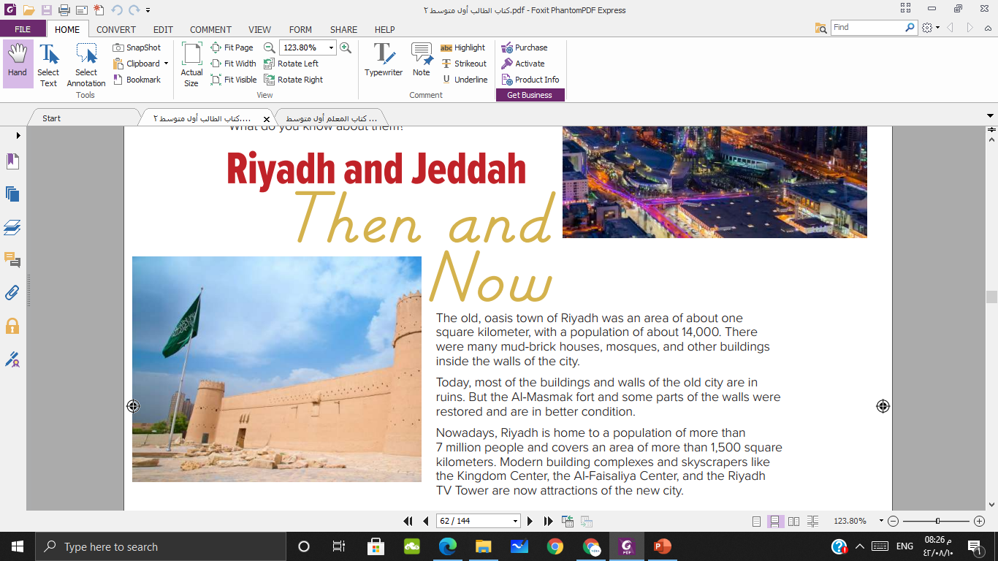

What was the population in old Riyadh and now?
Name some historical and modern building in Riyadh

Slide 10
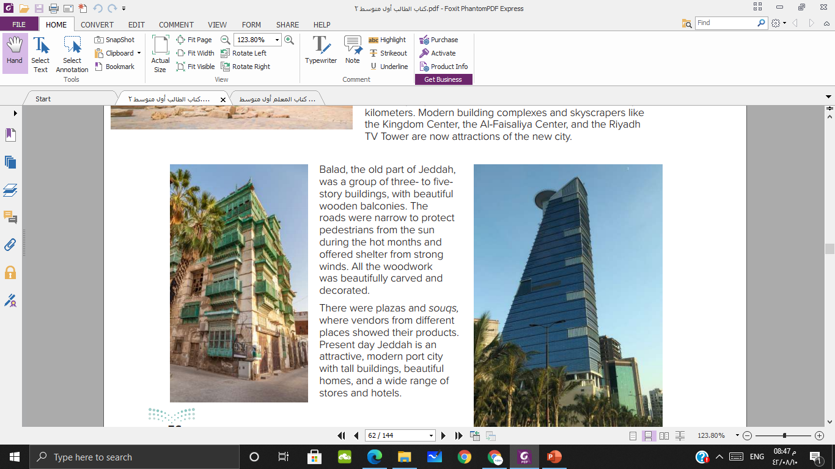
What is the name of the old part of Jeddah?
How was the buildings in Balad?
What were there in Balad?
How does Jeddah look now?

Slide 11
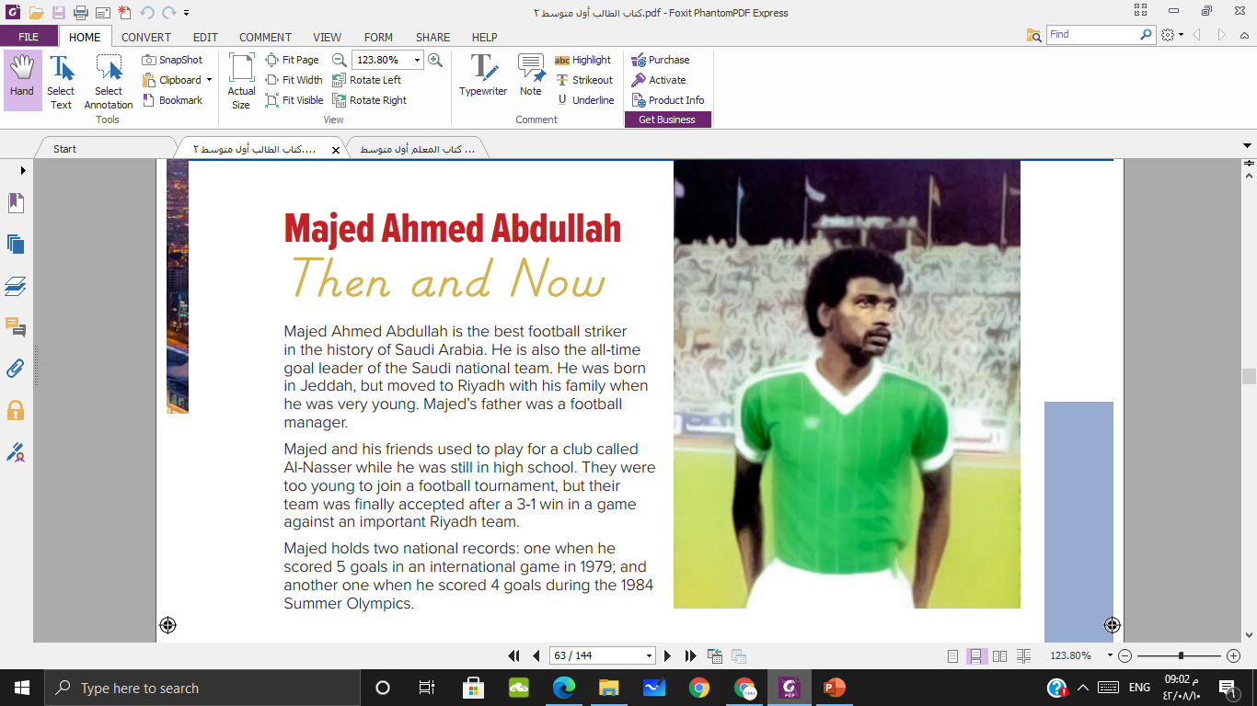
Who is this man?
What did he do?
Where was he born and raised?
What did his father do?
When did he scored 5 goals?
How many goals did he score in 1984?

Slide 12
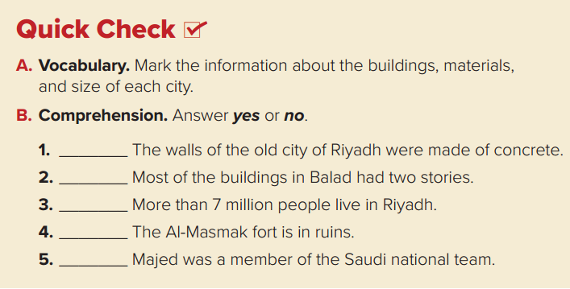
No
No
Yes
No
Yes

Slide 13
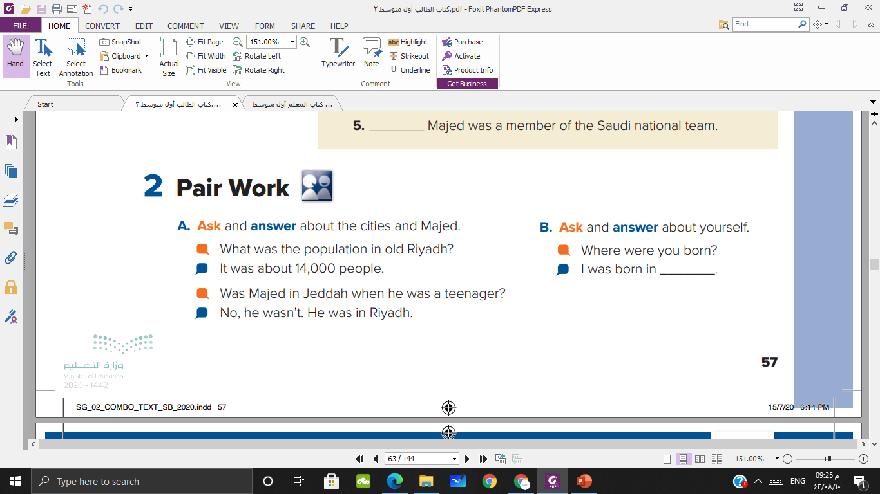

Slide 14
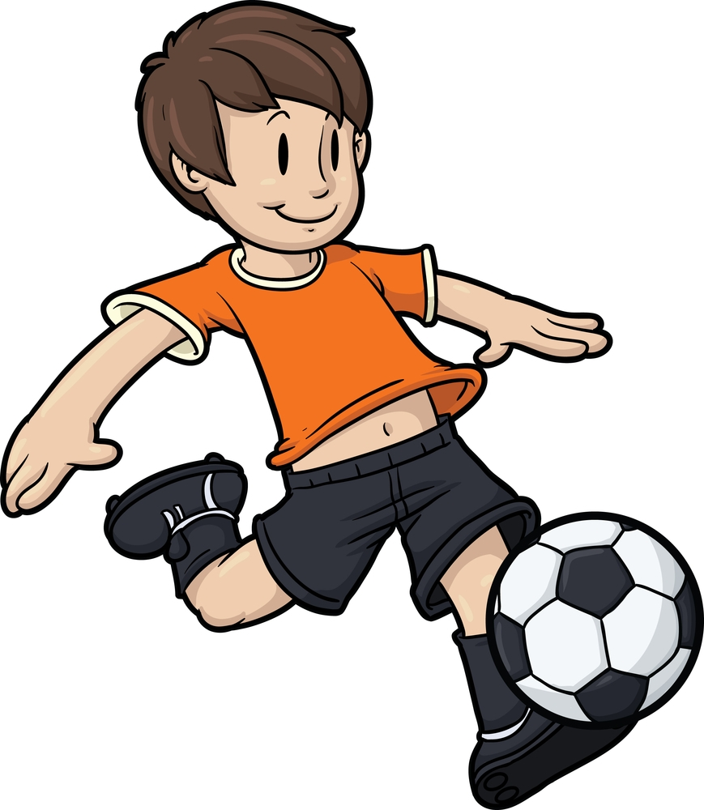
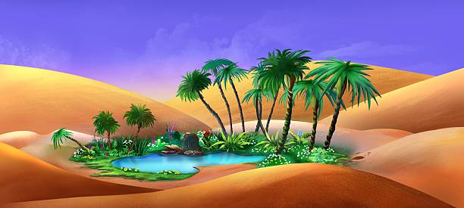

Football striker
Goalkeeper

Slide 15
Mountain
Oasis

Slide 16

Plaza
Skyscrapers

Slide 17
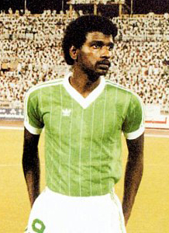
A celebrity
Unfamous

Slide 18
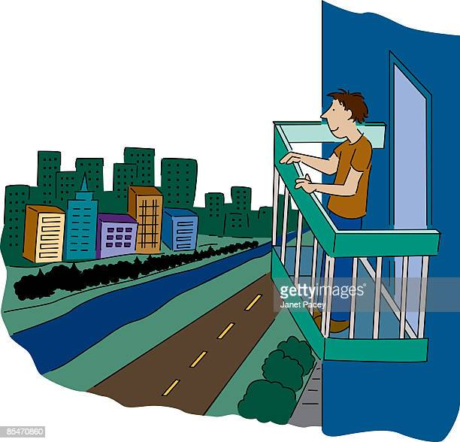
Balcony
Road

Slide 19
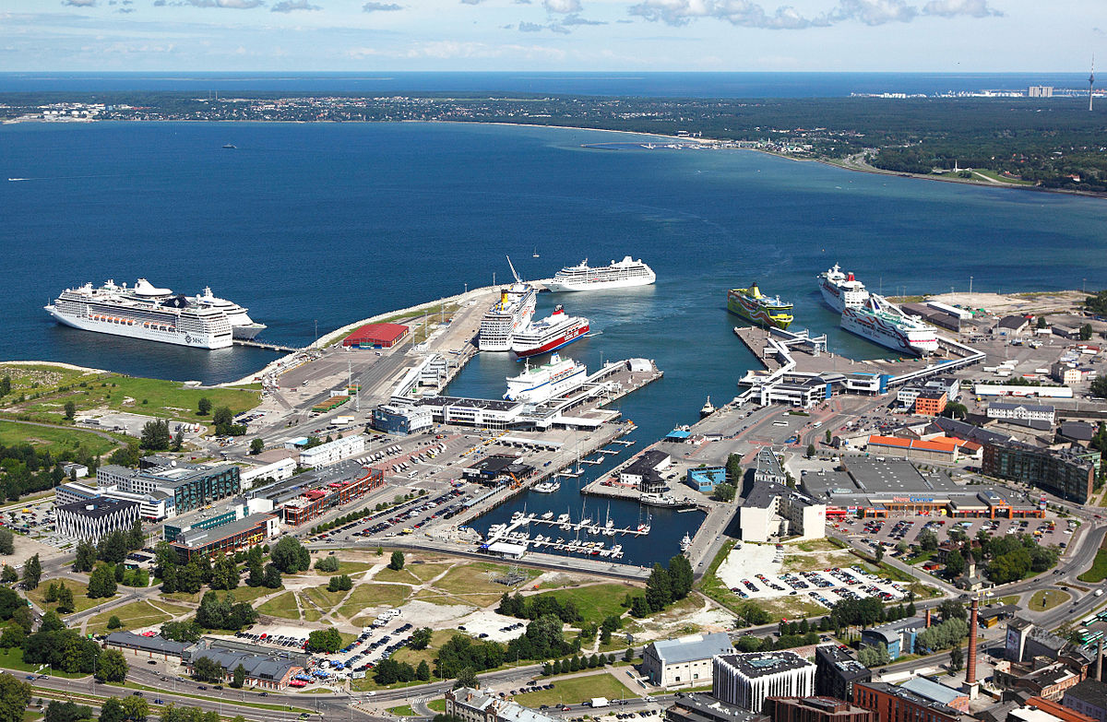
Capital city
Port city

Slide 20
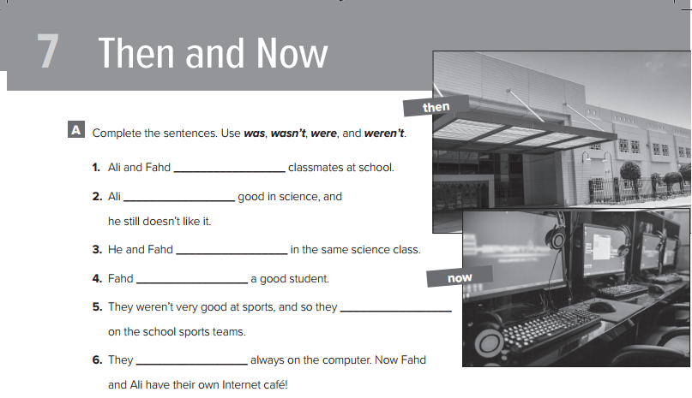
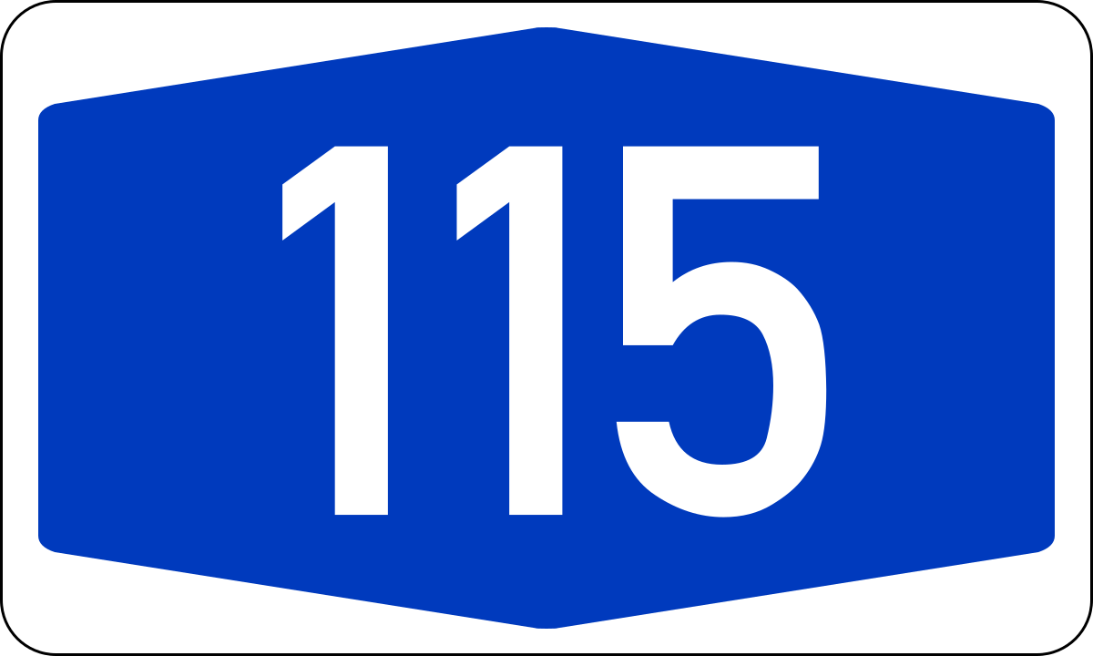

Slide 21


