Slide 1
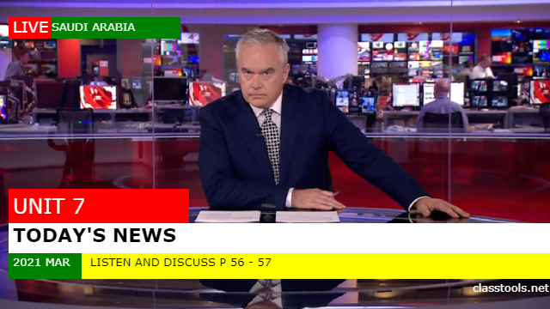

Slide 2


Do you like watching News Channels?
What’s is the best News channel to watch?

Slide 3
Did you ever hear an unusual piece of news on the radio or TV
Where?
When?
How?

Slide 4
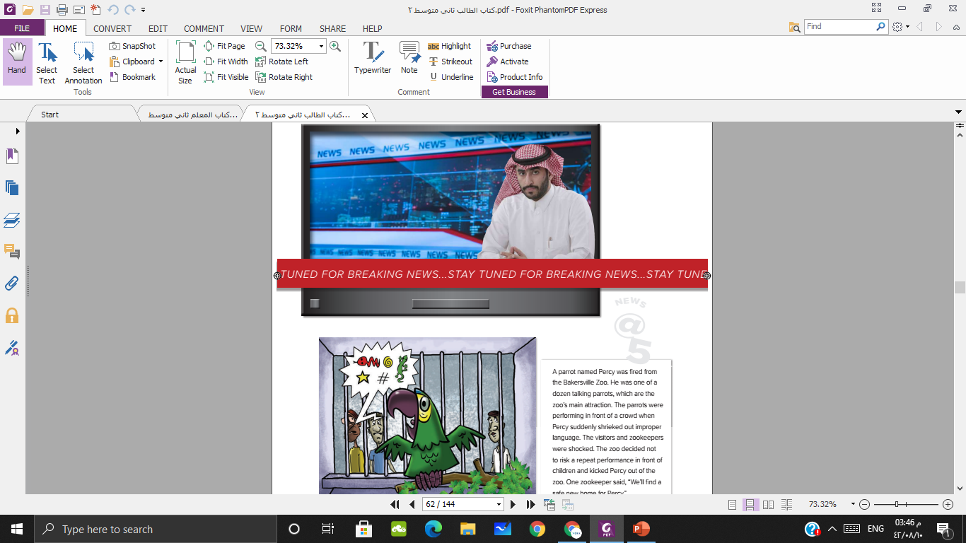

Describe what you say!
A news anchor
How interested are you in the news?
How do you get the news?
TV, Radio or Newspaper?

Slide 5

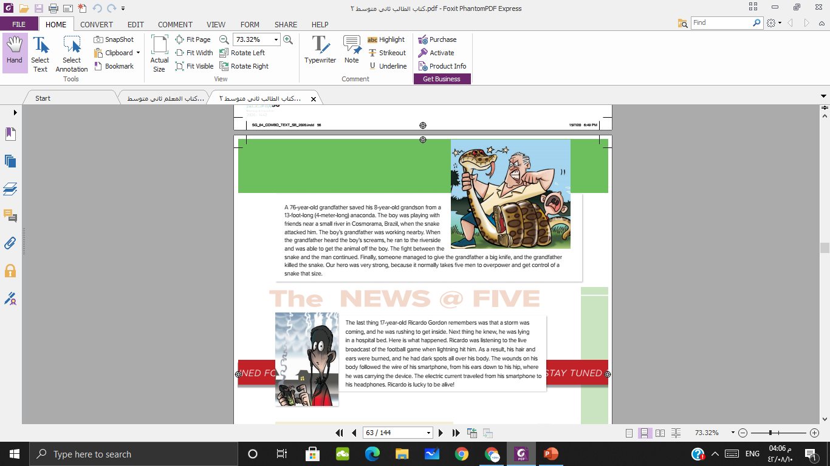
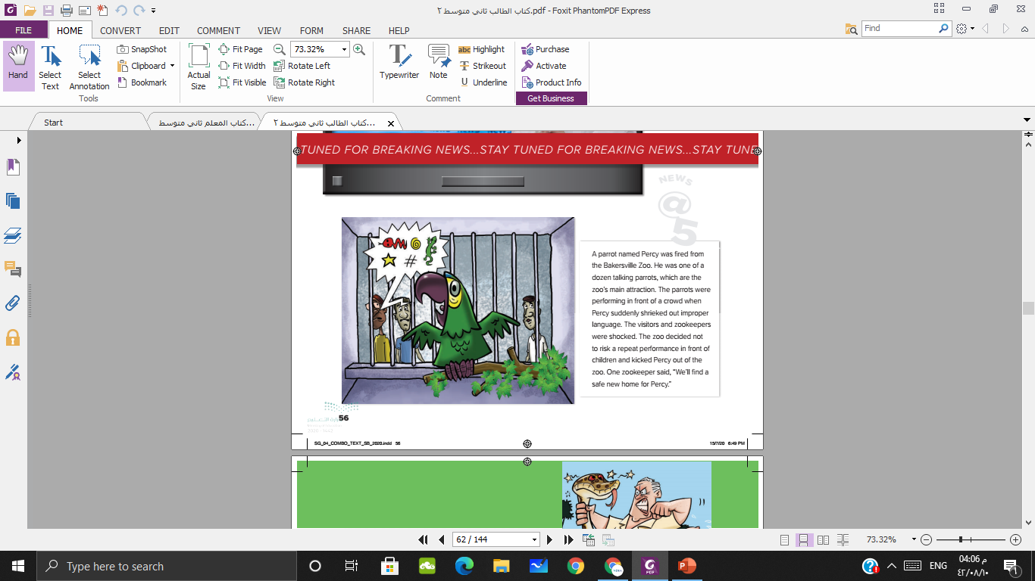

These pictures go with unusual news stories

Slide 6

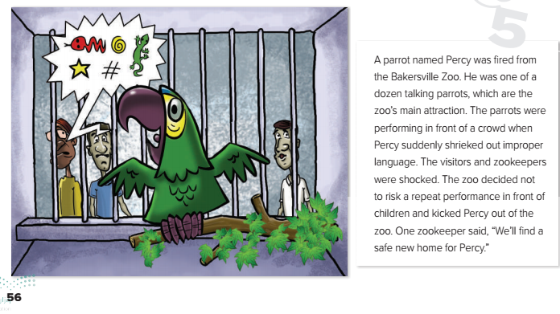
Bad language
What was the name of the parrot?
Where was the parrot performing?
What did Percy do that was wrong?
Is Percy still in the zoo?

Slide 7
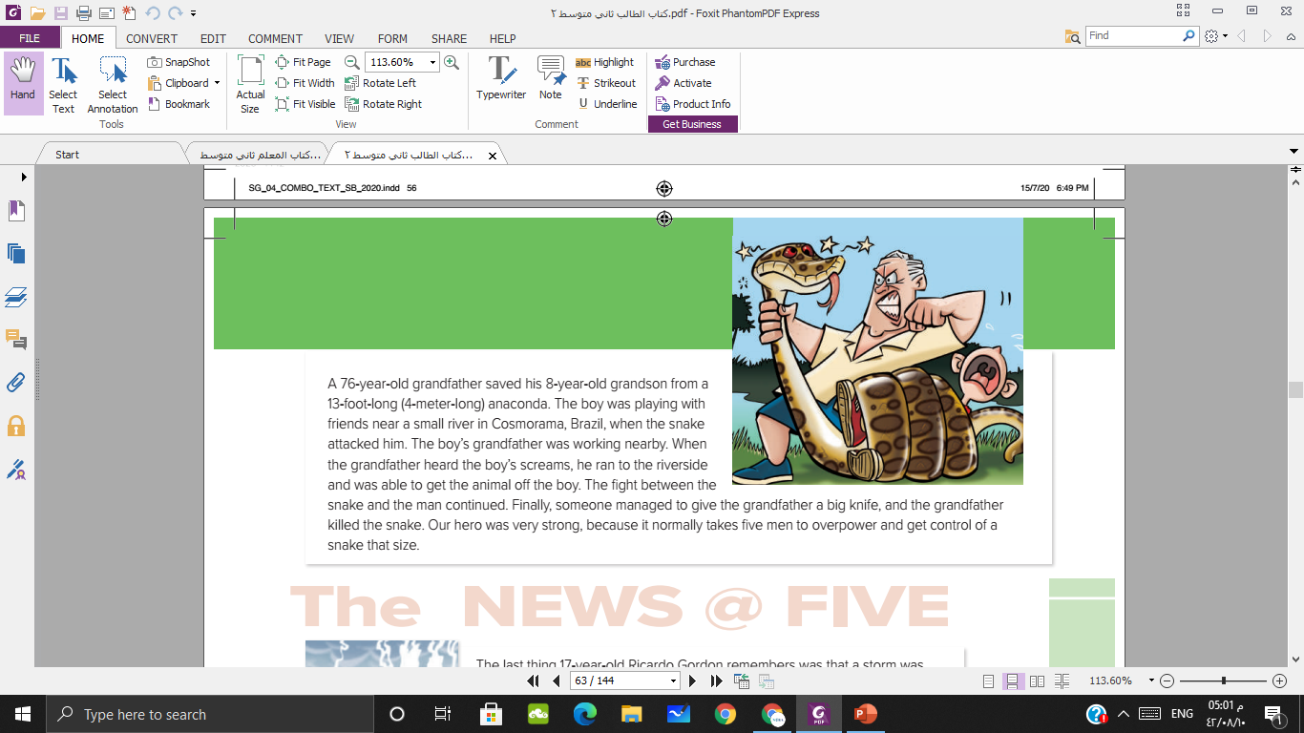
He was working nearby.
He was playing with friends.
He was fighting with the grandfather.

Slide 8
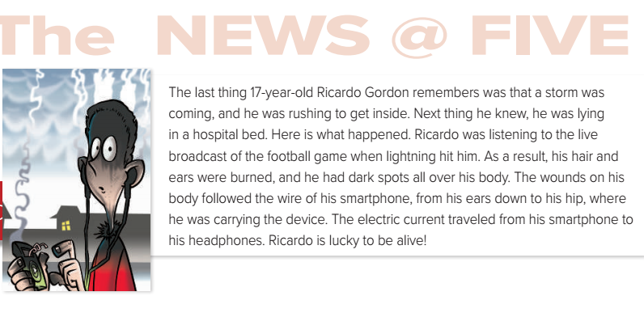
What was the name of the boy?
How old was he?
What was he listening?
What did happen to him?

Slide 9
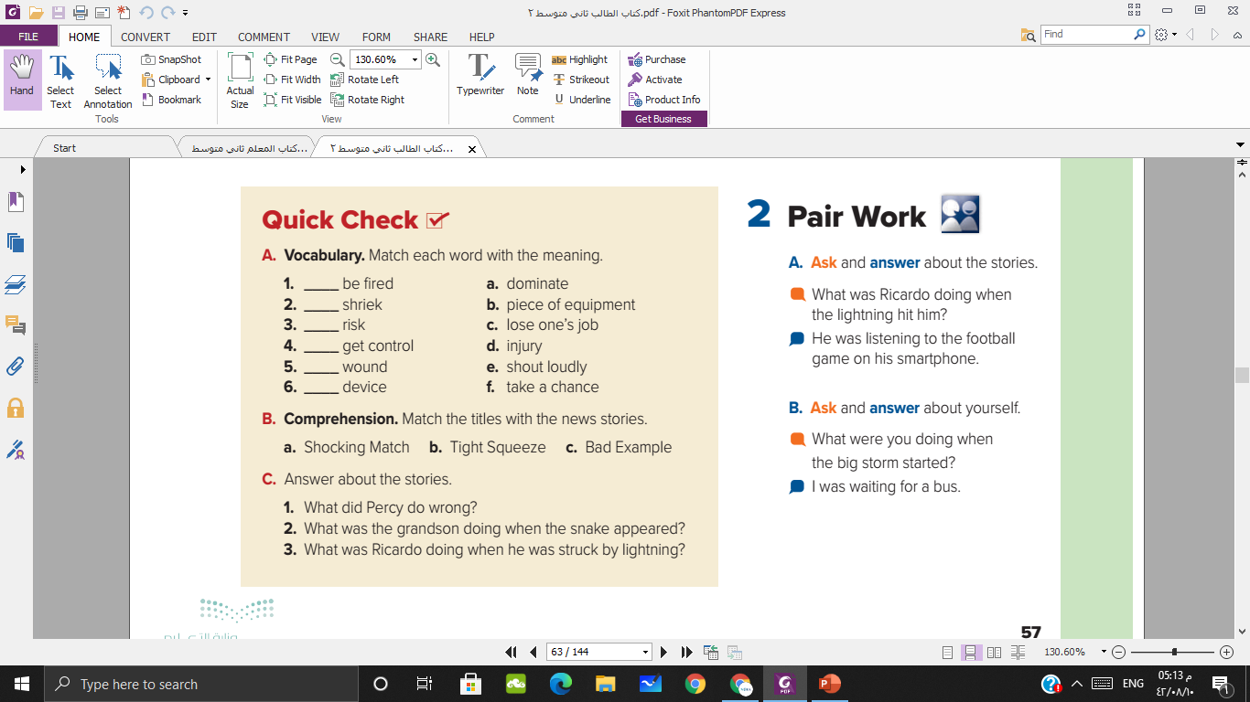
c
e
f
a
d
b

Slide 10
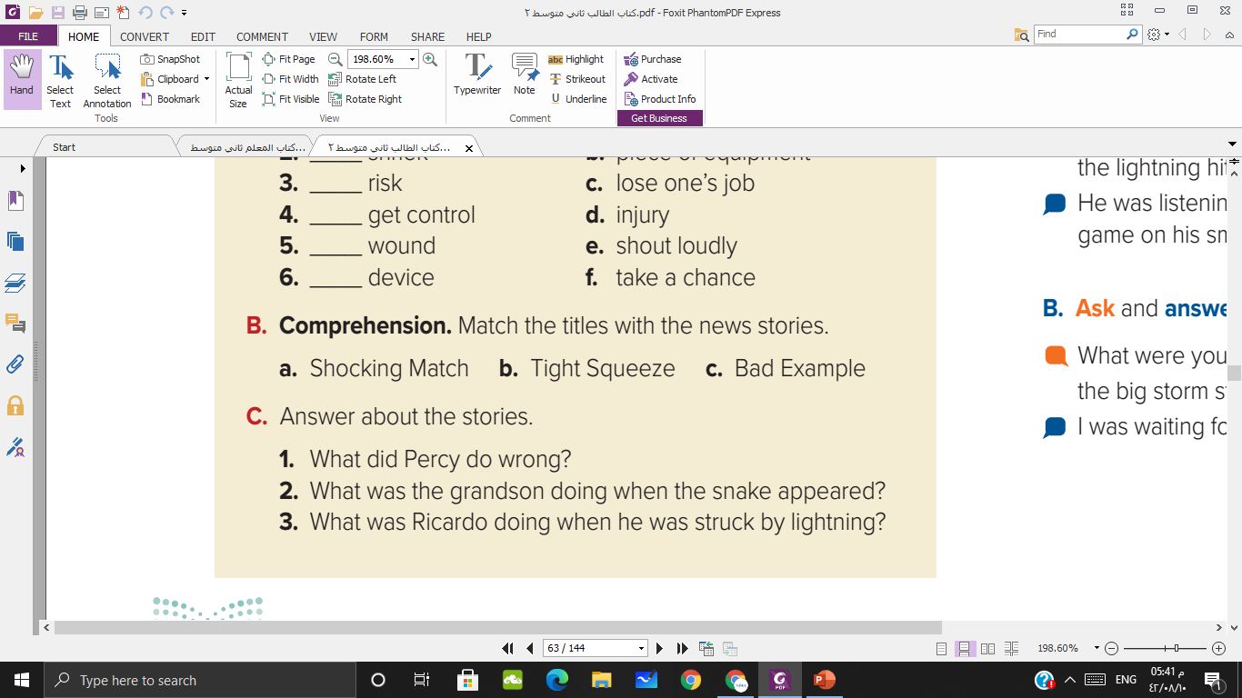
The story about the snake and the grandfather
The story about the parrot
The story about Ricardo Gordon

Slide 11
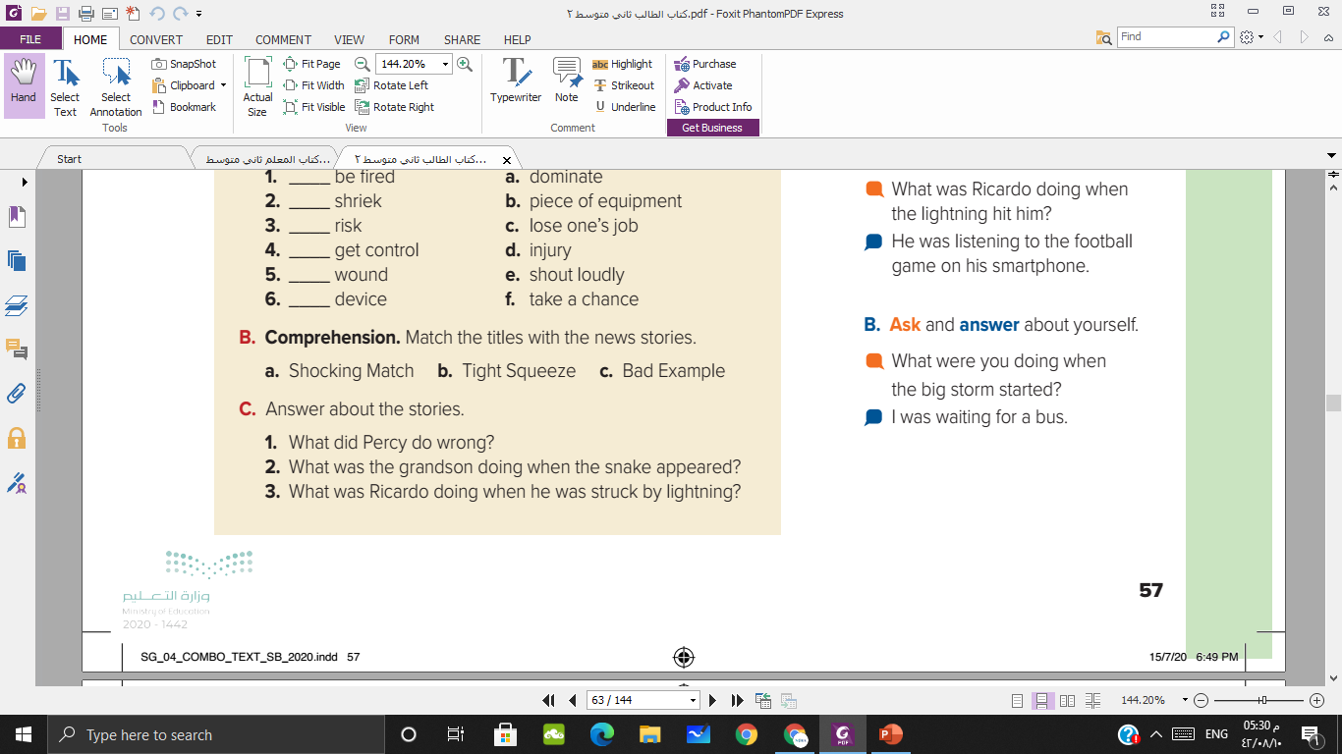
He was playing with friend when the snake appeared
He was listening to the football game in his smartphone
He used bad language

Slide 12


Slide 13


