Slide 1
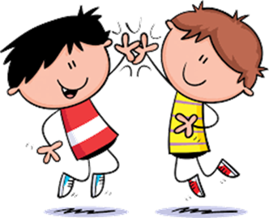
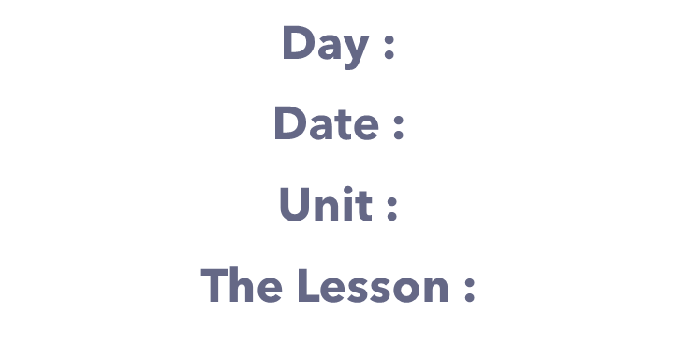

Slide 2
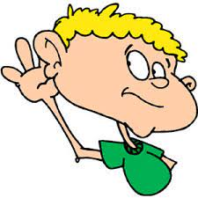
class rules
Listen to the teacher's explanation

Slide 3
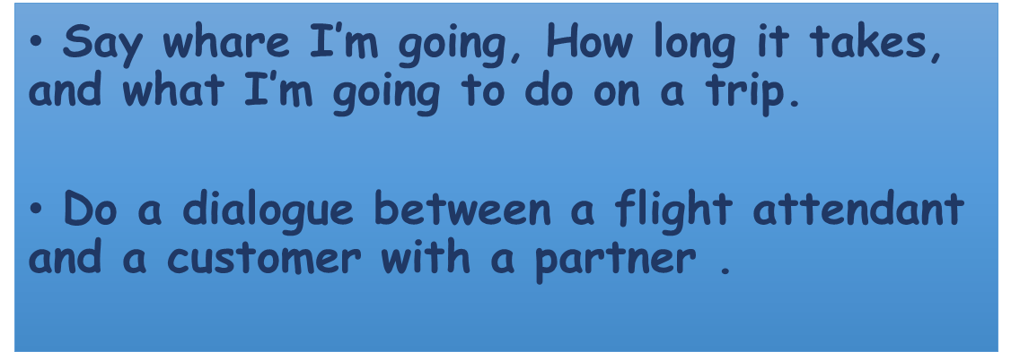

Slide 8
Where are you going ?
I’m going to Vancouver.
How long does it take to get there ?
It takes about 15 hours.
What are you going to do there ?
I’m going to go sightseeing.

Slide 9
Where are you going ?
I’m going to Dubai.
How long does it take to get there ?
It takes about 2 hours.
What are you going to do there ?
I’m going to shop .

Slide 11
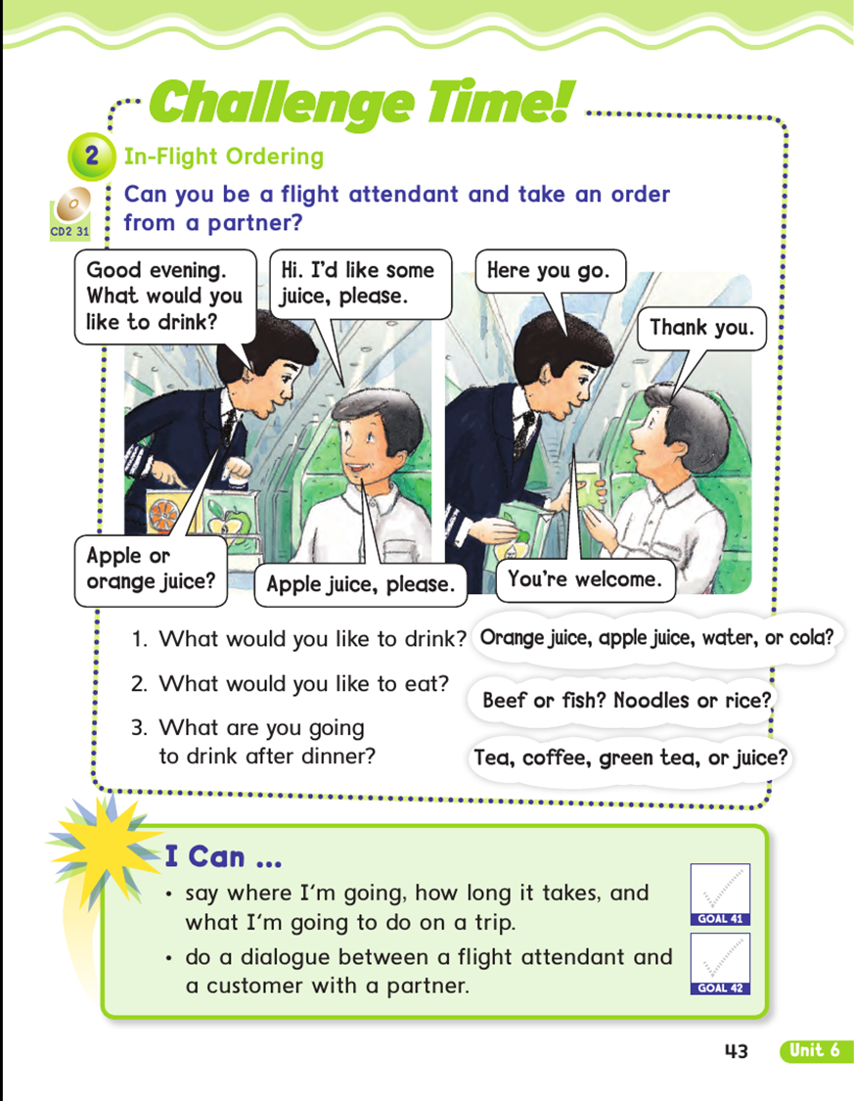

Slide 12
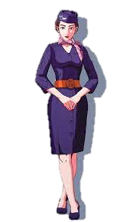
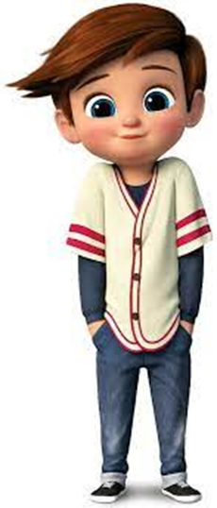
What would you like to drink ?
Hi, I’d like some juice, please
Apple , or orange?
Apple juice, please
Here you go .
Thank you
You’re welcome .

Slide 13
مسابقةالنجوم
star contest

Slide 14
Where ( are - is ) you going to ?
are
is

Slide 15
I ( is - am ) going to Abha .
is
am

