Slide 1
Do You Really Need It?
Mega Goal 5
Unit 5
Reading
Done by: Entisar AL-Obaidallah

Slide 2
Lesson Objectives
01.
02.
03.
04.
Name
Read
Answer
Talk
Places where they
see ads in everyday life
the text for specific information
Some comprehension question about the text
about techniques used in advertisement

Slide 3

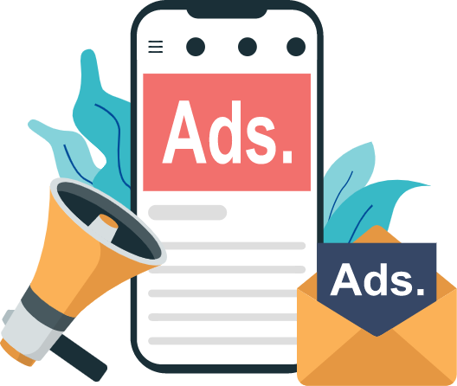
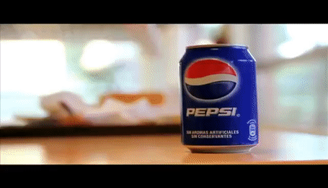
Warm Up
Do you remember this ADS ..
What does it mean?
It means : Advertisement

Slide 4

Your studen’s book p. (74)
Open

Slide 5
Reading
Before

Slide 6
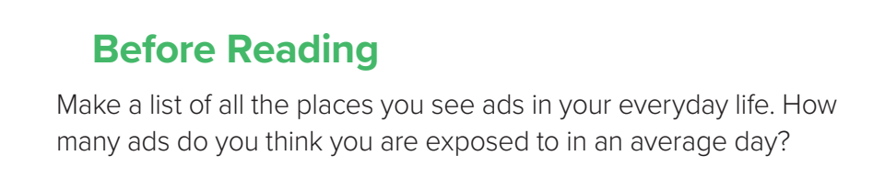
Brain storm

Slide 7
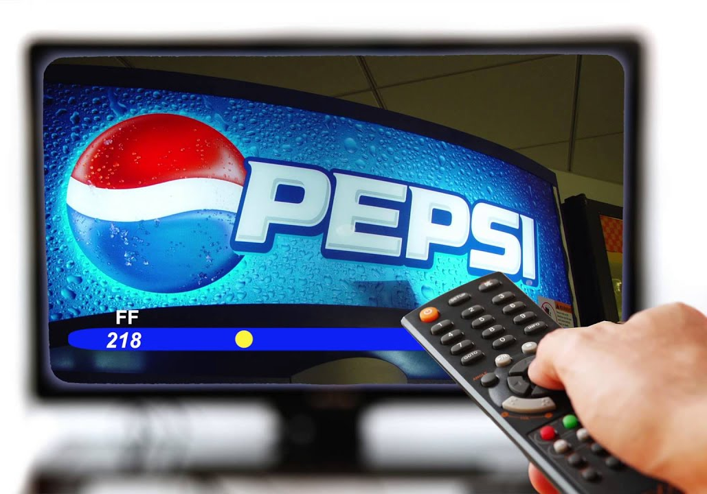
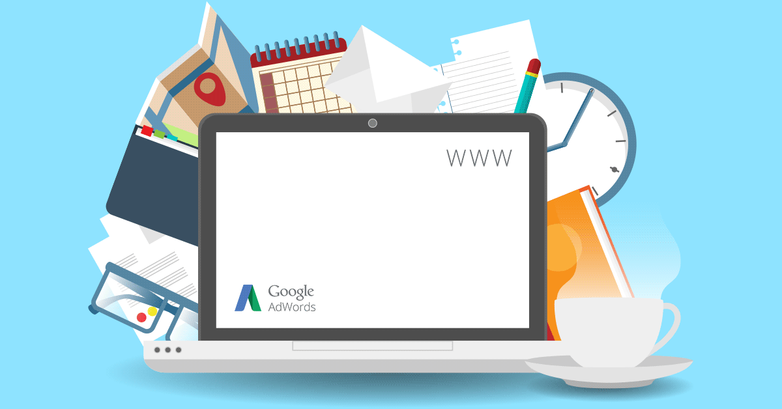
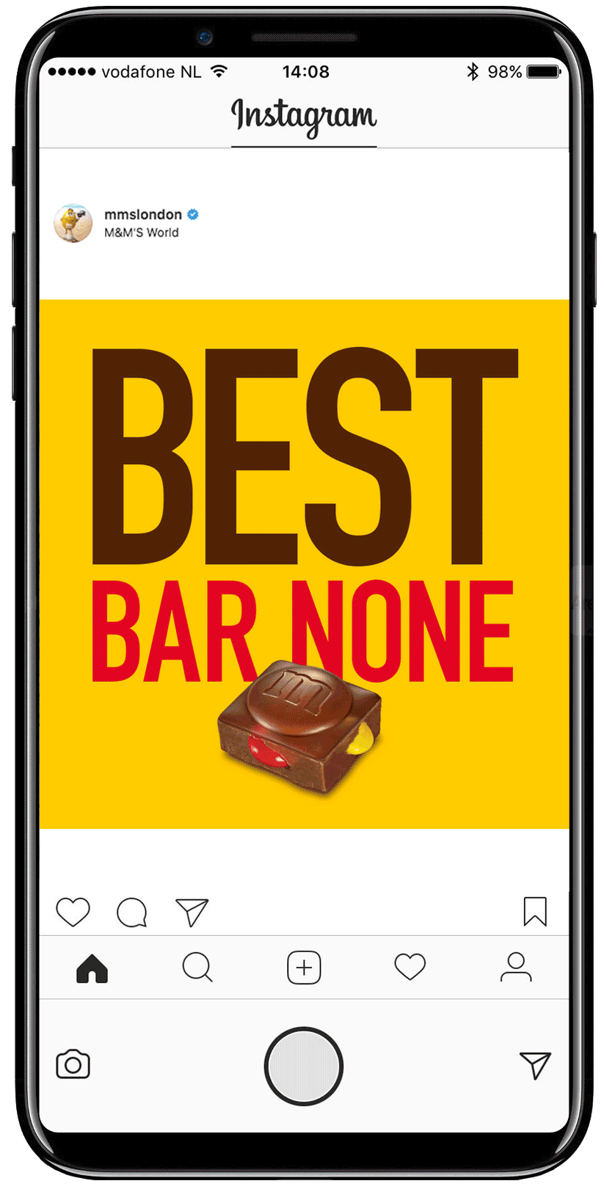
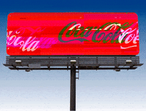
internet
Tv
billboard

Slide 8
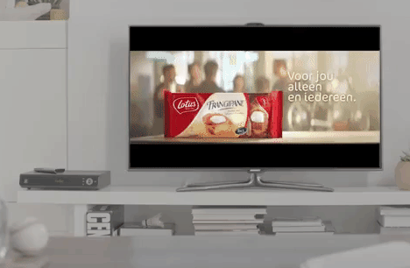

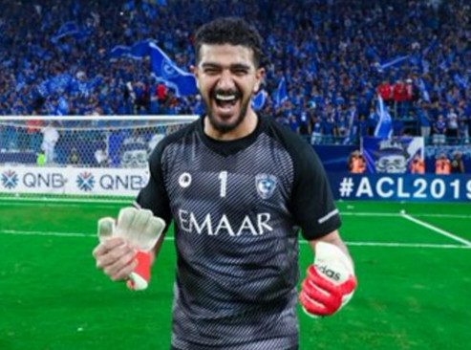
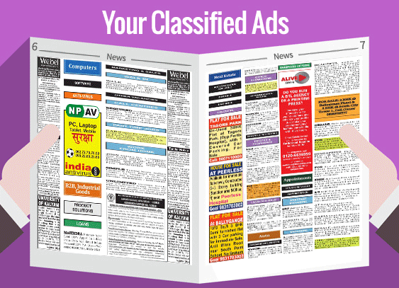
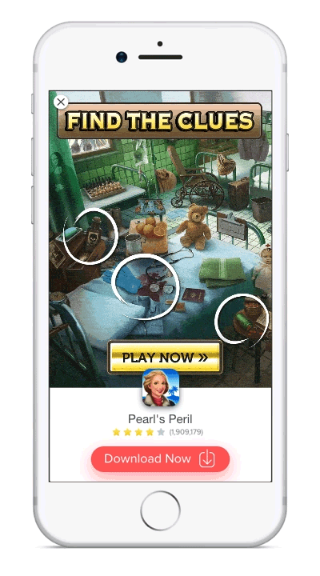
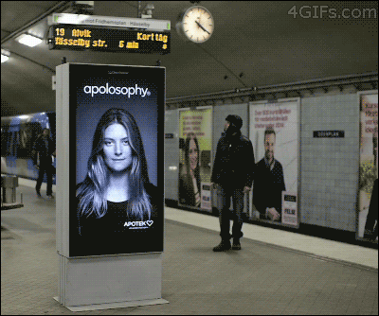

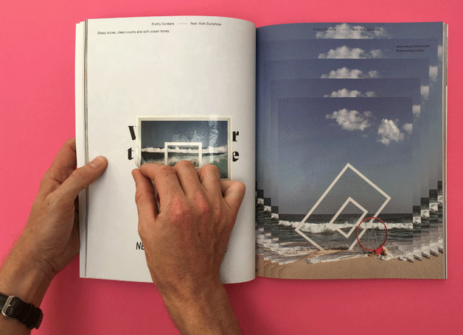

Slide 9
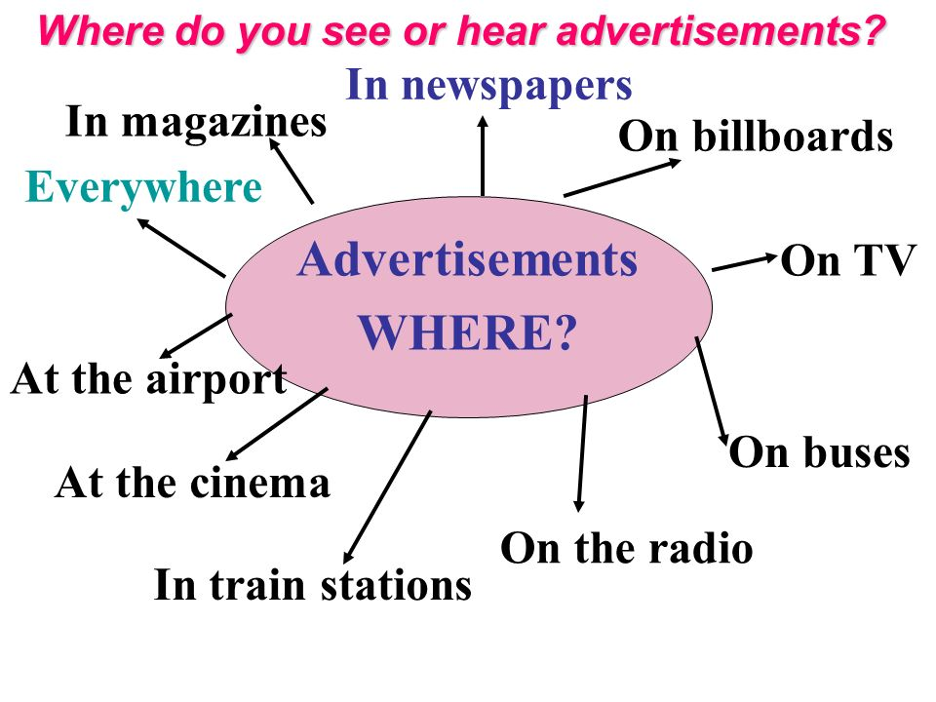
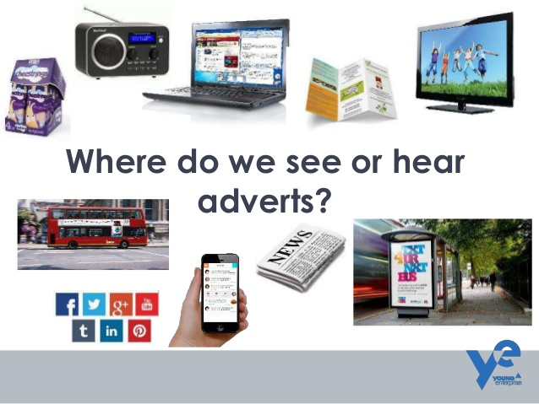

Slide 10
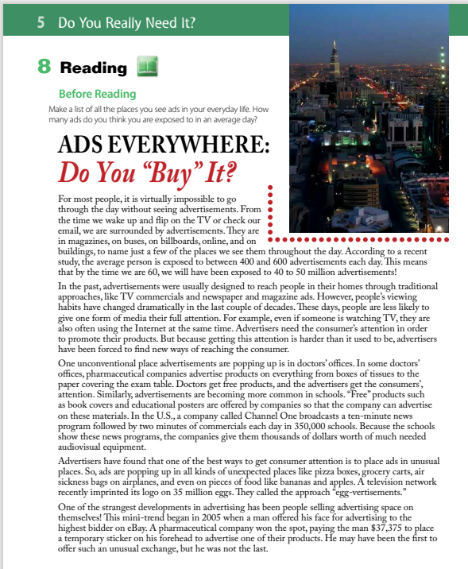
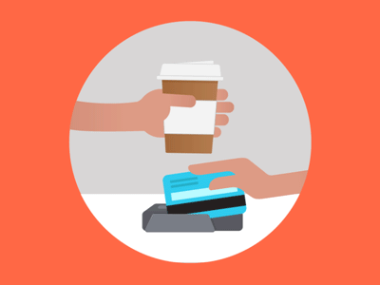
Why is “Buy” in quotation marks?
“buy” has two meanings in this title.
to accept, believe, or support something
to purchase something.

Slide 11
What are the two
meanings of the title?
Do you buy products that you see advertisements for?
Do you accept the practice
of being exposed to advertisements everywhere?

Slide 12
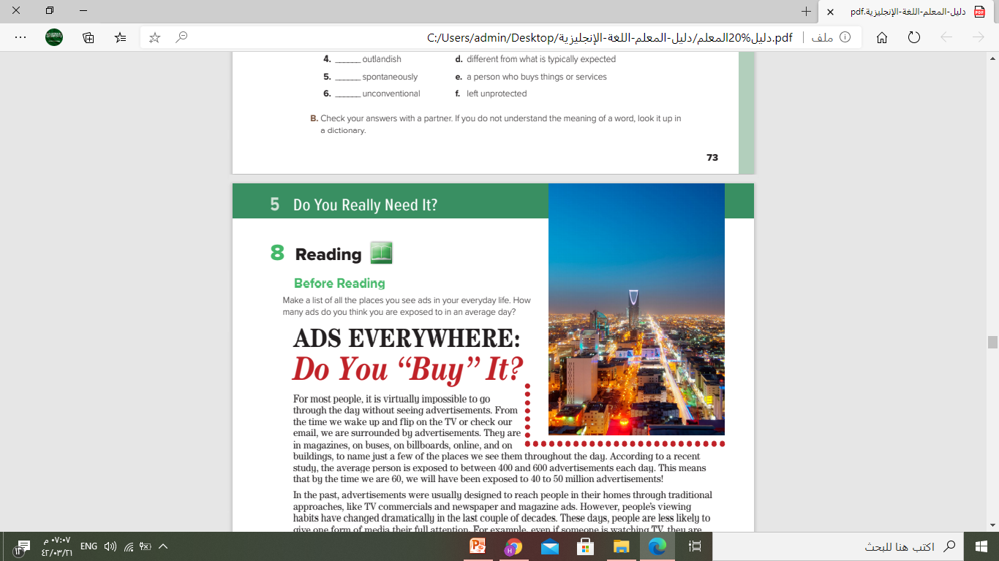
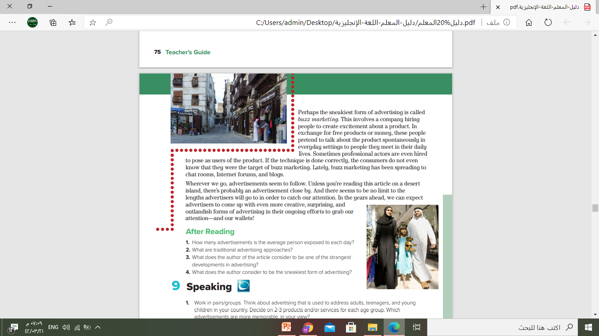
Do you recognize these cities?
Riyadh
Jeddah

Slide 13
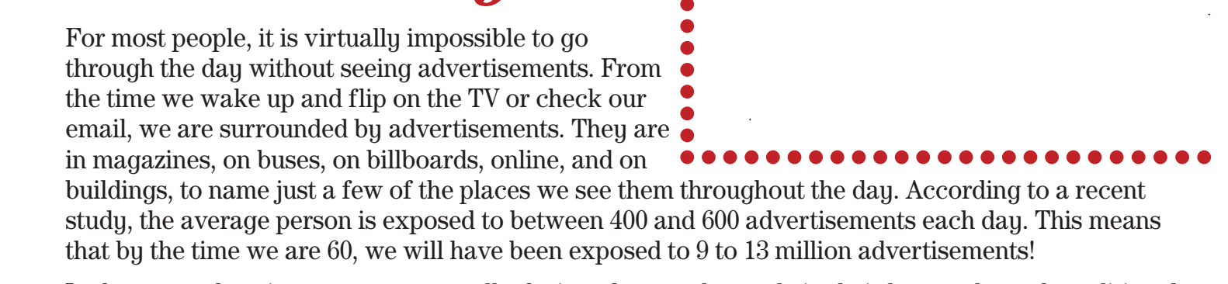

What is the main idea of this paragraph?
It is about The amount of advertisements people see in a day.

Slide 14
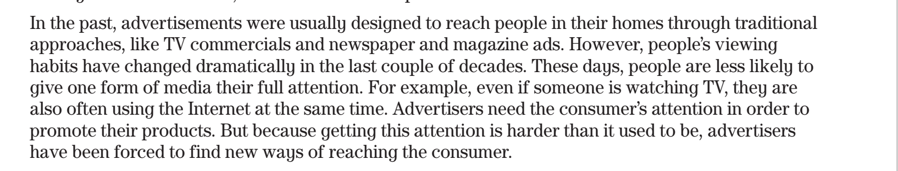
What do you think you will learn in this paragraph?
It is about how advertisements reach people today

Slide 15
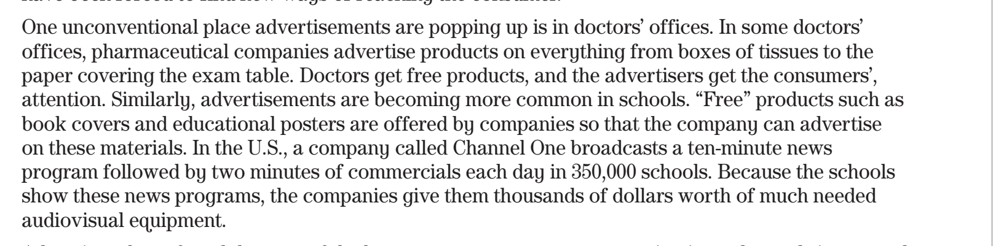
What do you think you will learn in this paragraph?
It’s about unconventional places of advertisement

Slide 16
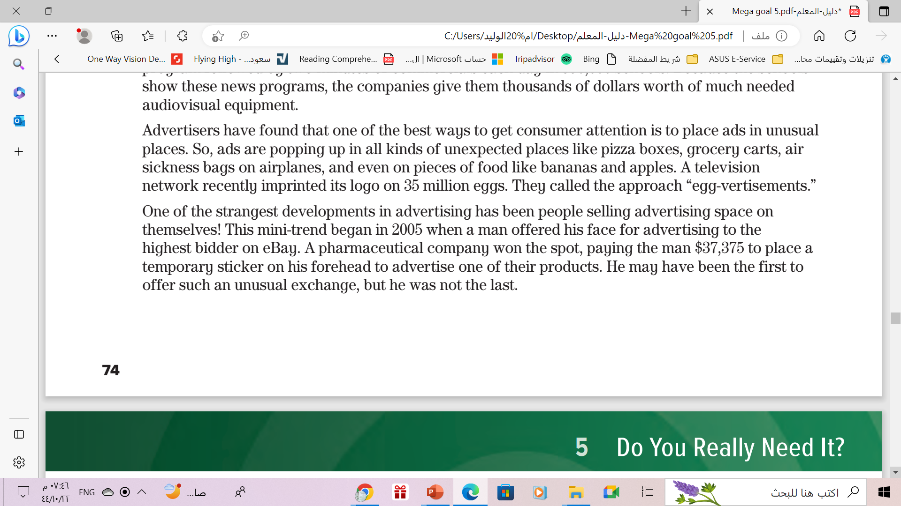
What do you think you will learn in this paragraph?
It’s about The best way to get consumer’s attention

Slide 17
What do you think you will learn in this paragraph?
It’s about The strangest development in advertising

Slide 18
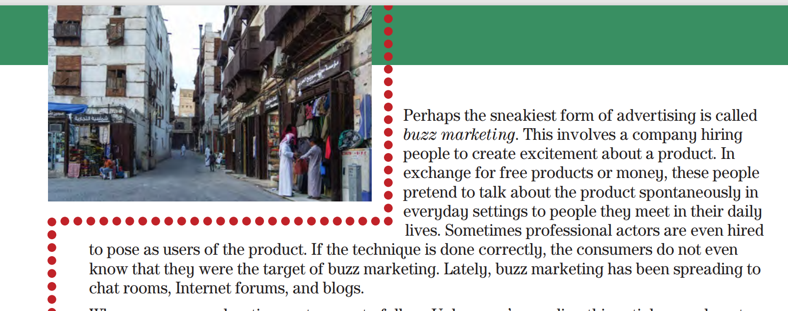
What is the main idea of this paragraph?
It’s about buzz marketing

Slide 19
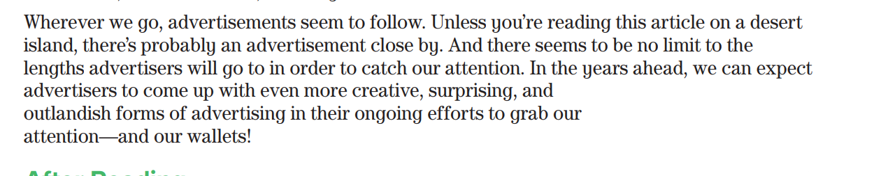
What is the main idea of this paragraph?
It’s about the advertisement everywhere

Slide 20
Your studen’s book p.
75
Open

Slide 21
Reading
After

Slide 22
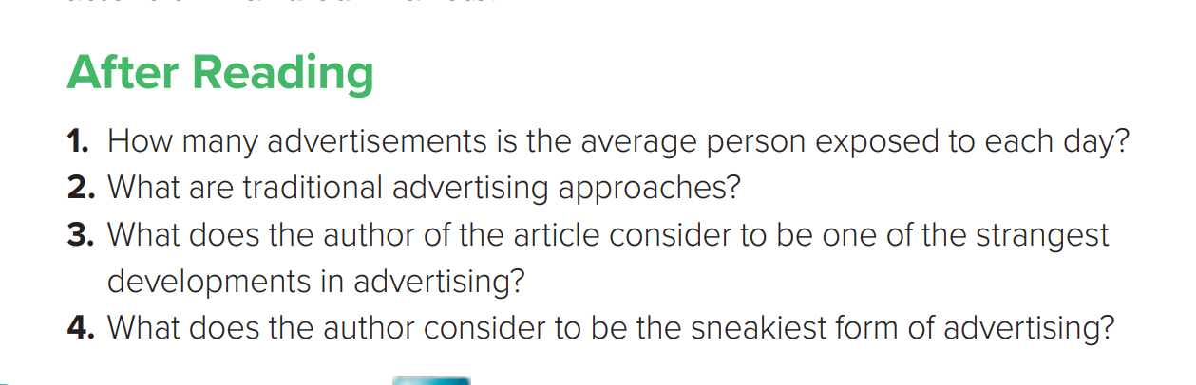
between 400 and 600 advertisements each day.
TV commercials, newspaper ads, and magazine ads
Selling advertising space on one’s body.
Buzz marketing .

Slide 23

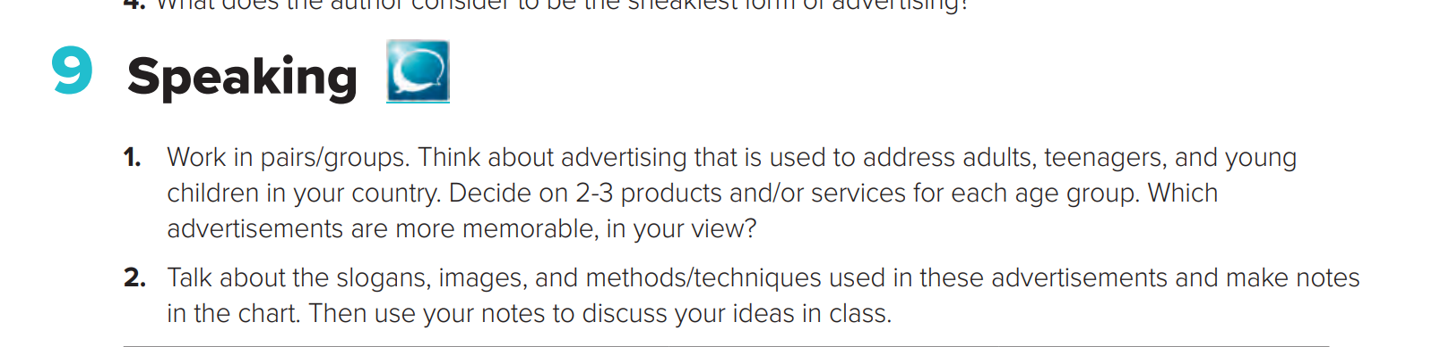

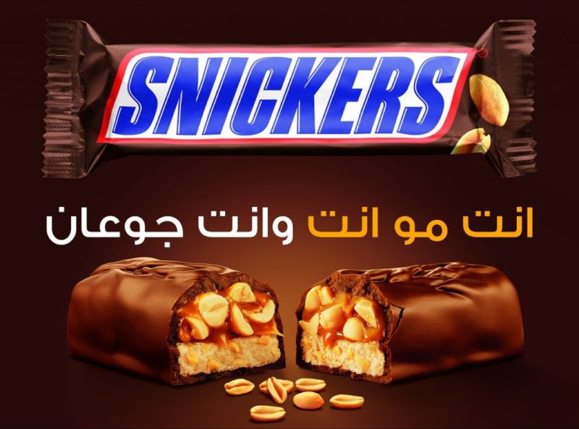
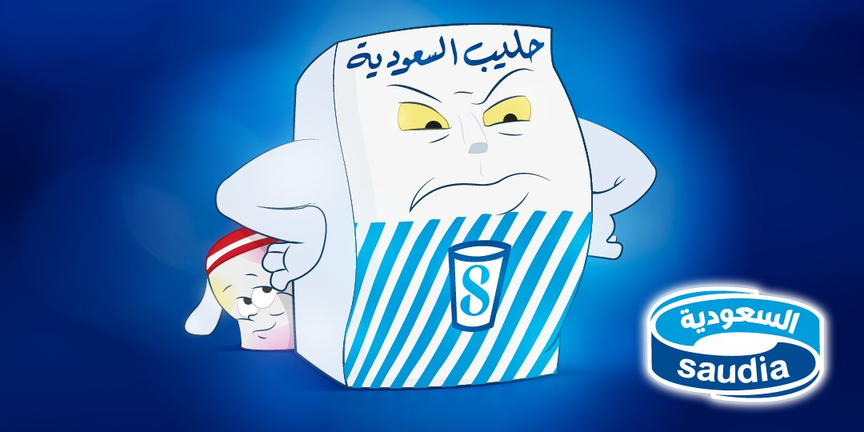
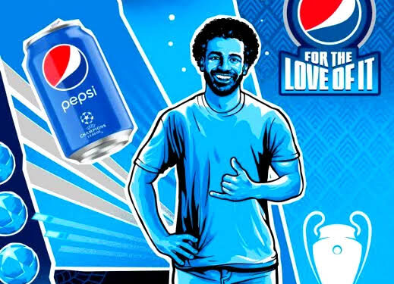

Slide 24
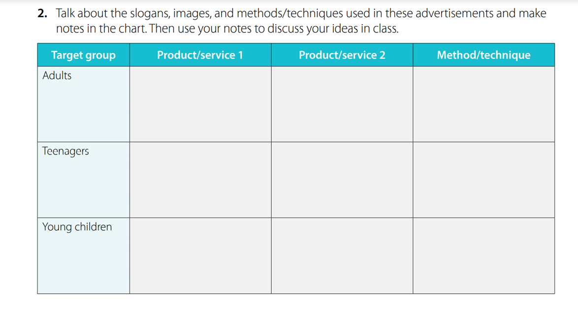
After Reading

Slide 25
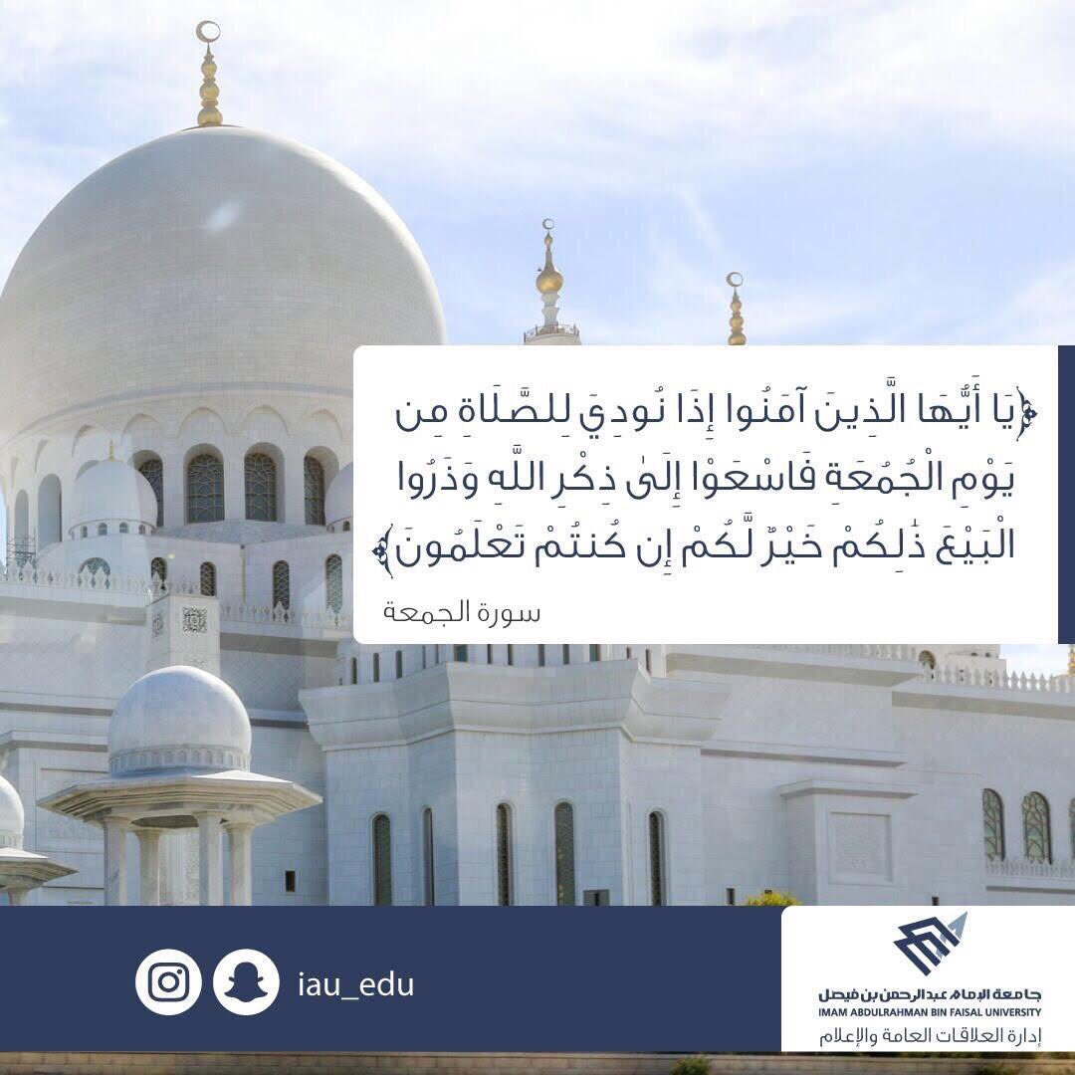
From The Holy Qura’an

Slide 26
Homework
Workbook p.(52) , exercise ( J)

Slide 27

Thanks !

