Slide 1
Oral examinations
3rd semester

Slide 2
4th grade
1
2
3
4
5
6

Slide 3


Hello , What’s your name ?
Nice to meet you
Do you have a pet ?
What’s this ?
11
Say the number

Slide 4

Hello , What’s your name ?
Nice to meet you
What day do you like ?
What’s the weather like ?
What is this ?

Slide 5
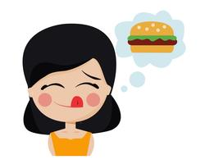
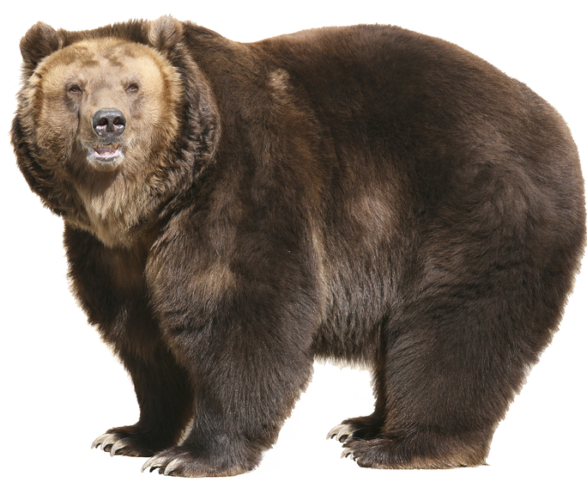
Hello , What’s your name ?
Nice to meet you
How old are you ?
What’s the matter ?
What is this ?

Slide 6

Hello , What’s your name ?
Nice to meet you
Do you have a pet ?
What’s this ?
17
Say the number

Slide 7

Hello , What’s your name ?
Nice to meet you
What day do you like ?
What’s the weather like ?
What is this ?

Slide 8


Hello , What’s your name ?
Nice to meet you
How old are you ?
What’s the matter ?
What is this ?

