Slide 1



Unit 4
What Would You Do?
Mega Goal 2.3
Grammar
Done by: Entisar Al-Obaidallah

Slide 2





Lesson Objectives
Form
Deduce
Apply
Sentences using Present Hypothetical Conditionals
the structure of implied conditionals
The rules to do the exercises correctly
1
2
3
4
5
Write
Use
Meaningful sentences using Past Hypothetical Conditionals
As If/As Though for unreal Situations

Slide 3
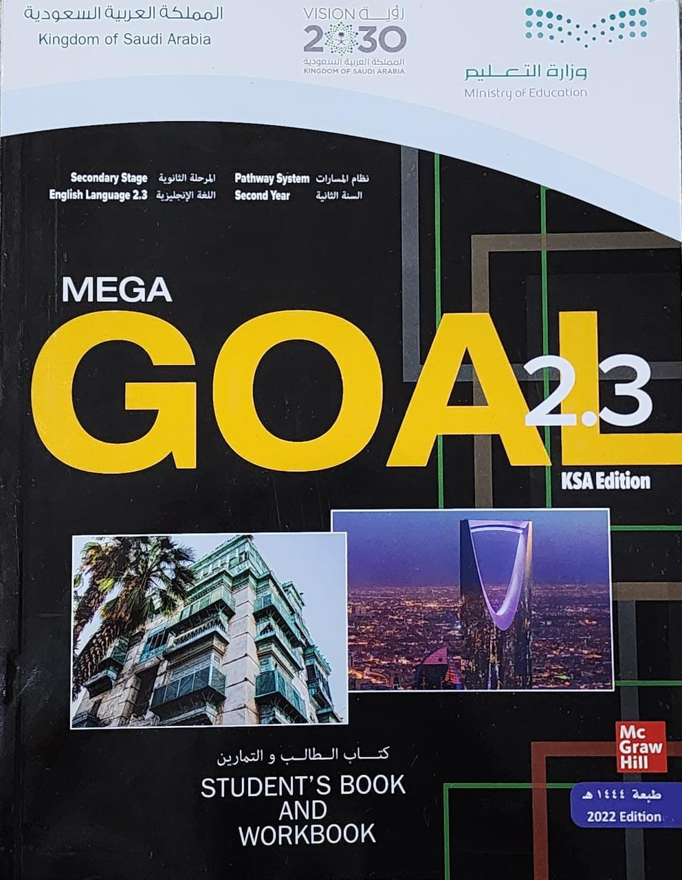
Book Open
Page ( 50 – 51 )

Slide 4
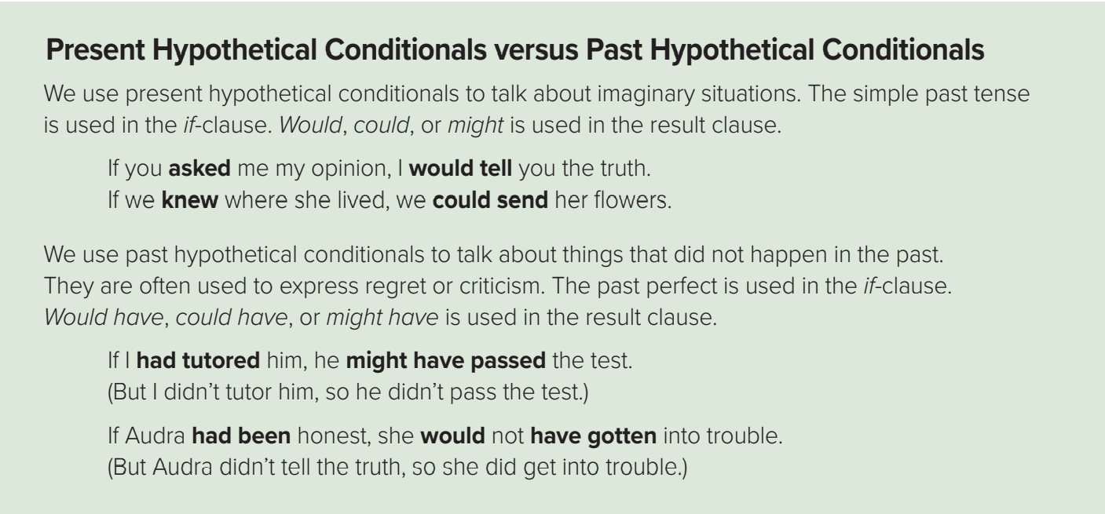

Slide 5
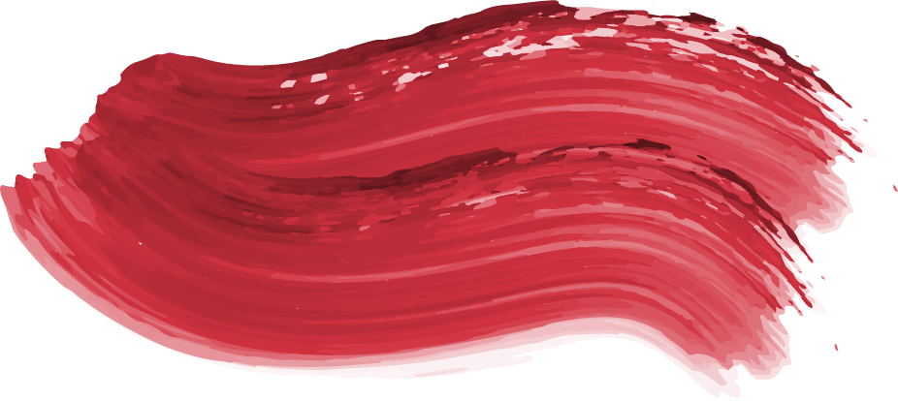



Hypothetical Conditionals Present of Miró
Use
to talk about imaginary situations
Form
If ….
Simple past
…would
V infinitive
Example
Past simple
would
Verb infinitive
If I had any money, I would lend it to you .
If clause
Result clause
Note ;Would, could, or might is used in the result clause.

Slide 6

Hypothetical Conditionals Past of Miró
Use
to talk about things that did not happen in the past.
used to express regret or criticism.
Form
If ….
had
V3
…would
have
V3
Example
Past perfect
Would +have+ V (3)
If I had got enough money, I would have bought the camera.
If clause
Result clause
Note : Would have, could have, or might have is used in the result clause

Slide 7


Slide 8

Complete using present hypothetical conditional
had
If she ( have) a car ,it would be the white one.

Slide 9

Complete using present hypothetical conditional
Would eat
If she went to a restaurant, she (eat)burger.

Slide 10

Complete using present hypothetical conditional
were
If I ( be)a millionaire, I would buy a house.

Slide 11

Complete using past hypothetical conditional
If I ( study) harder, I might have passed the physics test.
had studied

Slide 12

had saved
If I (save) my money, I would have bought a new computer.

Slide 13
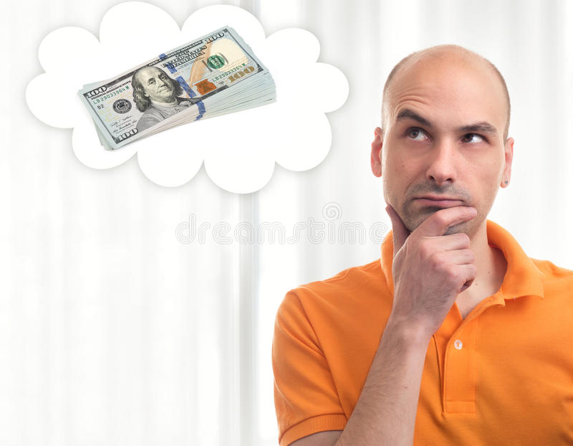
Complete using past hypothetical conditional
had got
If I a lot of money , I ( be) happy .
Would have been

Slide 14
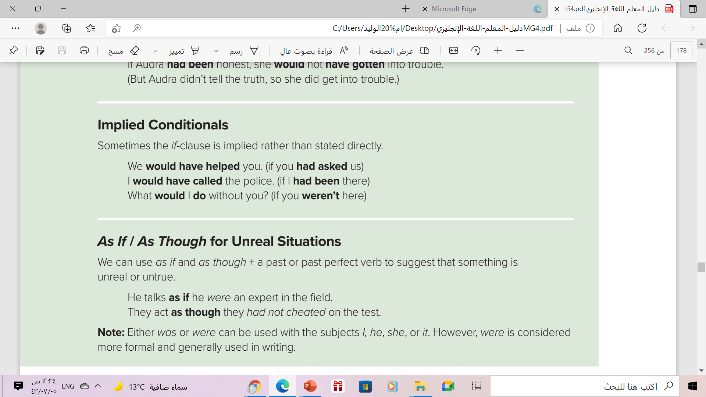

Slide 15
Implied Conditionals
Use
Conditional statement can be expressed without using “if”
Conditional verbs are used in the result clause
Use
Form
Past Modal
V ( infinitive )
Past Modal
have
V (3)
Result clause
Example
I would buy a Ferrari , but I don’t have enough money
Implied conditional: (if I had enough money …)
Result clause
I would have stayed longer , but he didn’t ask me to .
Implied conditional: (if he had asked me to )

Slide 17
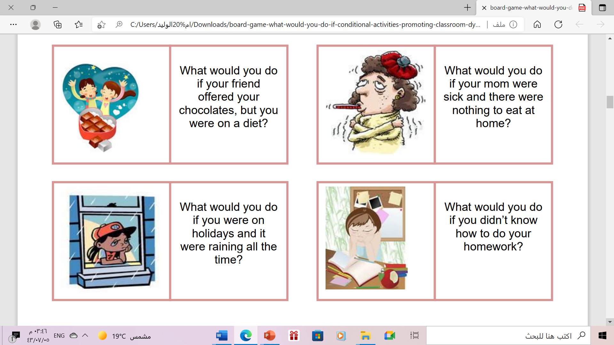
I would ask for help.
I would go to the restaurant

Slide 18
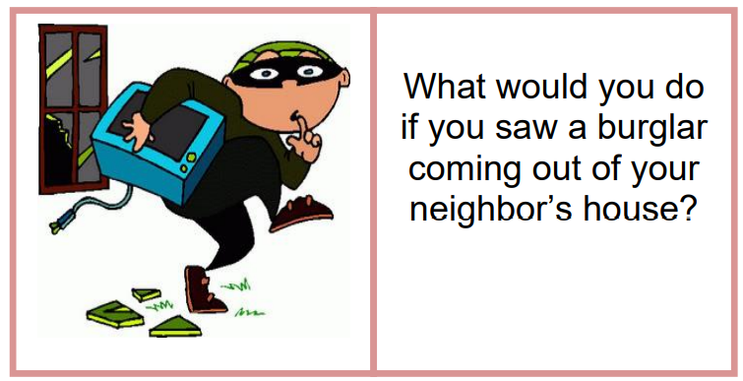
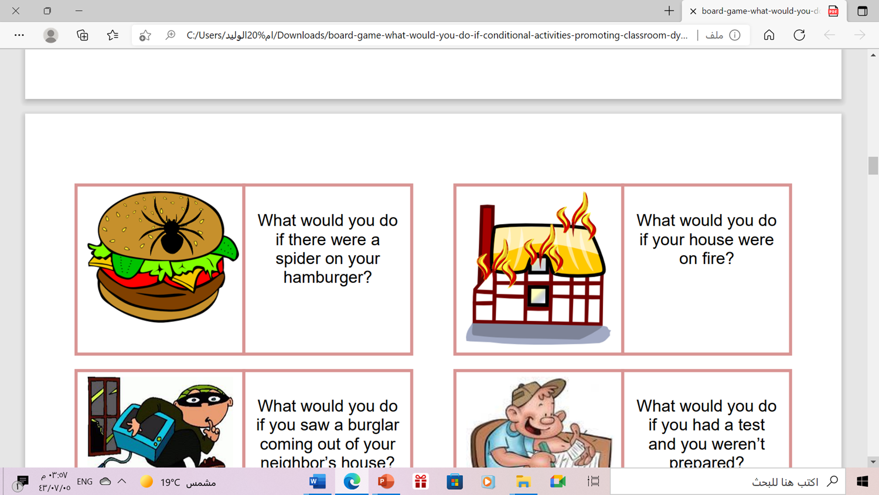
I would call the police
I would call the firefighters.

Slide 19

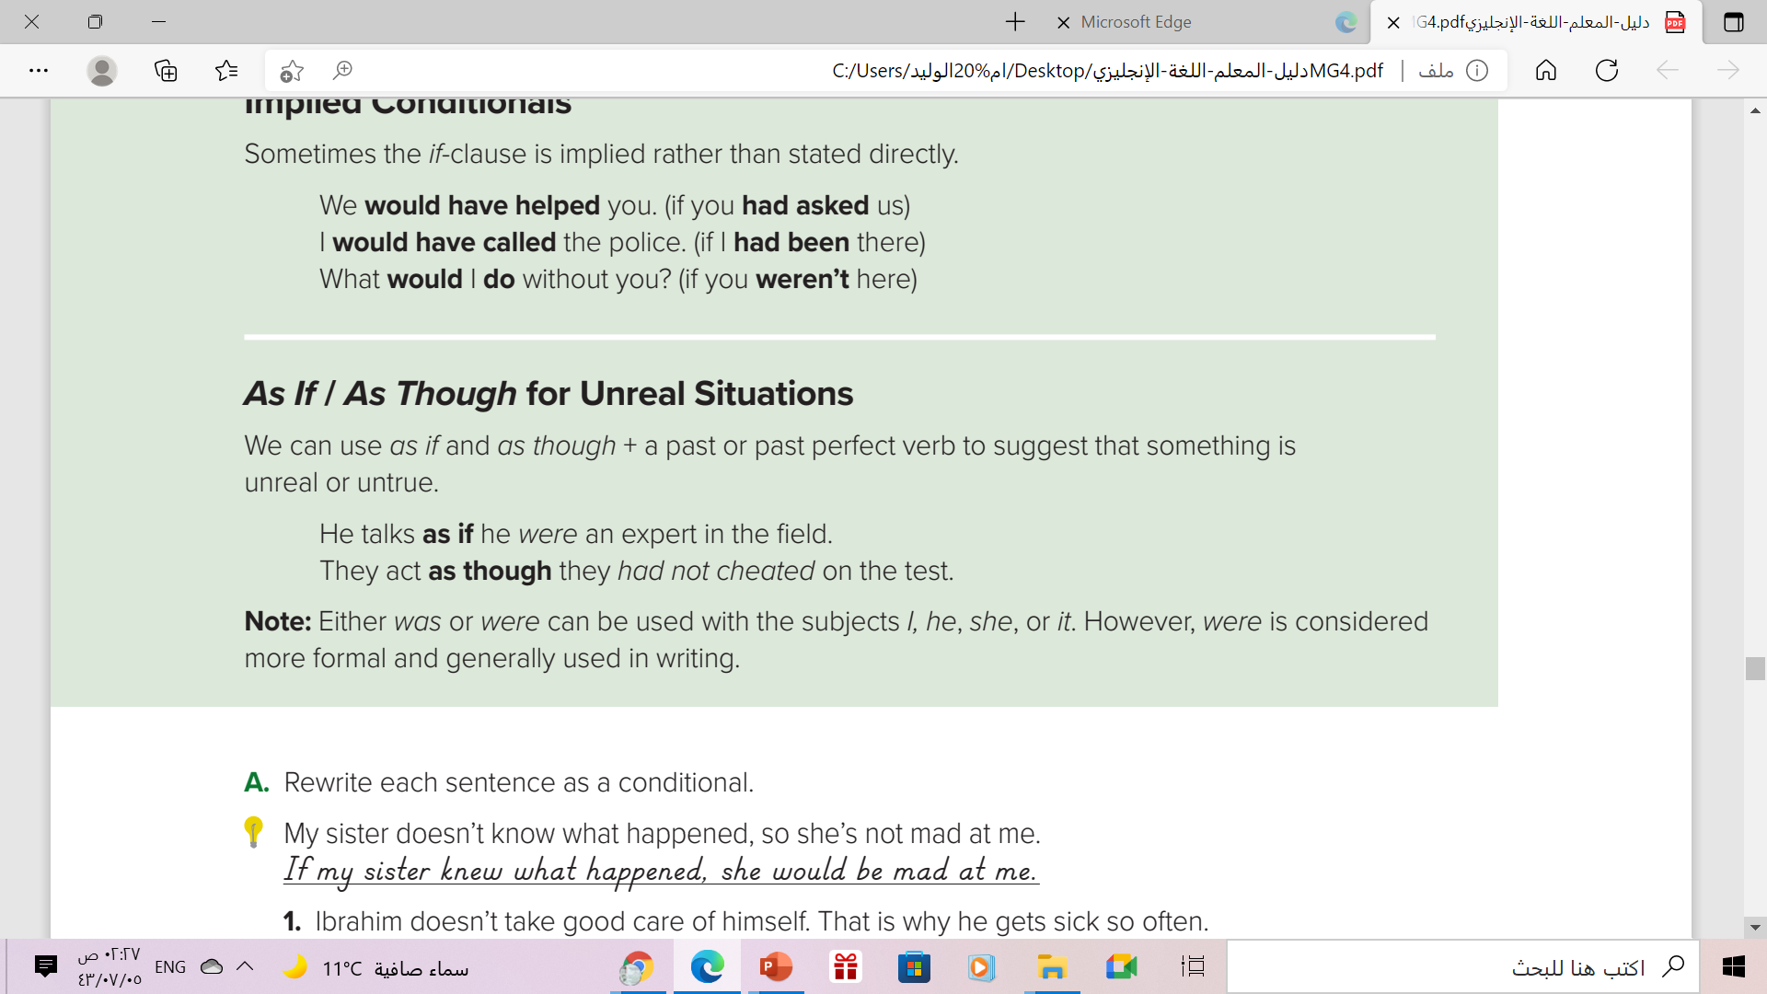

Slide 20
As If / As Though for Unreal Situations
Use
to suggest that something is unreal or untrue
Form
.. as if / as though ..
Past verb
.. as if / as though ..
had
V (3)
Example
Past simple
He behaved as if he were a clown .
Past perfect
You look as though you hadn’t slept well.
Note :Either was or were can be used with the subjects :I, she, he , or it .However, were is considered more formal and generally used in writing .

Slide 22

Make a sentence using the given words:
Samy is not King.
act / as if
He acted as if he were a king

Slide 23

Make a sentence using the given words:
Maher is not clown
behave / as if
He behaved as if he were a clown

Slide 24
https://wordwall.net/ar/resource/13505944

Slide 25
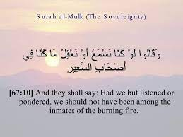
From The Holy Qura’n

Slide 26
Home work
Workbook , page ( 110 ), exercise ( N )

Slide 27

Thank you!

