Slide 1
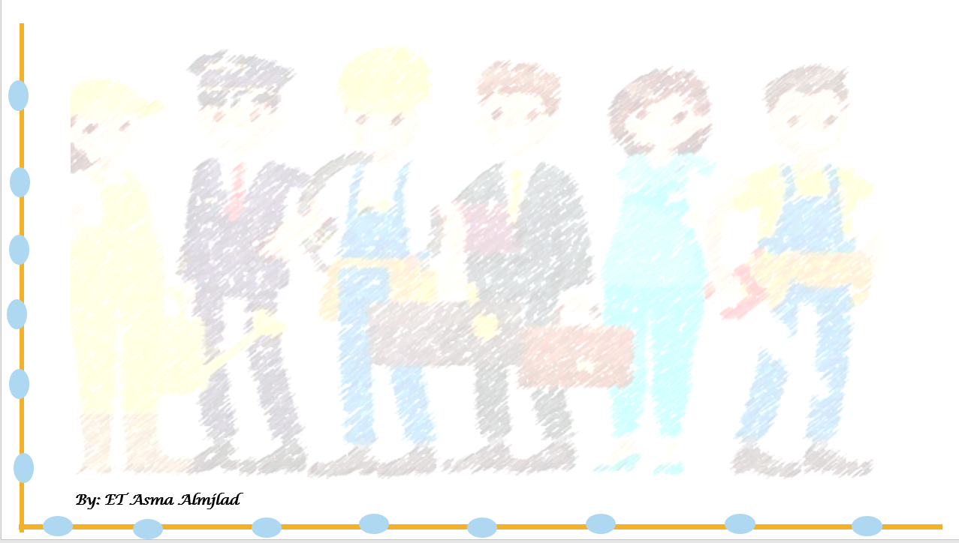
Unit :3
Lesson : 3
Who’s
Who ?
Reading
By: Asma Almjlad

Slide 2
Objectives
describe the jobs in the text
Explain jobs mentioned in a text
Find the meaning of new words in the text

Slide 3
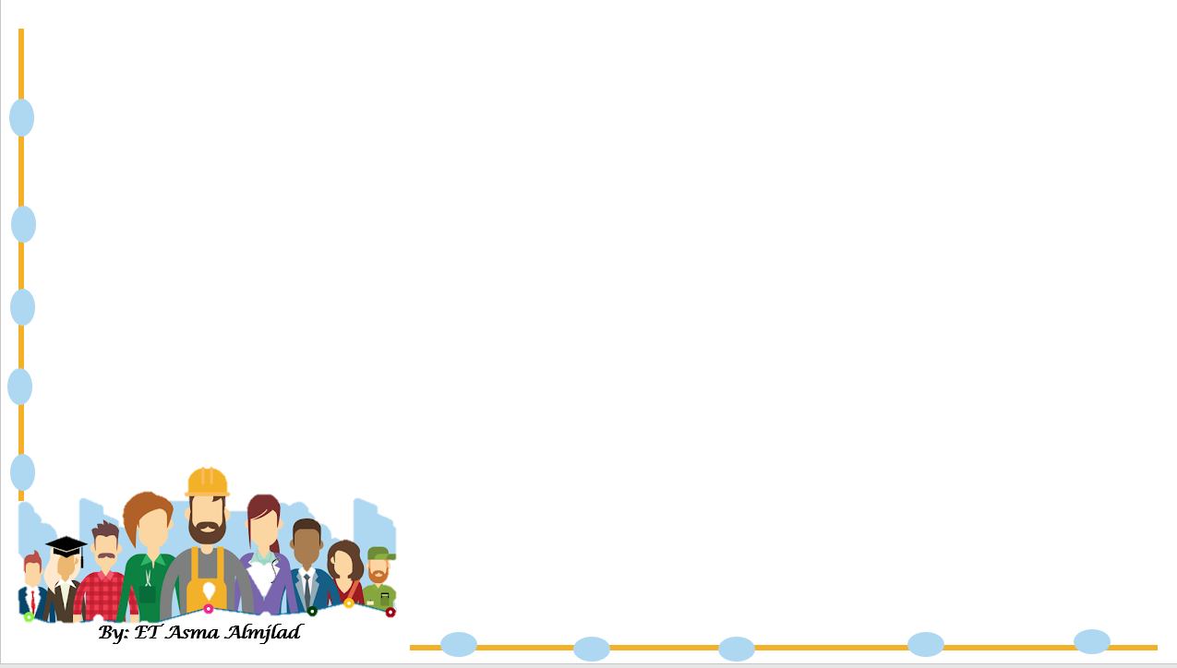


Slide 4


What do you know about 2030 vision ?
Who is the leader of 2030 vision ?

Slide 5
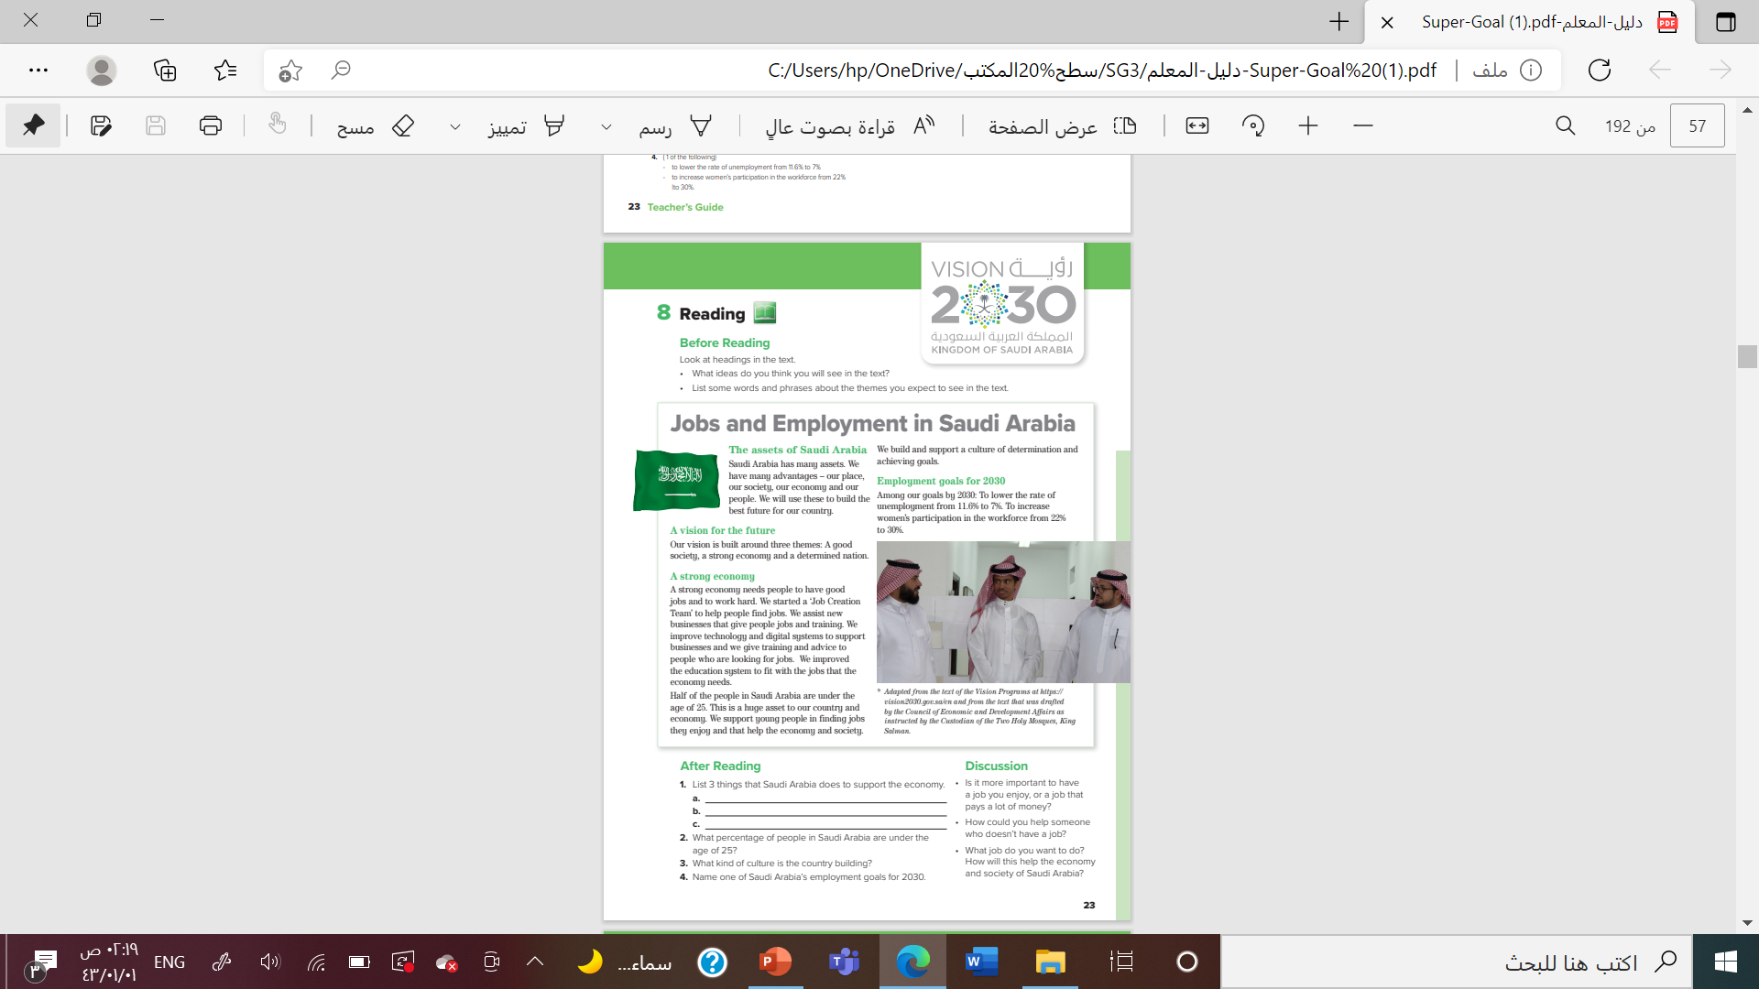



Listen

Slide 6
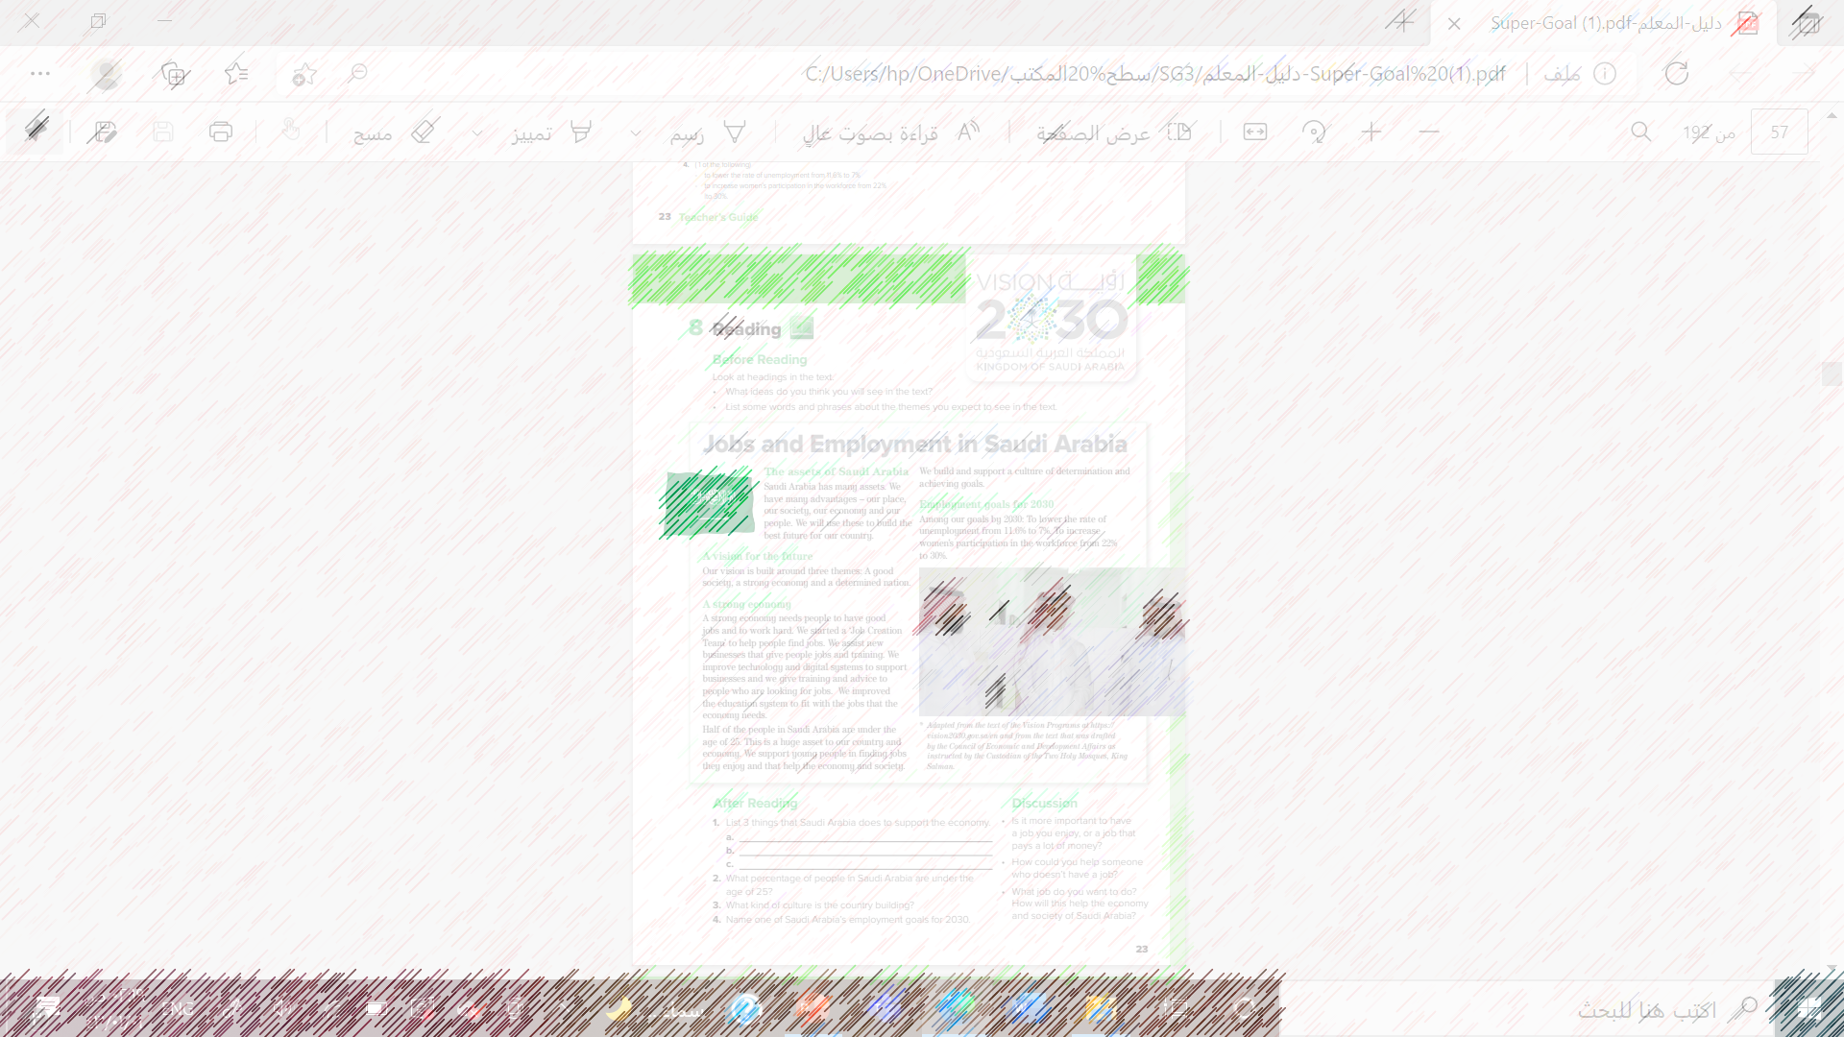

What is the title of the reading?
How many subtitles
What are the three themes that the vision is built around?”

Slide 7
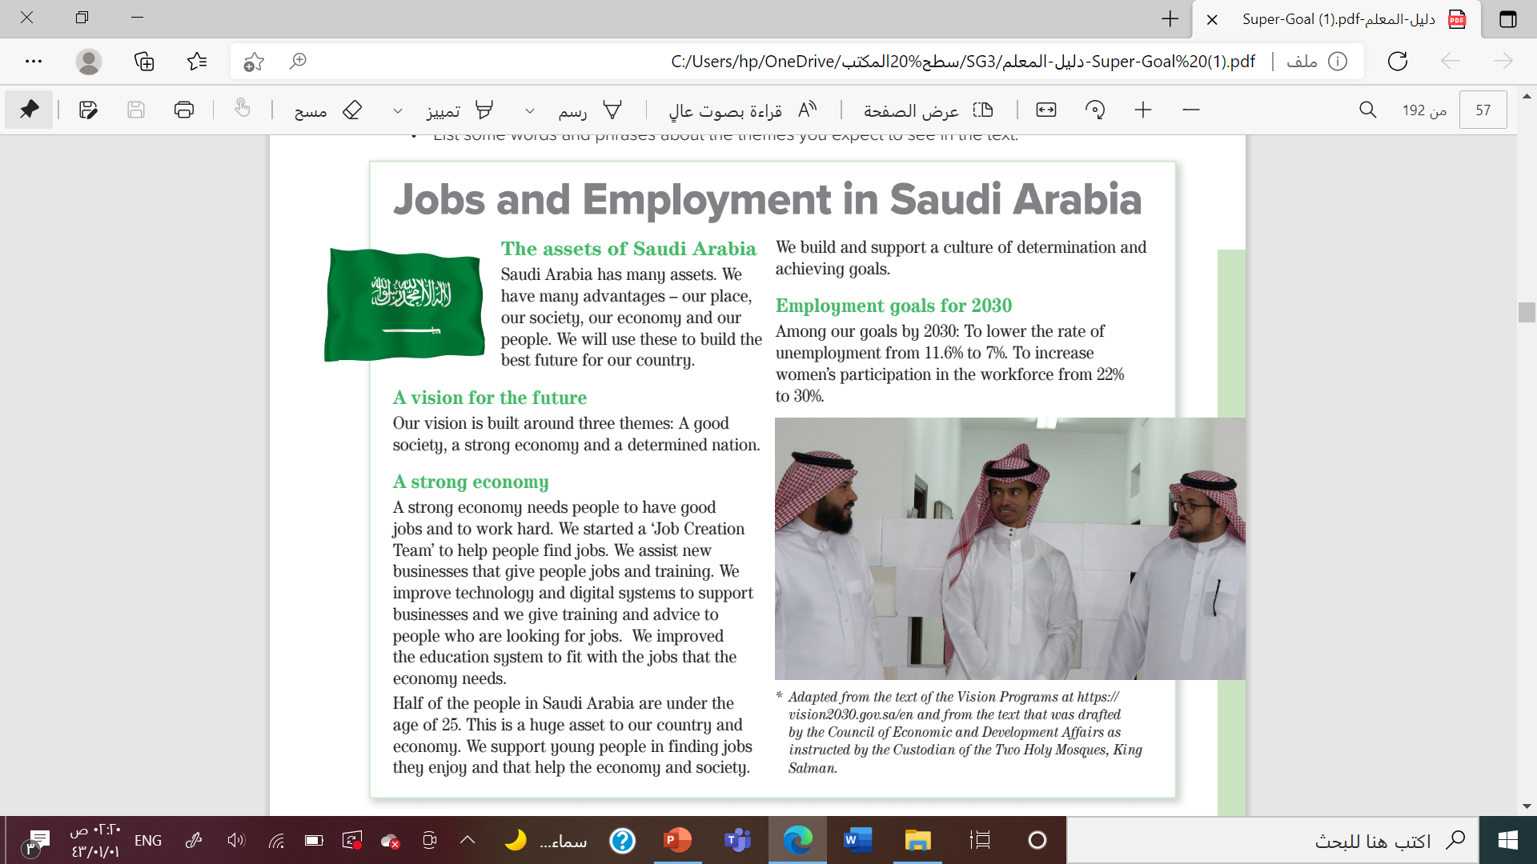
Underline the difficult words

Slide 8



New Words

Slide 9




Advantage
Training
Economy
Improve

Slide 10



Education
Increase
unemployment

Slide 12
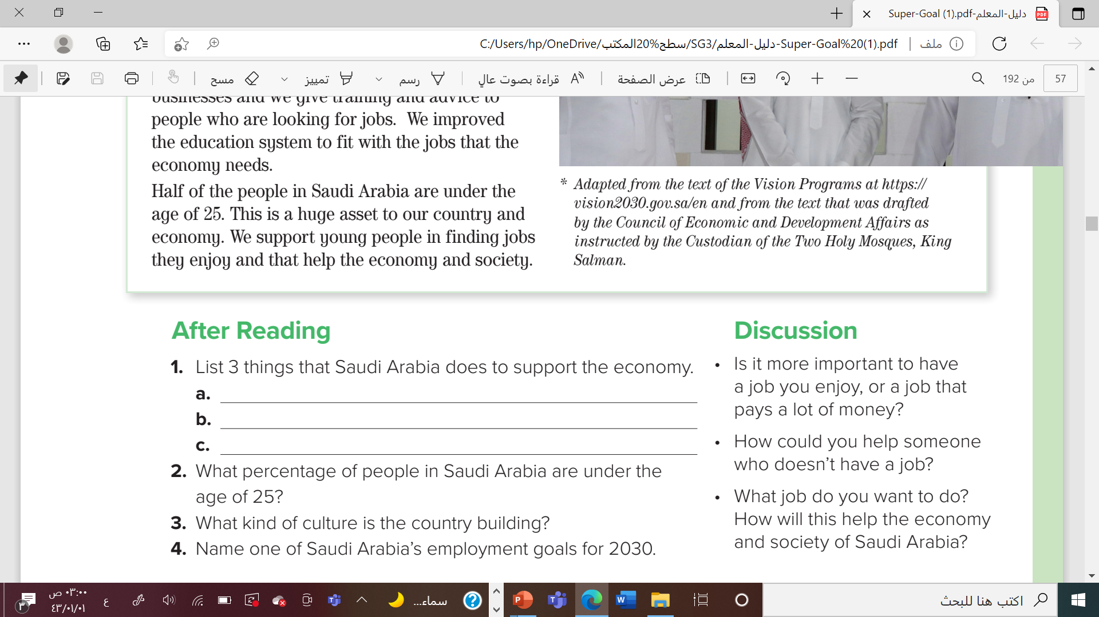


Has a ‘Job Creation Team’ to help people find jobs
Assists new businesses that give people jobs and training.
Improves technology and digital systems to support businesses.
50%
A culture of determination and achieving goals.
to lower the rate of unemployment from 11.6% to 7%

Slide 13


Slide 14
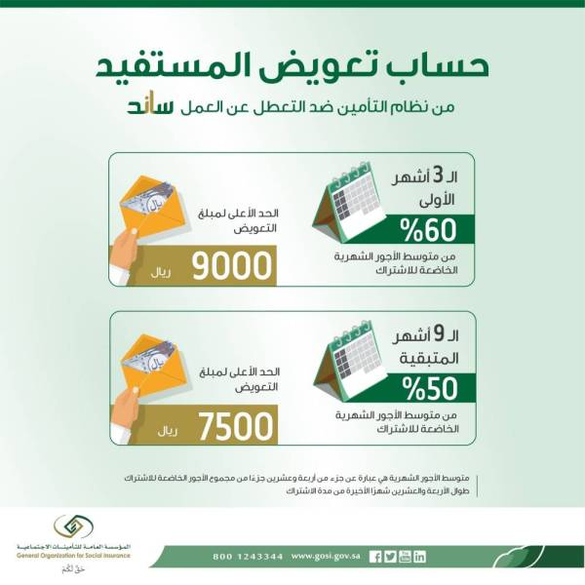

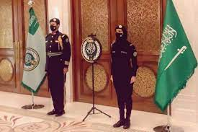
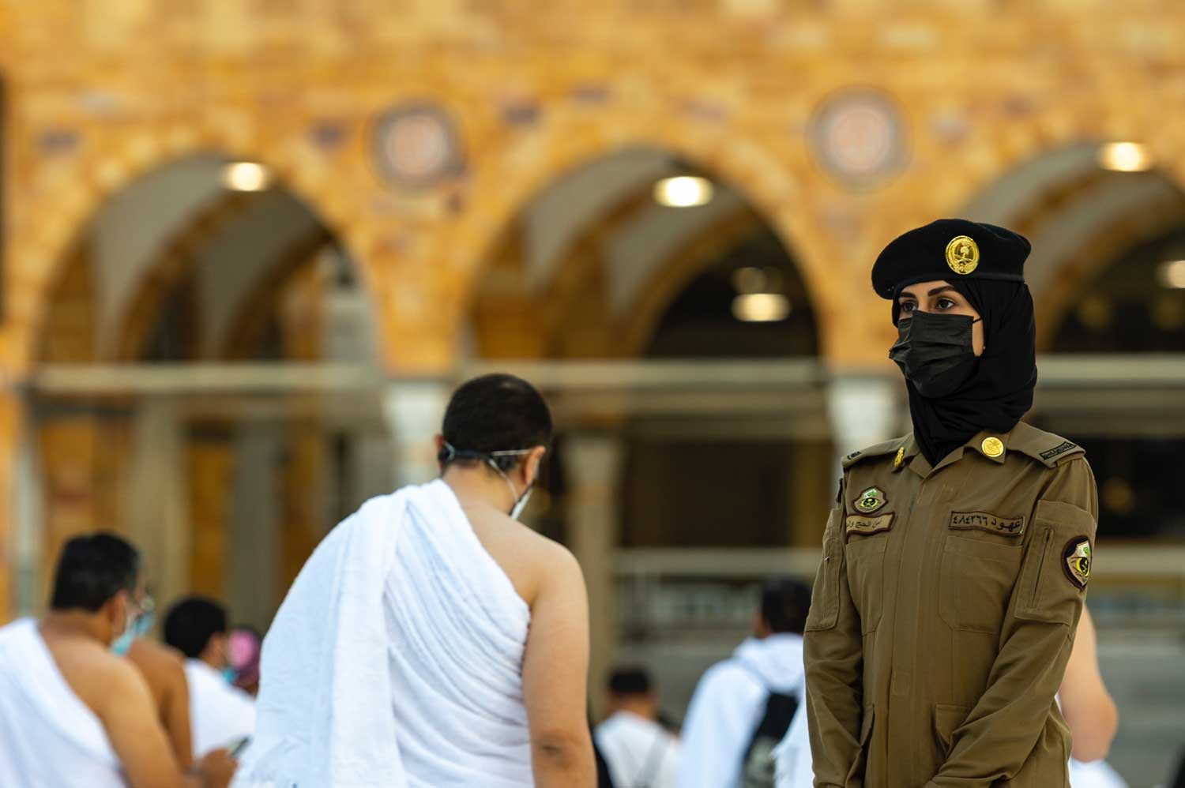

Slide 15




Slide 16


