Slide 1
U 3 Grammar p 20
Tr. Nora Khalid

Slide 2
Goals:
To introduce Present simple positive and negative sentences, and some question forms. Ss will be able to make Positive ,negative sentences in simple present tense.
To introduce Verb Want + Infinitive. Ss will be able to make questions and answers using
want + Invinitive.

Slide 3
reads
He ……….. books every day.

Slide 4
works
She ……….. in a company.

Slide 5
drives
He ……….. a car for the school.

Slide 6
write
I ……….. history books .

Slide 7
What’s the difference?
drives
He ……….. a car for the school.
write
I ……….. history books .

Slide 8
He
She
It
I
We
They
You
Verb + s ( reads – writes – watches – walks )
Verb ( read – write – watch – walk )

Slide 9
He
She
It
I
We
They
You
Does not + Verb ( doesn’t read – doesn’t walk )

Slide 10
She does not work.
He does not drive.

Slide 11
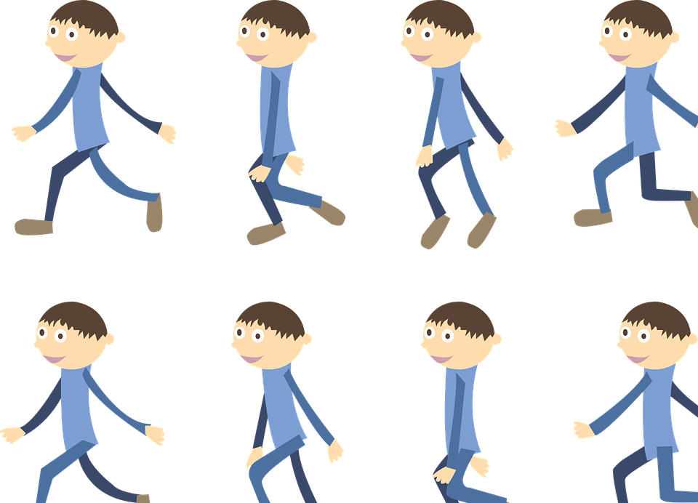
I do not write.
They do not walk.

Slide 12
Question words !!!!

Slide 14
What – he – work - ?
What does he work?

Slide 15
Where – they – work - ?
Where do they work?

Slide 16
Where – she – work - ?
Where does she work?

Slide 17
What – I – work - ?
What do I work?

Slide 19
What do you want to be?
I want to be an engineer

Slide 20
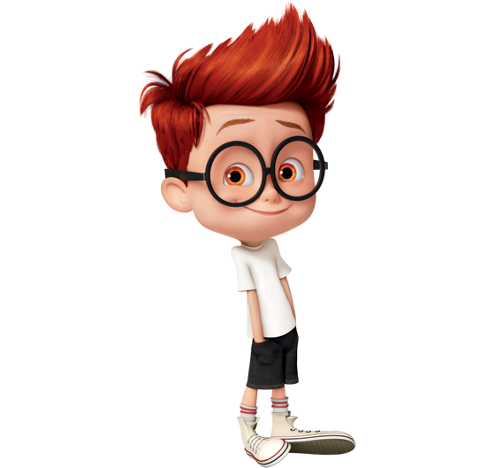
What does he want to be?
He wants to be a pilot

Slide 21
He writes
They work
He drives
He sells
He writes

Slide 22
What does Fahad do
Where does he work
Where does he live
What does he want to be
What does he do during the day?

Slide 23
do
work
work
wants
to be
works
speaks

Slide 24
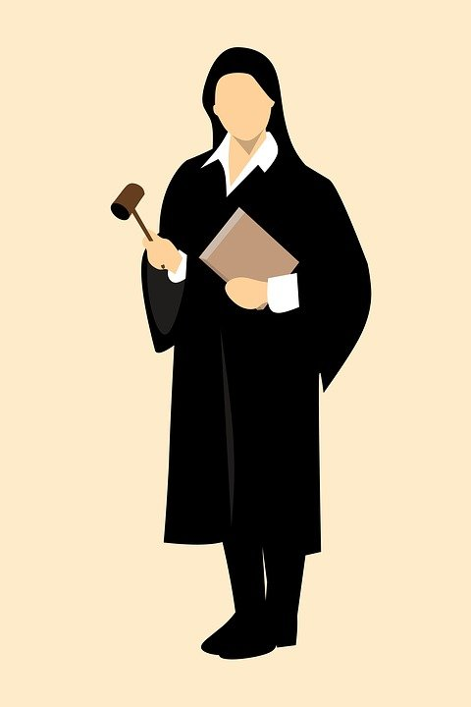
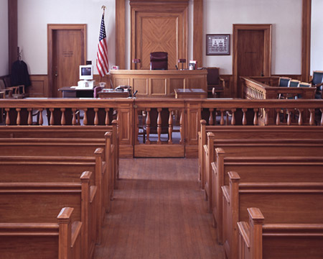

Slide 25
yes
yes
No
No
yes
yes

Slide 27
Homework p 98-88

