Slide 1
Connected by
Reading
By : Asma AlMjlad

Slide 3
Objectives
1
Summarize a story about reconnecting with a friend via the internet
2
Name ways to connect via the internet
3
Answer questions about the text

Slide 4
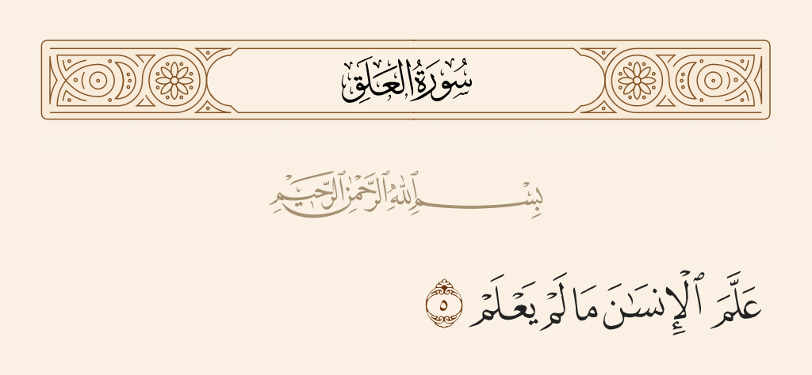
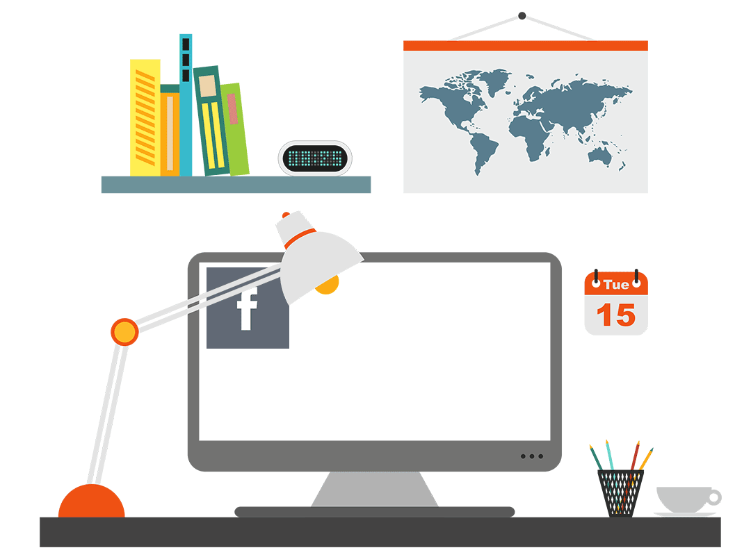

Slide 5
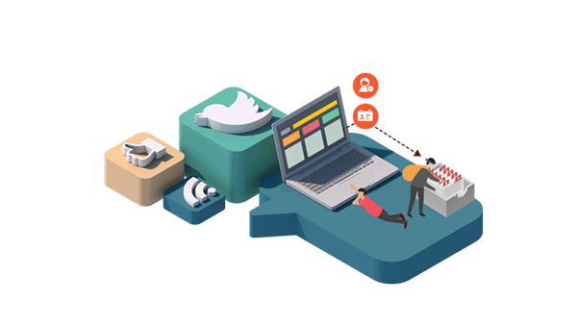
Name some ways to connect via the internet
What do you use the internet for ?
Has the Internet ever helped you meet or reconnect with a friend?

Slide 6
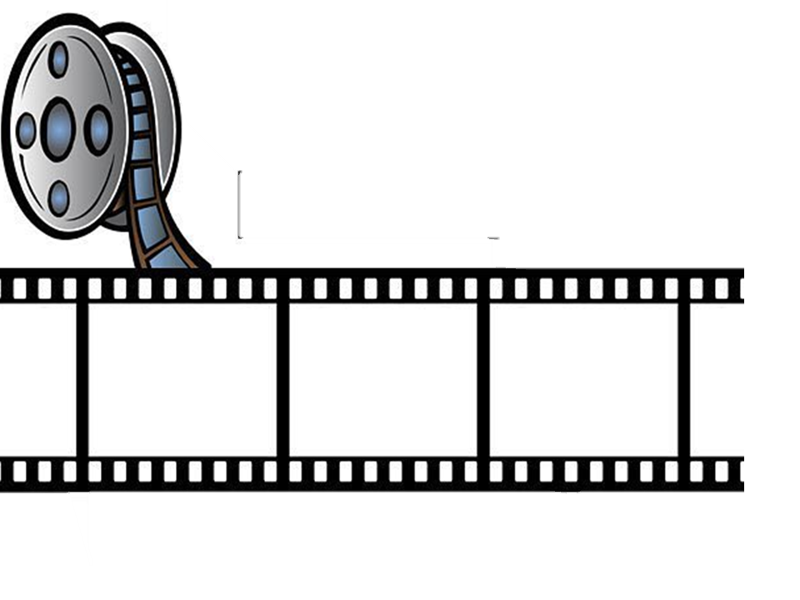
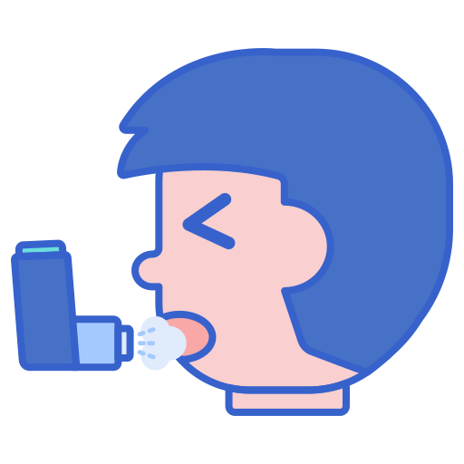
Let’s remember
Tom suffers from …….…..attack .

Slide 7
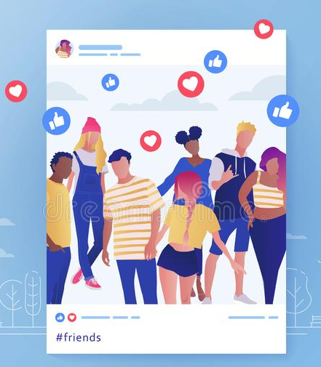
Let’s remember
You ………. your photo on Instagram .

Slide 8
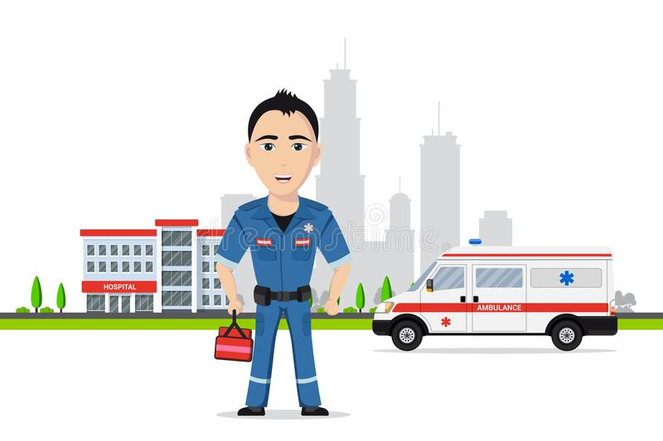
Let’s remember
a person who is trained to give emergency medical treatment ……………....

Slide 9
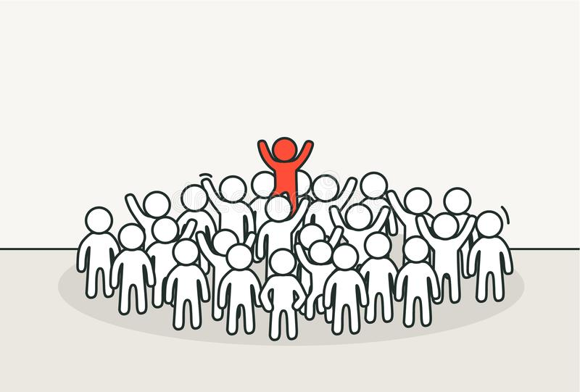
Let’s remember
You have to be ………and different

Slide 10
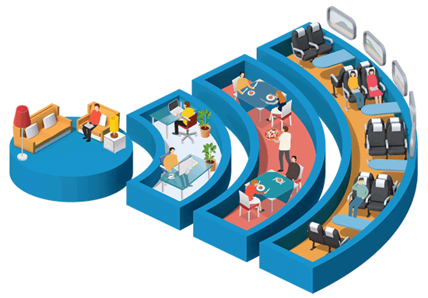
Open your book @ page 12-13
What is the tittle ?
How many paragraphs are they ?
What can you see in this pictures ?

Slide 11
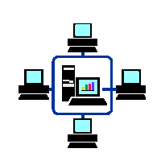
Listen

Slide 12
What can you tell about the people in the pictures?
How old are they?
Where are they?
What are they doing?

Slide 13
What was Sean Redden doing?
What problem was the Finnish woman having?
Why couldn’t she get help?
Was this part of the game or was it real?
what did Sean do?

Slide 14
Who is Patrick Swales?
Who did he see on the subway?
Why didn’t he speak to him?
How did he find him?
What are Patrick and Manuel doing now?

Slide 15
What was the relationship between Asma and Sabah in the past?
Why did they lose contact?
Who helped Asma find Sabah? How?
What is the relationship between Sabah and Asma now?

Slide 16
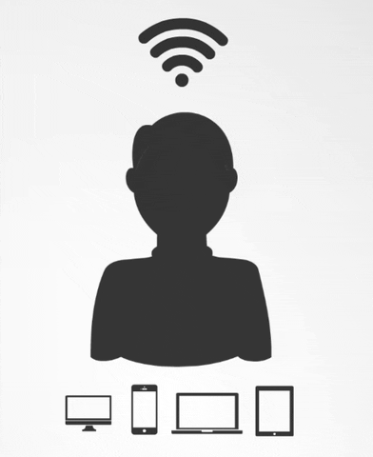

Slide 17
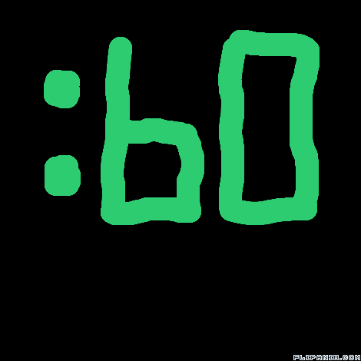
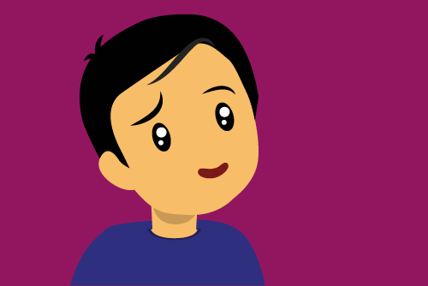

Slide 18
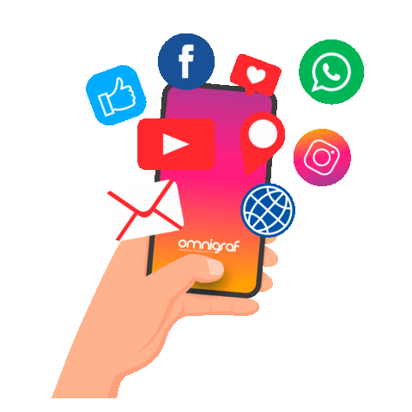
It makes communication much easier
Threat of our privacy
Source Of Information
Waste time
Buying and selling things online
Virus are spread in the internet
Source of Entertainment
Not Safe Place For kids

Slide 19
Work book

Slide 21
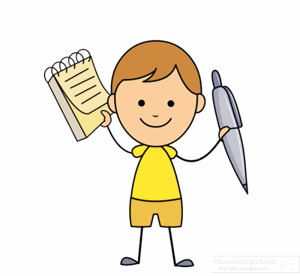

Slide 22
By: ET Asma AlMjlad

