Slide 1

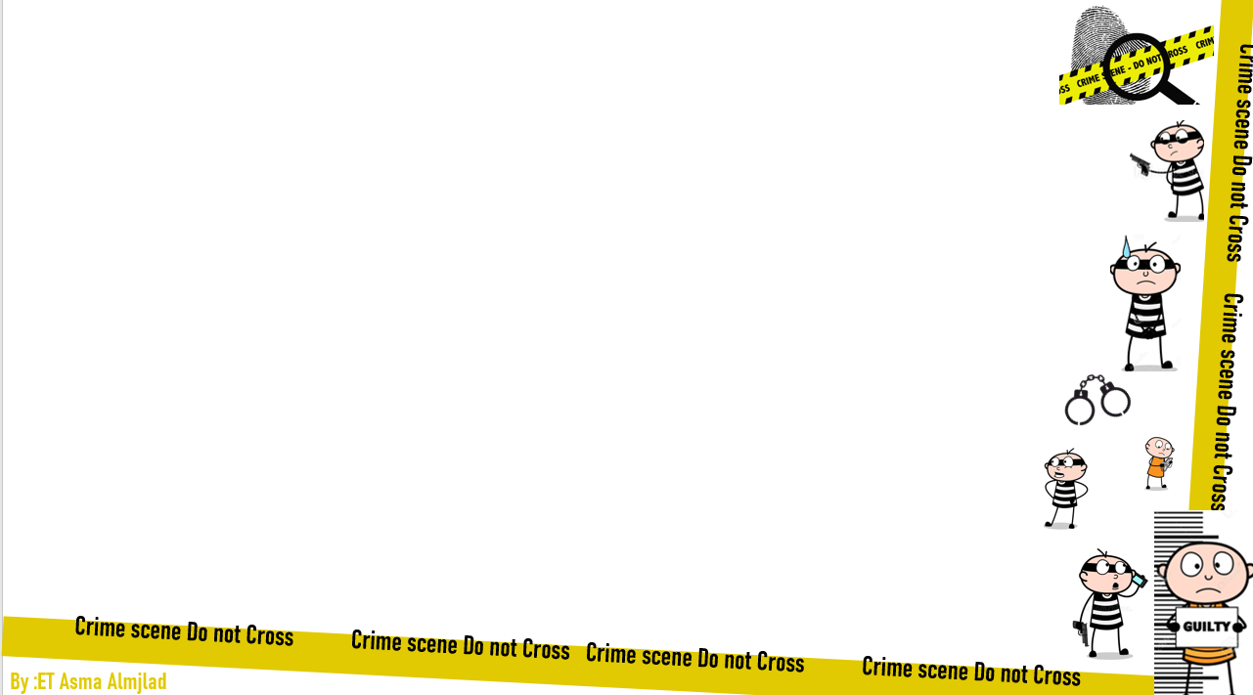


U:2
Doesn’t pay
conversation
By : ET Asma Almjlad

Slide 2
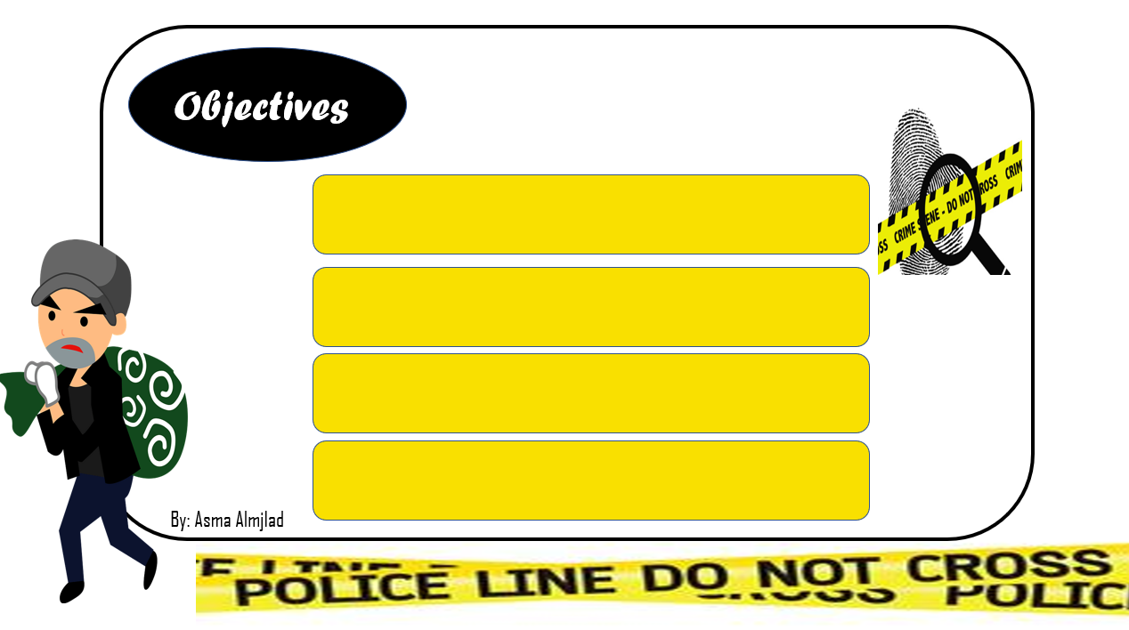
Make use of real talk phrases in a real conversation.
Identify the new words
Use the new words in sentences
Answer the questions in the book

Slide 3
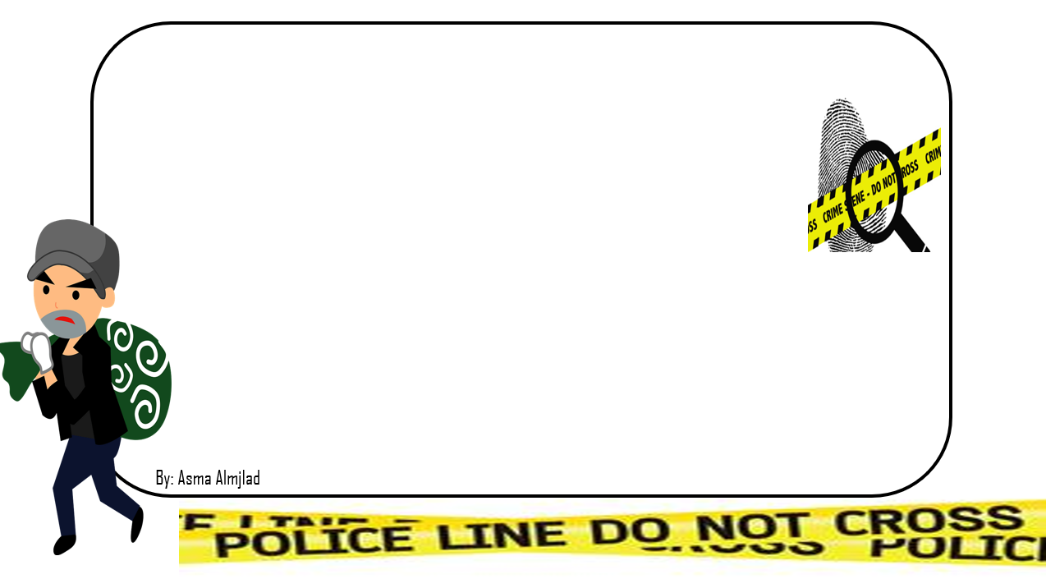
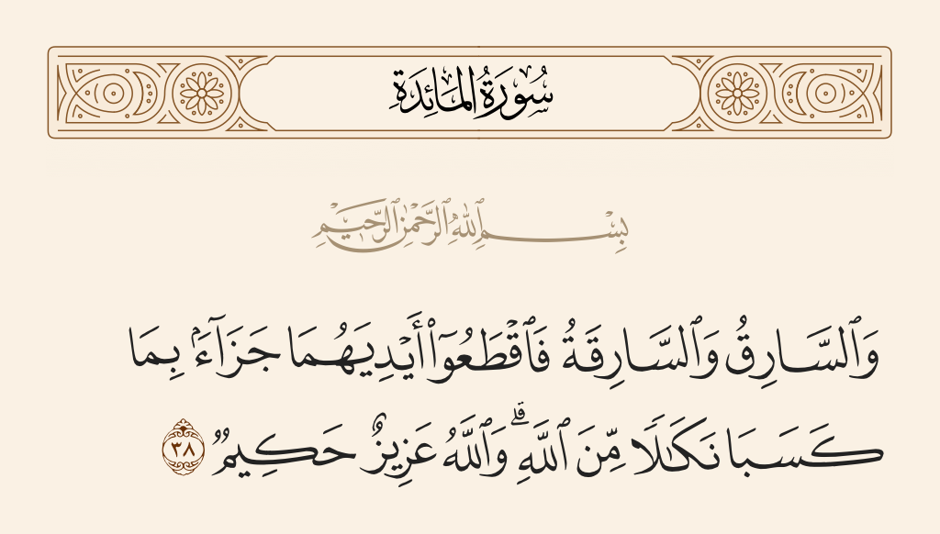

Slide 4
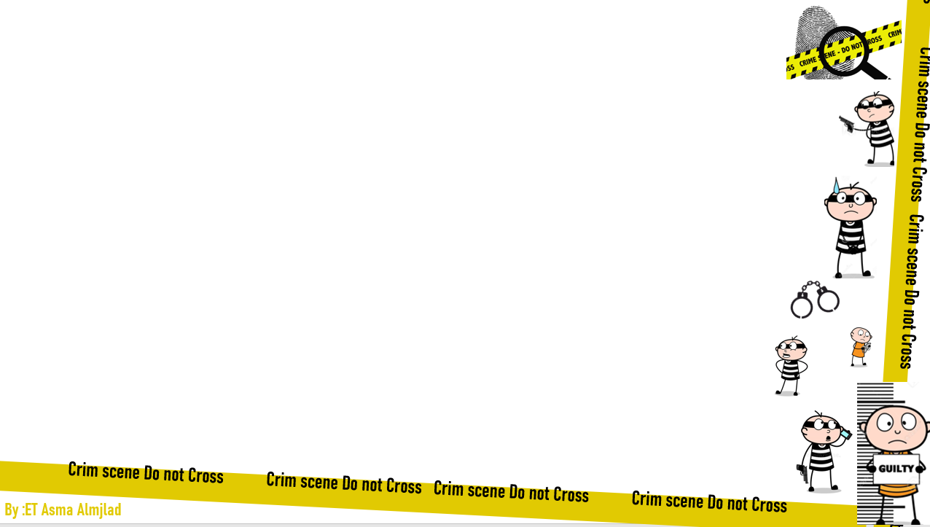
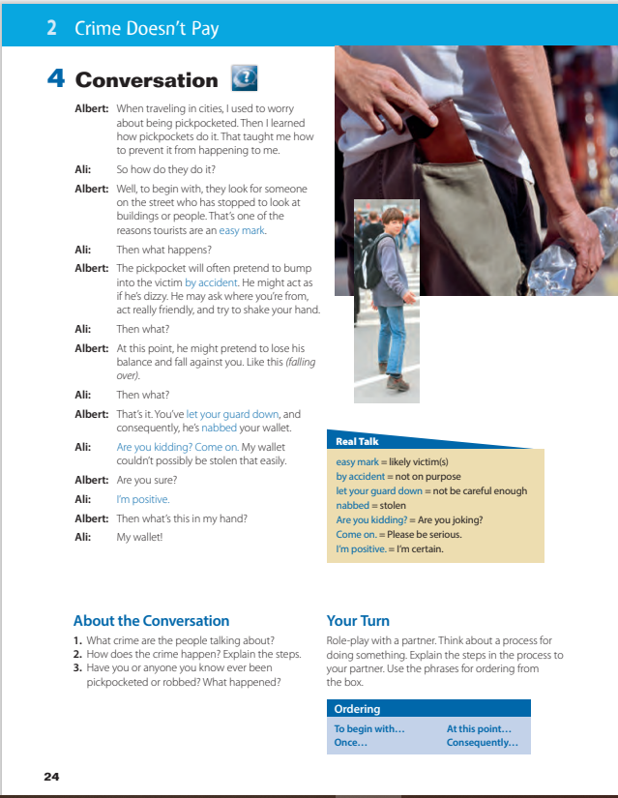


@ Page 24
listen

Slide 5

What’s happening to the person with the wallet?

Slide 6
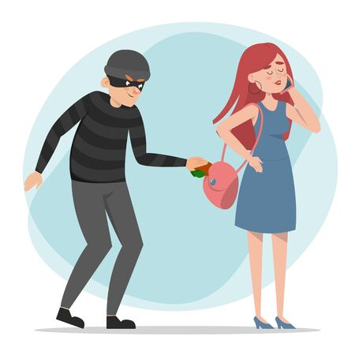
Pickpocket ( V – N)
To pickpocket
to steals things from another person’s pockets
A pickpocket
pickpocket
is someone who does this.
Thanks for
T. Talal Alhazmi

Slide 7





Slide 8
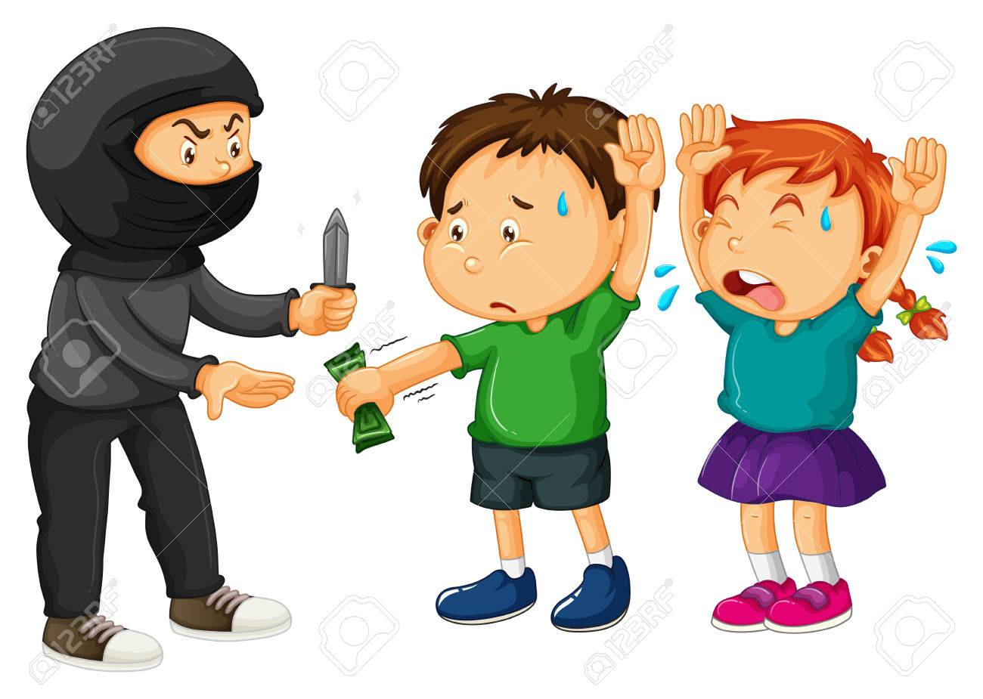
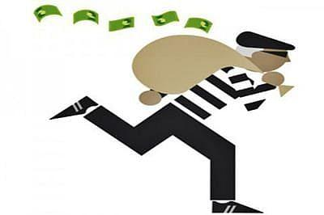
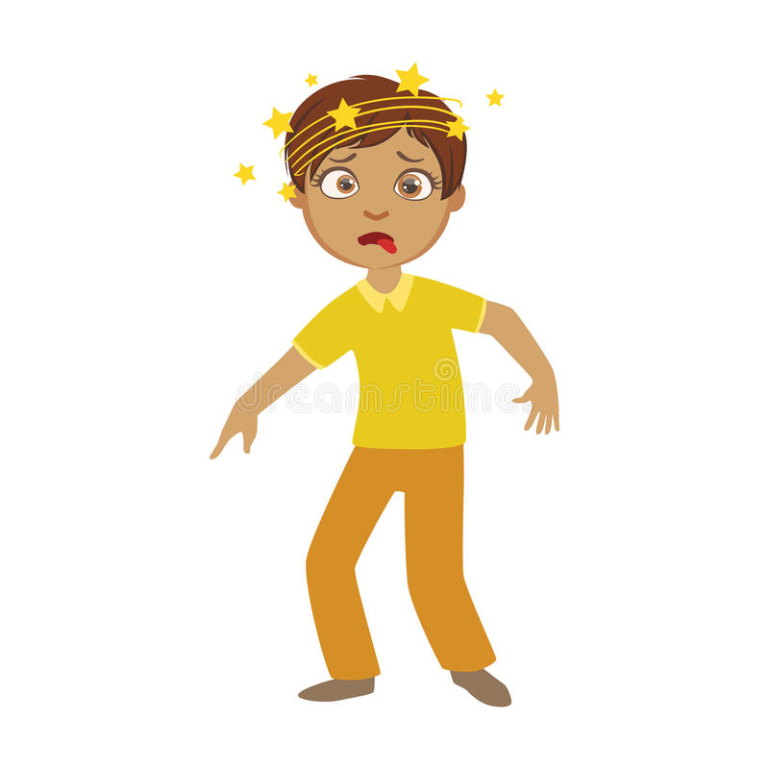
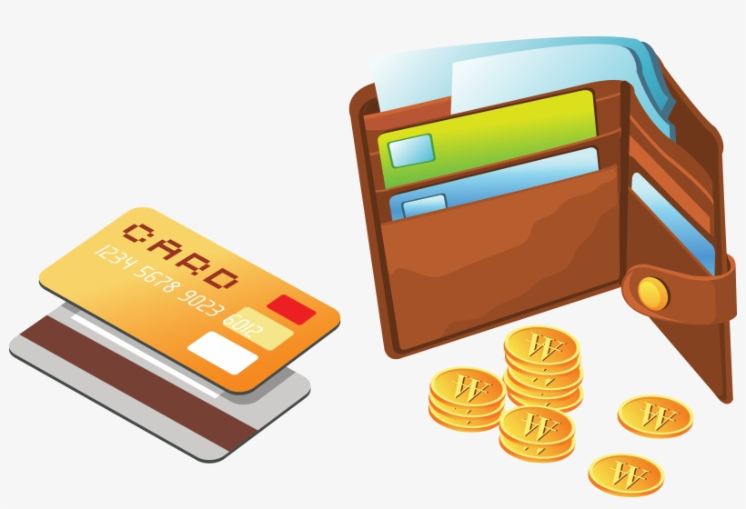
nabbed
victim
dizzy
wallet

Slide 9
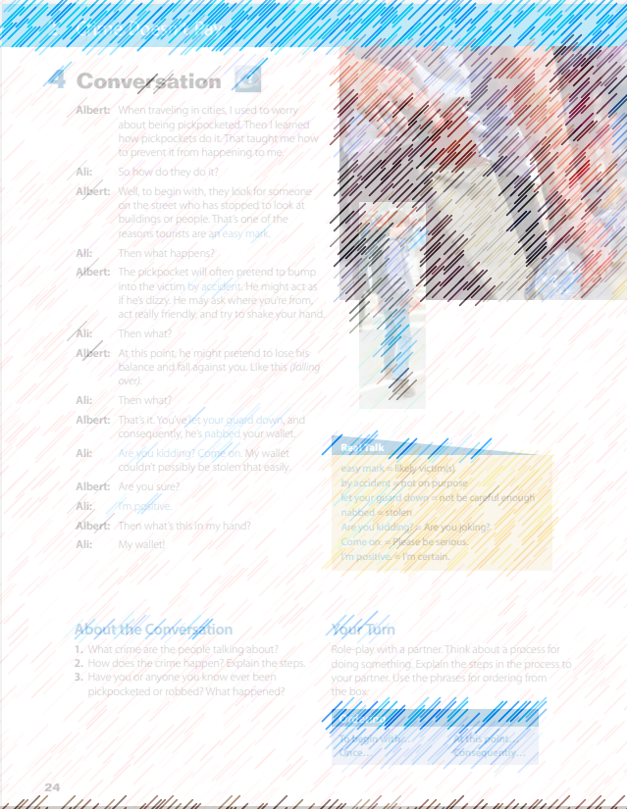

How many characters in this conversation ?
Who are the people?
What are they probably talking about?

Slide 10
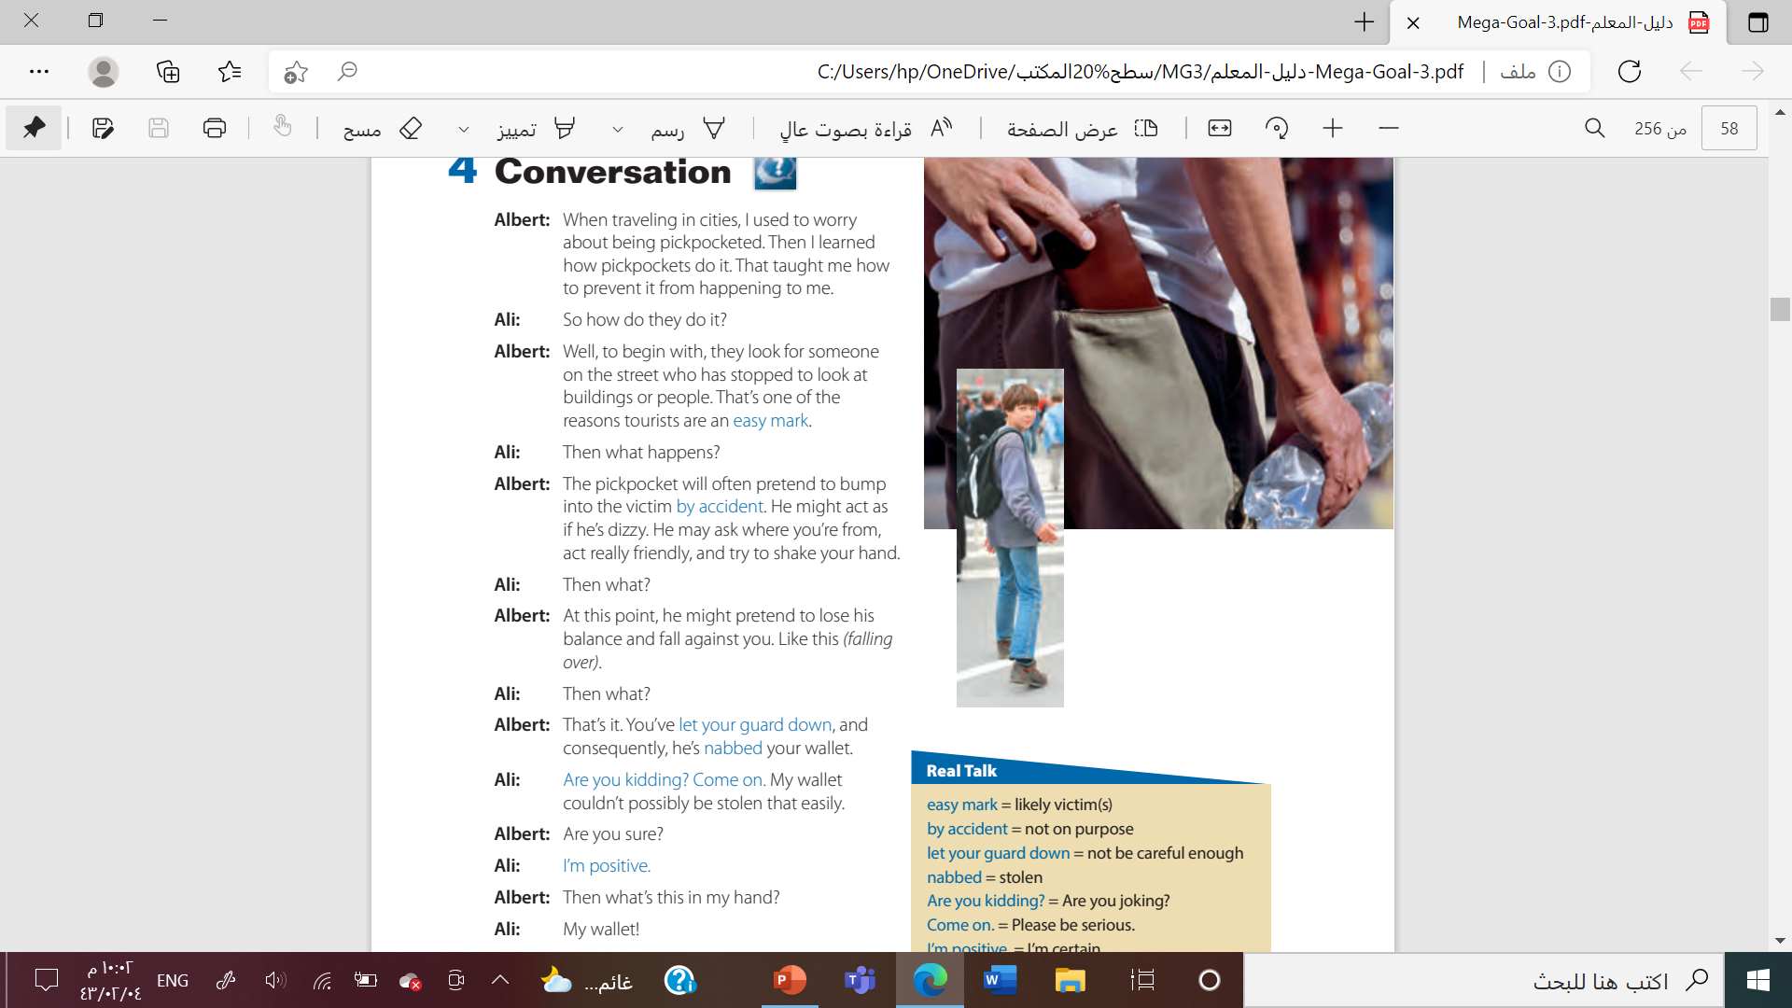
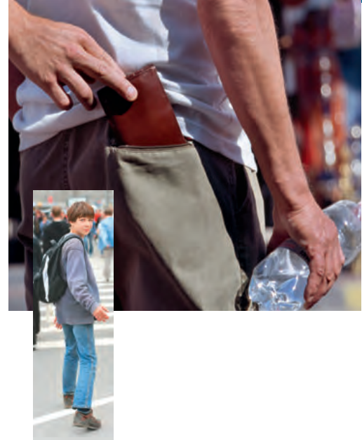


Slide 11
How do pickpockets choose their victims?
What do they do before they commit the crime?
What do you think Albert does when he says, Like this?
Why is Ali surprised at the end of the conversation?

Slide 12
let your guard down
not on purpose
not be careful enough
easy mark
by accident
likely victim(s)
Are you joking?
stolen
Are you kidding?
Come on!
nabbed
Please be serious
I’m certain
I’m positive
Thanks for T. Talal Alhazmi

Slide 13
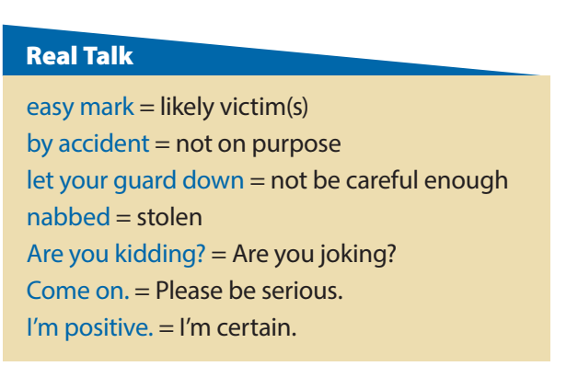
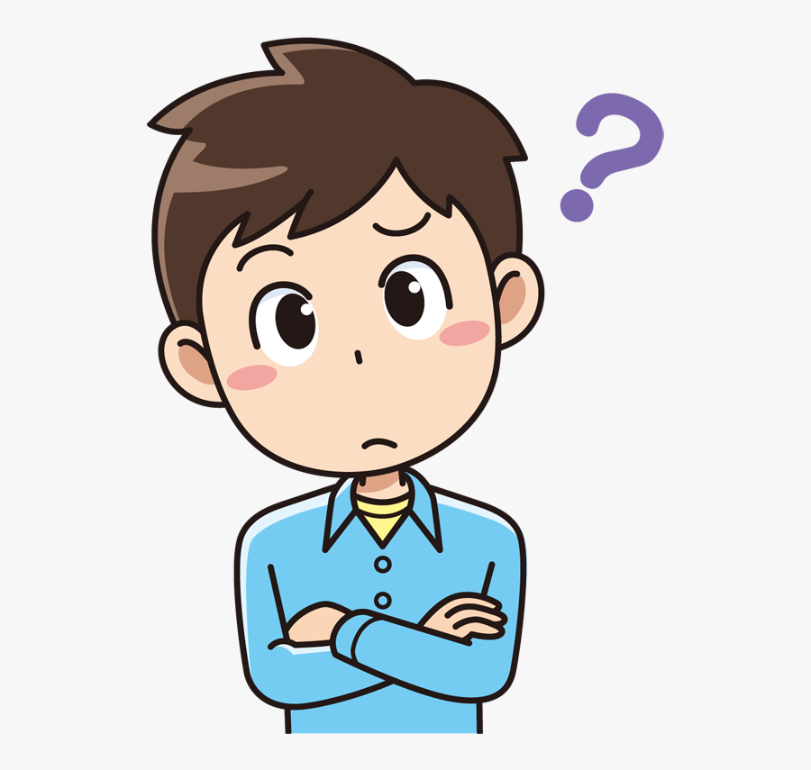
Who’s say easy mark?
Who’s say by accident ?
Who’s say let your guard down ?
Who’s say nabbed?

Slide 14
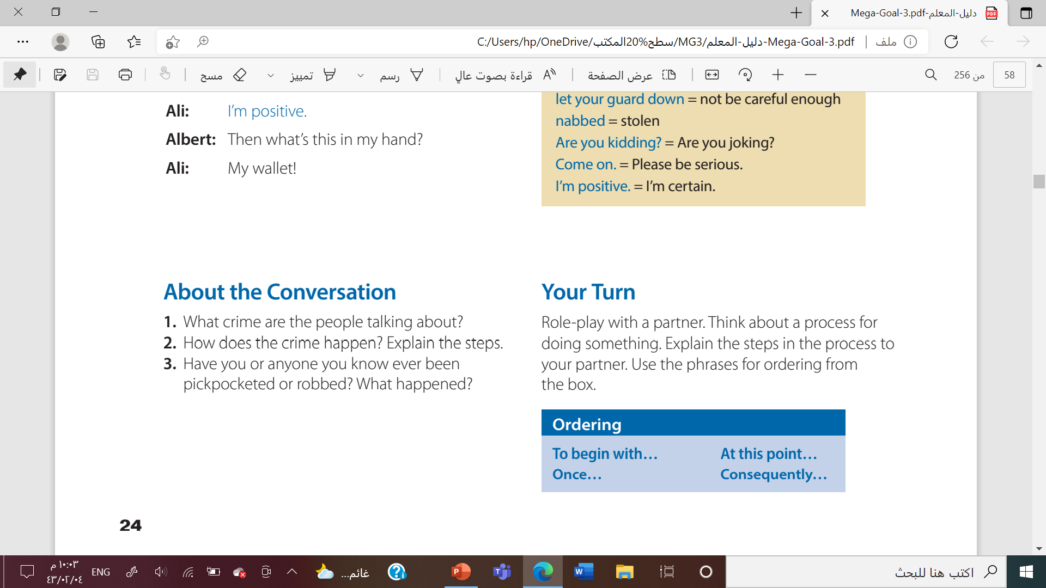

1. They are talking about pickpocketing
2. Look for someone who isn’t walking; pretend to bump into the victim by accident; shake victim’s hand, act really friendly; take wallet and walk away

Slide 15


Slide 16



Slide 17


