Slide 1

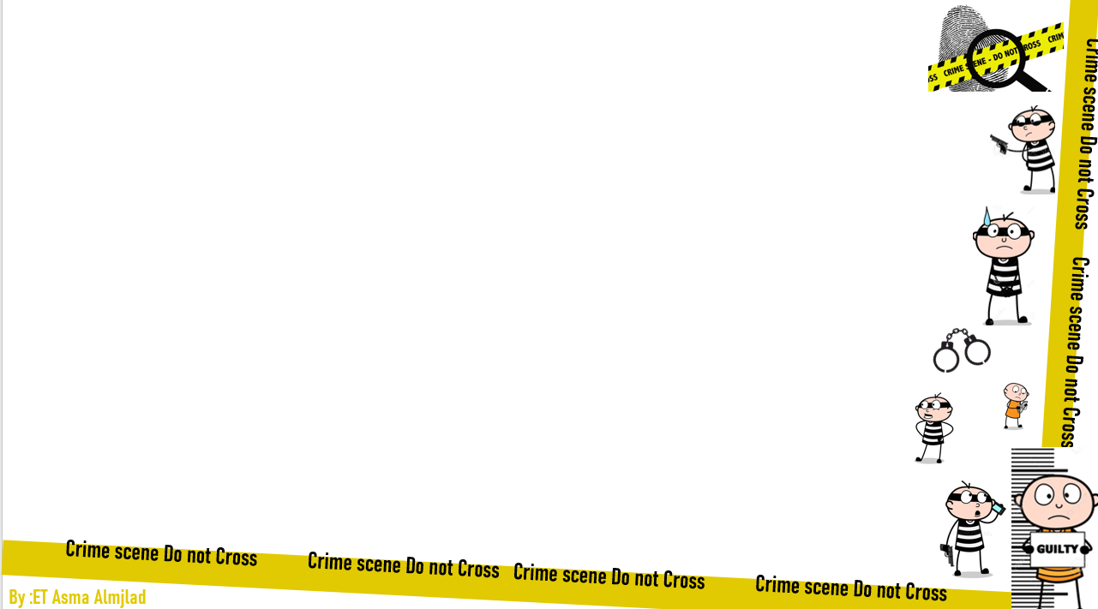
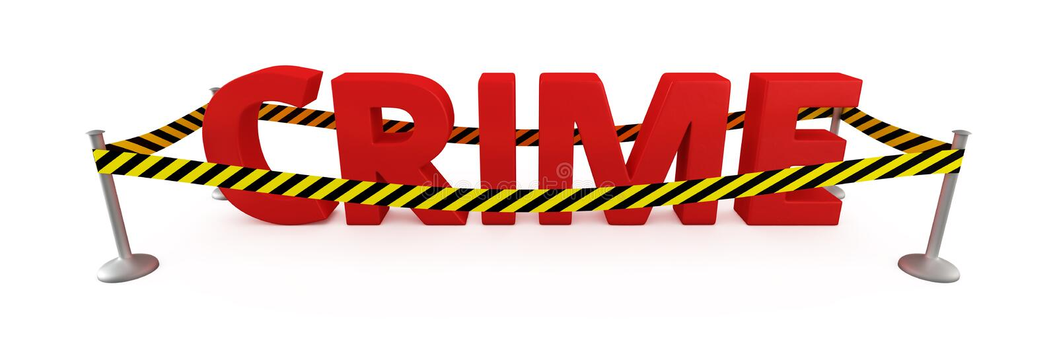
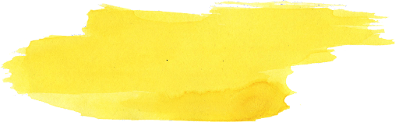
U:2
Doesn’t pay
Listening
By : ET Asma Almjlad

Slide 2
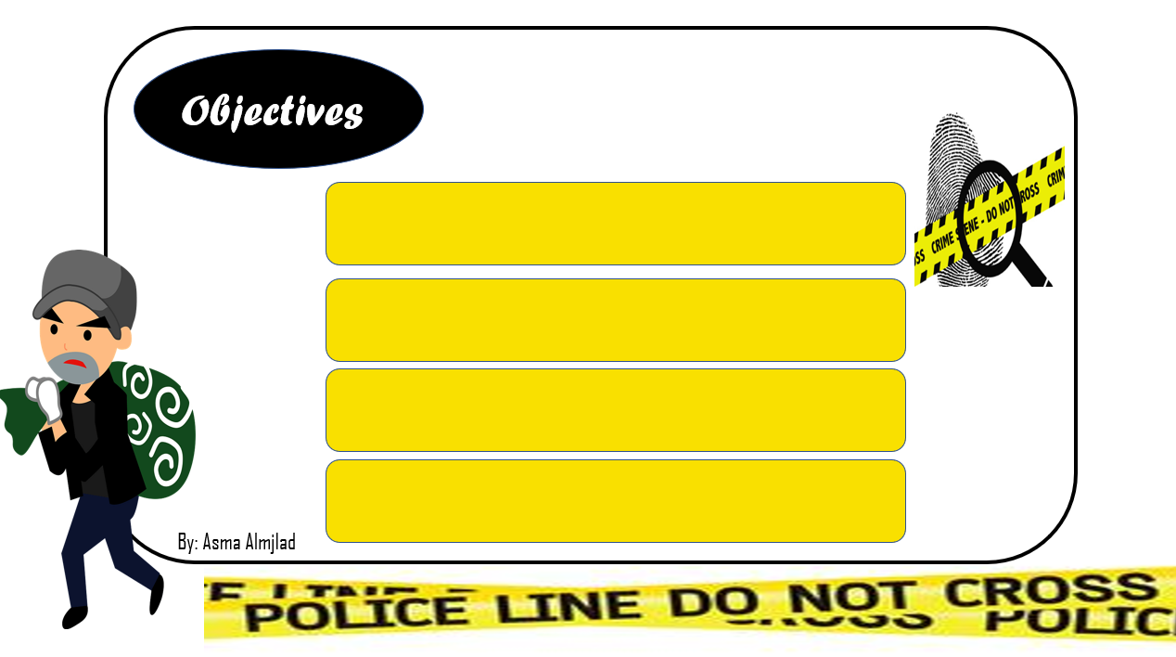
Identify the new words
link the word ends with the same consonant sound that the next word begins with,
List things you can do to stay safe
Answer the questions in the book

Slide 3
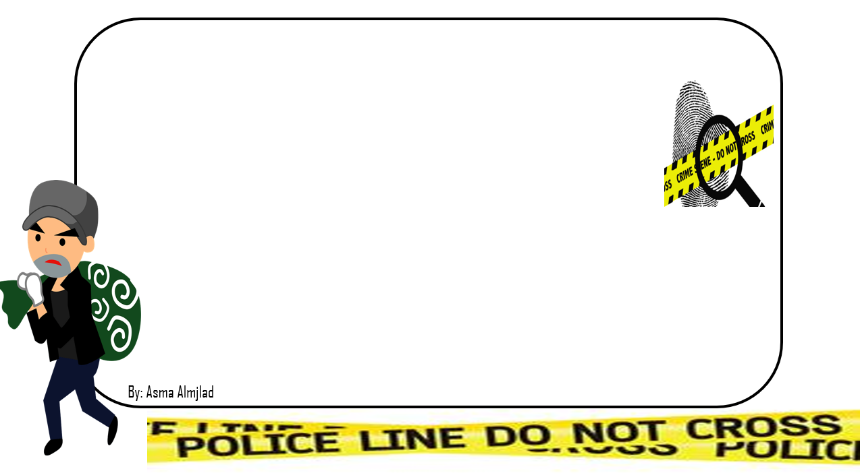
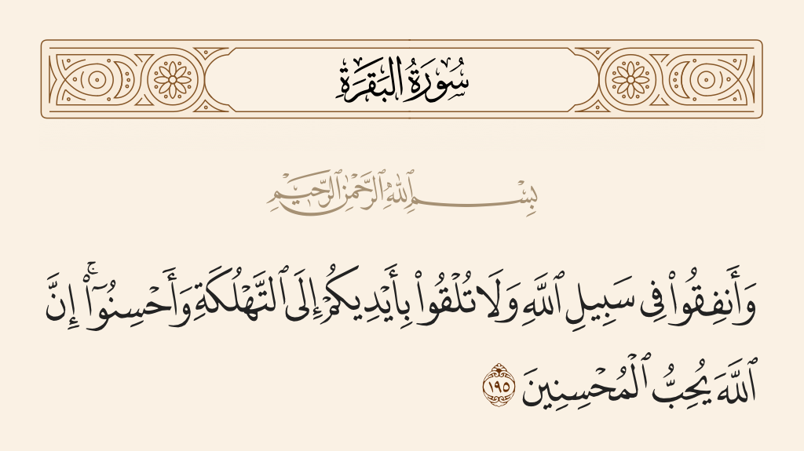

Slide 4
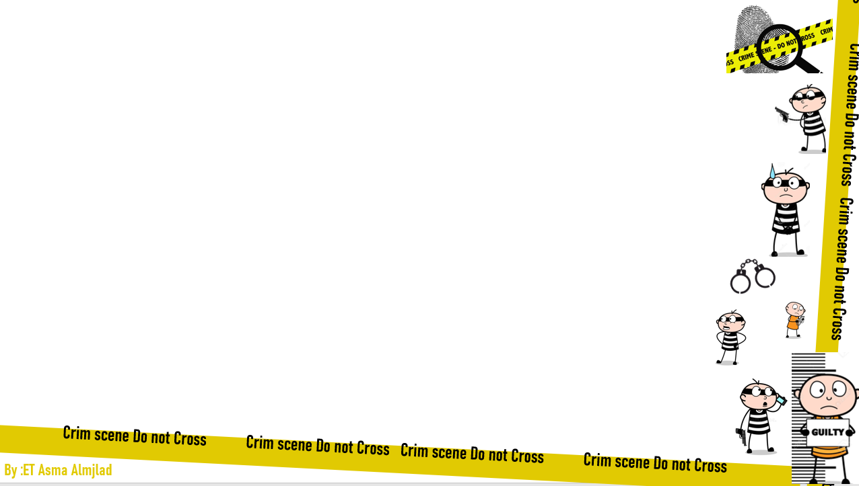
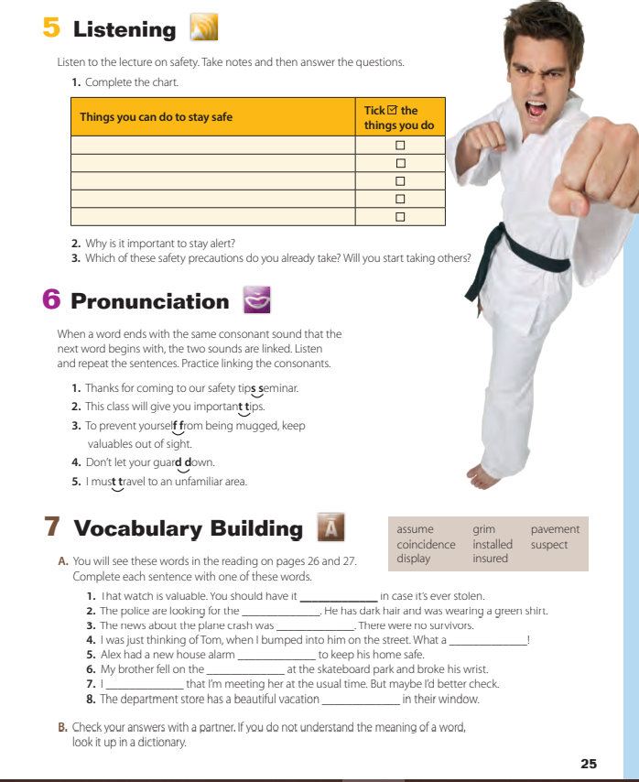

@ page 25
What do you think the man is doing?

Slide 5
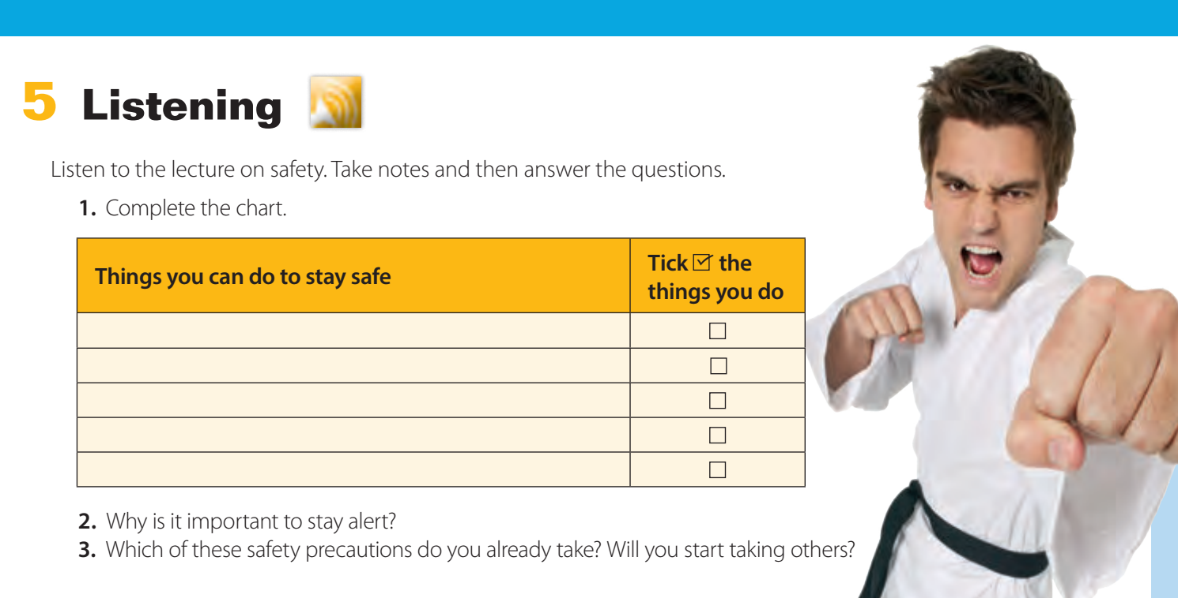


listen

Slide 6
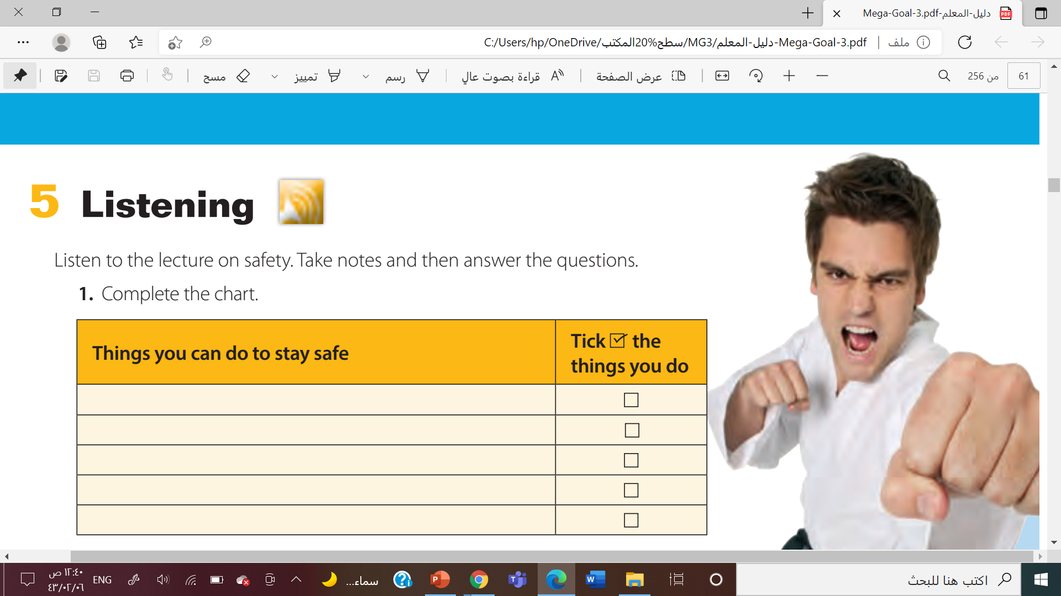
Keep valuables out of sight.
Travel with another person
Stay alert
Avoid unfamiliar locations.
Take a self-defense class.

Slide 7
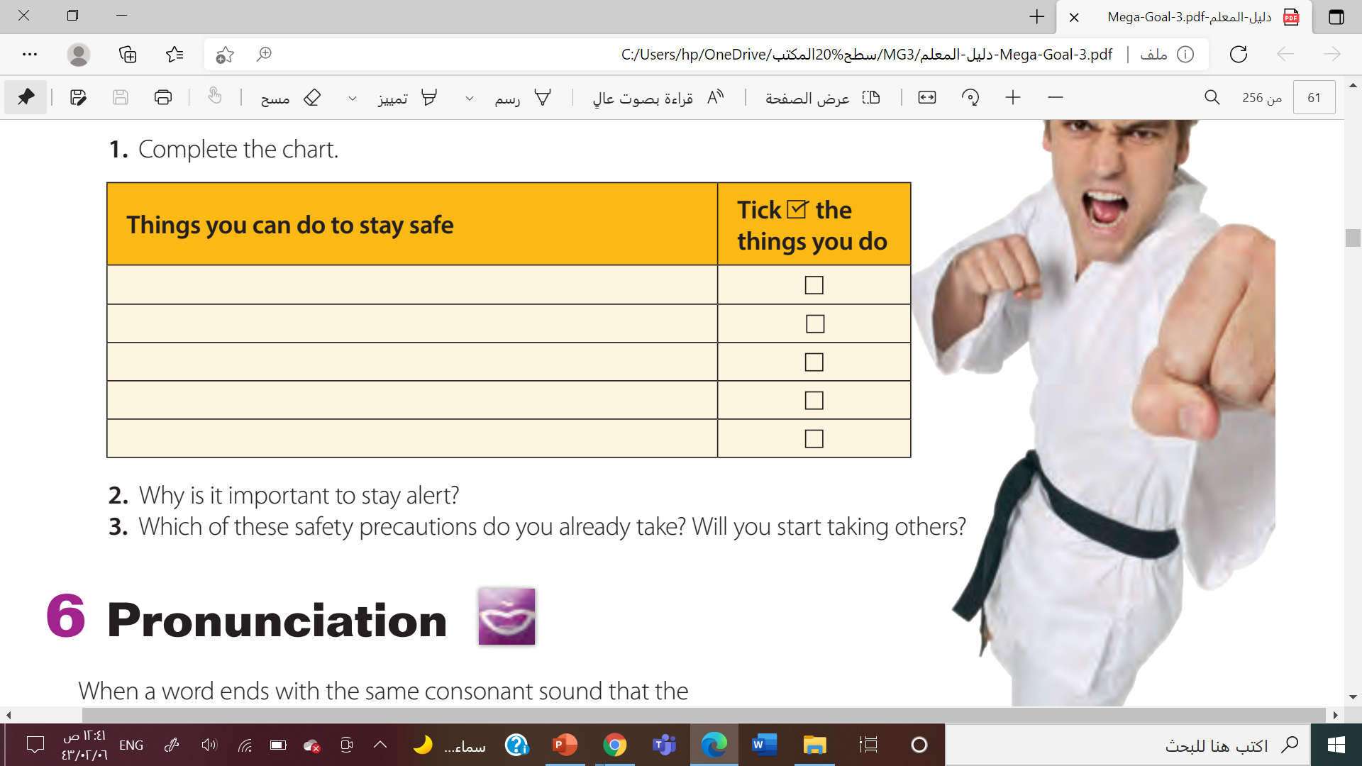

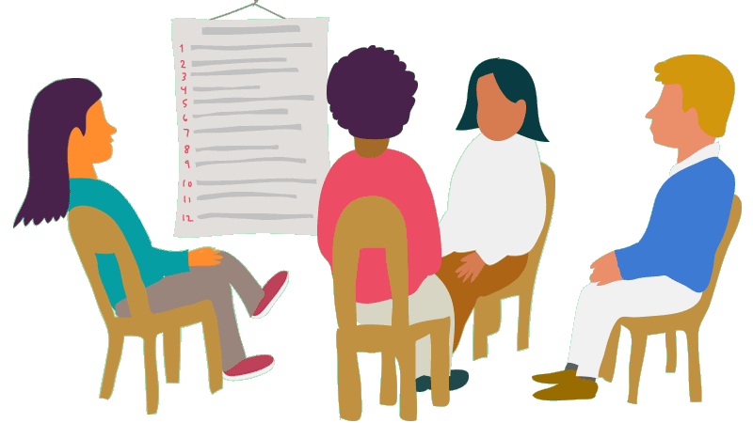
You can recognize dangerous people or situations.

Slide 8
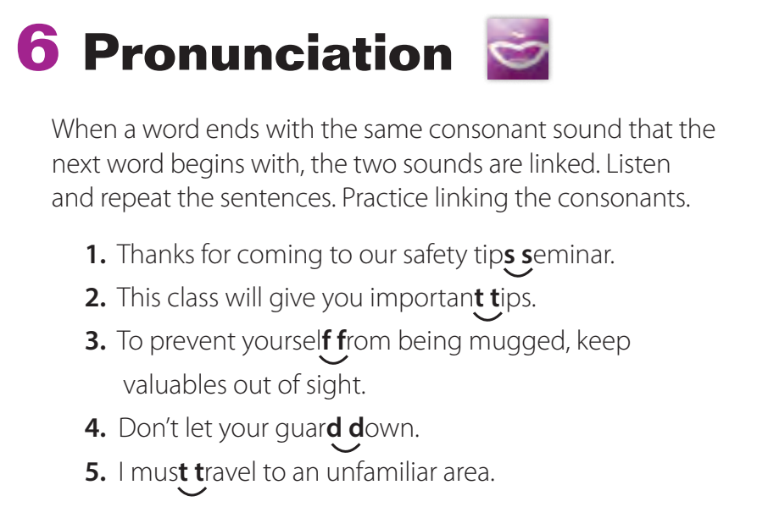
Listen and practice

Slide 9
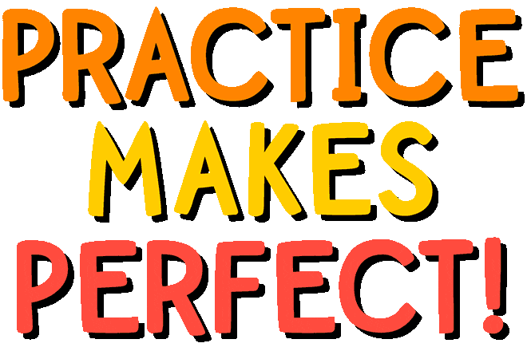

Slide 10
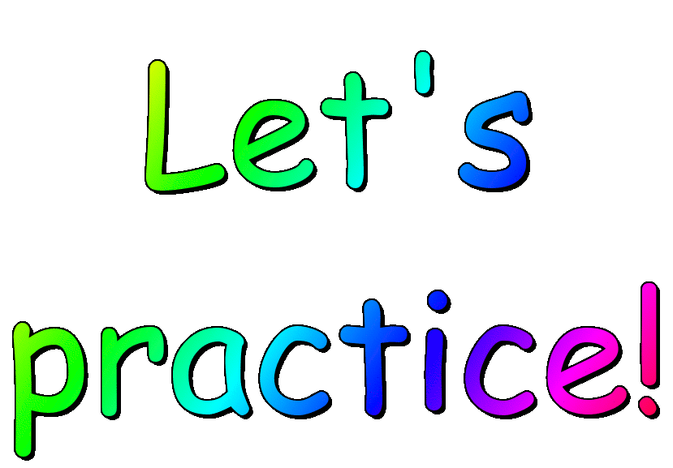

Gas station
Big game
Hot today
Many years
More rice
Black cat

Slide 11



Slide 12
(v) to think that something is probably true without knowing that it is true
assume
(adj) causing feelings of sadness or worry; gloomy or depressing
grim
(n) the hard surface of a road, driveway, etc.
pavement
(n) a situation in which events happen at the same time in a way that is not planned or expected
coincidence
install
(v) to make a machine or a service ready to be used in a certain place
suspect
(n) a person who is believed to be possibly guilty of committing a crime
display
(n) an arrangement of objects as a decoration, or advertisement
insure
(v) to provide insurance for something, such as a house, car, or health
Thanks for T. Talal Alhazmi

Slide 13

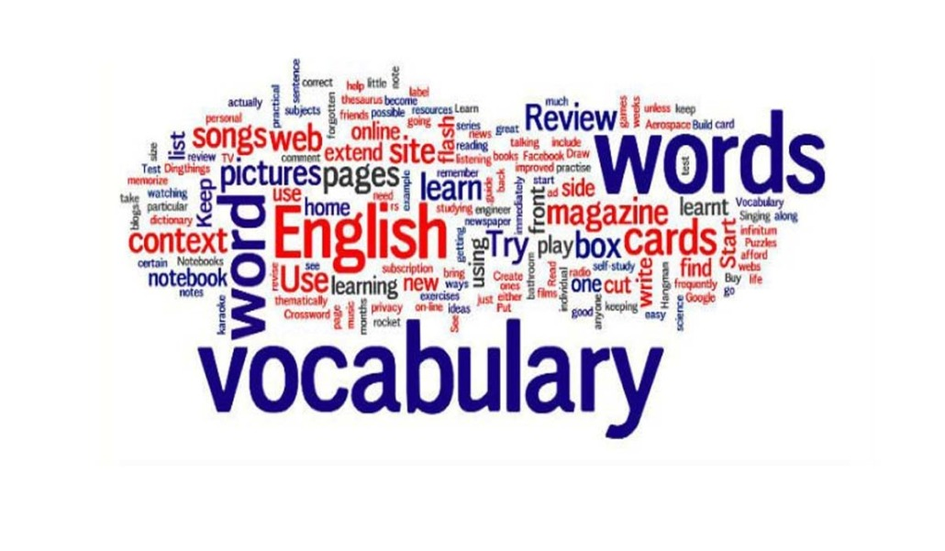
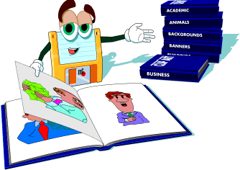
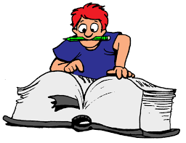

Slide 14
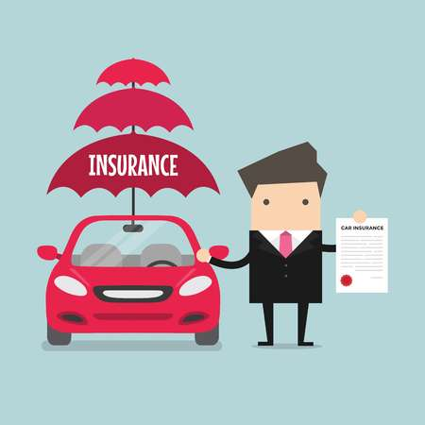
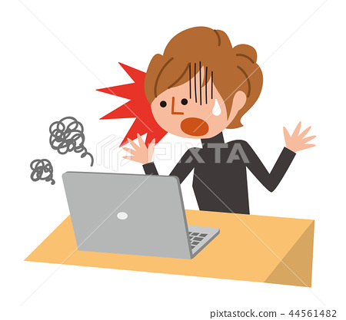
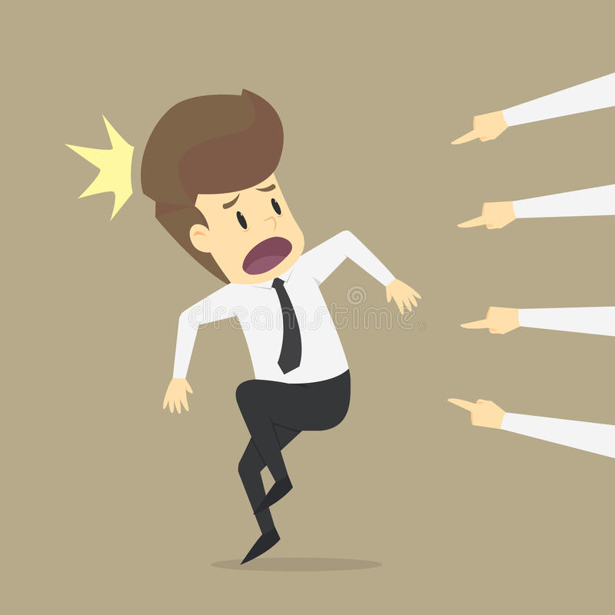

insured
grim
suspect
installed

Slide 15
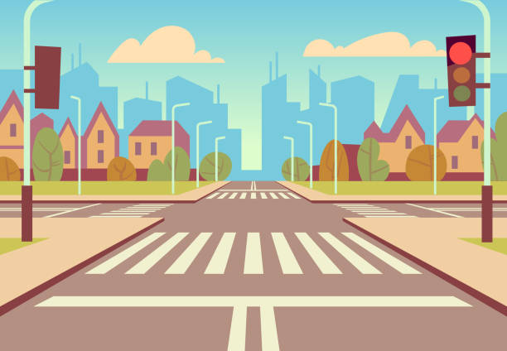
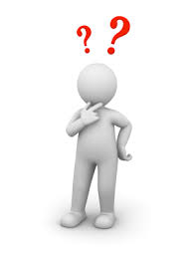
assume
Pavement

Slide 16
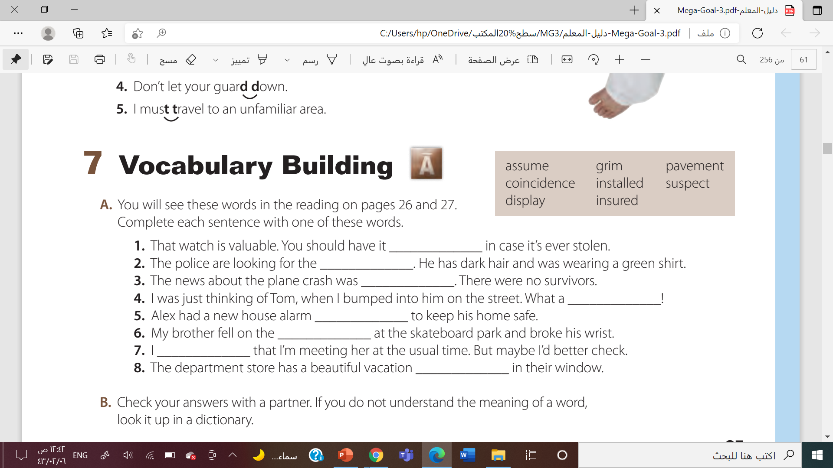
insured
suspect
grim
coincidence
installed
pavement
assume
display

Slide 17



Slide 18


