Slide 1

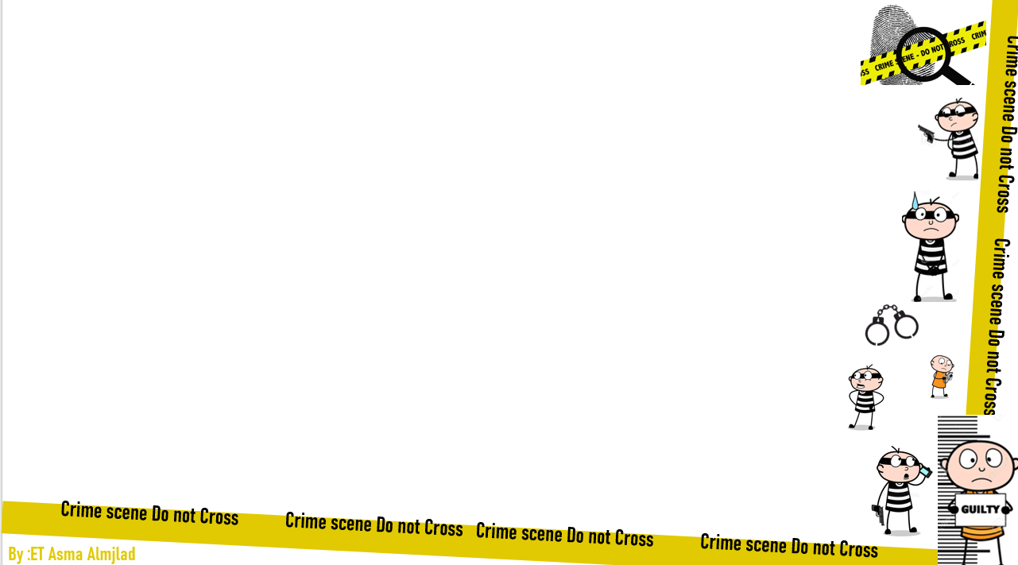


U:2
Doesn’t pay
Form, Meaning and function
By : ET Asma Almjlad

Slide 2
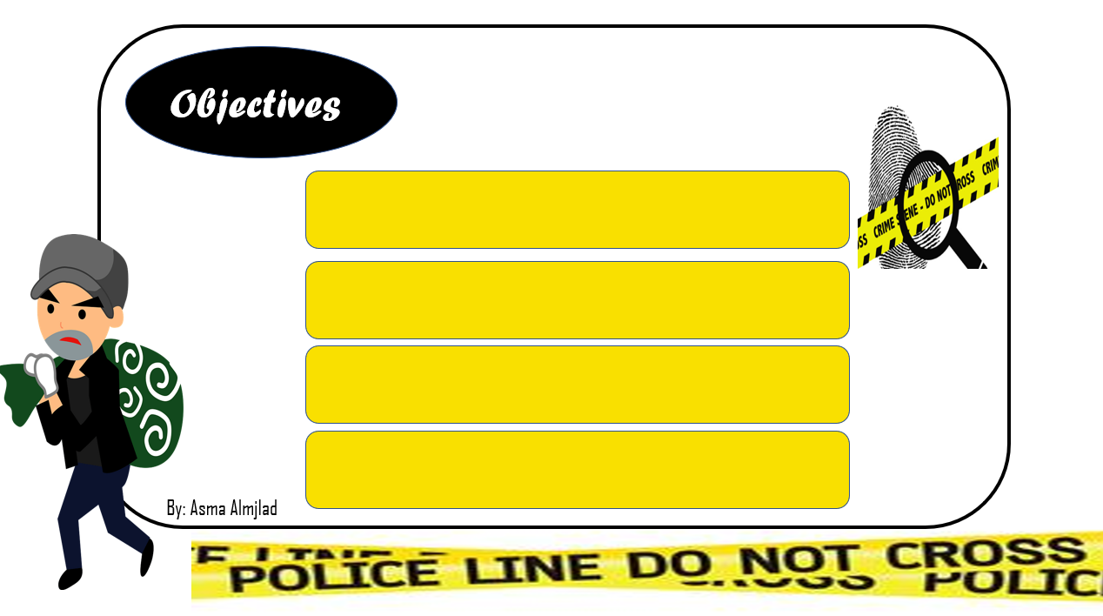
Use the correct verb (to be ) in the simple past
Use regular verbs in the simple past tense.
Use ( used to+ would ) with past tense
Use past progressive correctly

Slide 3
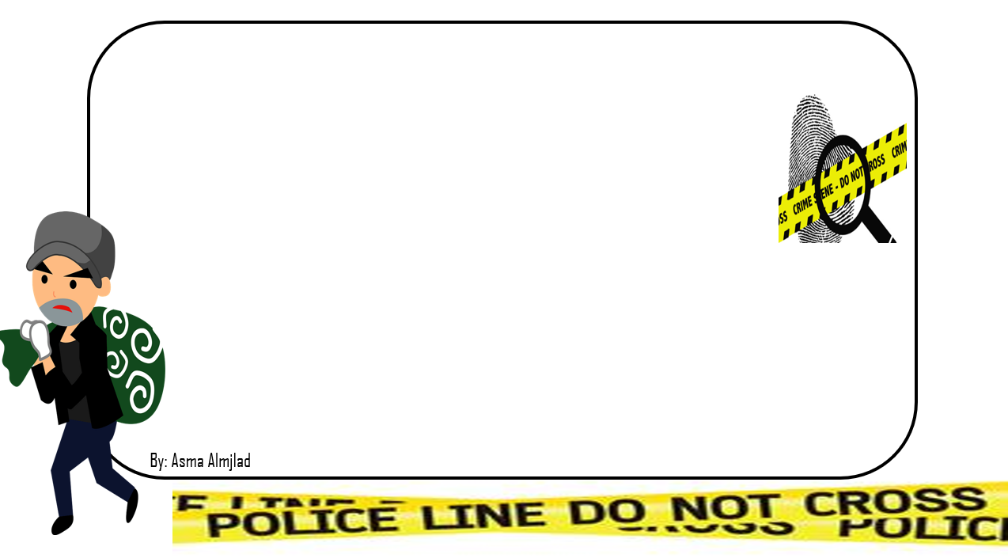


Slide 4
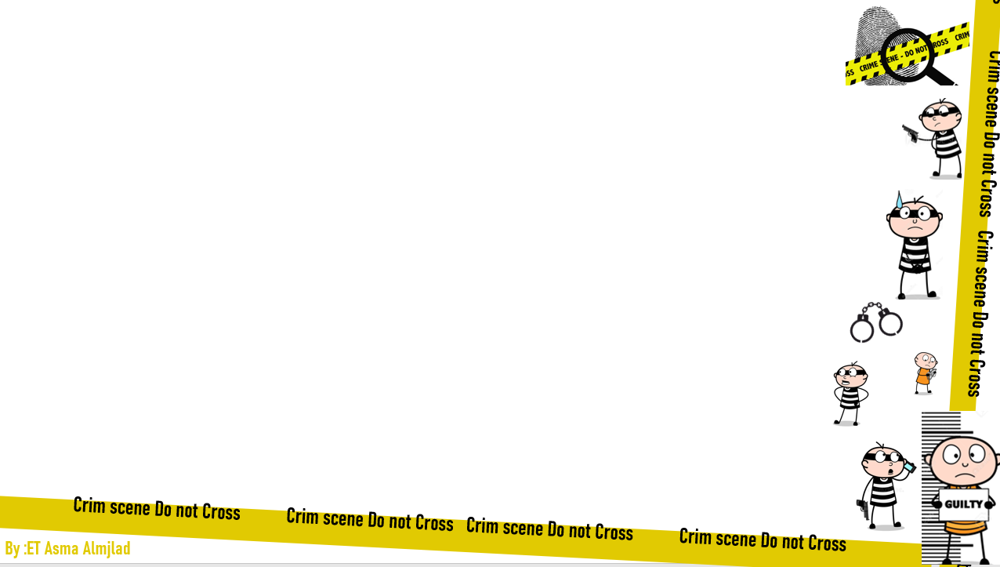
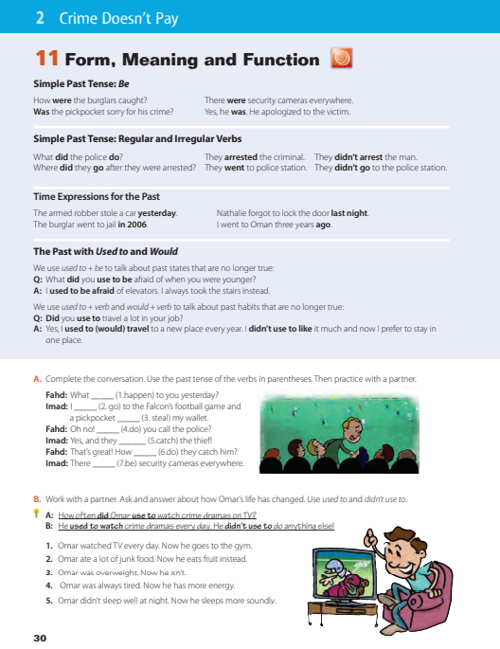
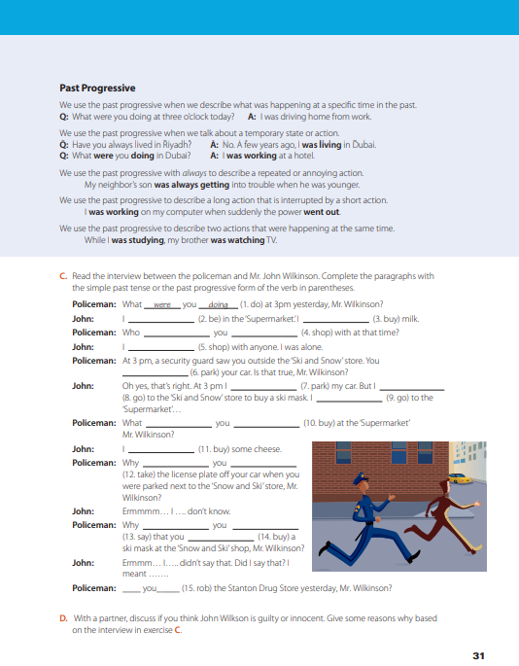

Page 30+31

Slide 5


Do you watch this video at home ?

Slide 6



Slide 7


Slide 8
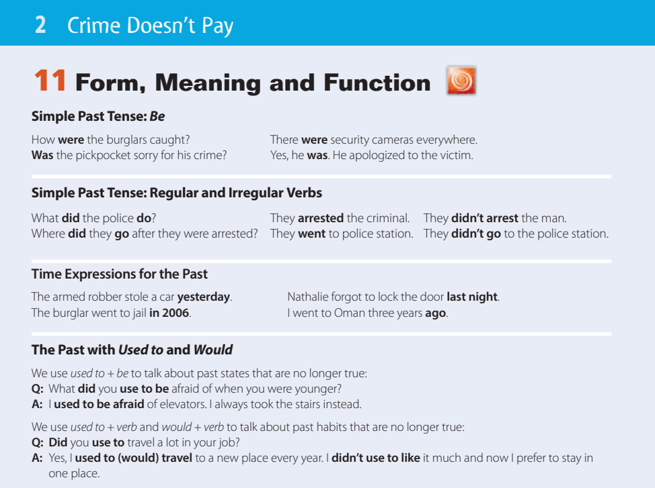

Slide 9

What is the present simple of verb to Be ?
Simple past tense : Be
Was goes with ….
What is the past simple of verb to Be ?
Give me example .
Were goes with ….
Give me example .

Slide 10
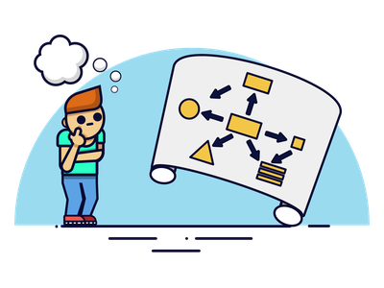
Simple past tense : Be
Write a mind map .

Slide 11
Simple past tense : Be
I
She
He
it
e.g
Was ( not)
I was happy ☺
I wasn’t sad ☹
They
We
you
e.g
They were quite .
Were ( not)
We weren’t late

Slide 12




Simple past tense : Be
e.g
I
She
He
it
She was rich.
Was
…..?
Was she rich?
e.g
They
We
you
They were late .
Were
Were they late?

Slide 13
Simple past tense : Be
I
She
He
it
Was
Wh
…?
They
We
you
Were

Slide 14

Simple past tense :
regular irregular verbs
Let’s remember
What is the past tense of these verbs.
Is it regular or irregular verb?
write
play
study
make
buy
cook
read
close

Slide 15

Simple past tense :
regular irregular verbs
How can I make
information questions
in the past?
How can I make
Yes or No questions
in the past?
e.g.
Did Sami play football?
Give me example.
Did + S + v-inf …..?
What did Sara do ?
Wh + did + S + v-inf ….?

Slide 16



Did you write the H.W?
Yes, I did.
No, I did n’t.
Did Sami play football?
Yes, he did
No, he did n’t

Slide 17

Did
Did + v-inf
The auxiliary didn’t is used in negative sentences.
The auxiliary did is used for all persons, singular or plural.
The auxiliary did is also used in short answers to yes/no questions.

Slide 18


Make questions
They went to the school .
Where…………………………..?
Noura cooked the lunch.
Did……………………..…………..?
Ali played football yesterday
Did …………………………..?

Slide 19

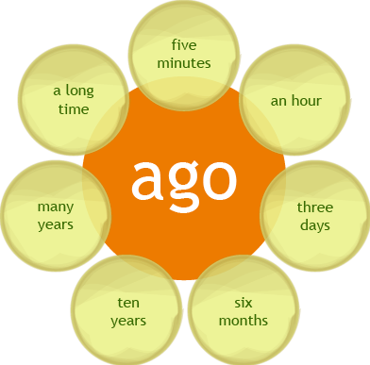
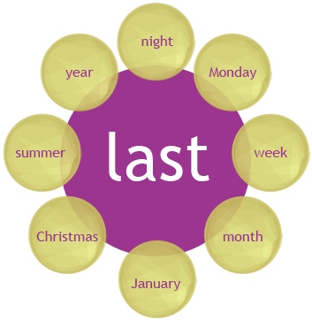
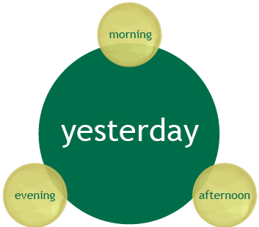
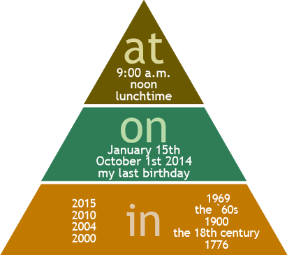
Sunday

Slide 20

When you were younger, what were you afraid of?
The Past with
Used to and Would
When I was younger, I was afraid of the dark.
used to be describes a past state (or situation) which is no longer true
we can substitute used to for would when we talk about past habits but not when we talk about past states

Slide 21

venn diagram
Used
Would
+ V-inf
Past
Past activities and states
Past habits only

Slide 22




I used to work for a big company.
But I don’t work there now
I would to work for a big company but I don’t work there now.
Omar used to have a sport car
But n’t any more
Omar would to have a sport car But n’t any more
Mona used to live in Dubai .
But she doesn’t live in Dubai now
Mona would live in Dubai but she doesn’t live in Dubai now

Slide 23
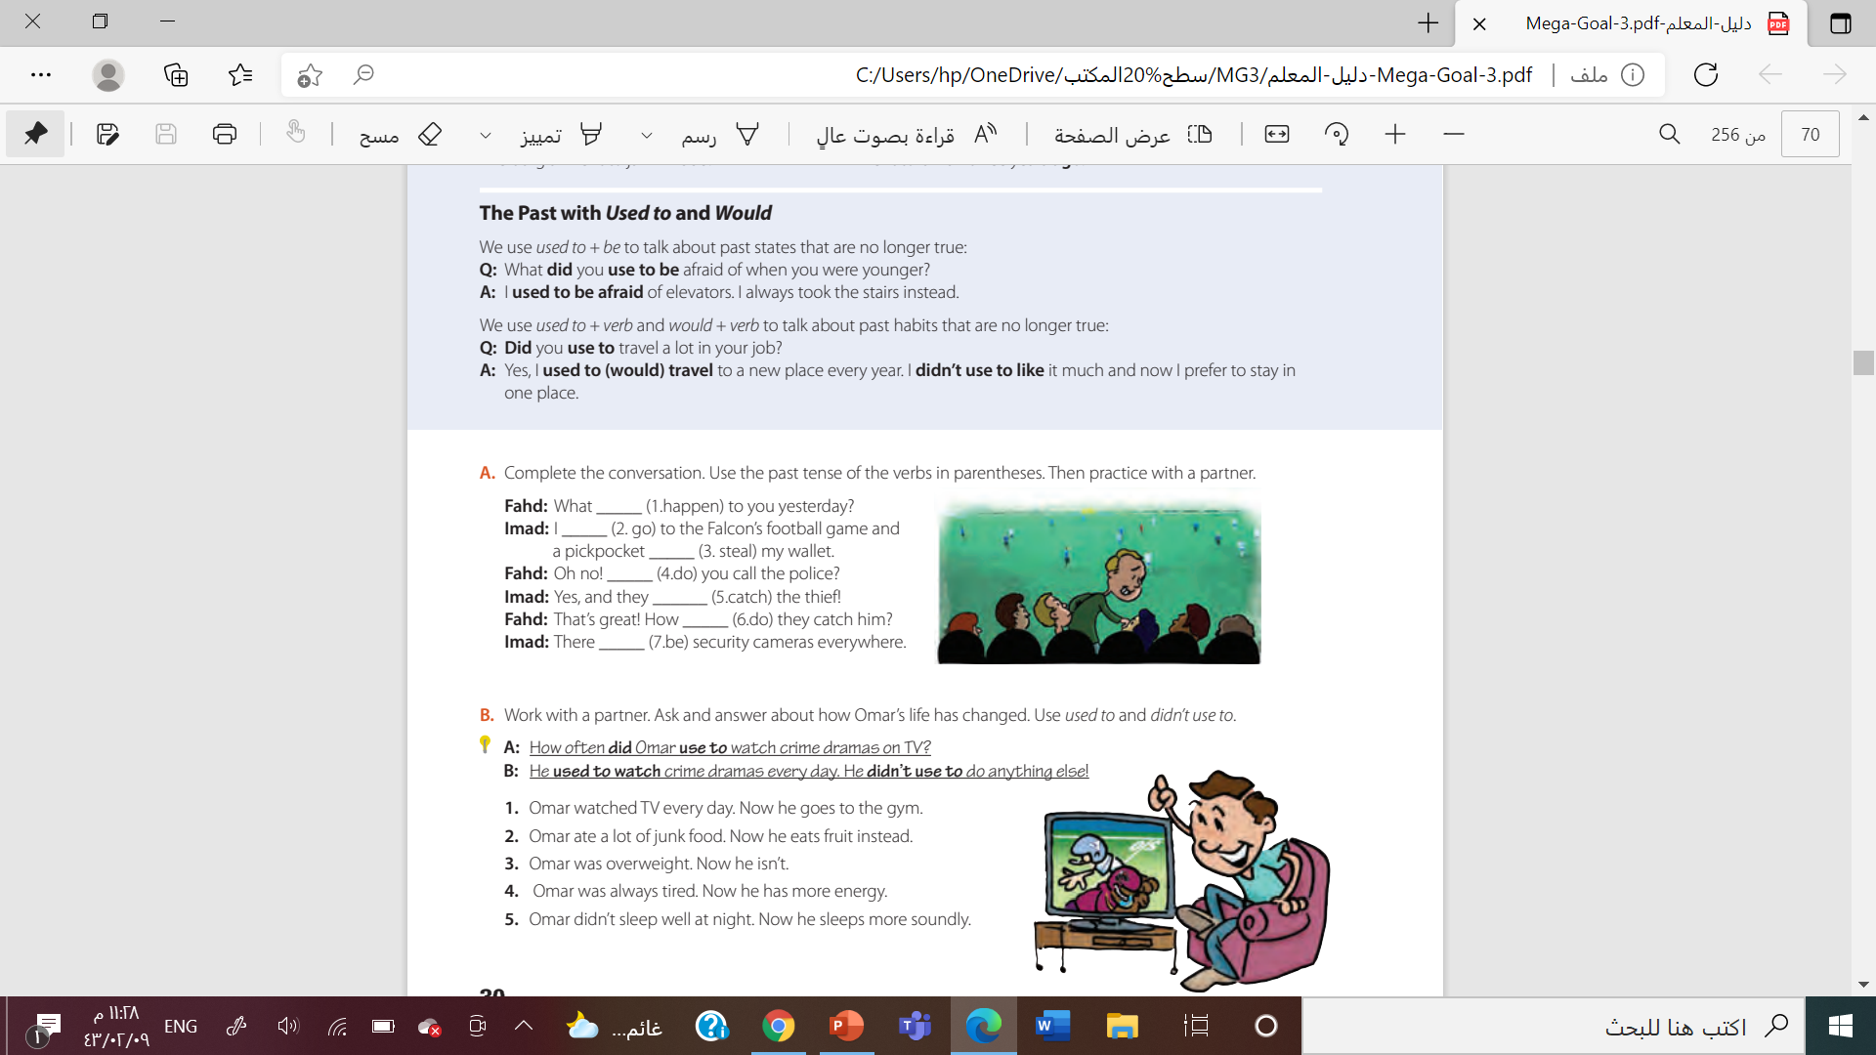
happened
went
stole
did
Cought
did
were

Slide 24

1. A: What did Omar use to do every day?
B: He used to (would) watch TV every day. He didn’t use to go the gym.
2. A: What did Omar use to eat?
B. He used to (would) eat a lot of junk food. He didn’t use to eat fruit.
3. A: What did Omar use to look like?
B: Omar used to be overweight. He didn’t use to be slim.
4. A:How did Omar use to feel?
B: Omar used to feel tired. He didn’t use to have much energy.
5. A: How did Omar use to sleep?
B: Omar didn’t use to sleep well.
He used to be awake most of the night/ have insomnia

Slide 25

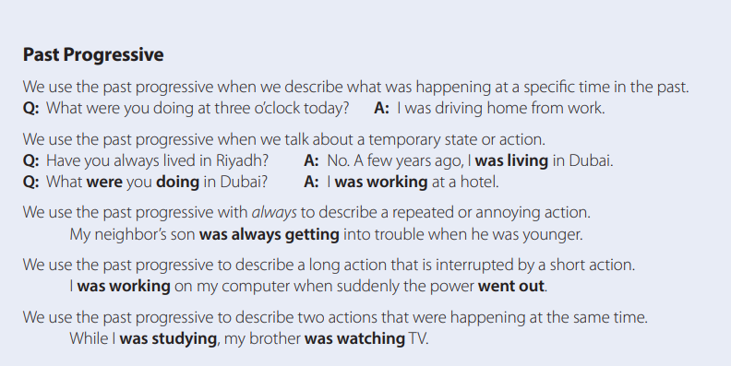
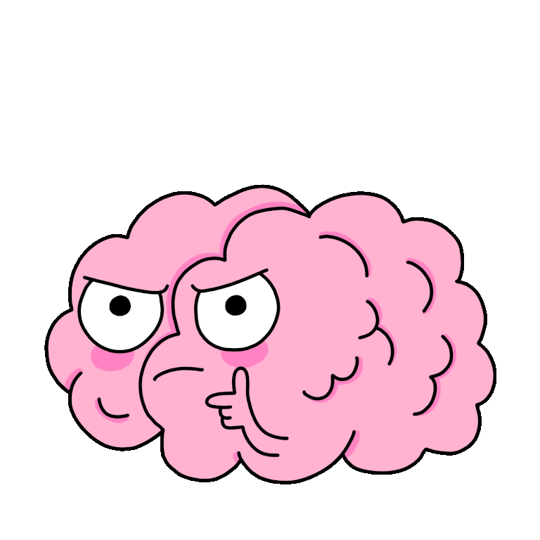

Slide 26
Past progressive
I
She
He
it
Was ( not)
e.g
I was working here.
V + ing
They
We
you
Were ( not)
e.g
They were studying in England

Slide 27

Yes or No questions
Was
were
S
V+ing
….?
Information questions
Wh
Was
were
S
V+ing
….?

Slide 28

Choose
( were – was – did ) they watching T.V at midnight ?
Sara ( were – was – am ) eating lunch in the cafeteria .
( was – were – is ) he working here ?
I was ( walked – walking – walk ) home when I saw the car accident .

Slide 29


Find the fib
While Ali was cleaned the house , we were cooking.
Was you talking on phone a few minutes ago ?
Tom wasn’t done his homework . He was playing with his friends .

Slide 30
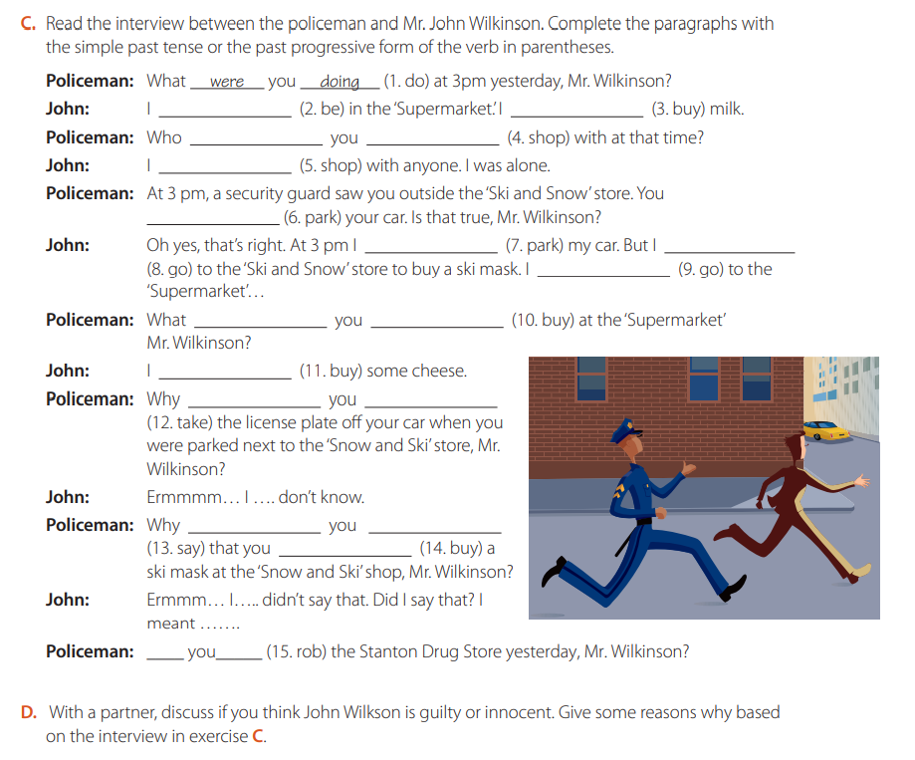


Slide 31



Work
book

Slide 32
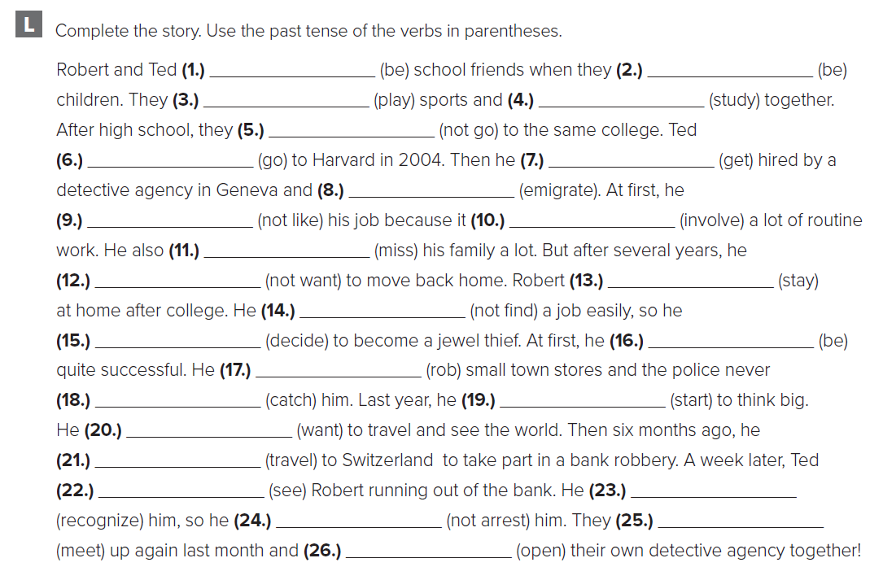
Simple past
were
were
played
studied
didn’t go
went
got
emigrated
didn’t like
involved
missed
didn’t want
stayed
didn’t find
decided
was
robbed
caught
started
wanted
traveled
saw
recognized
didn’t arrest
met
opened

Slide 33
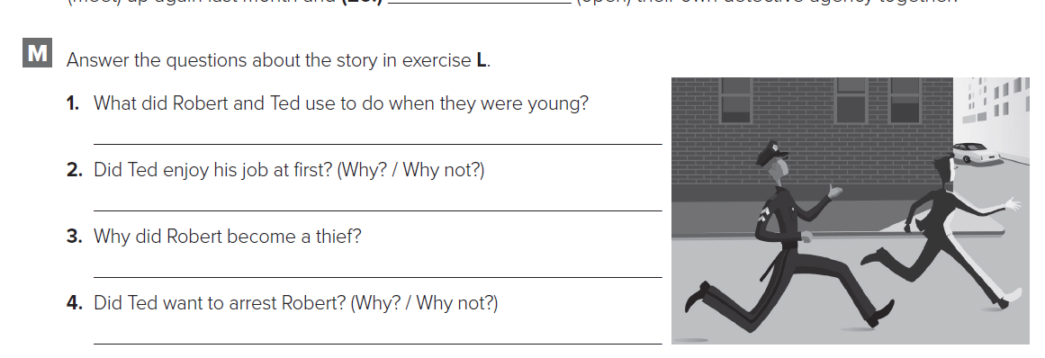
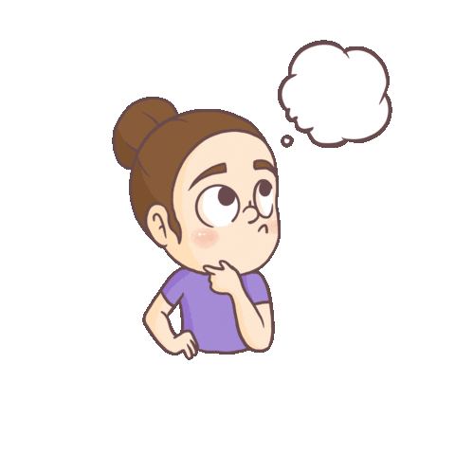
They used to play sports and study together
No, he didn’t because it involved a lot of routine work.
He became a thief because he couldn’t find a job easily.
No, he didn’t, because they were school friends

Slide 34

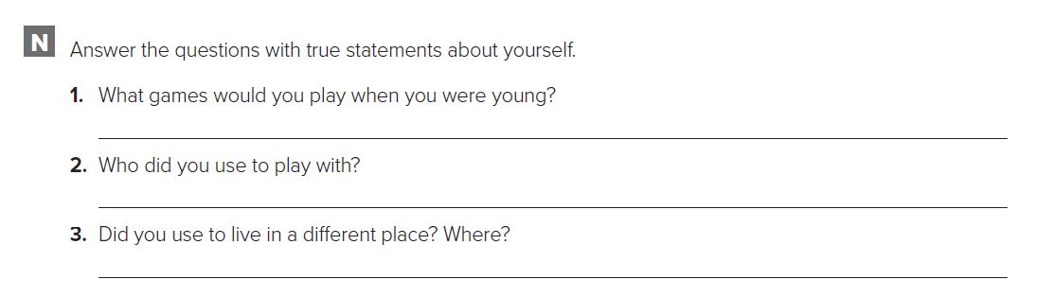


Slide 35



Slide 36


