Slide 1
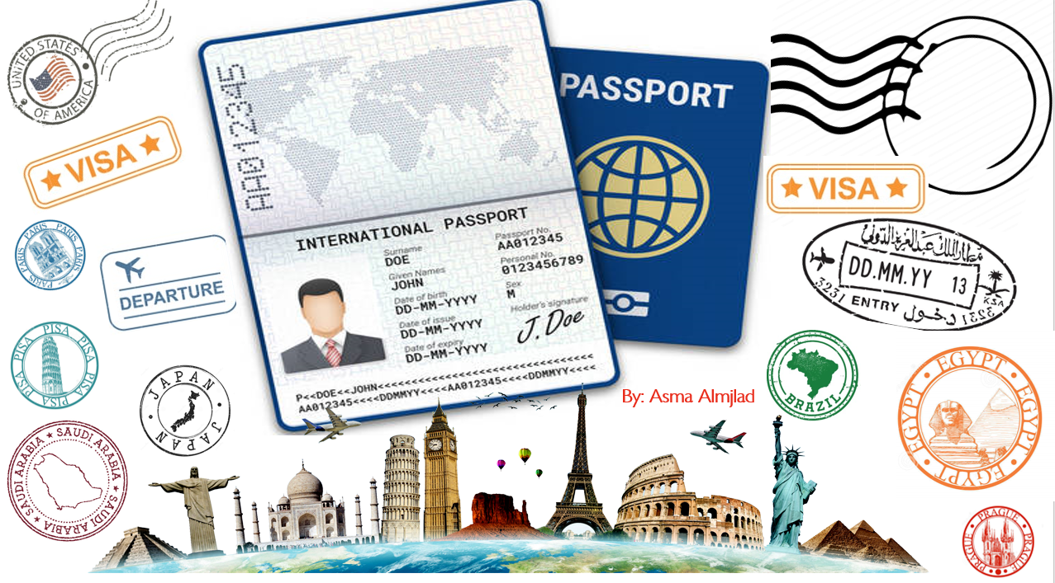

U:3
Far and away
MG3
U3:Far and away
Conversation
Sept 2021

Slide 2
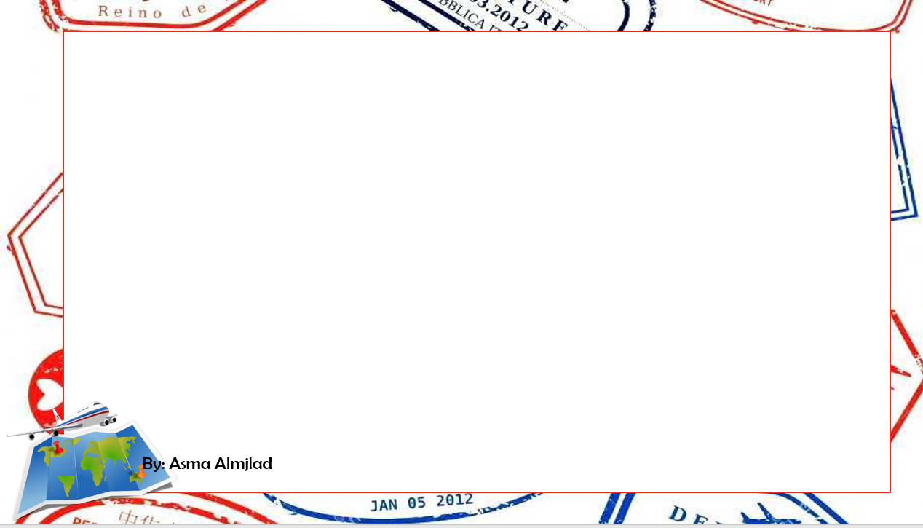
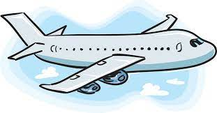
Objectives
Name stuff to take along when traveling
Use the new words in a conversation
Use the "real talk " phrases in new sentences

Slide 3
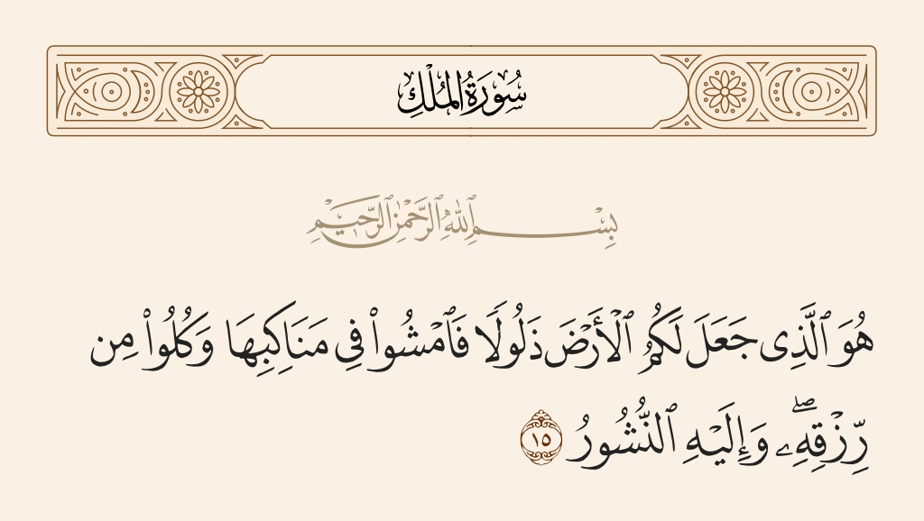

Slide 4

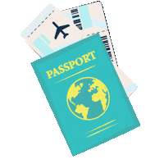


Slide 5

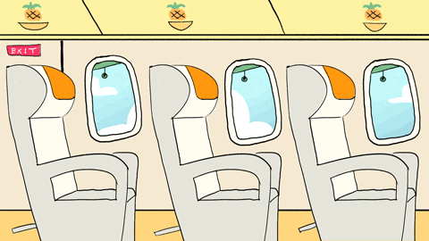
What do you do when you board a plane?
Do you have to sit in your assigned seat?
Where do you like to sit—
by a window or on the aisle?

Slide 6
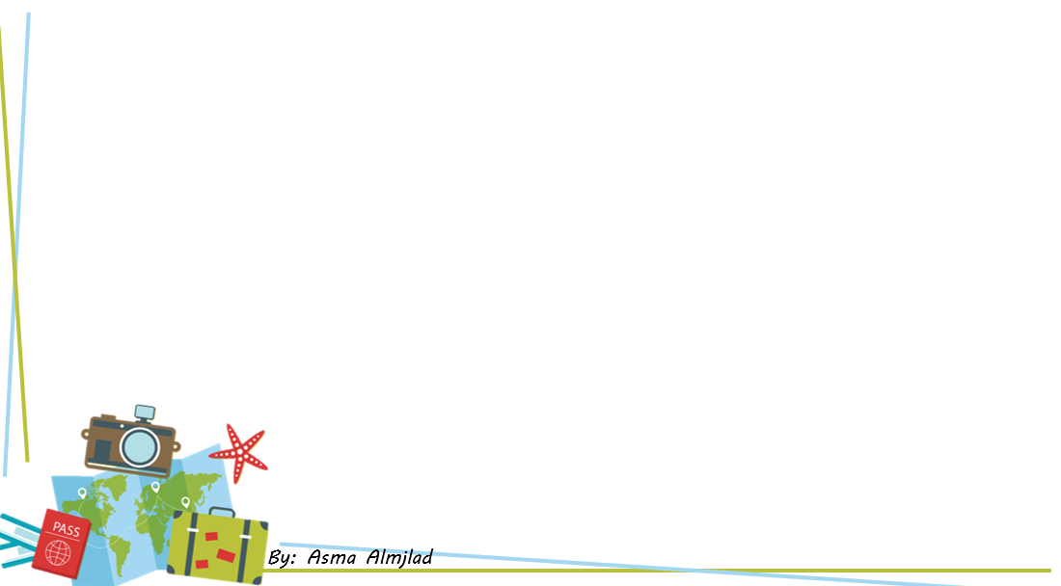
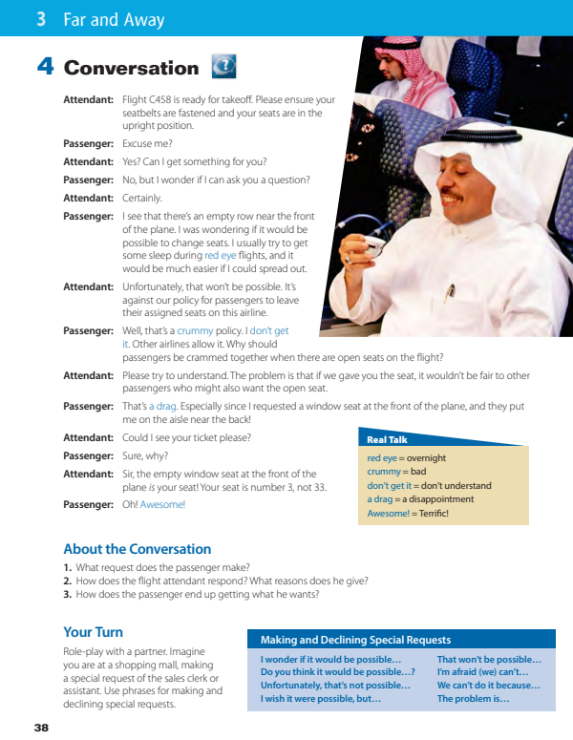


@ page 38

Slide 7
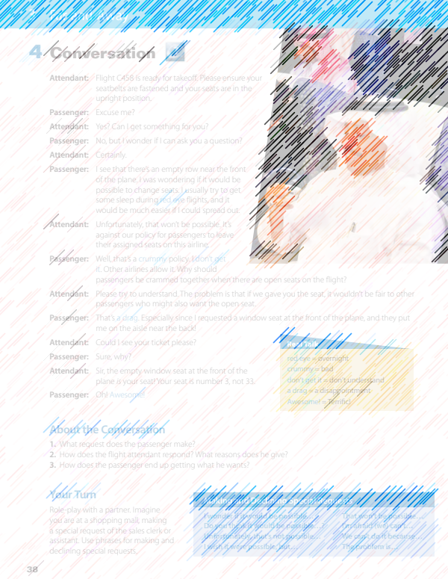
How many characters in this conversation?
Who are they ?
What is the picture show?
What do you think they talk about ?

Slide 8
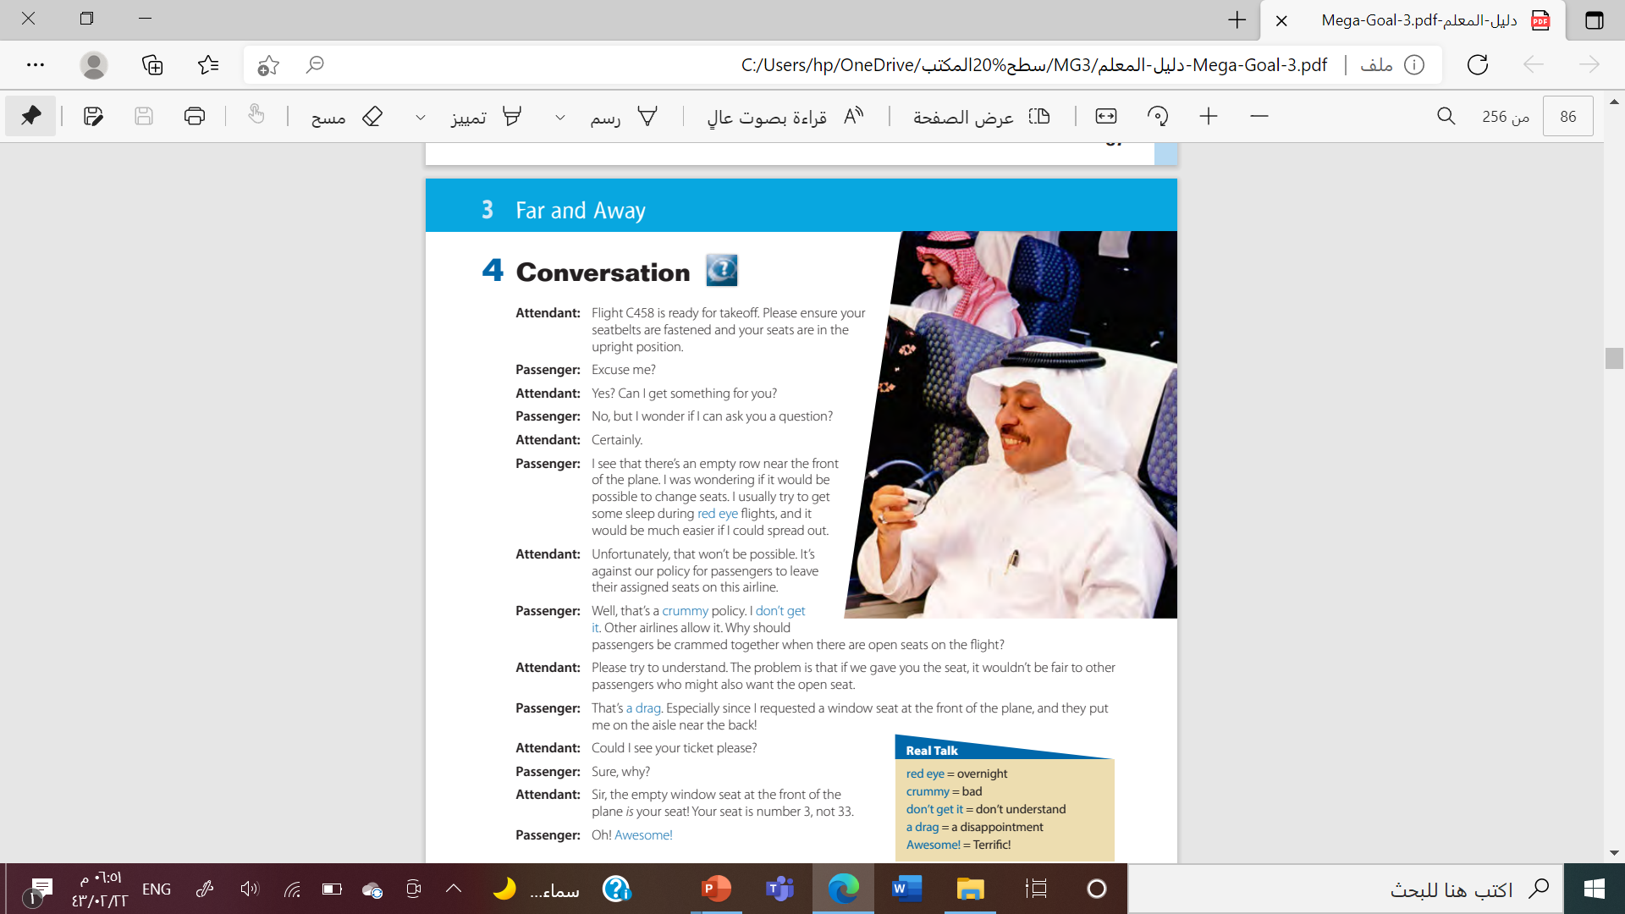


Listen

Slide 9


Slide 10
What is your opinion of the man’s request?
Was it OK to ask for the seat change?
What do you think of the airline policy?

Slide 11
overnight
red eye
bad
crummy
don’t understand
don’t get it
a disappointment
a drag
terrific
awesome
By: ET Tala Alhazmi
Done by T. Talal Alhazmi

Slide 12


By: ET Ammar Al-Eid

Slide 13

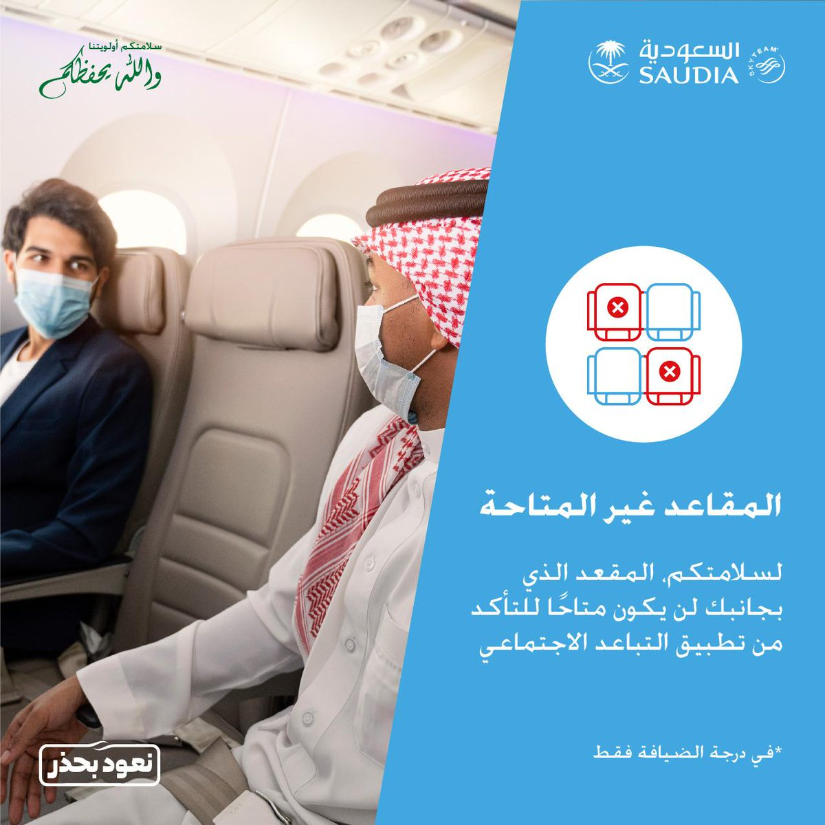

Slide 14
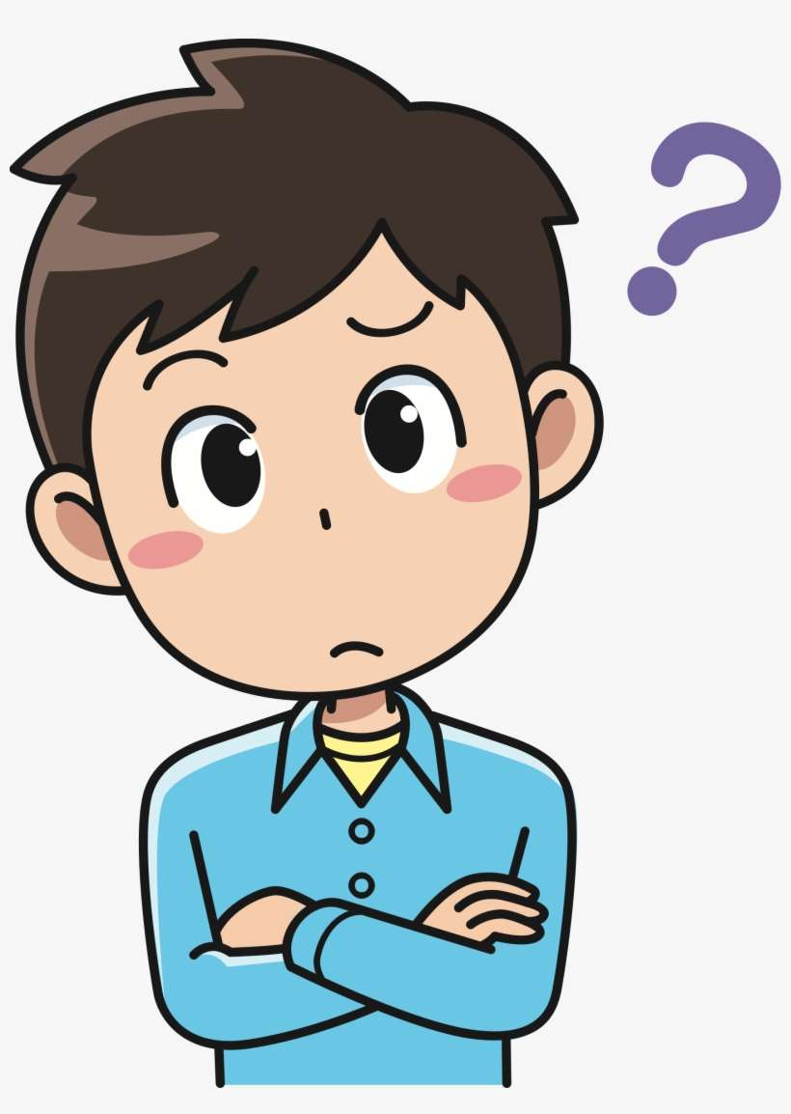
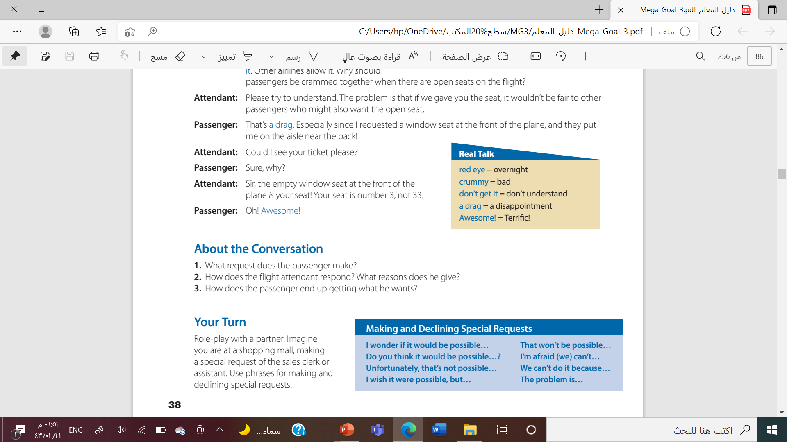
He would like to change seats.
He says that changing seats won’t be possible because it wouldn’t be fair to other passengers. It’s also against the policy of the airline.
The passenger was in the wrong seat to begin with. He moves to his assigned seat, which is the one that he wanted.

Slide 15
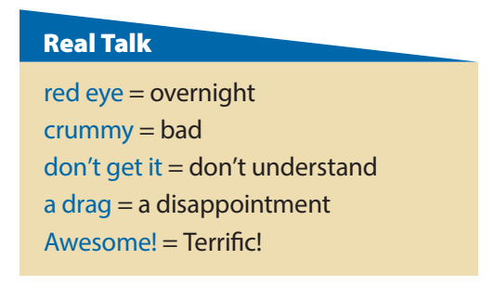

Why do you think that overnight flights are called red-eye flights?
Are the expressions crummy and a drag formal or informal expressions?
What doesn’t the passenger get?
Why does the passenger say Awesome! at the end of the conversation?

Slide 16
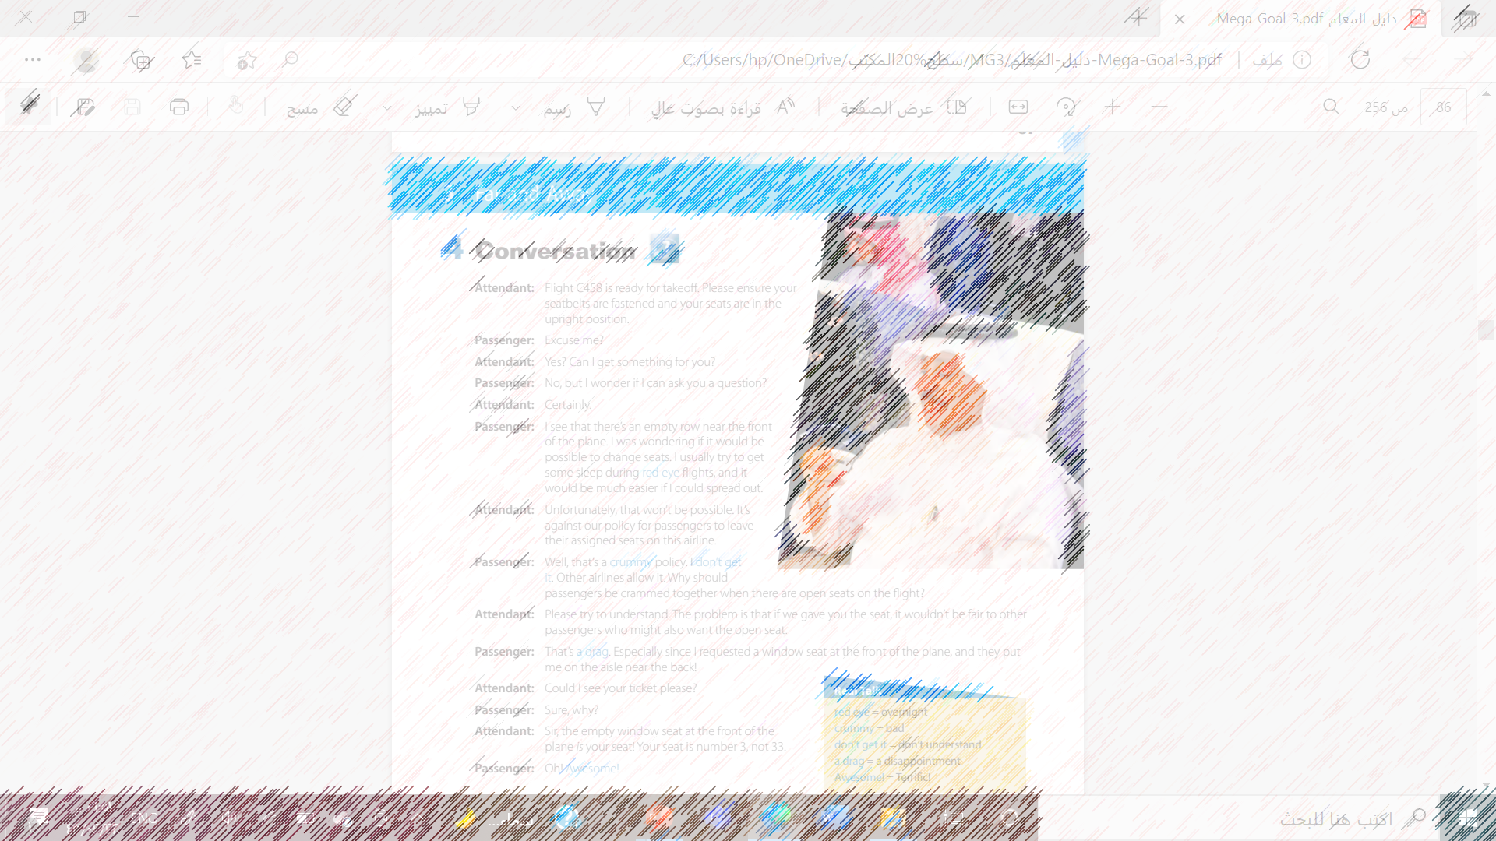
Find examples of those phrases in the conversation

Slide 17
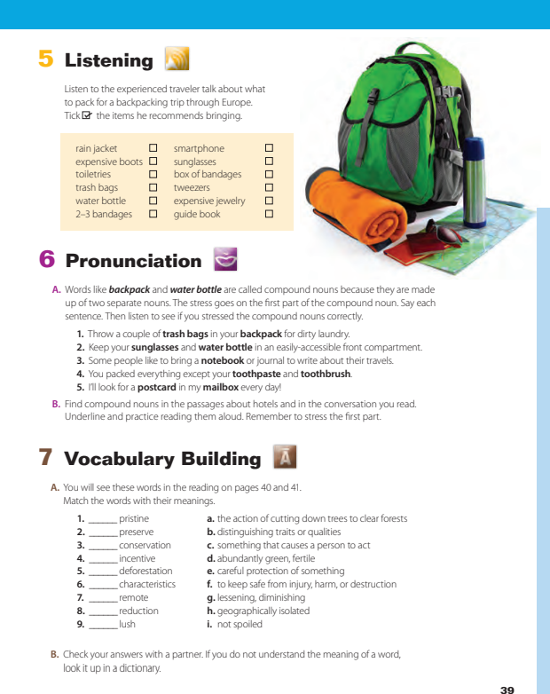
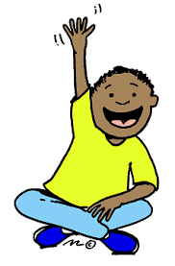
@ page 39

Slide 18
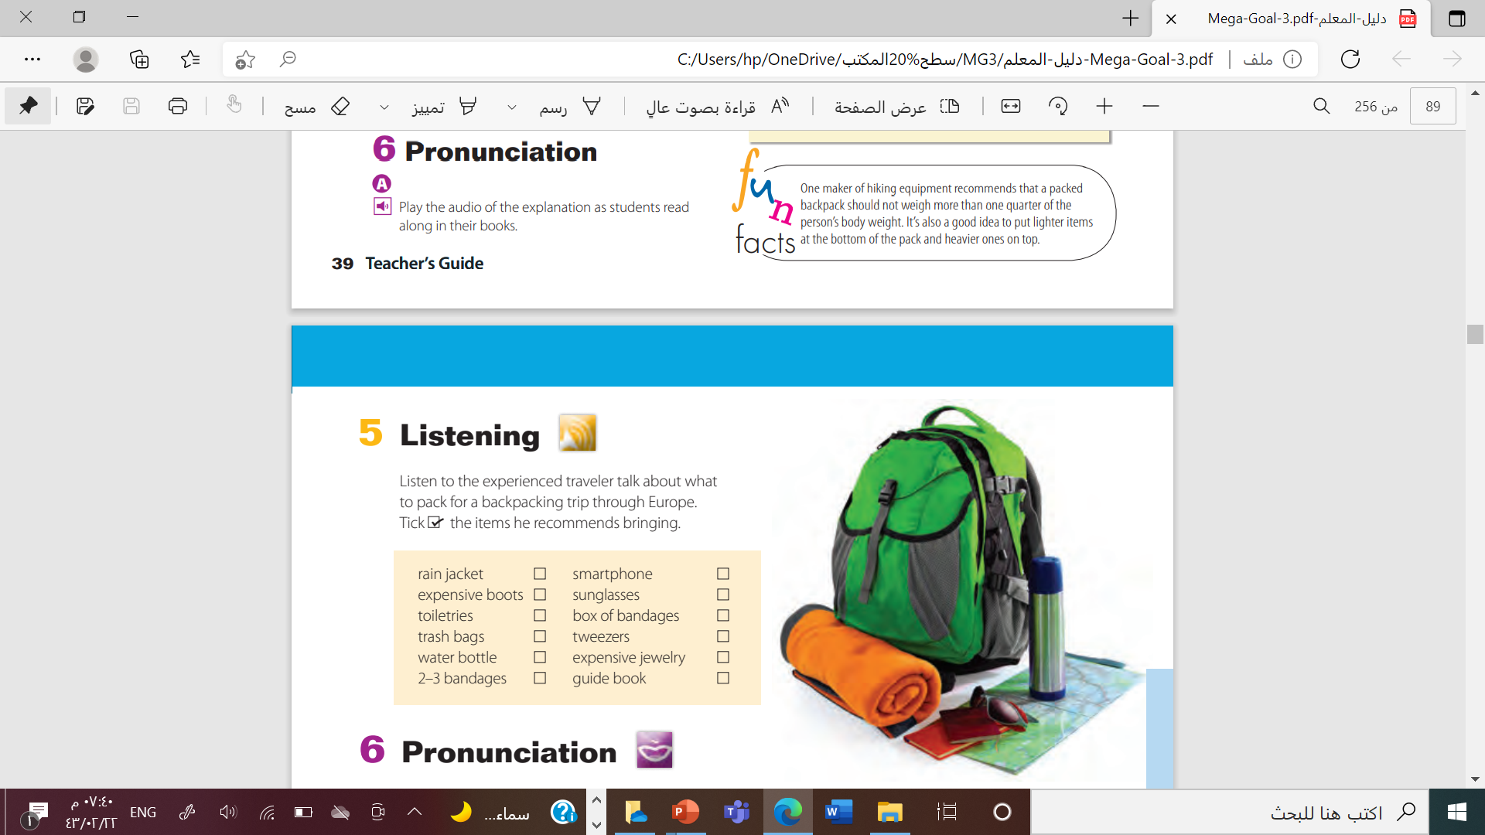


Slide 19


Slide 20
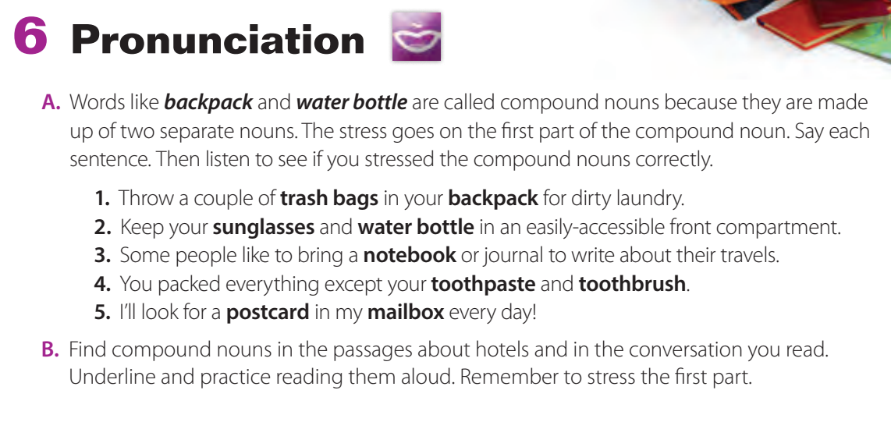

Slide 21
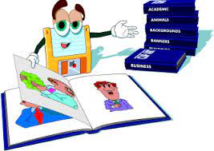
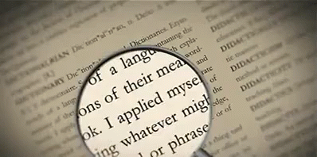
to keep safe from injury, harm, or destruction
preserve
pristine
not spoiled
conservation
careful protection of something
By: ET Tala Alhazmi

Slide 22
something that causes a person to act
the action of cutting down trees to clear forests
incentive
deforestation
characteristics
distinguishing traits or qualities
geographically isolated
remote
reduction
lessening, diminishing
lush
abundantly green, fertile
Done by T. Talal Alhazmi

Slide 23
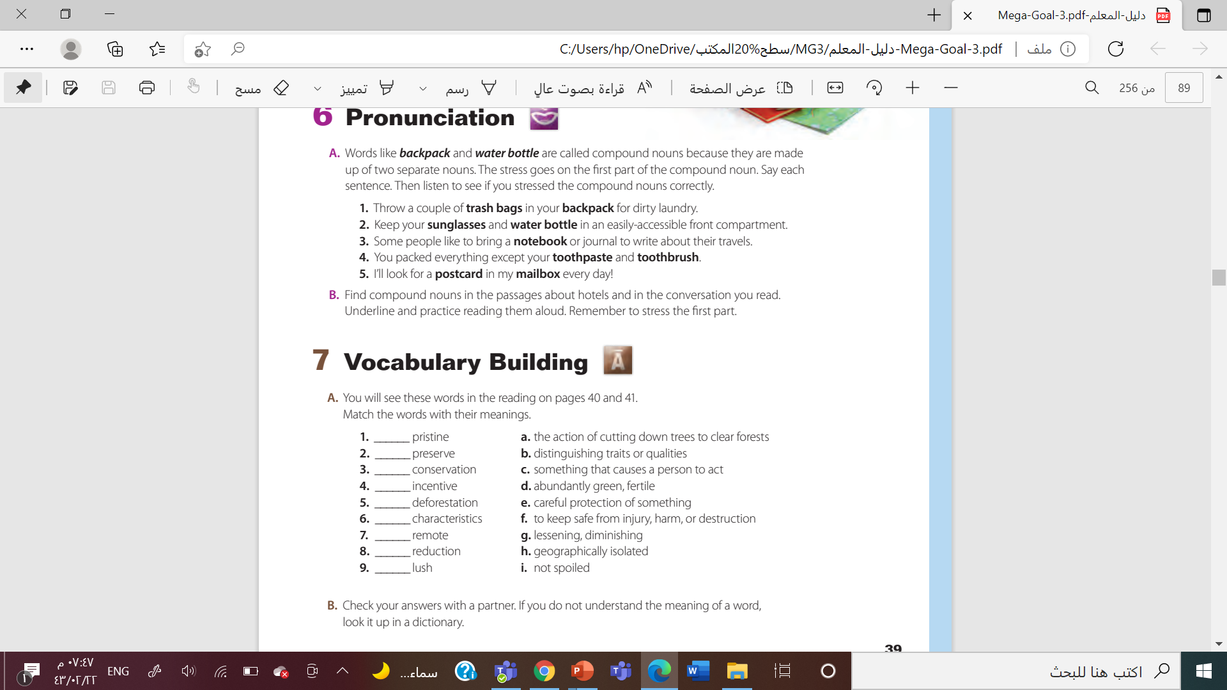

i
f
e
c
a
b
h
g
d

Slide 24



Slide 25

By Asma Almjlad

