Slide 1

Unit 1
Lifestyle
Part 4

Slide 2


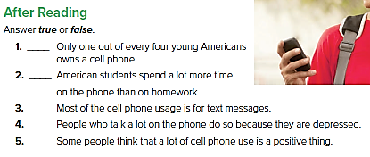
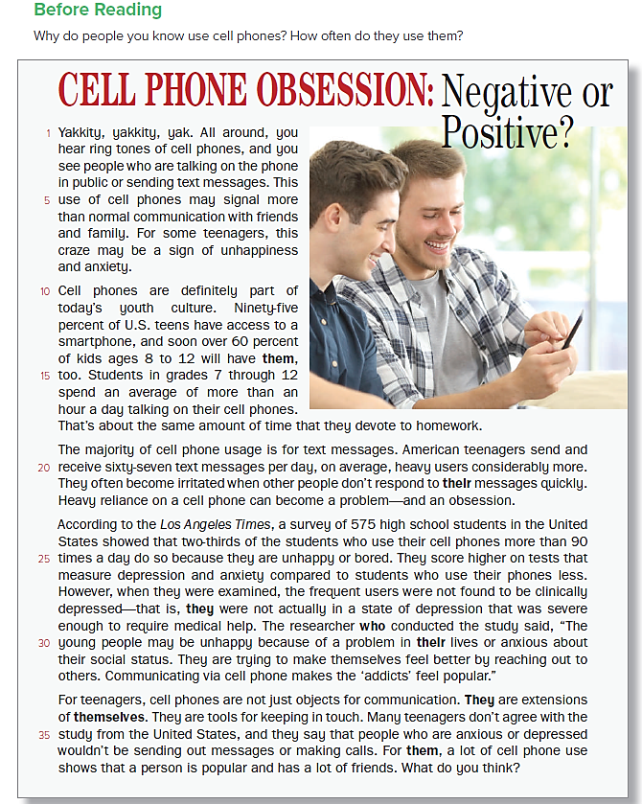
false
false
true
false
true

Slide 3
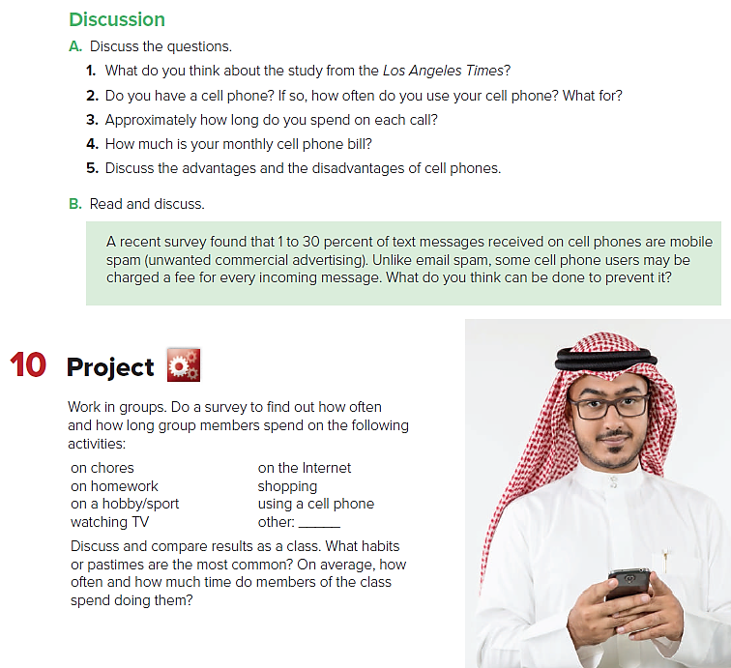

Slide 4
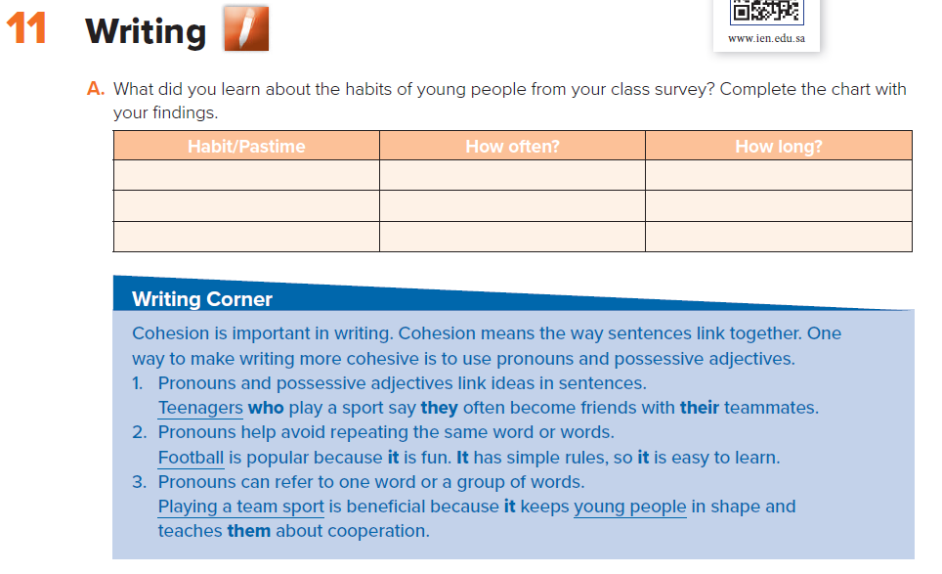
Sample answers
watching TV
everyday
2 hours

Slide 5
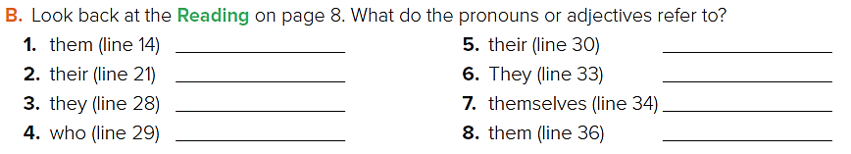
cell phones
the heaviest users
the frequent users
the researcher
young people
Cell phones
teenagers
many teenagers

Slide 6
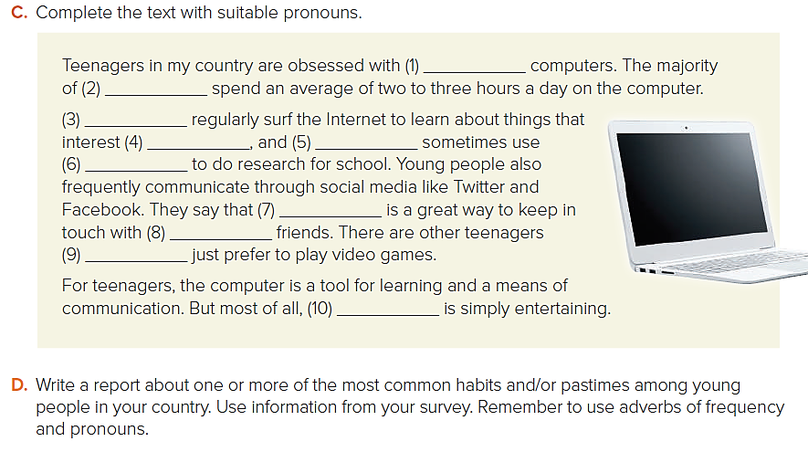
their
them
They
them
it
it/this
their
who
it
they
One of the most common habits (or pastimes) among teens in my country is using cell phones. Cell phones are part of today's culture. Teenagers spend an average of an hour a day talking on their cell phones.

Slide 7
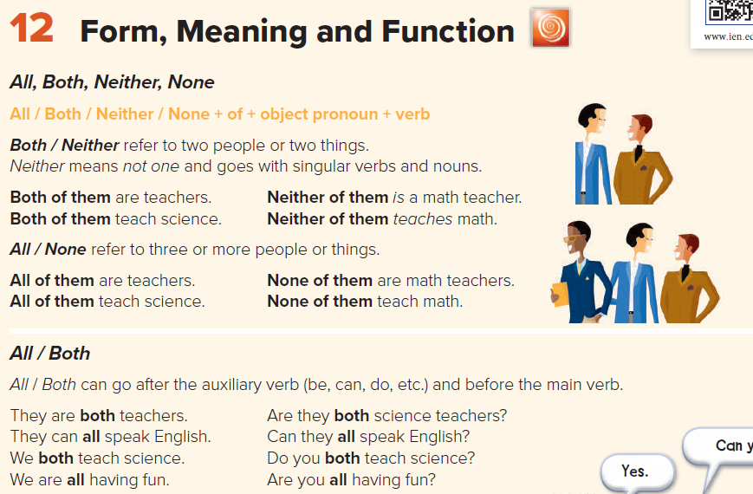

Slide 8

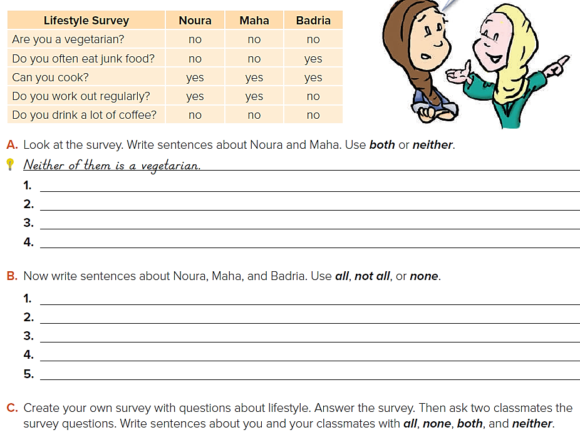
Sample answers:
Neither of them eats junk food often.
Both of them can cook. / They can both cook.
Both of them work out regularly. / They both work out regularly.
Neither of them drinks a lot of coffee.
Sample answers:
None of them are vegetarians.
Not all of them eat junk food often. They don’t all eat junk food.
All of them can cook. / They all can cook.
Not all of them work out regularly. / They don’t all work out regularly.
None of them drink a lot of coffee.

Slide 9
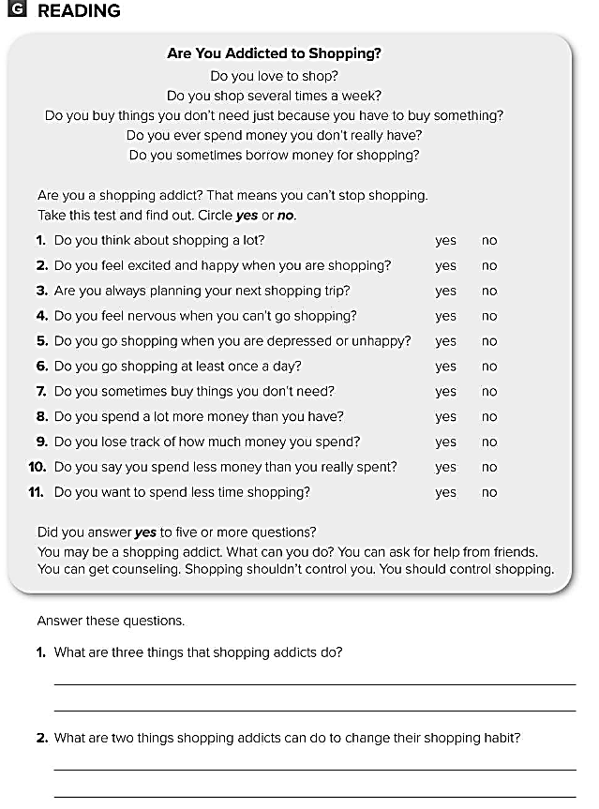
They go shopping when they’re depressed - They spend more money than they have - They feel nervous when they can’t go shopping .
They can ask friends for help .
They can get counseling .

Slide 10
