Slide 1
Welcome to class
T.

Slide 2
1
Unit 2

Slide 3
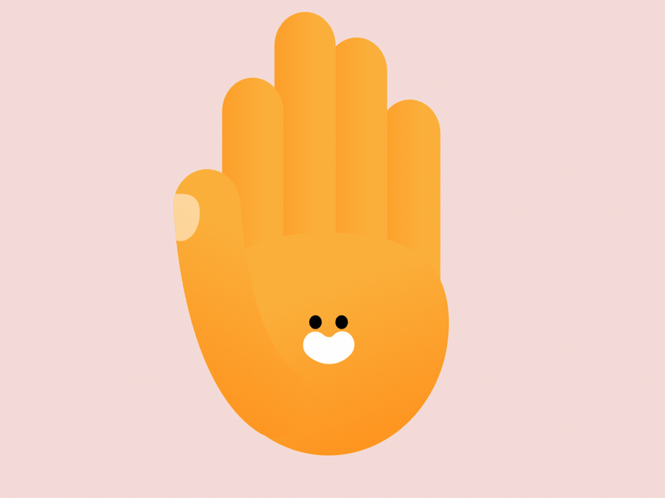
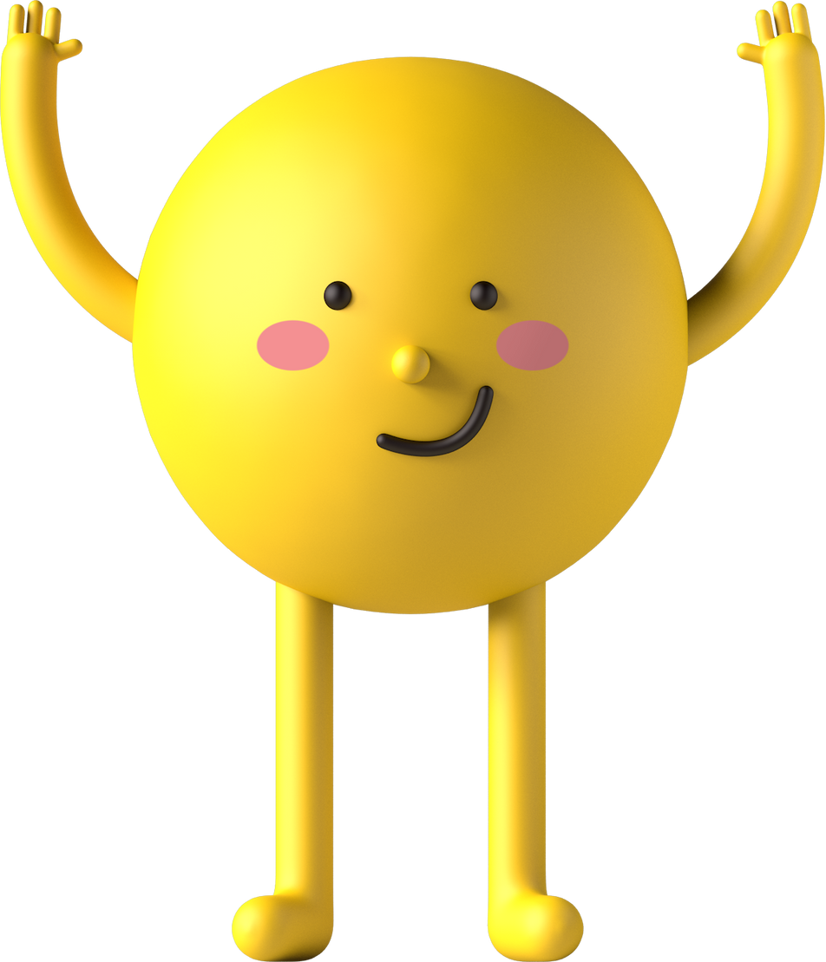
workbook
Pages 53 , 54

Slide 4
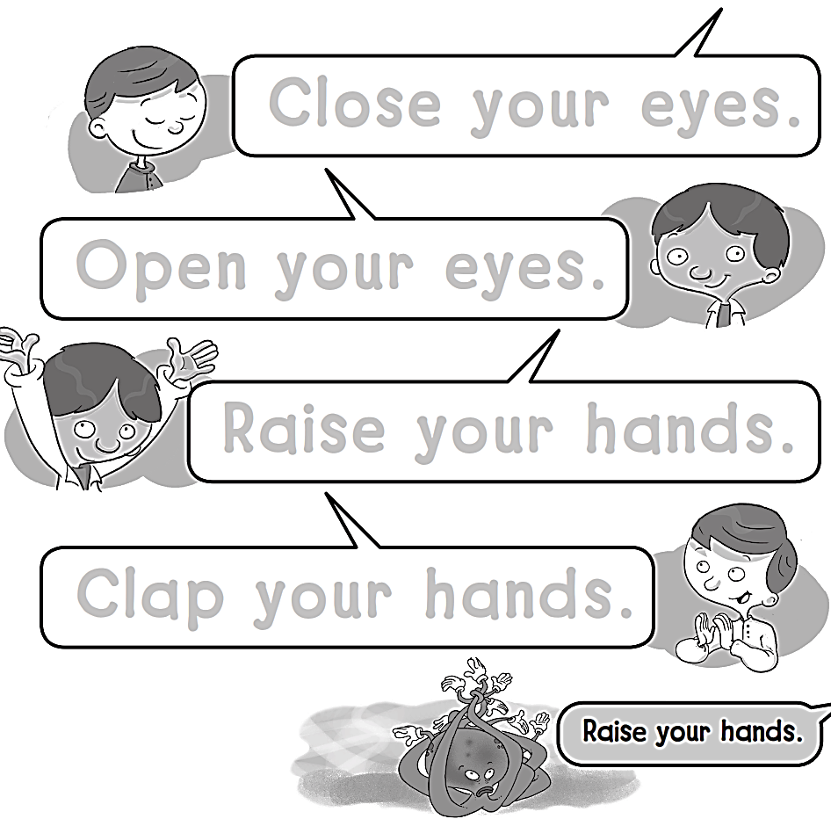
Close your eyes.
Open your eyes.
Raise your hands.
Clap your hands.

Slide 5
I I I I I I I I I I I

Slide 6
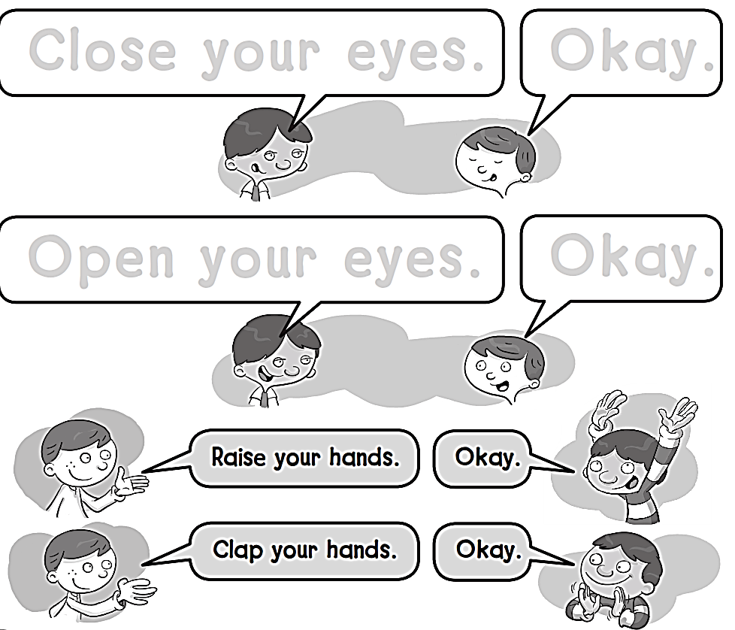
Close your eyes.
Okay.
Open your eyes.
Okay.

Slide 7
J J J J J J J J J

Slide 8
workbook
Pages 55 , 56

Slide 9
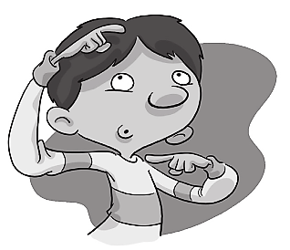
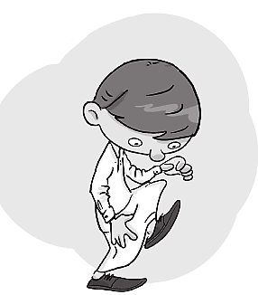
Head , shoulders
knees
toes

Slide 10
K K K K K K K

Slide 11
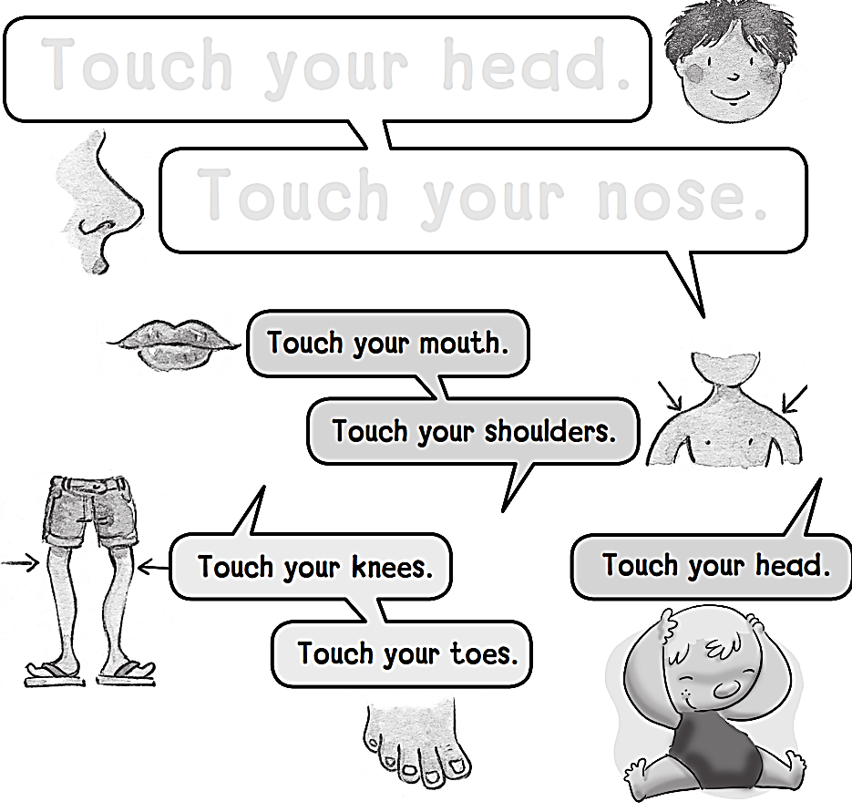
Touch your head .
Touch your nose.

Slide 12
L L L L L L L L

Slide 13
workbook
Pages 57 , 58

Slide 14
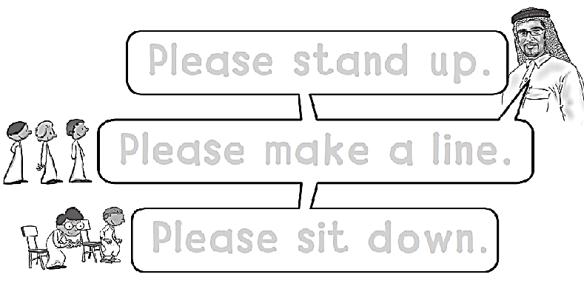
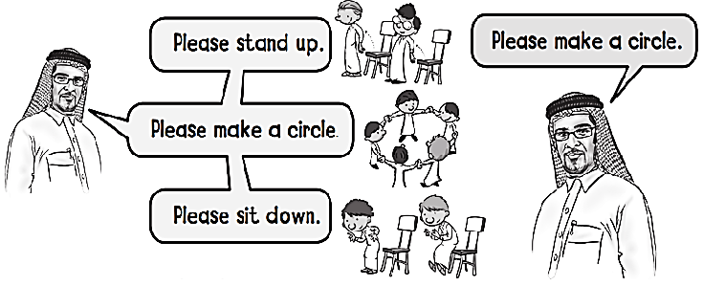
Please stand up .
Please make a line .
Please sit down .

Slide 15
M M M M M

Slide 16
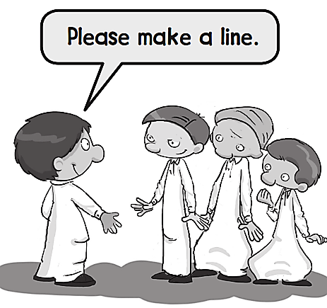
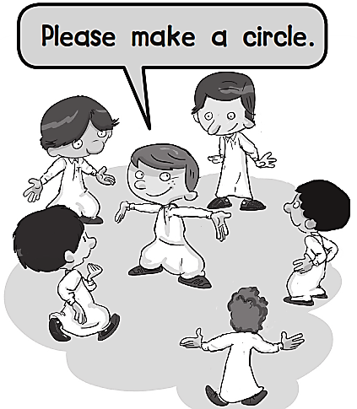
Please stand up .
Please come
to the front .

Slide 17
N N N N N N N

Slide 18
workbook
Pages 59 , 60

Slide 20
O O O O O O

Slide 22
P P P P P P P P

