Slide 1

GOOD MORNING

Slide 2

Big Changes

Slide 3
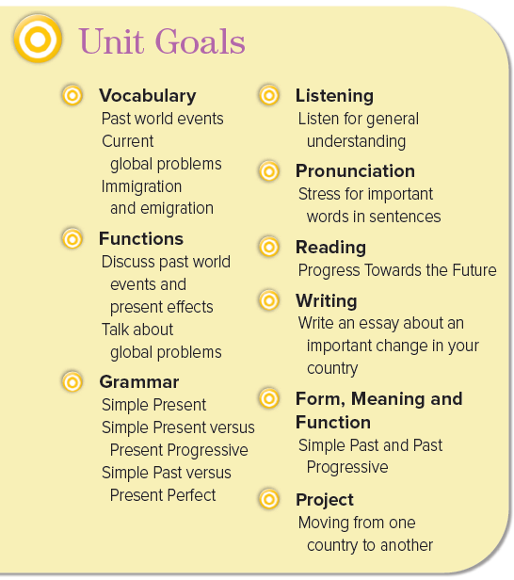


Slide 4
The objectives :
At the end of this session, the students will be able to :
Find the importance of each issue and explain the reason behind it
Write facts about some events Saudi Arabia.
Discover the meaning of the new words .

Slide 5
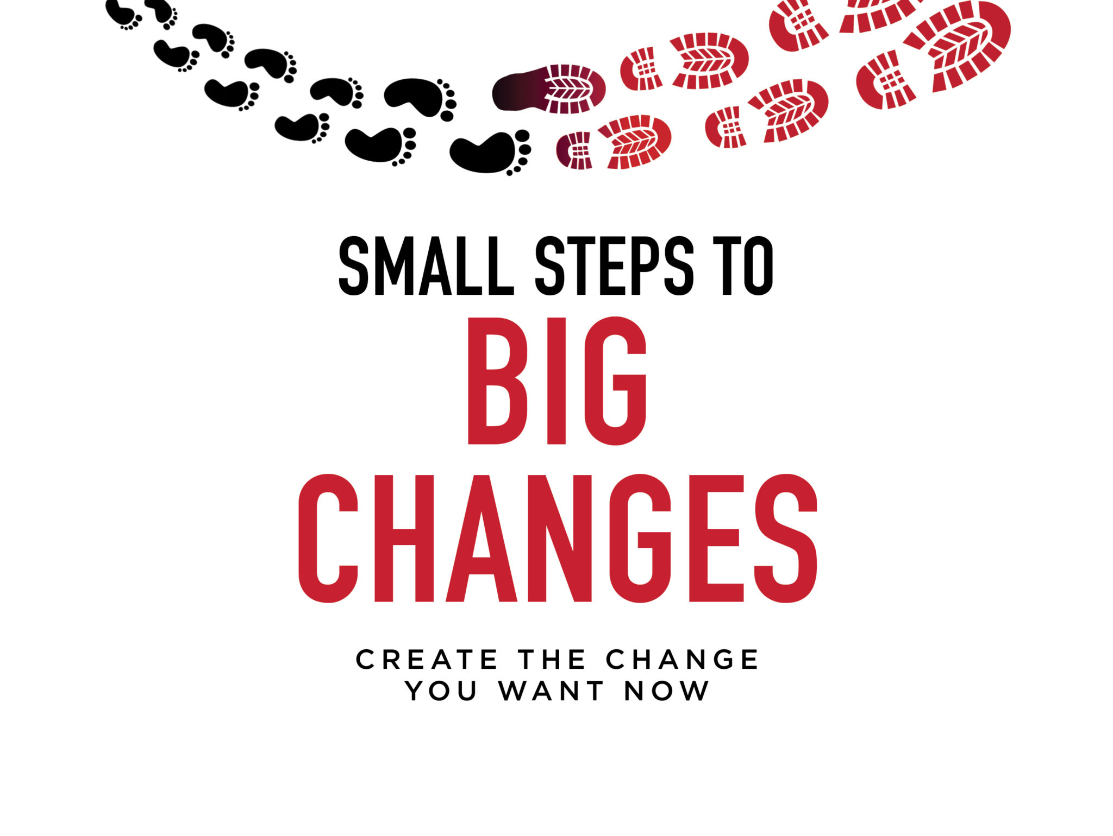
overpopulation
endangered species
space exploration
What have you read or seen on TV about these issues?
Which issues are positive and which are negative in your opinion?
Are there any other changes that have impacted our world significantly?

Slide 6


The world is constantly going through changes. Look at some
important events that have changed the world and affected the lives of
many people in modern times.
The Unification of The Kingdom of Saudi Arabia
King Abdulaziz, a gifted leader, was responsible for the legendary event that
marked the beginning of modern Saudi Arabia. In 1902, he regained Riyadh, beat
the city garrison, took the Masmak Fortress, and established his headquarters
in the city. He expanded Saudi Arabia to include all of the Hijaz, Makkah and
Madinah and united all the tribes. On September 23, 1932, the Kingdom of Saudi
Arabia was officially established, as an independent country, with Arabic as the
national language and the Holy Qur’an as its constitution. King Abdulaziz initiated
the building of infrastructure and set Saudi Arabia on the road to modernization

Slide 7
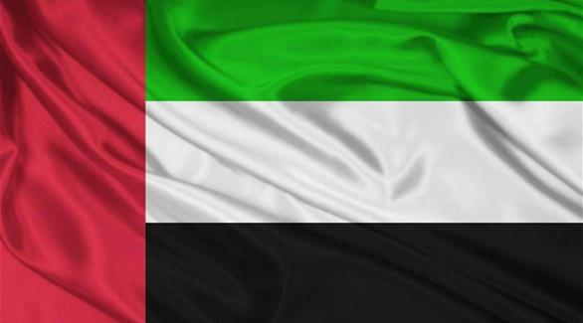
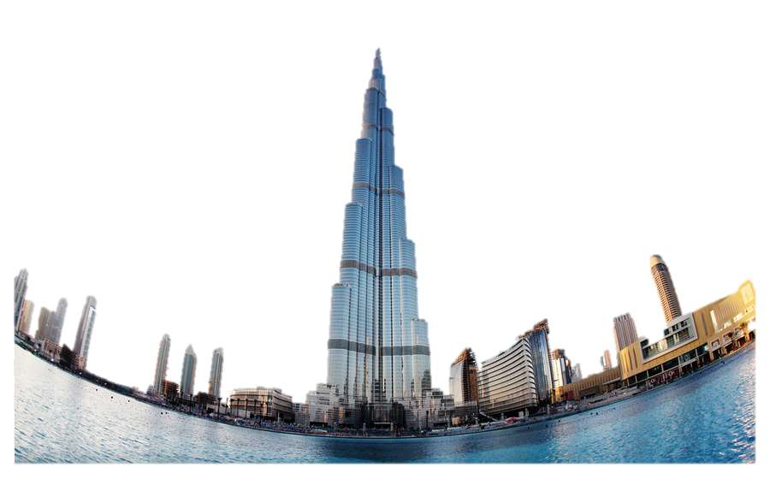
The United Arab Emirates – UAE
The federation of the United Arab Emirates, known as UAE, consists of seven sheikhdoms;
Abu Dhabi, Ajman, Dubai, Fujairah, Ras Al-Khaimah, Sharjah and Umm Al Quwain. The
city of Abu Dhabi in Abu Dhabi is the capital. The UAE was officially established in 1971. It
came after the discovery of enormous oil reserves in Abu Dhabi in 1958. The UAE dirham, a
single national currency, was launched in 1973. The oil revenues as well as income from other commercial
activities have been used to develop a thriving economy and social infrastructure. Abu Dhabi now hosts
its own grand prix at Yas Marina Circuit and Dubai is home to the tallest building in the world, the Burj
Khalifa.

Slide 8
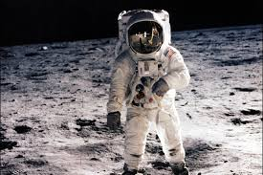
The Space race
The Russians launched the world’s first artificial satellite, Sputnik 1, on October 4, 1957.
Next, Sputnik 2 went up into space on November 3. The Americans won the race to
land on the moon more than ten years later—with Apollo 11 on July 20, 1969. “This is
one small step for a man, one giant leap for mankind,” said astronaut Neil Armstrong,
the first person to walk on the moon. Prince Sultan bin Salman bin Abdulaziz Al Saud
flew on STS-51G Discovery in June 1985 as the representative of the Arab Satellite
Communications Organization (ARABSAT). He was the youngest person to fly on the
Space Shuttle at the age of 28.

Slide 9
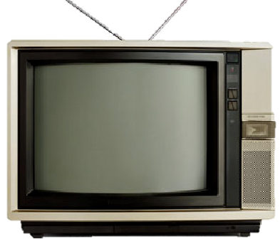
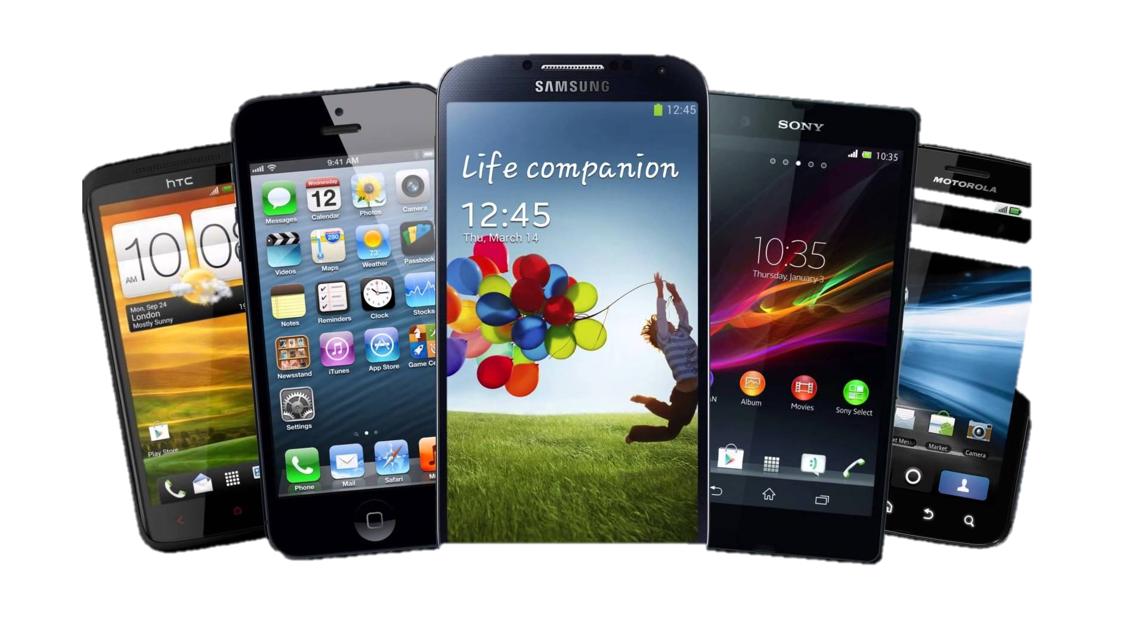
The communications revolution
The first communications satellite, called Telstar, was launched from Cape Canaveral on
July 10, 1962. This marked the start of rapid transmission of TV signals over wide areas.
What we take for granted today—satellite television, cellular telephones, wireless and highspeed
Internet connections, and so forth—were part of science fiction only 40 years ago.
Teenagers today are the first real citizens of the digital world. Unlike their parents, they
have grown up in a world in which electronic delivery of information and entertainment is
natural and more accepted than conventional forms like the newspaper, tape, or film.

Slide 10

Global Issues
Mark the global issues that you think affect us the most.
Write a fact for each issue you chose and an effect for
that fact.
____ global warming ____ pollution
____ poverty ____ diseases
____ security ____ unemployment
____ fresh water ____ traffic
____ economy ____ globalization
____ endangered species ____ natural disasters
____ terrorism ____ overpopulation

Slide 11

Quick Check:
A. Vocabulary. Find each vocabulary word in the texts on page 6.
Read the words that come before and after that vocabulary word and then decide which meaning is best for it.
1. ___ to affect a. to set up, start
2. ___ to launch b. to send into space
3. ___ to take for granted c. to produce a change
4. ___ to establish d. to accept as part of life
5. ___ to host e. to provide a place for
B. Comprehension. Answer true or false.
1. ___ Sputnik was the name of a Russian space ship.
2. ___ King Abdulaziz set Saudi Arabia on the road to modernization.
3. ___ At present the UAE has 10 member states.
4. ___ The UAE dirham came into use in 1963.
5. ___ Digital forms of information are something of the past.
c
b
d
a
e
T
T
F
F
F

Slide 12

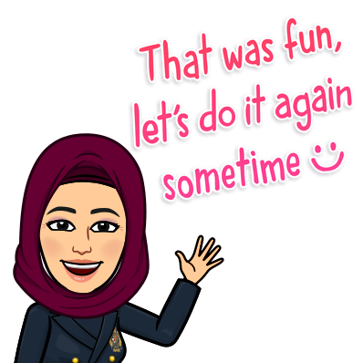
Hissah Alotaibi

