Slide 1
Super Goal 1

Slide 2
Unit 1

Slide 3

The objectives of the lesson :
At the end of this session, the students will be able to :
Read loud and fluently
Practice forming a conversation with a new friend

Slide 4


Slide 5
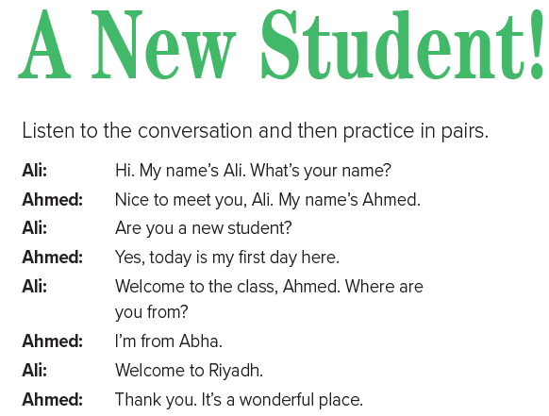


Slide 6
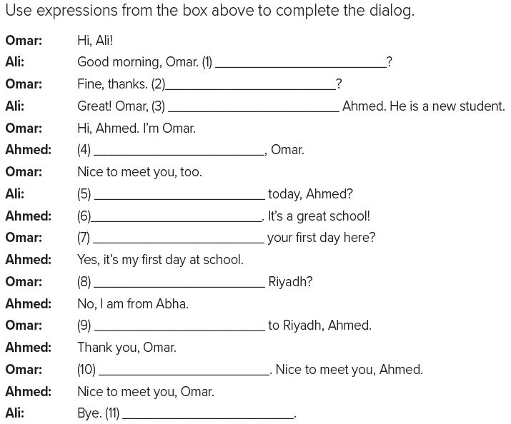
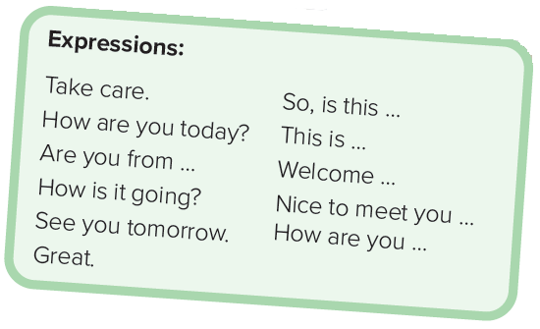
How are you today
How is it going
This is
Nice to meet you
How are you
Great
So , is this
Are you from
Welcome
See you tomorrow
Take care

Slide 7
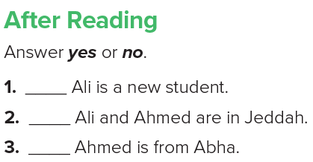
no
no
yes

