Slide 1


Slide 2
verb to be
am
is
are

Slide 3

I am Abdullah.
You are a student.
He is Saudi.
They are from France.
She is happy.
It is big.
He is tall.
We are at home.

Slide 4
Subject pronouns
+
be
am
are
is
Ali
is
is
is
are
are
Ali and Tom
are
are

Slide 6

He Tom .
He is Tom .

Slide 7

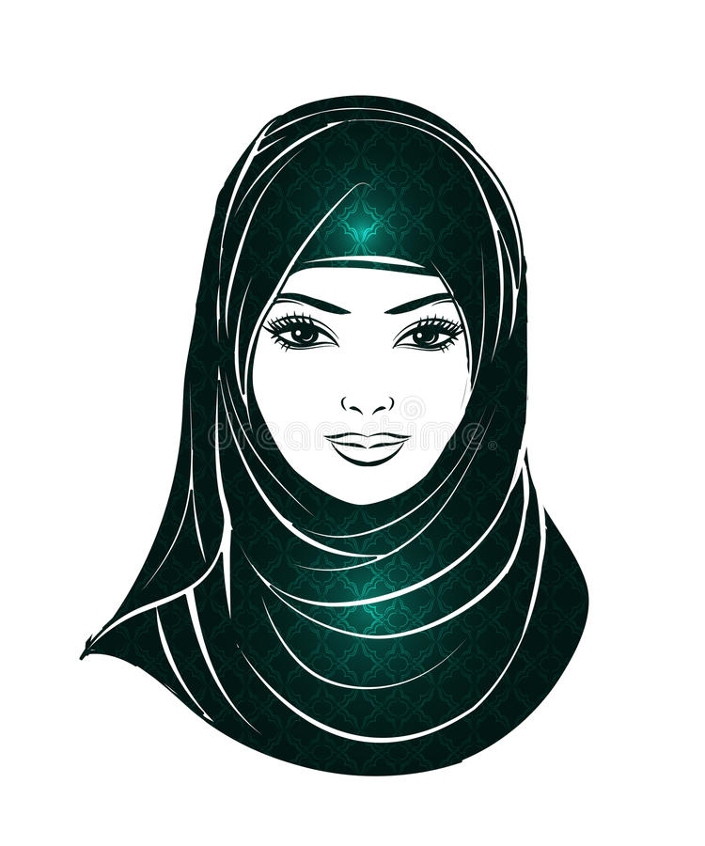
She Fatima.
She is Fatima.

Slide 8
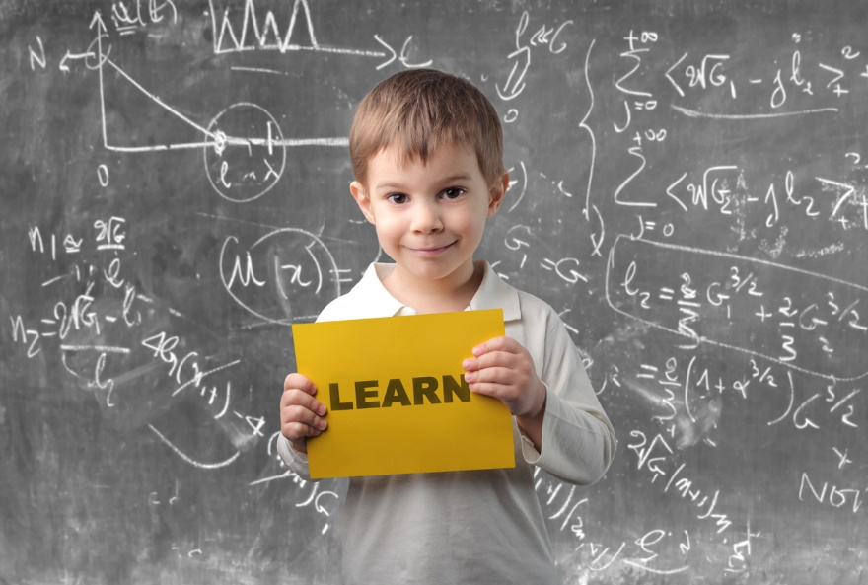
I am at school.
I at school.

Slide 9
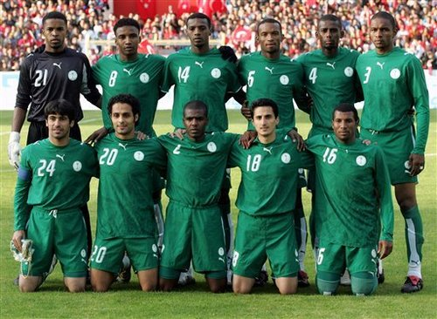
They football players.
They are football players.

Slide 10
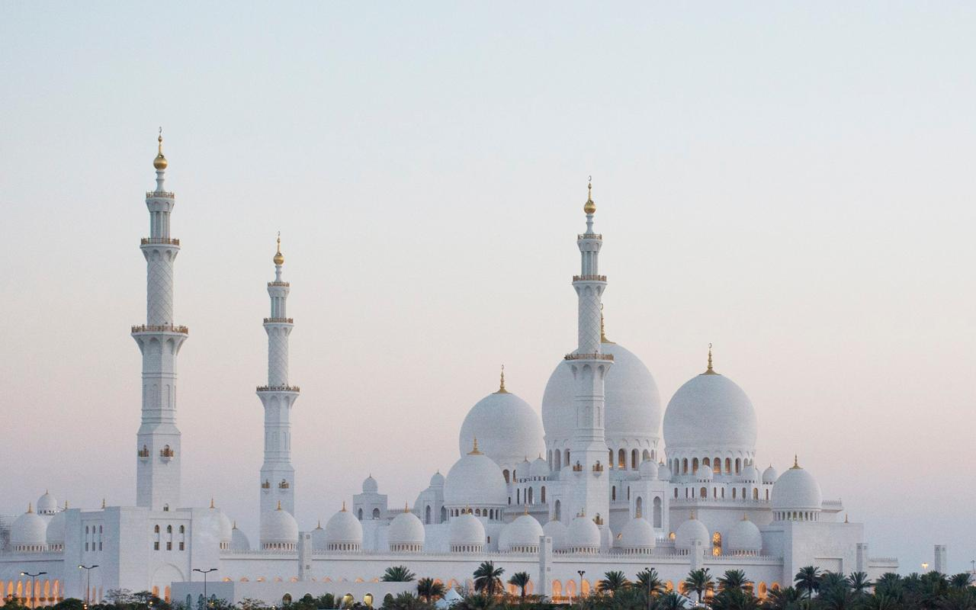
It a mosque.
It is a mosque.

Slide 11

I am from Saudi Arabia.
Ahmed is a chef.
Sara is in the kitchen.
Ameer and Hasan are classmates.

Slide 12
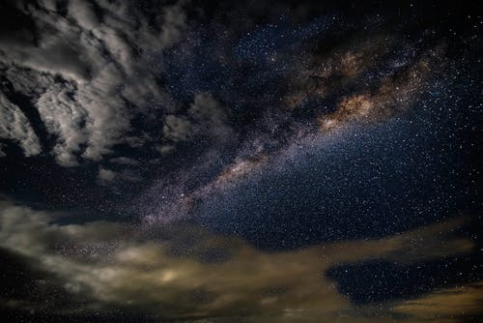
Possessive Adjectives
my, your, his, her
My book
Your iPad
Her dress
His laptop

Slide 13

a. I am a doctor.
my
name is Peter.
b. Ali has got a bike.
his
bike is red.
c. This is my mother.
her
name is Sara.
d. You are Mohammed.
What is
your
Job ?

