Slide 1
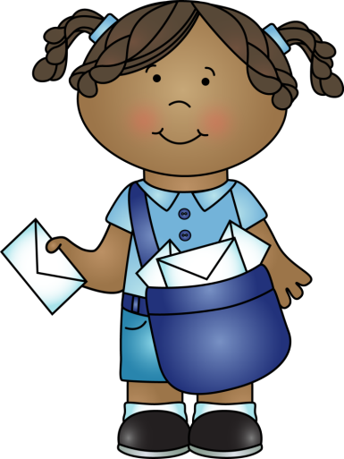
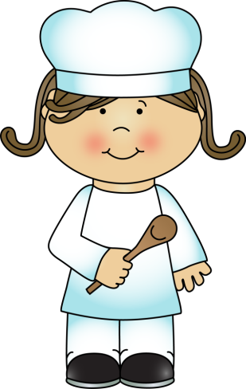


Guess My Job
Meshnology

Slide 2

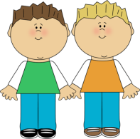

I do so many things that it’s amazing. I can help you in many ways. Above all, I protect you. I can direct traffic. I can find the bad guys and arrest them. I drive a black and white car. I am a ________________.
police officer

Slide 3
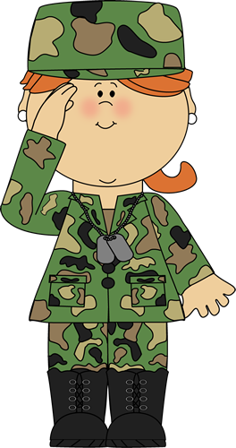
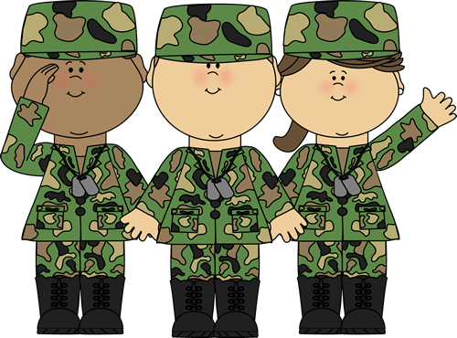
We are in the army. We are wearing our camouflage uniforms so that the enemy cannot see us. Our job is to protect our country. Sometimes we travel in helicopters. We always obey orders.
We are _________.
soldiers
Meshnology

Slide 4
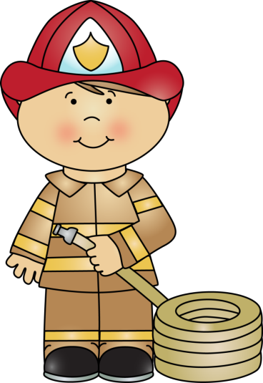
My job is very important. I protect and save your home. I wear a special uniform. I ride in a big yellow truck. I spend a lot of time practicing to do my job well, and I am always ready to help you. I am a ____________.
fireman
Meshnology

Slide 5

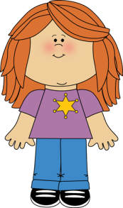
I take care of everyone from babies to old people. I give you advice about what to eat. I also give you shots and pills. Sometimes I take your temperature. I am just like a vet except that I take care of people. I am a ___________.
doctor
Meshnology

Slide 6


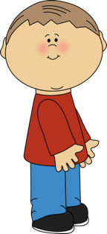
Scared. This is how most people feel when they visit me. I help keep your teeth healthy. I clean them and I fill your cavities. I am a _____________.
dentist
I just visited my dentist. He gave me a new toothbrush. And I lost another tooth today- !
Meshnology

Slide 7
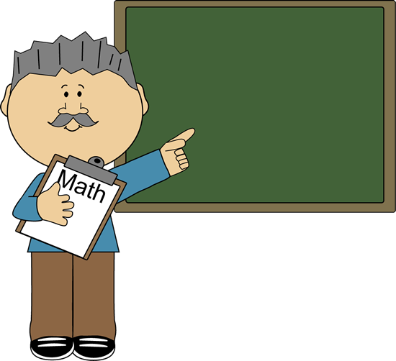


I can be a man or a woman. I work with children and adults. I work in a special building. I teach the whole world to read and write and also teach them lots of interesting things. I am a _____________.
teacher
Good Morning!
Today is September 10th
^{Welcome.}
Good morning class. Today is Monday, September 10th.
Meshnology

Slide 8
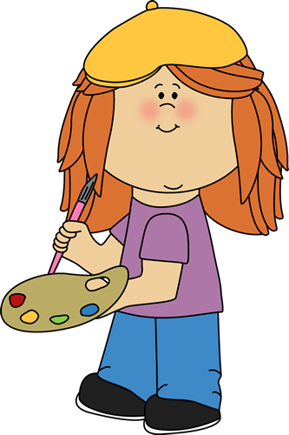
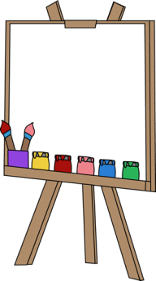


I love to paint pictures. I am crazy about working with paints and brushes. Today I am painting a picture of my cat Whiskers. I hope to become a famous __________ one day.
artist
Meshnology

Slide 9



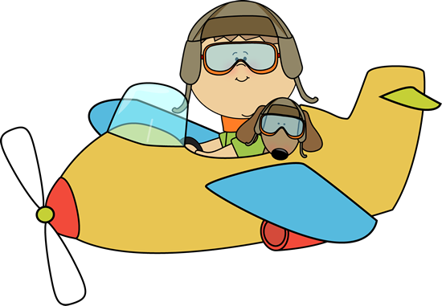

I fly in the sky like a bird. I travel all around the world. I am a ________.
pilot
Meshnology

Slide 10

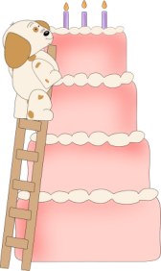





I like to make sweet things. I bake these things in an oven. I make special ones for a special occasions .
I am a ________.
baker

Slide 11
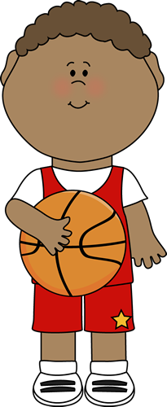

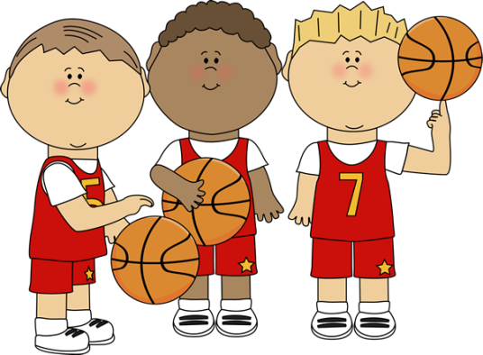
I am very tall. I play a sport that has a big orange ball and a net. I run a lot. I am a __________.
basketball player
Meshnology

Slide 12
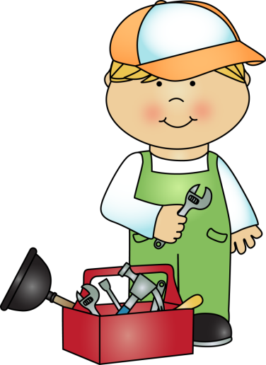

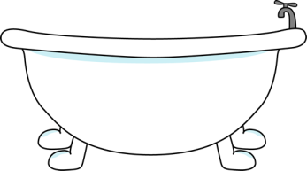


What would you do without me? I solve all your kitchen and bathroom problems. I have a big tool kit. Water is my friend and sometimes your enemy. I am a ___________.
plumber
Meshnology

Slide 13
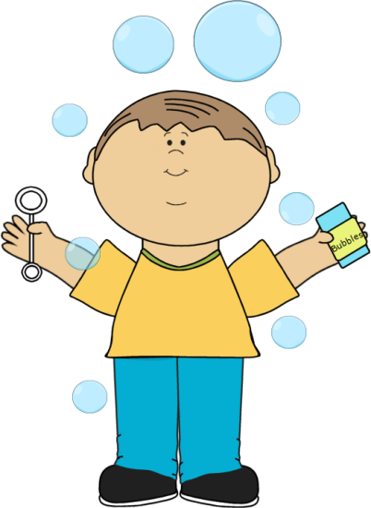
The End
Meshnology

