Slide 1
Unit 3 Who’s who
Workbook

Slide 2
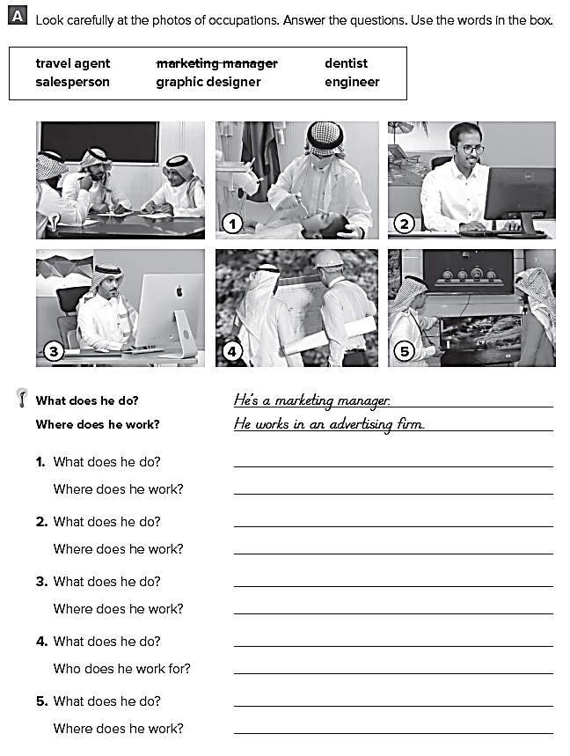
Page 97
He is a dentist
He works at a dental clinic
He is a travel agent
He works at a travel agency
He is a graphic designer
He works for an advertisement firm
He is an engineer
He works for a construction company
He is a salesperson
He works in a store

Slide 3
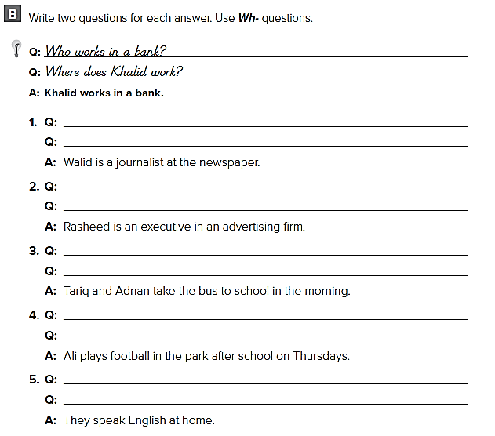
Page 97
What does Walid do ?
Where does Walid work ?
What does Rasheed do ?
Where does Rasheed work ?
Where do Tariq and Adnan take the bus to ?
Who takes the bus to school ?
Who plays football in the park ?
When does Ali play football ?
Where do they speak English ?
What do they speak at home ?

Slide 4
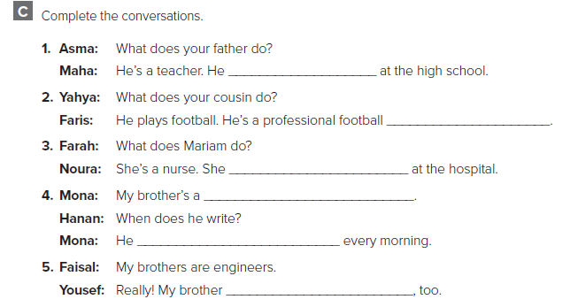
Page 97
teaches
player
works
writer
writes
is an engineer

Slide 5
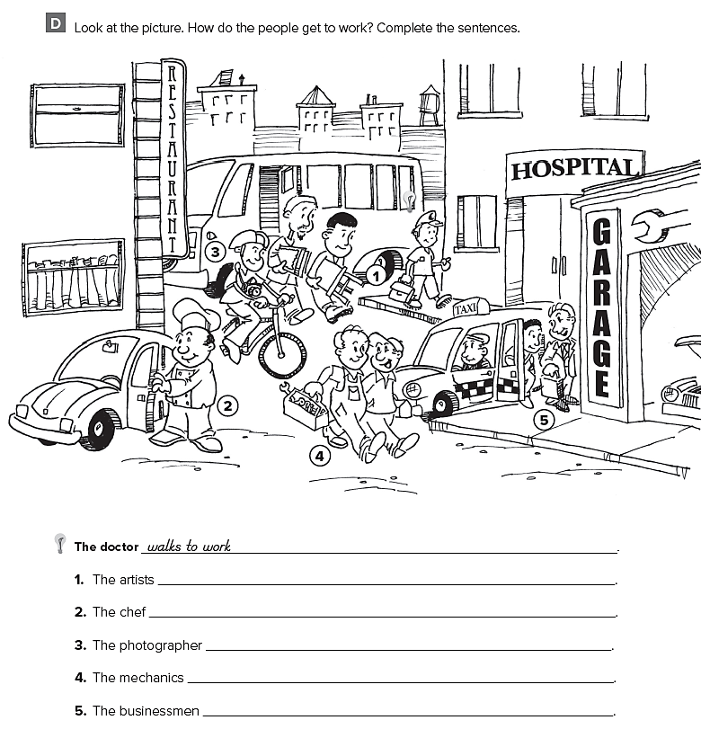
Page 99
take the bus to work
drives his car to work
rides his bike to work
walk to work
takes a taxi to work

Slide 6
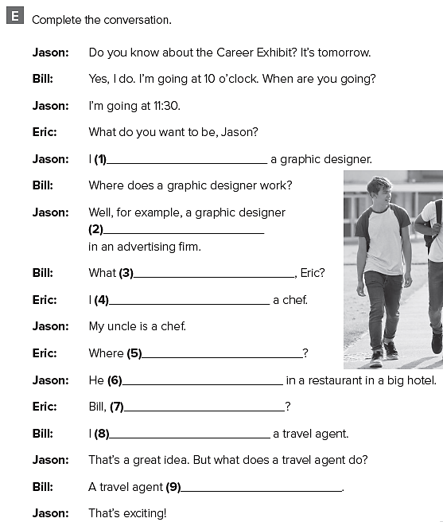
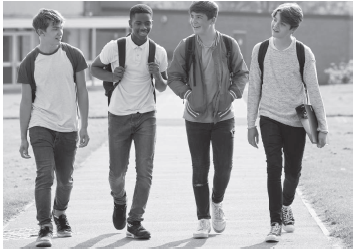
Page 100
I want to be
works
do you want to be
want to be
does he work
works
what do you want to be ?
want to be
arranges trips for customers

Slide 7
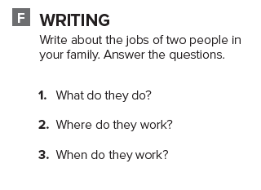
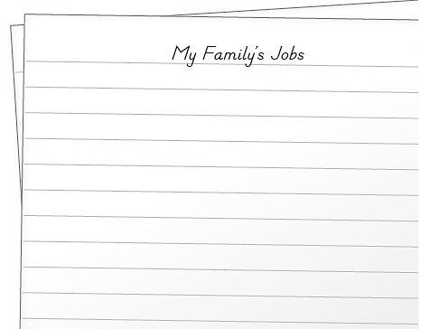
Page 100
My father and uncle have great jobs.
My father is a teacher. He works at a school. He teaches science .He works from Sunday to Thursday .
My uncle is a doctor. He works in the hospital. He helps sick people. He works all the time.

