Slide 1
U 3 writing
P 24
Nora Khalid

Slide 2
Writing about Ss dream job using the conjunctions
“but – and – because”

Slide 3
What’s the title of the unit?
Who’s who?
What is the unit talking about ?
It’s talking about jobs

Slide 4
What do you want to be in the future?
I want to be …………………………………………………

Slide 6
Teacher
interesting
Salary
Summer vacations
Long work hours
Relations with students
Careless students

Slide 7
enjoy, like, love, easy, help, challenging, responsible, creative, exciting, interesting, satisfying, rewarding, difficult, boring, stressful, early, late, problem, money, happy.

Slide 8
And
But
Because
Conjunctions
To connect nouns, verbs and adjectives

Slide 9
I like teaching reading.
and

Slide 10
I like teaching I don’t like writing.
but

Slide 11
I like teaching I like kids.
because

Slide 12
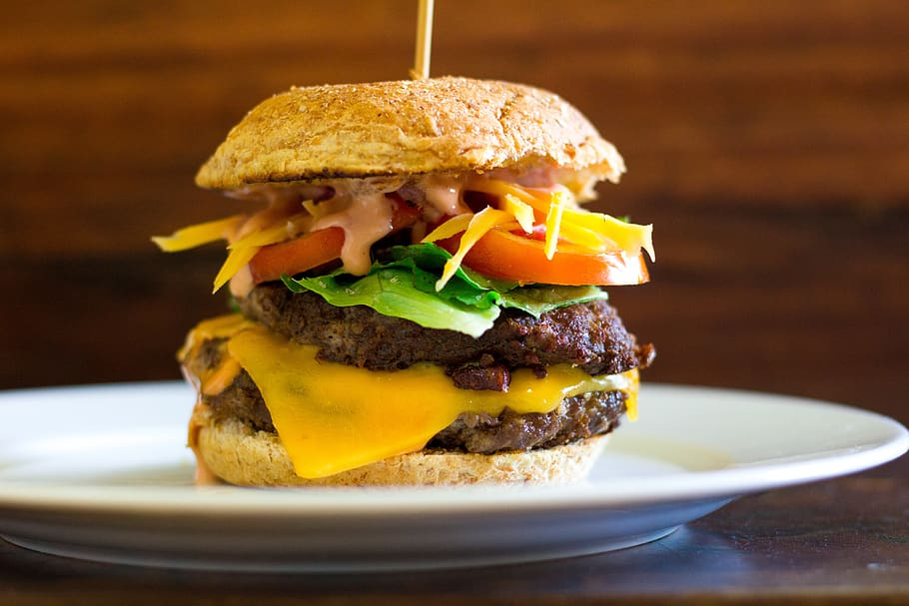
Like / don’t like but / and

Slide 13
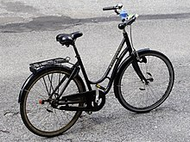
Like / don’t like but / and

Slide 14
Like / don’t like because

Slide 15
Like / don’t like because

Slide 16
Back at the Reading on page 23
and find examples of each.

Slide 19
Write about your dream job. Write about the good things and the bad things. Use your notes from the chart and words and phrases from this unit.
Say why your job does something good for your country. Use the connectors: and, but, because

