Slide 1

U 3 – Form, meaning and function
Nora Khalid

Slide 2

To provide practice of relative pronouns: who, which, that

Slide 3


Slide 4

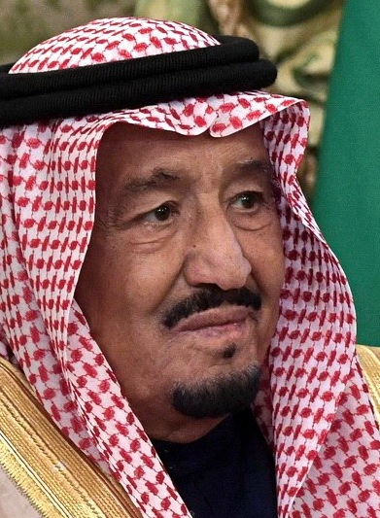
A man who is the king of Saudi Arabia

Slide 5
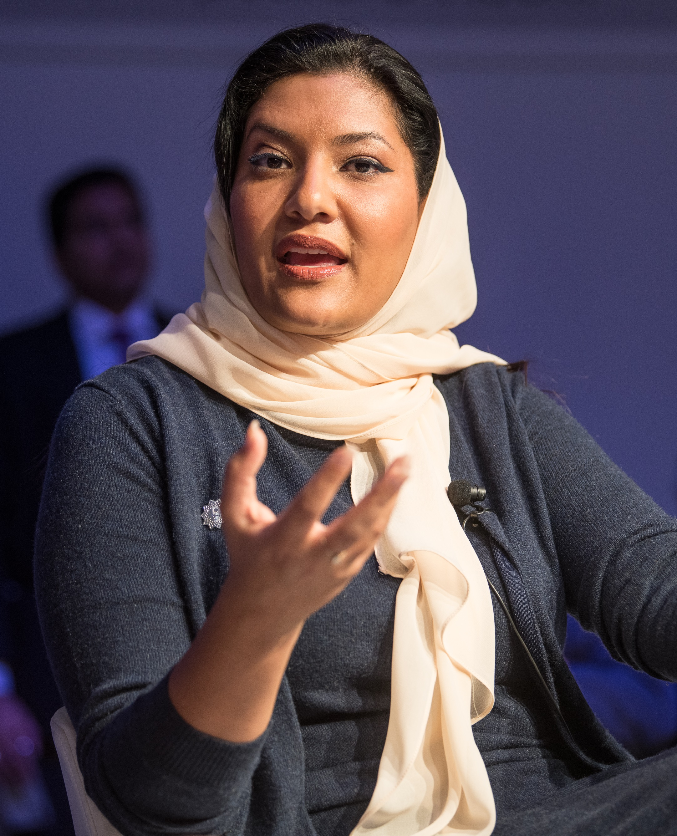
A woman who is the Saudi ambassador
to the United States

Slide 6
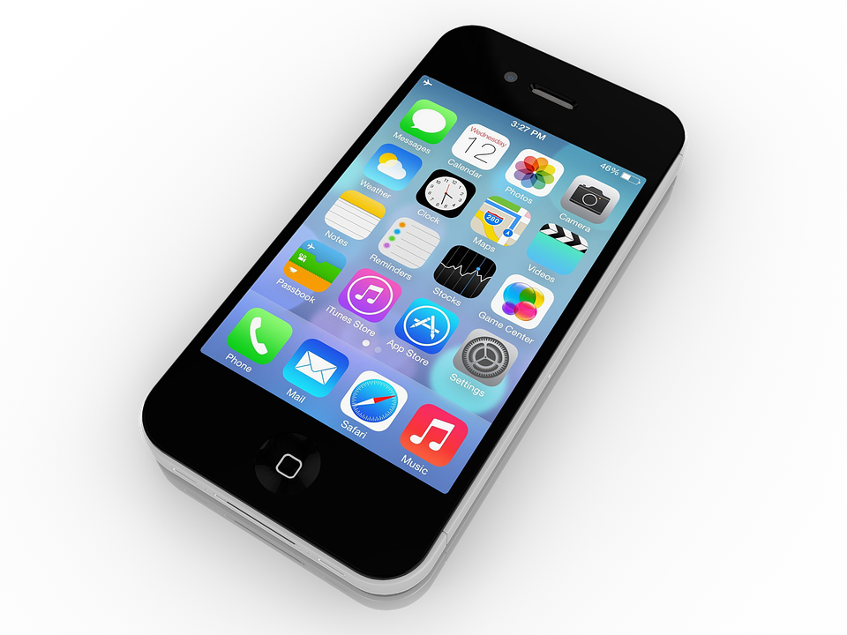
With which you can call and chat your friends. Also you can study and watch videos

Slide 7
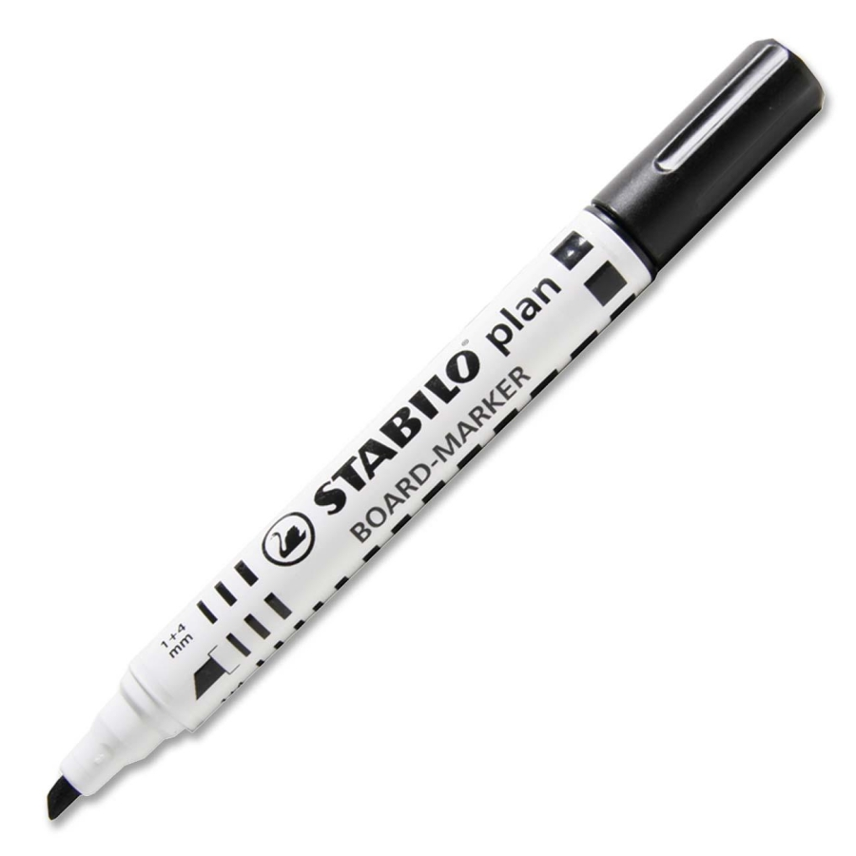
which your teacher use to write
on the board

Slide 8
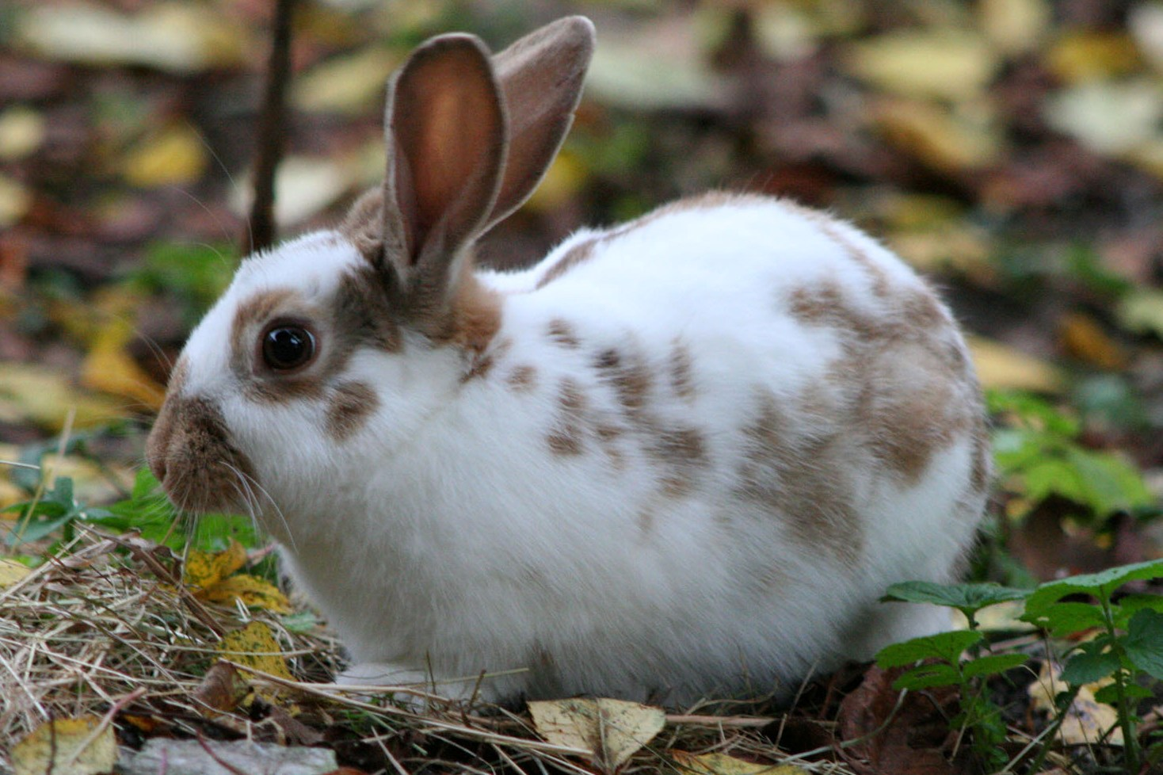
which is fast and has fur

Slide 9

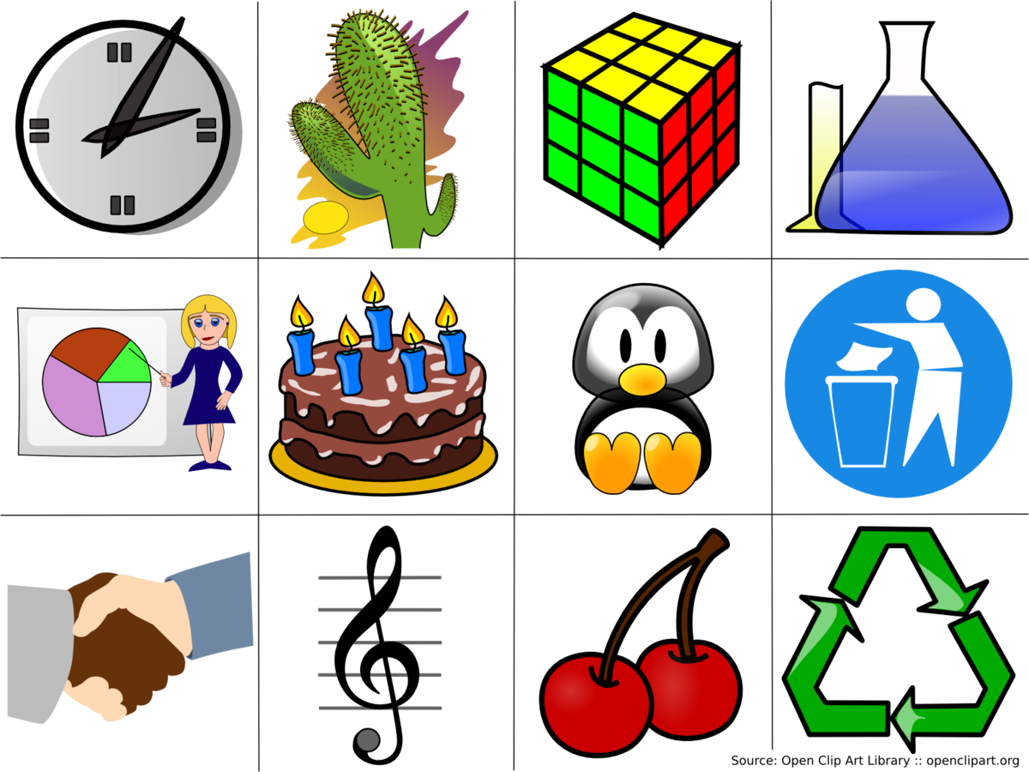

Who
Which
That

Slide 10

I work in a school. The school is big.
Which
I work in a school which is big.

Slide 11
I like my teacher. My teacher teaches Math.
Who
I like my teacher who teaches Math.

Slide 12
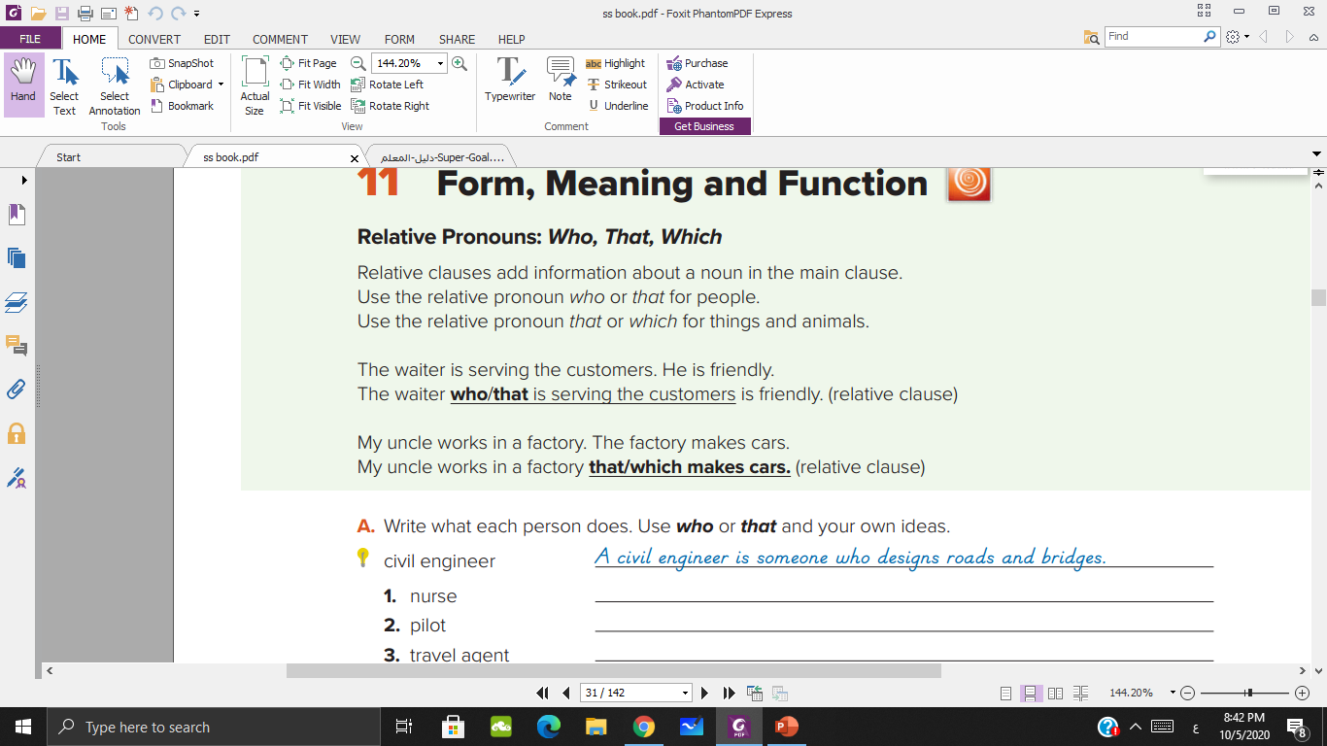

Slide 13
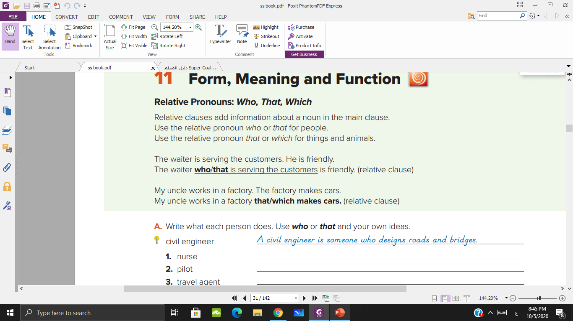

Slide 14
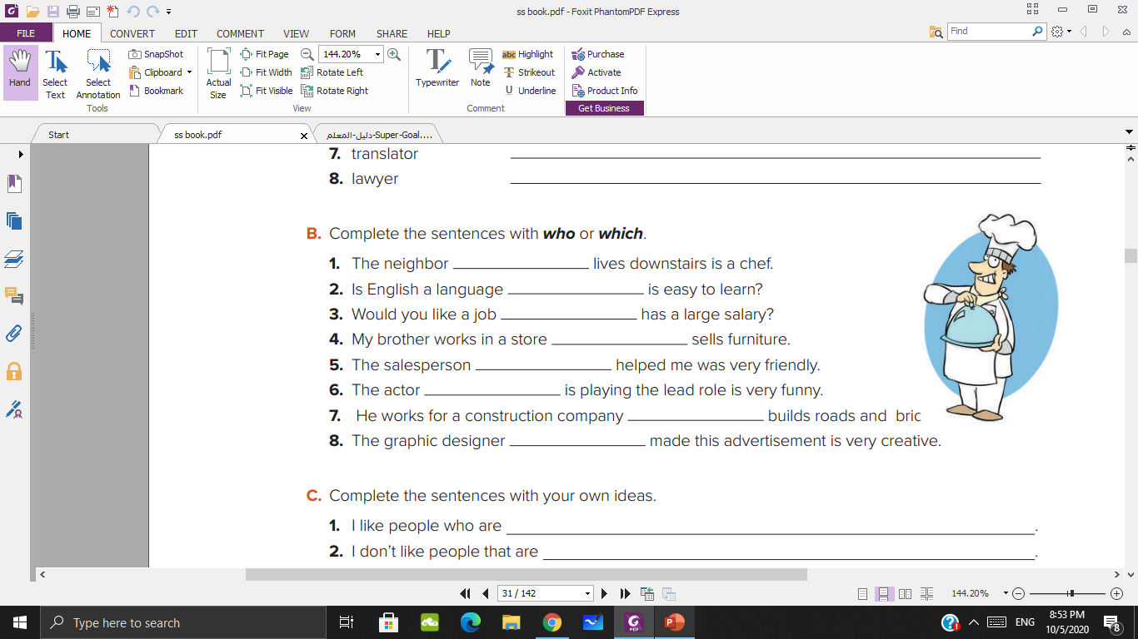
who
which
which
which
who
who
which
who

Slide 15
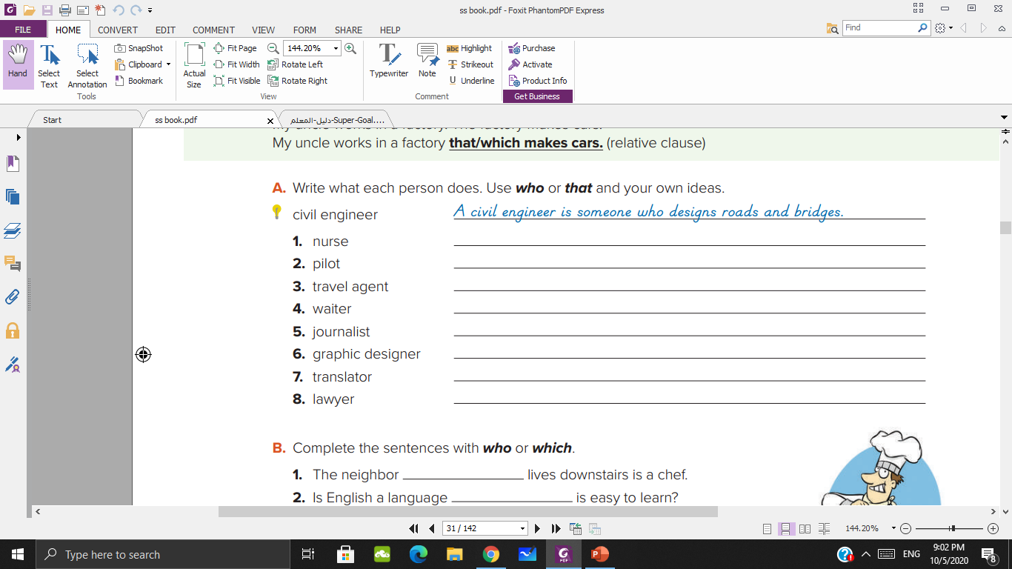


Slide 16


is someone who/that
takes care of sick people

Slide 17

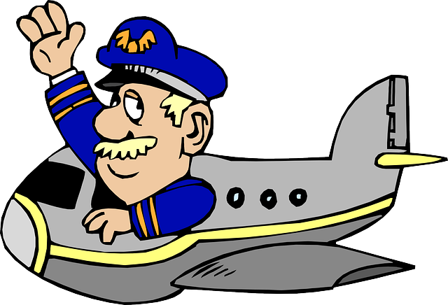
is someone who/that
flies airplanes

Slide 18


is someone who/that
organizes tours.

Slide 19


is someone who/that
serves food in a restaurant

Slide 20
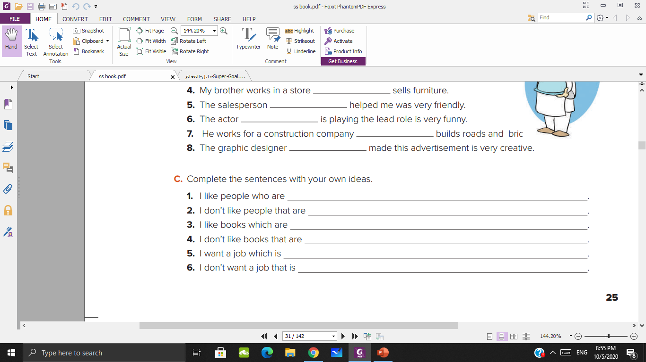
polite and friendly
impolite
exciting
boring
satisfying
stressful

Slide 21
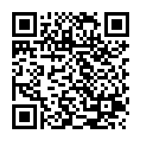
https://en.islcollective.com/video-lessons/relative-pronouns-video-lesson

