Slide 1


GOOD MORNING

Slide 2

Unit -1-
Big Changes
11-
FORM,MEANING & FUNCTION

Slide 3


Slide 5
The Objectives
Write short answers for Yes/No questions.
Use "When" with past progressive tense
Use past simple tense and past progressive
Form sentencesin the past simple &progressive
Transform an affirmative sentence to negative
Draw mind map for the lesson

Slide 6

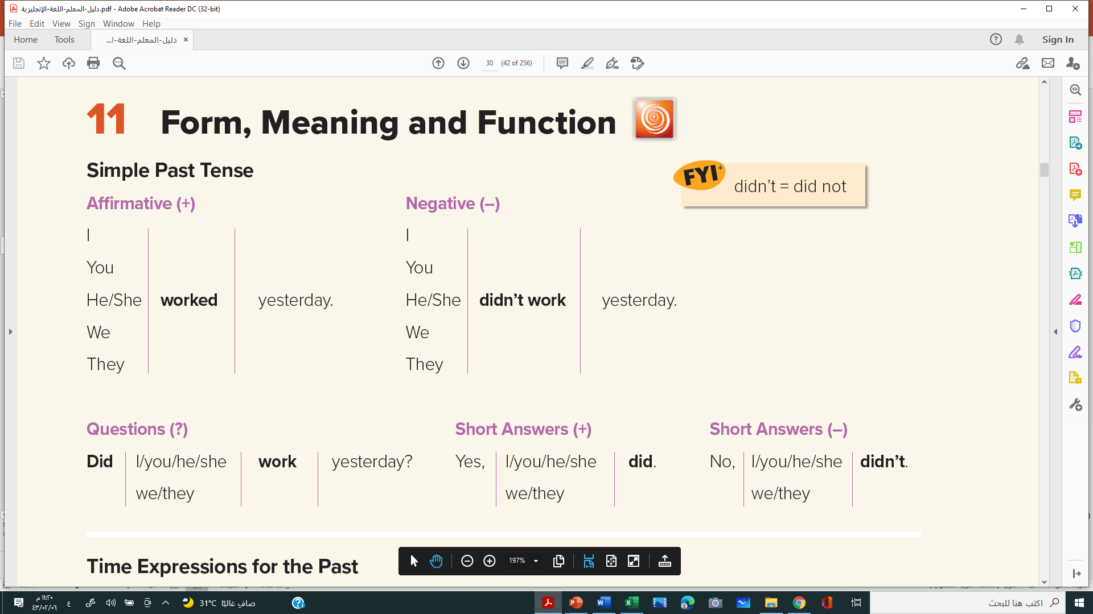
Simple Past Tense

Slide 7

Time Expressions for the Past
I went to Pakistan last month.
We visited the Roman baths.
When did you visit Pakistan?
Where did you go yesterday?
I watched a TV documentary about global warming.
Q: What did you do last night?

Slide 8
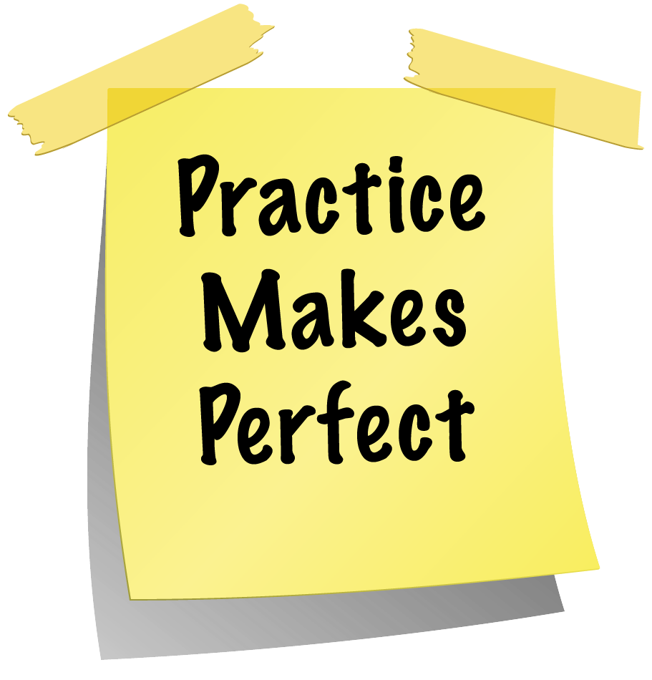
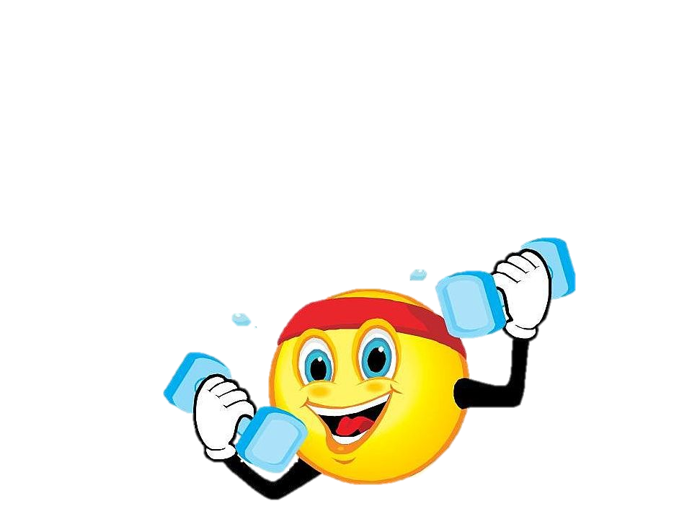

Slide 9


A. What can you remember about Hans and Samir on page 11? Use the list below to make true sentences. Use the simple past, present perfect simple, and simple present tense.
1. Hans isn’t from Leipzig.
2. Saud is from Dubai.
3. Hans didn’t move to West Germany.
4. Saud has been in Berlin for almost 3 years.
5. Hans was born in Berlin.
6. Hans is from Germany.
7. Saud is a biologist.
8. Saud has a good job.
9. Saud has lots of friends.
10. Saud is happy.

Slide 10

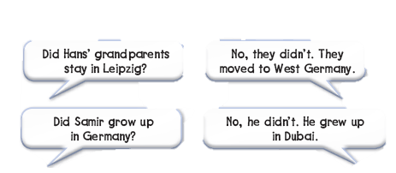
B. Compare your answers in exercise A with your partner. Ask and answer questions. Use the past simple tense.

Slide 11

Complete with correct answers:
Saudi Arabia ……………in 23rd of September
A
established
B
establishing
C
establish
D
establishes
>
tekhnologic

Slide 12
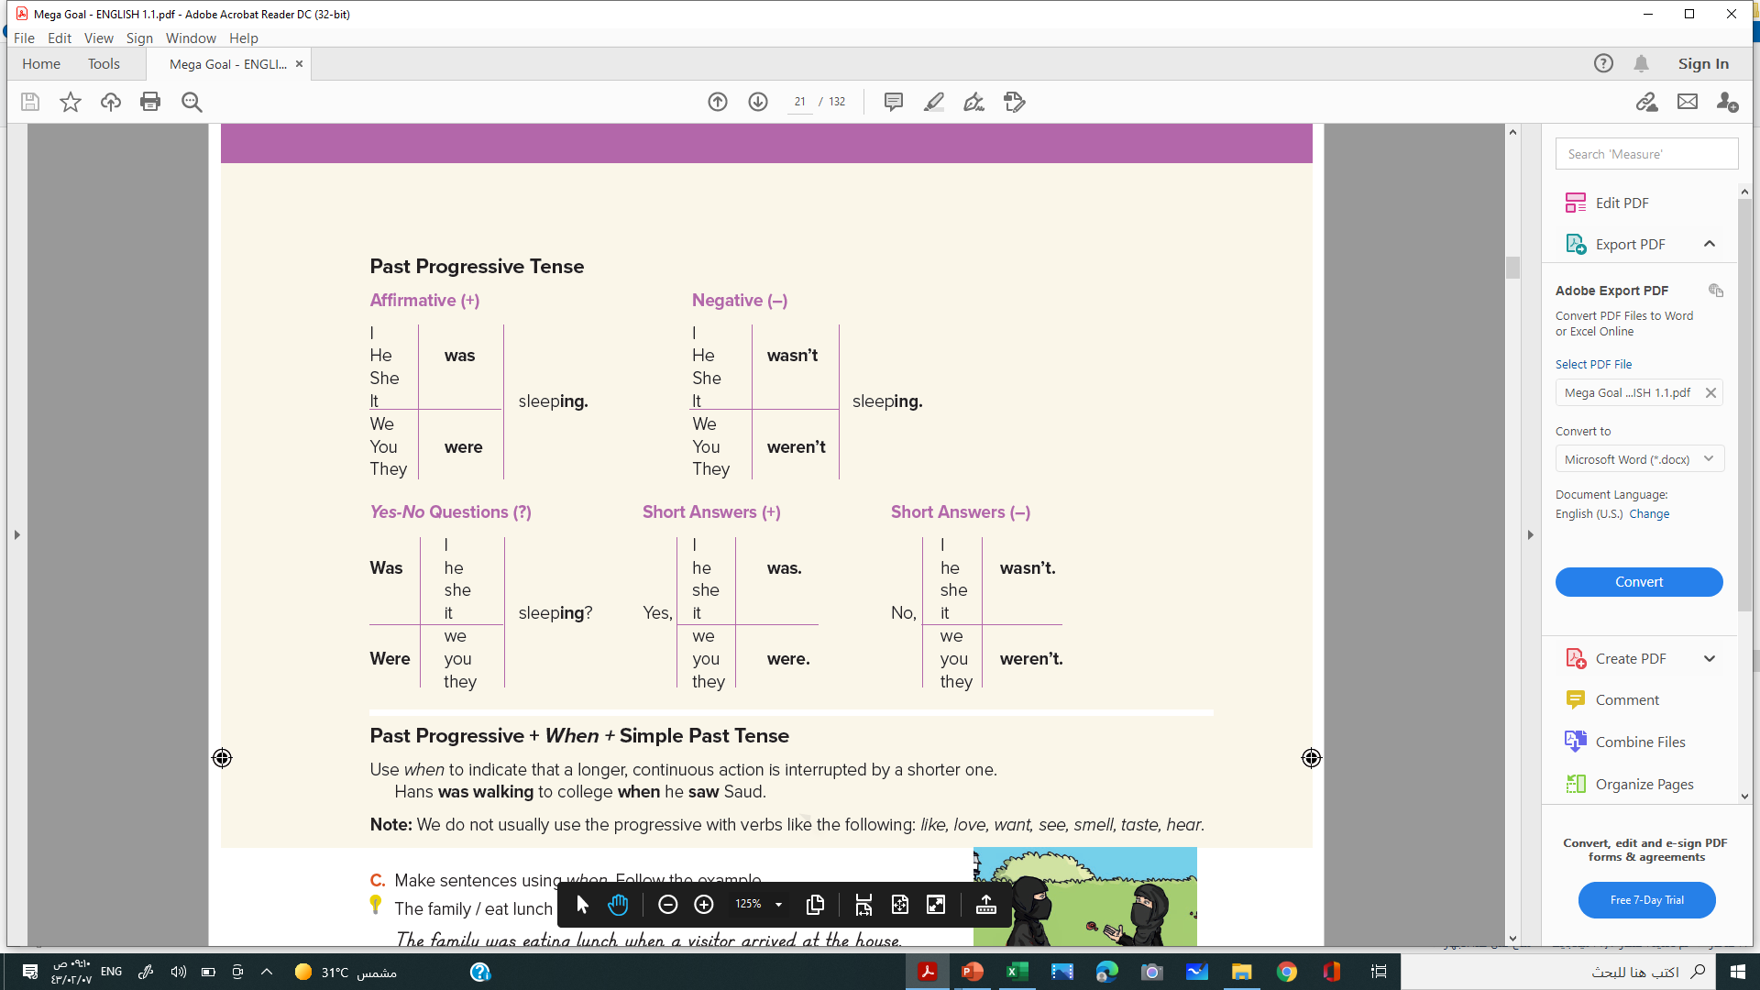
Past Progressive Tense

Slide 14
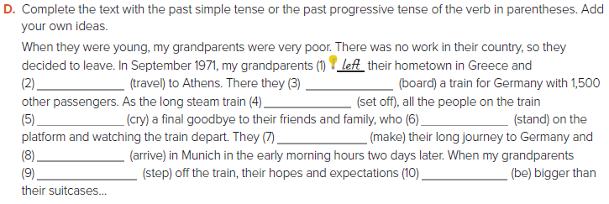
traveled
boarded
was setting off
cried
were standing
made
arrived
stepped
were

Slide 15

Past Progressive + When + Simple Past Tense

Slide 16
C
Make sentences using when. Follow the example.
The family / eat lunch / a visitor / arrive / at the house.
The family was eating lunch when a visitor arrived at the house.
1. The people / sleep // the earthquake / happen
1. The people were sleeping when the earthquake happened.
2. Fatima / going home // see / her friend, Nawal
2. Fatima was going home when she saw her friend, Nawal
3. Majid / look at / trees // he / see / parrot
3. Majid was looking at the trees when he saw a parrot
4. The students / wait for / bus // rain / start
4. The students were waiting for a bus when it started to rain.

Slide 17


Slide 18

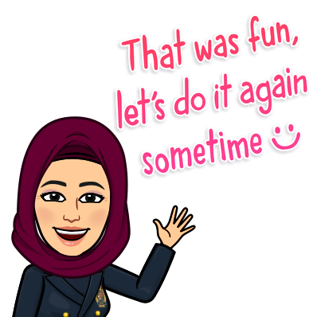
Hissah Alotaibi

