Slide 1
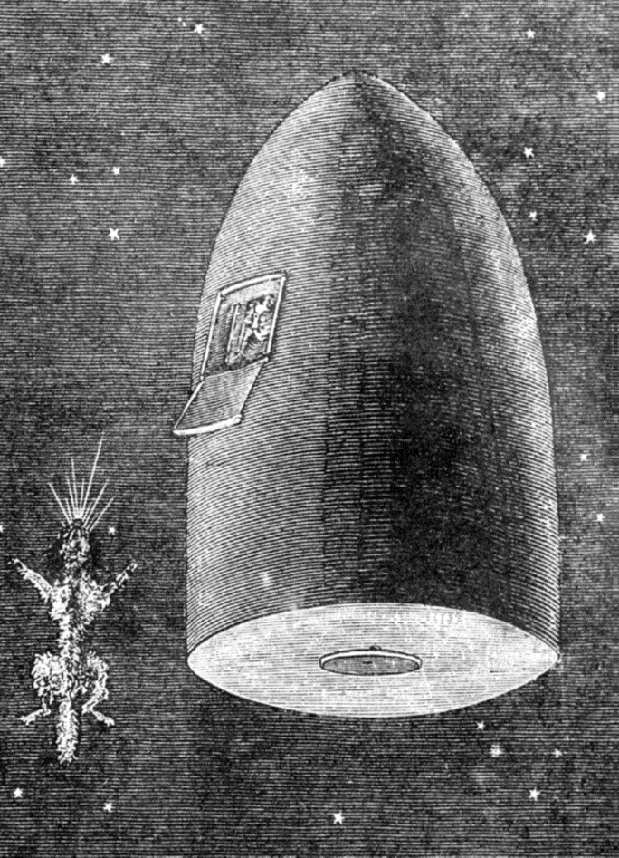


Slide 2

Good Morning

Slide 3
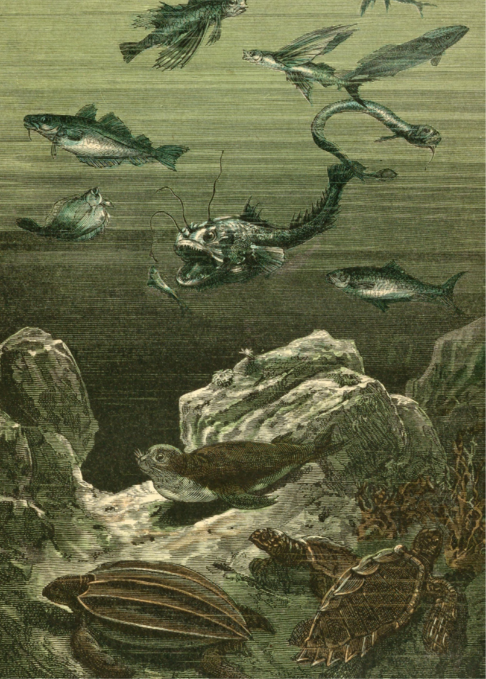
Unit-3
What Will Be , Will Be
L2 Grammar

Slide 4



Write their predictions using the future tense.
Use of future tense with will /going to
Change a future sentence into a negative and affirmative form
Construct a question and answer in future tenses
Form correct future progressive questions
Write short answers for yes/no questions
Ask yes/no questions with" will or be going to
Express a plan with be going to
Write sentences in the future progressive
Ask questions in the future progressive tense

Slide 5

Warm Up
Answer the Question:
“What will life be like at the end of the 20th century—one hundred years from now?”

Slide 6



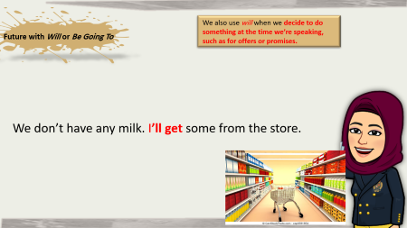
Future with Will or Be Going To
Use will or be going to to make predictions about the future.
Subject
Verb (infinitive
will
Subject
Be
Going to
Verb (infinitive
Future
Now
Affirmative (+) Negative (–)
Computers will perform many functions. Computers won’t have feelings.
. People are going to have more free time. Machines aren’t going to control us
Questions (?) Answers (Opinions)
Will people eat artificial food? I guess so. I hope not.
Are we going to travel to other planets? I think so. I don’t think so.

Slide 7


We also use will when we decide to do something at the time we’re speaking, such as for offers or promises.
Future with Will or Be Going To
We don’t have any milk. I’ll get some from the store.

Slide 8
Use be going to to express a plan that is already made or decided. Use will to express uncertainty, often with maybe or probably.
What are your vacation plans? I’m going to spend a month in Abha. Maybe I’ll go to Abha.

Slide 9



Slide 10
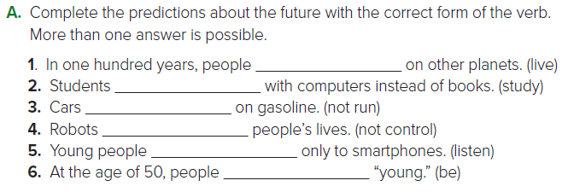

will live
will be studying
won’t run
won’t control
are going to listen
will be

Slide 11

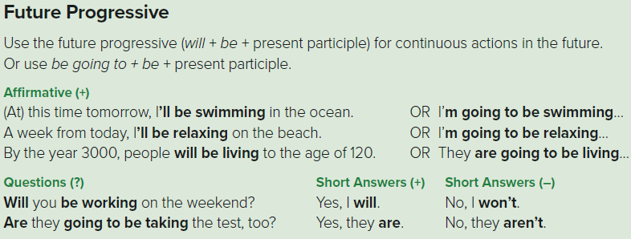
Use the future progressive (will + be + present participle) for continuous actions in the future. Or use be going to + be + present participle
Future Progressive
Subject
Will +be
Verb +ing
Subject
Be
Verb +ing
Going to be
Future Progressive

Slide 13
B-Work in groups. Answer this question:
Which of the following do you think people will still be using in 50 years?
ballpoint pens
personal computer
magazines
cell phone
flat screen TV
DVD player
microwave oven

Slide 14
C. Work with a partner. Ask and answer:
Which of the following do you think will be solved in the next 50 years? Add your own ideas.
A: Do you think there will be enough food for everyone in the world?
B: I believe there will be.
A: Do you believe there will be peace on Earth?
B: No, I don’t. Nations are too selfish.
Researchers will find a cure for cancer. Global warming will melt the ice at the poles. People will be preserving the environment. There won’t be any more pollution. There won’t be any more war. Many plant and animal species won’t exist anymore

Slide 15


