Slide 1


Slide 2


Slide 3
Unit-3- What Will Be ,Will Be
L4 Language in Context
L5 Listening
L6 Pronunciation

Slide 4
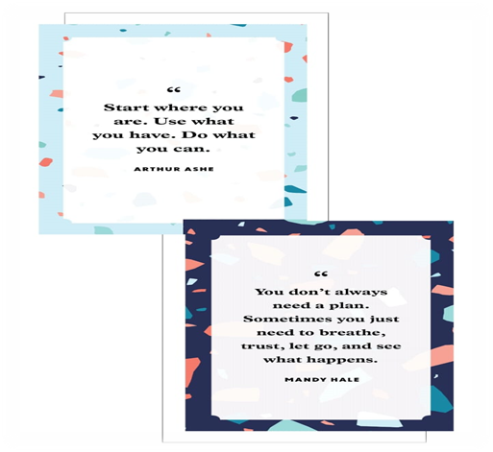
Ehsan Salah H.w

Slide 5



Warm Up
Lets Check What you know
I am going to ……….vacation in Riyadh to enjoy Riyadh season
spend
spent
spending
By the end of this week, I will be my grandmother
Visiting
Visited
Visit

Slide 6

Objectives
Identify future sentences in a video
Identify unstressed words in a sound clip
Formulate correct life decisions
Find out non stressed words in a sentence
Analyze a text to its elements
Match questions with answers
Asses their classmates sentences in order to give them present

Slide 7

L4 Language in Context

Slide 8
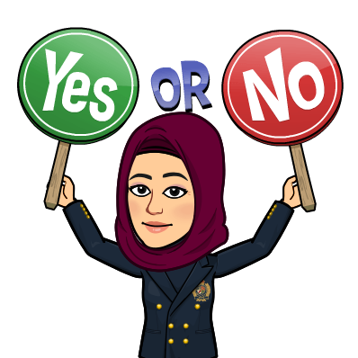
I will work hard to finish English contract
I won’t go to bed late
I will eat healthier food
How are these sentences the same

Slide 9



Write down three things you want to change and improve in your life. Compare your ideas with a partner
I won’t use my cell phone so much.
I’ll start exercising.
I’ll study more.

Slide 10
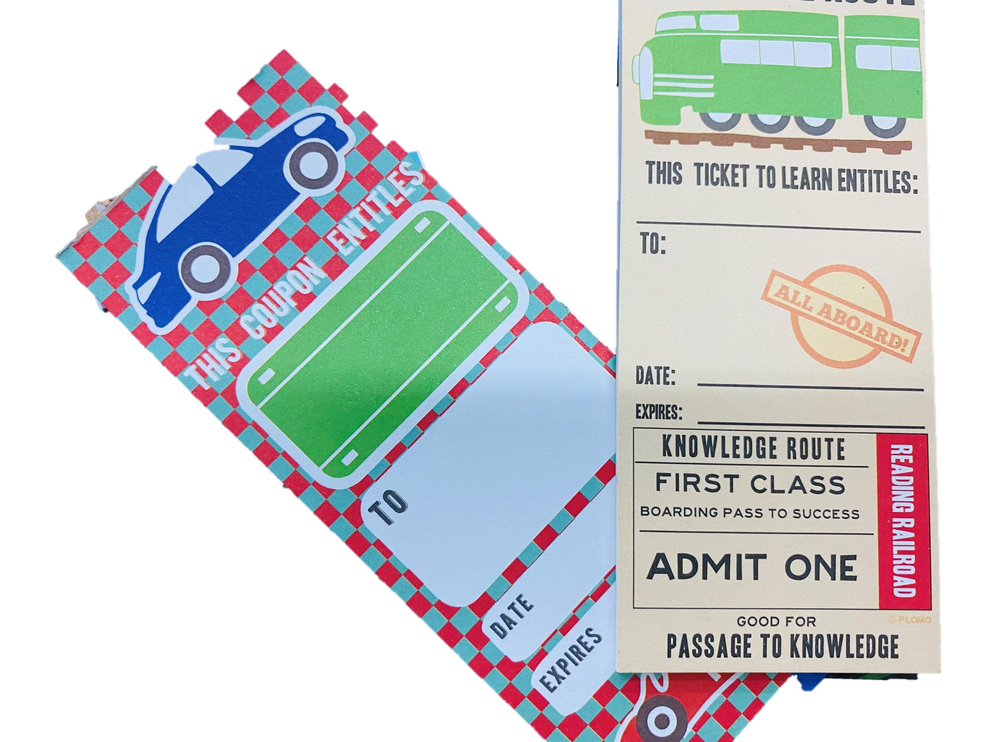

Asses your classmates sentences

Slide 11
L5 Listening

Slide 12

Who usually goes to the graduation?
What do you think the principal will talk about?
Who has been to a high school graduation?

Slide 13


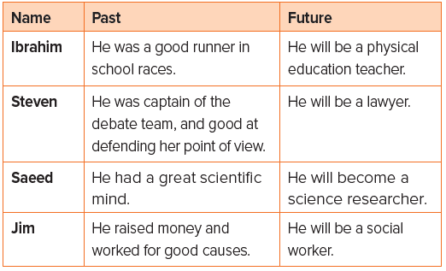
Listen to the principal’s speech at graduation, and complete the chart about the students’ past and future

Slide 14
L6 Pronunciation

Slide 15
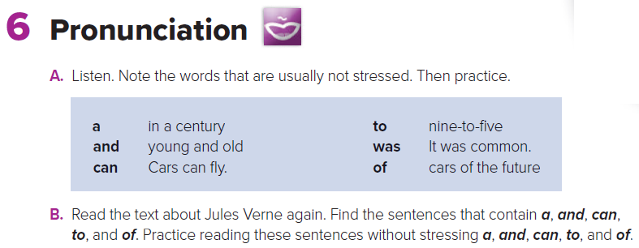

Slide 16

Name 3 things that you have learned today
Do you need to learn more and search about any points?
Did you enjoy the lesson today?

Slide 17


