Slide 1
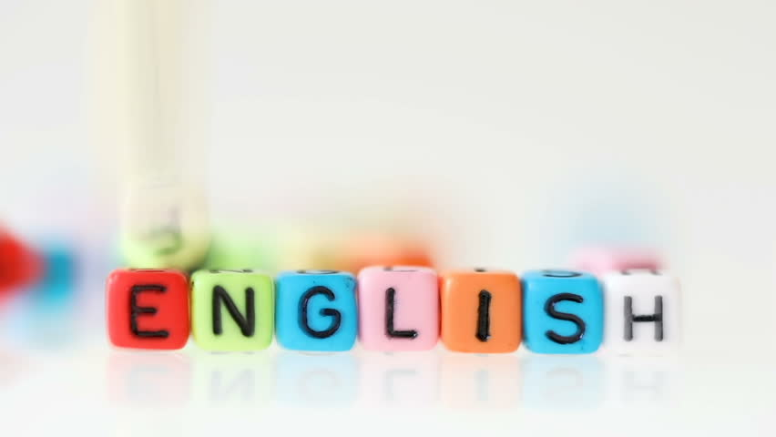
Super goal 5
Unit 2
Lesson 1 listening & discuss + pair work
اعداد المعلم / يحيى المنقري متوسطة المأمون بالهفوف

Slide 2

Learning Objectives
*By the end of this lesson, Ss will be able to:
1- Ask about the people in the news.
2- Relate past events in learners' life
3- Talk about past actions

Slide 3
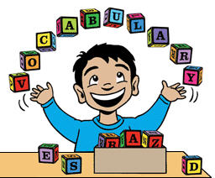

Slide 4
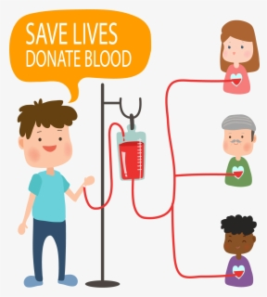

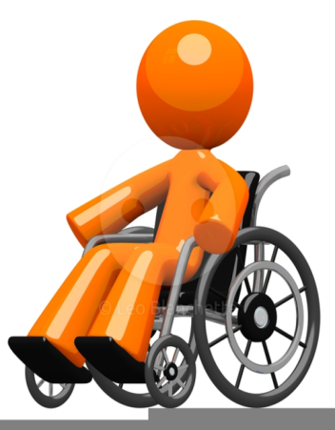


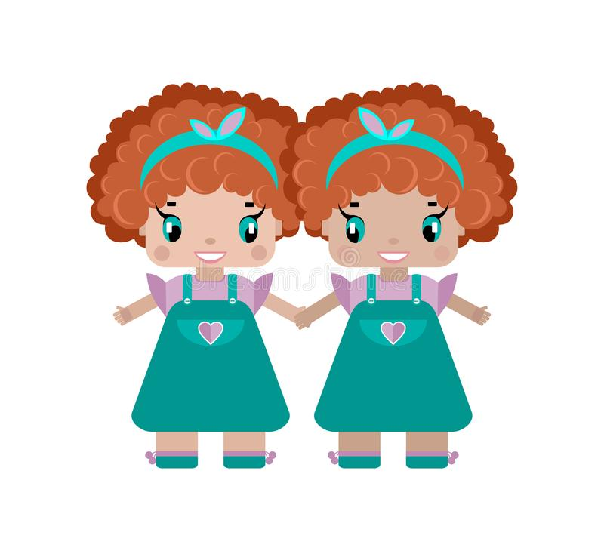
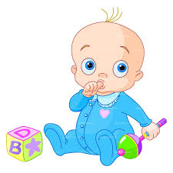
Donating blood
Crippling
Flag
Infant
Twins

Slide 5
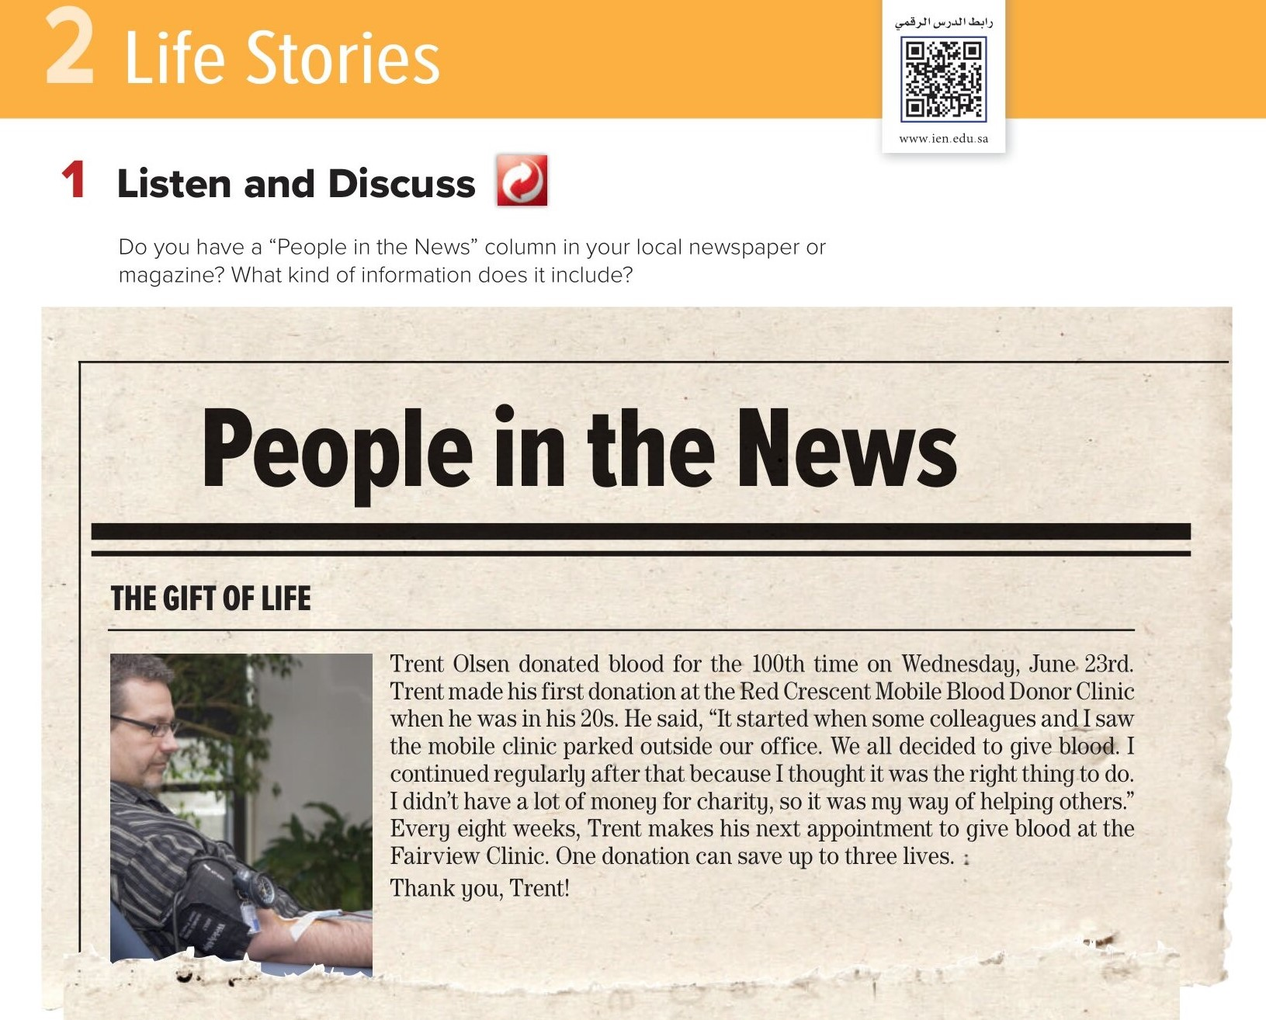

Slide 6
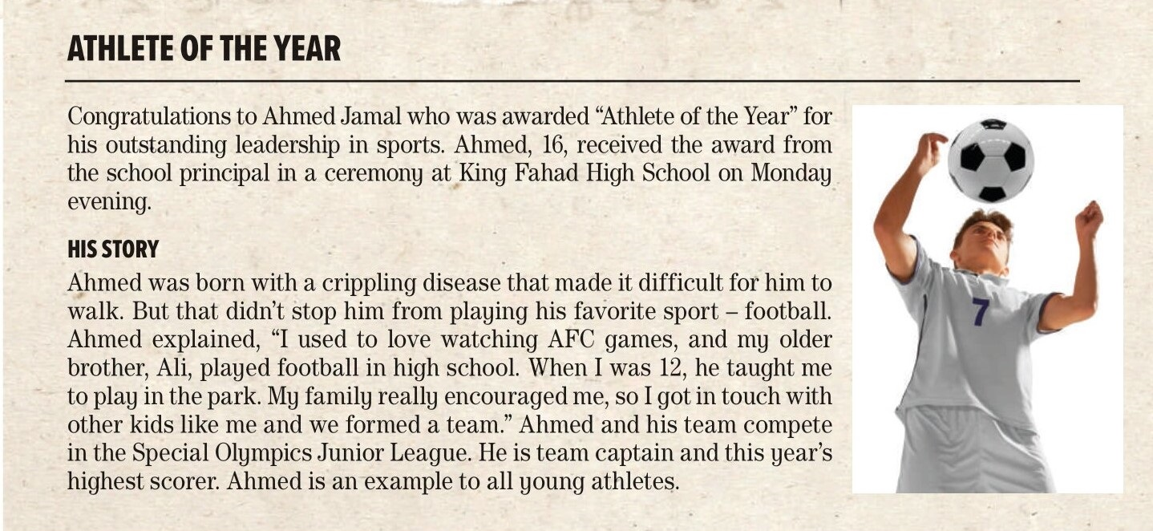

Slide 7
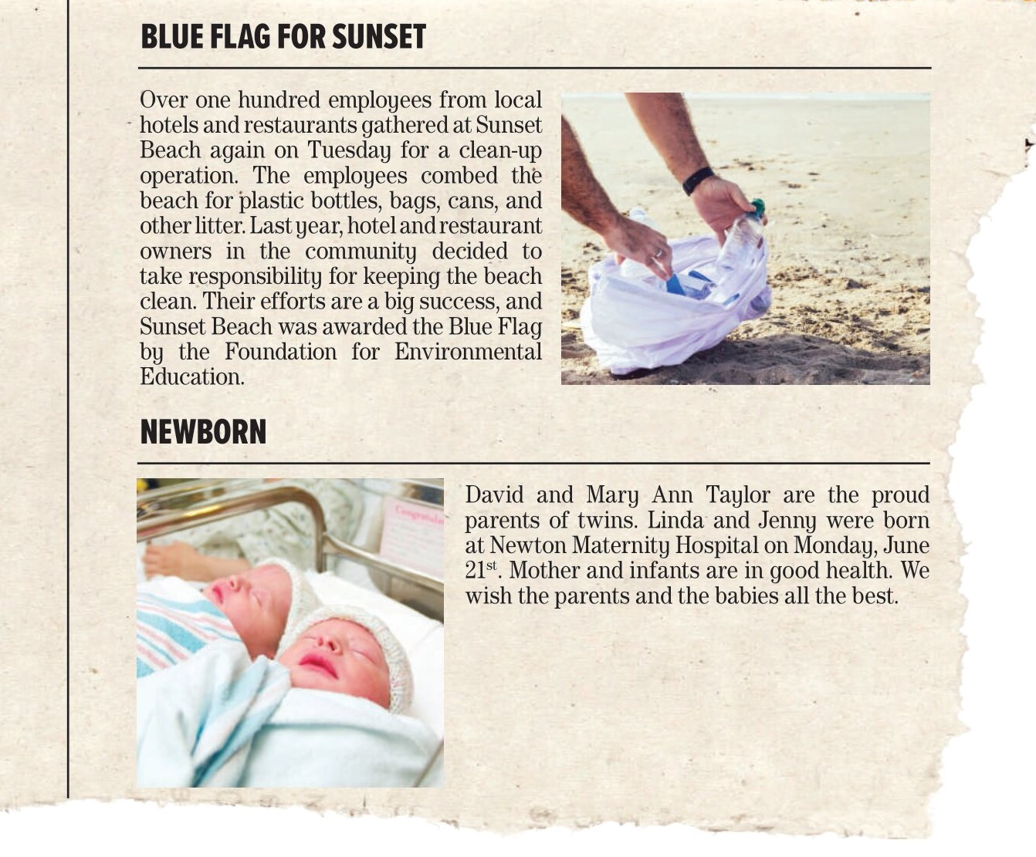

Slide 8
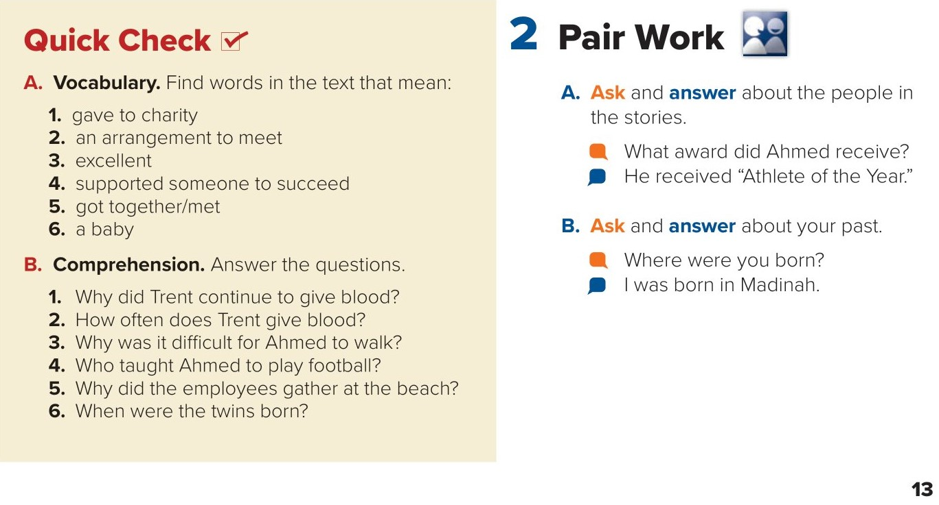
donated
appointment
outstanding
encouraged
gathered
infant/newborn
B-
1. Because he thought it was the right thing to do.
2. He gives blood every eight weeks.
3. Because he was born with a crippling disease.
4. Ahmed’s brother, Ali, taught him how to play football.
5. They gathered at the beach for a cleanup operation.
6. The twins were born on Monday, June 21.

Slide 9
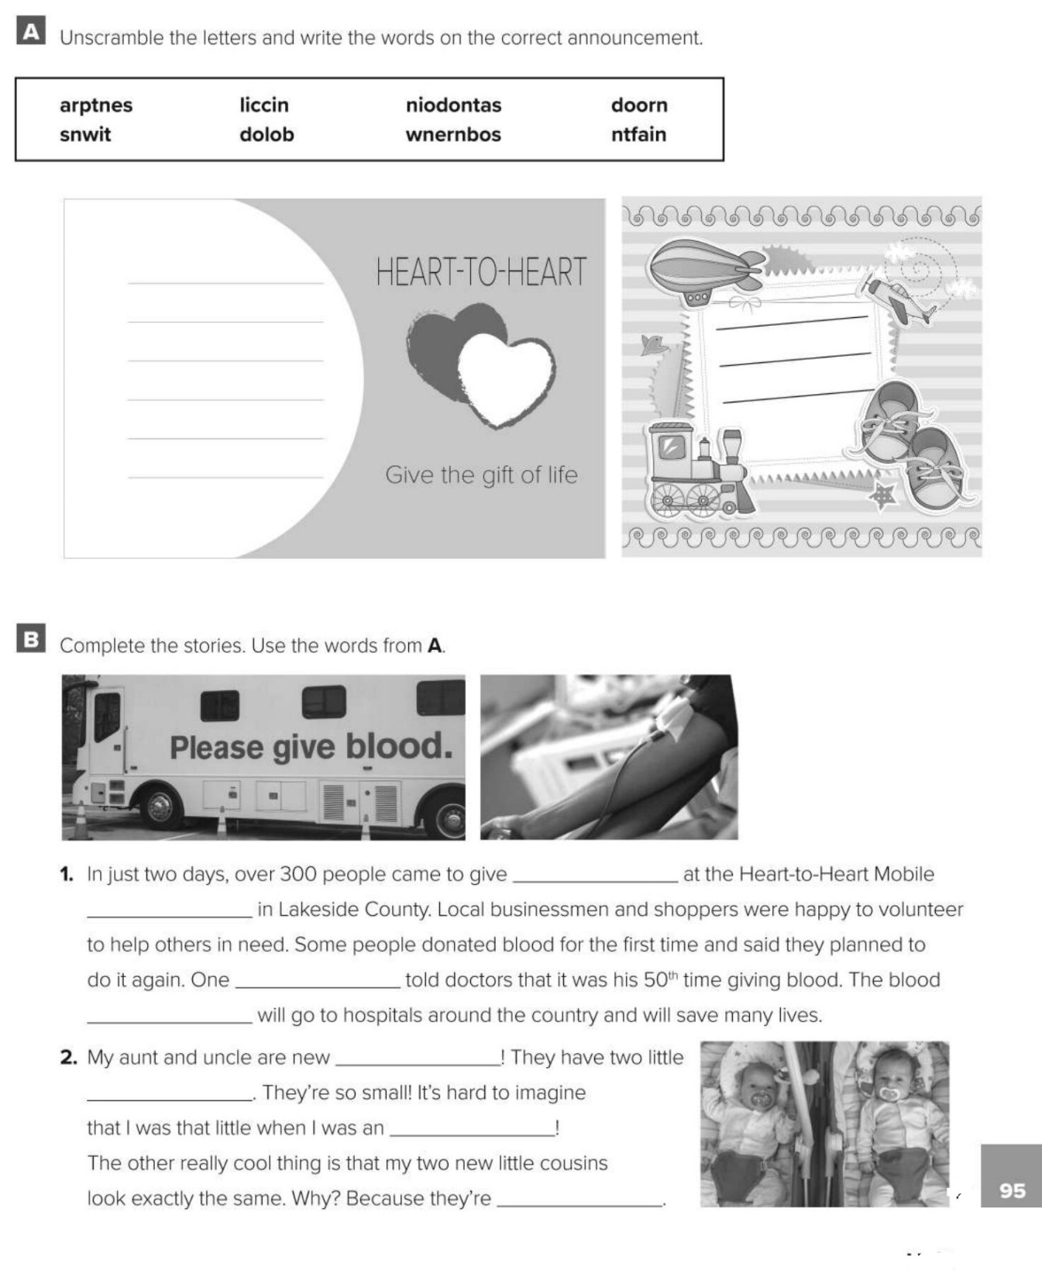
clinic
blood
newborns
donations
infant
donor
parents
twins
blood
Clinic
donor
donations
parents
newborns
infant
twins

Slide 10
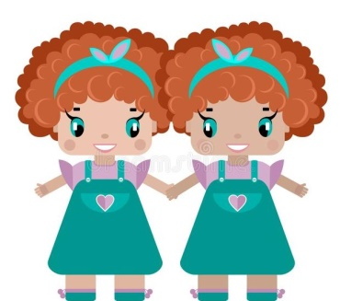
Choose the correct answer :
1-
Outstanding =
excellent
Bad
2-
an arrangement to meet =
encouraged
appointment
3-
4-
Crippling
Guys
Twins
Infants

Slide 11


Slide 12


Back

Slide 13


Back

