Slide 1

Super goal 5
Unit 2
Lesson 4 conversation
اعداد المعلم / يحيى المنقري متوسطة المأمون بالهفوف

Slide 2

Learning Objectives
*By the end of this lesson, Ss will be able to:
1- Use the "real talk" in new sentences.
2-Find the meaning of new words in the text.
3-Interview partner about Internet use

Slide 3


Slide 4





Basketball
Coach
Gym

Slide 5
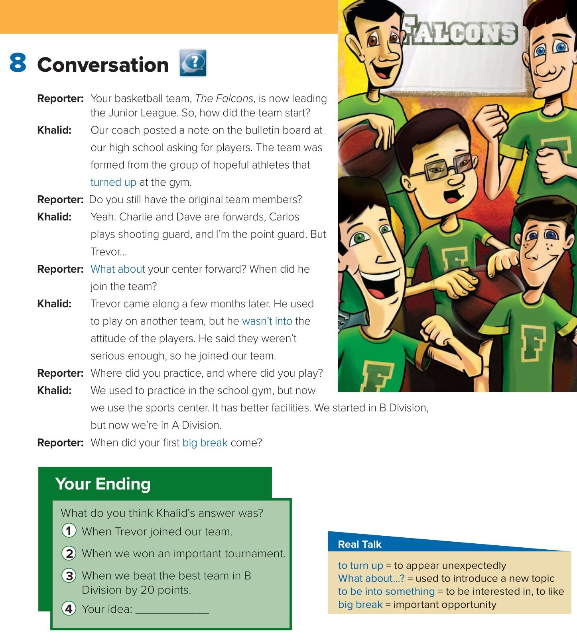
Choose
Best ending

Slide 6
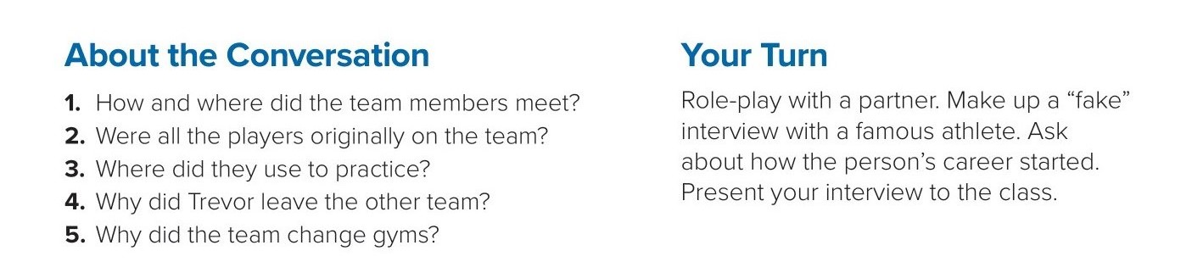

1.. The coach put a note on a bulletin board
asking for players. They met in high school
2. No, Trevor was not originally on the team.
3. They used to practice in the school gym.
4. He wasn’t into the attitude of the players.
5. The sports center has better facilities.

Slide 7
Choose the correct answer :
1-
important opportunity =
big break
to turn up
2-
to be into something =
to be interested in, to like
to appear unexpectedly
3-
4-
Coach
Stadium
Goalkeeper
gym

Slide 8


Slide 9


Back

Slide 10


Back

