Slide 1

Super goal 5
Unit 2
Lesson 2 grammar
اعداد المعلم / يحيى المنقري متوسطة المأمون بالهفوف

Slide 2

Learning Objectives
*By the end of this lesson, Ss will be able to:
1- Form correct simple past tense WH questions.
2-Form correct simple past tense Yes/No questions.
3-Write correct sentence about their birth place.
4-Transform passive sentences into past simple.
5-Refer to past events with (used to)

Slide 3
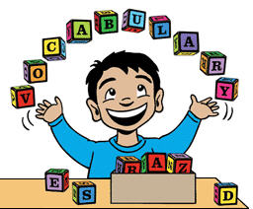

Slide 4

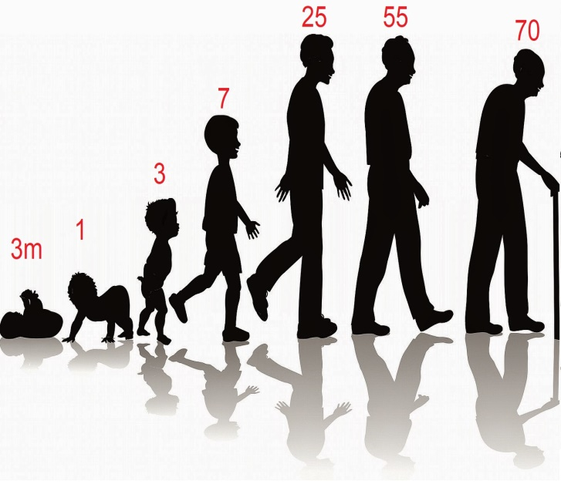
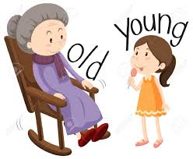


Age
Young
Parents

Slide 5
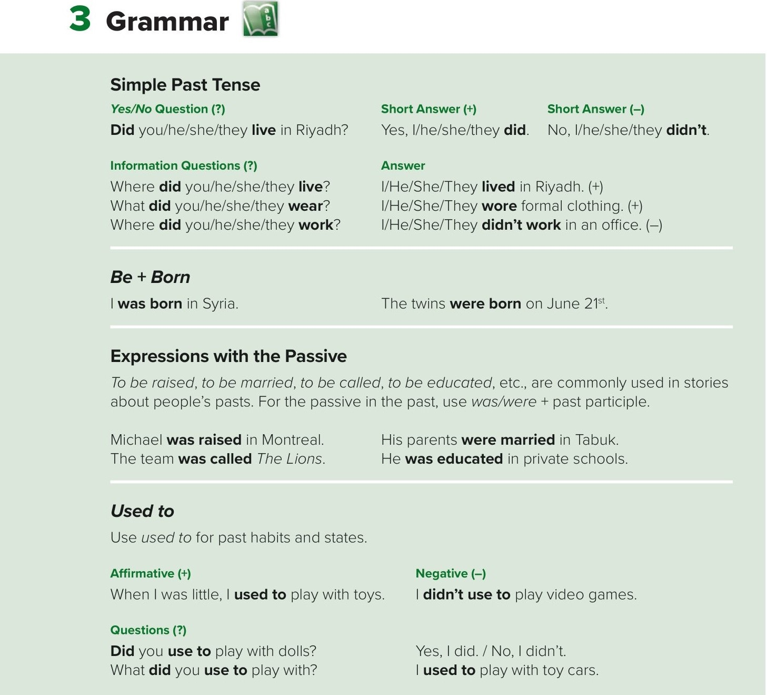

Slide 6
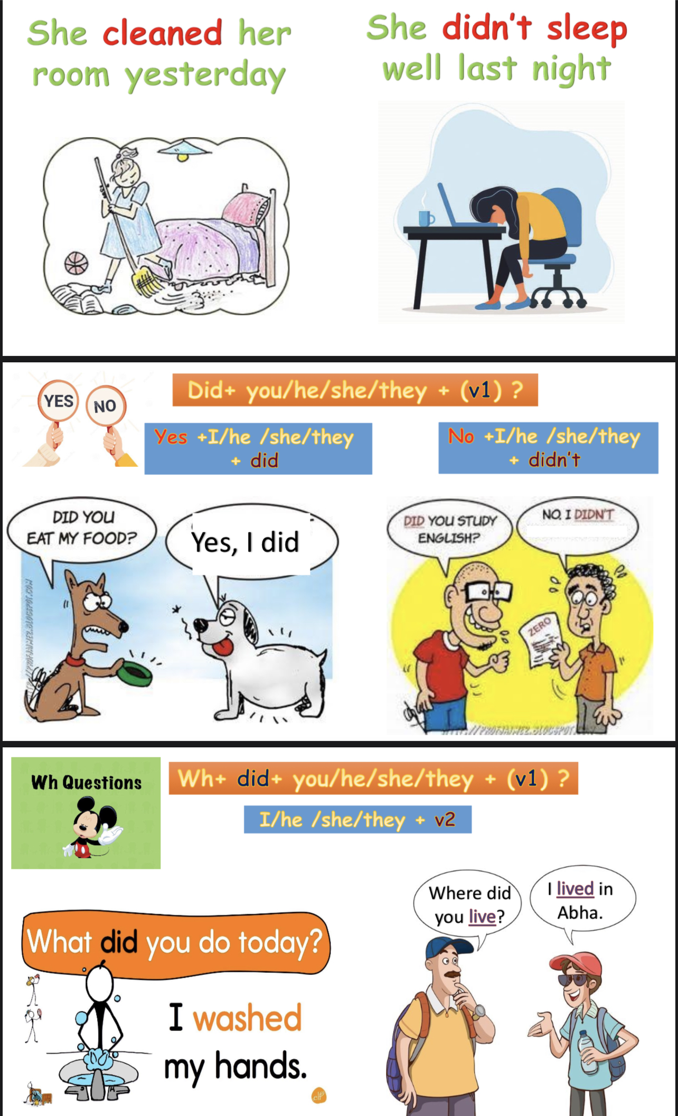

Slide 7
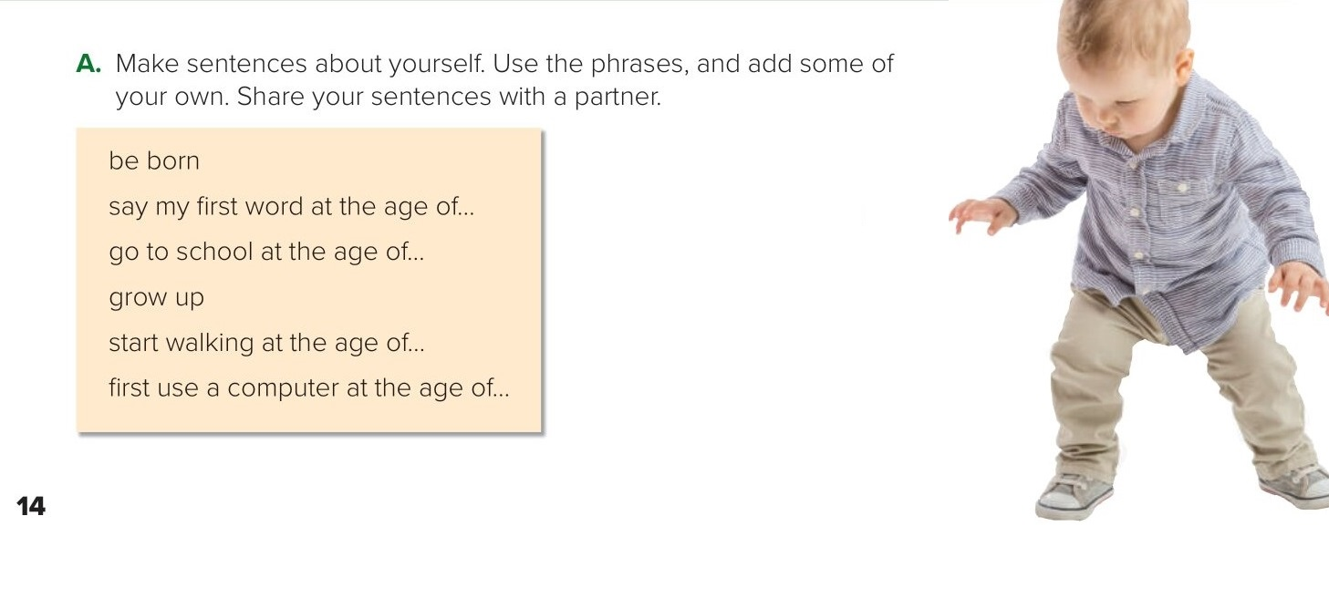
I was born in California.
I grew up in Los Angeles.
I don’t remember when I
said my first word. I
started walking at the
age of 18 months.
I went to school at the
age of five. I first used a
computer at the age of
six.

Slide 8
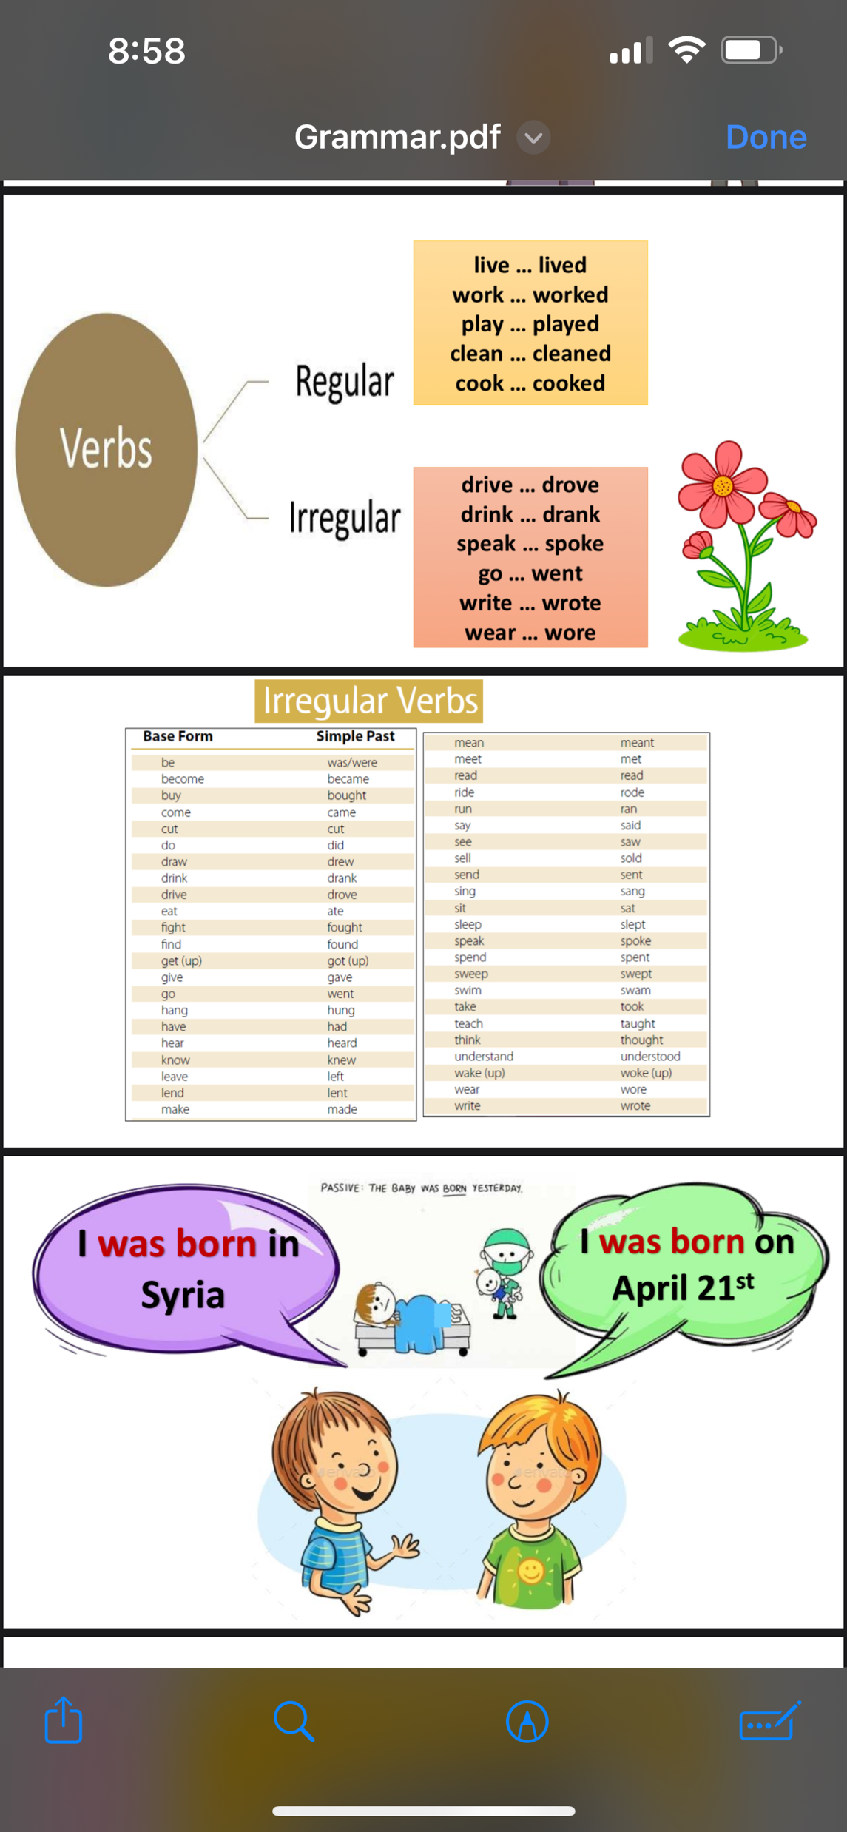

Slide 9
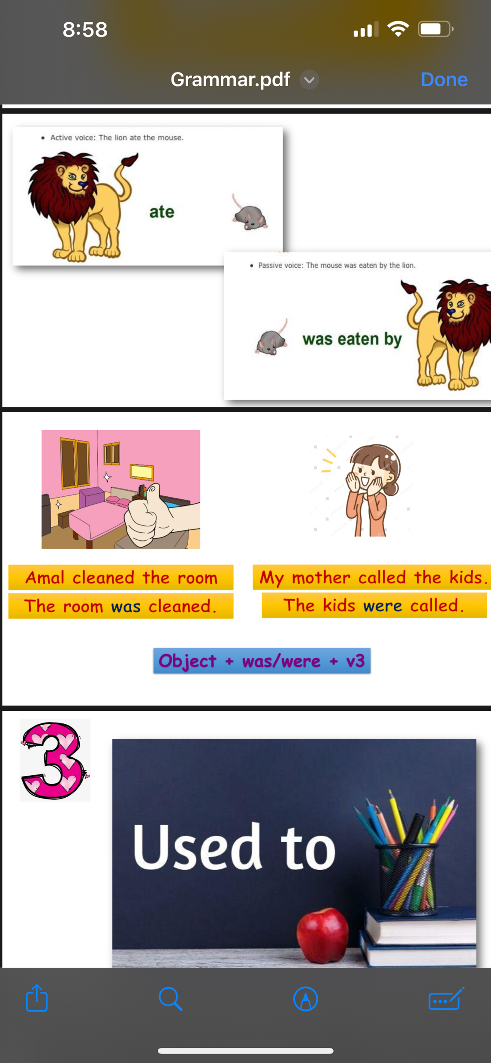
passive

Slide 10
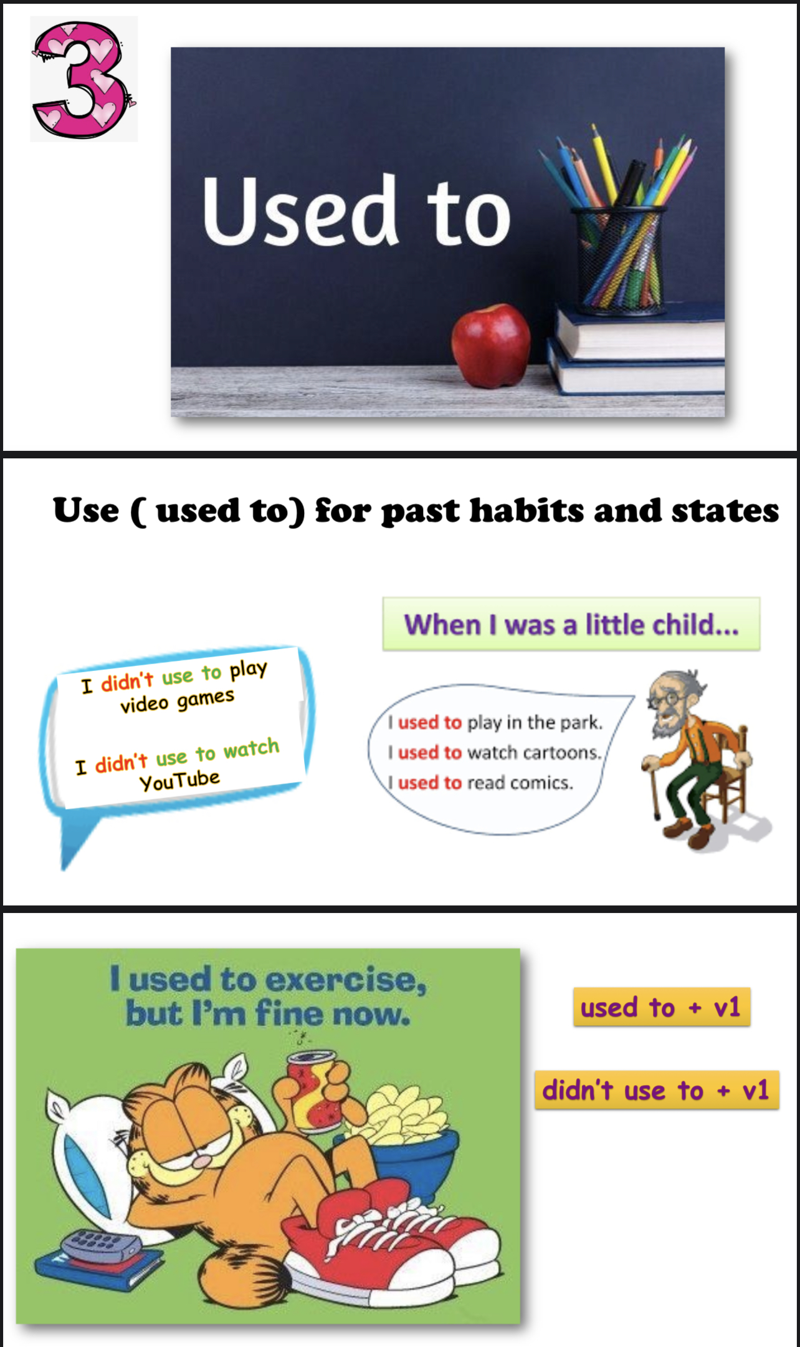

Slide 11
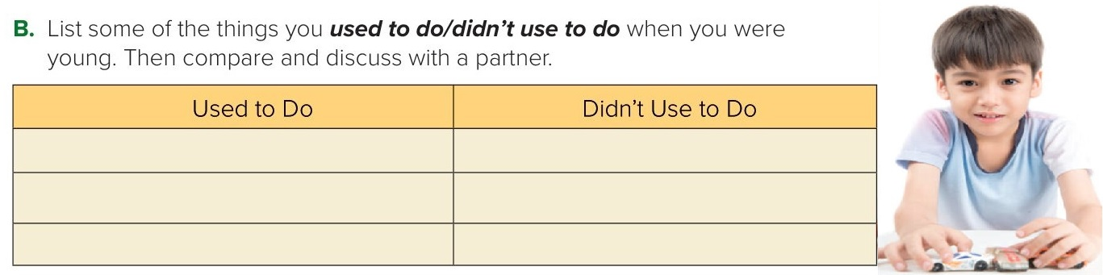
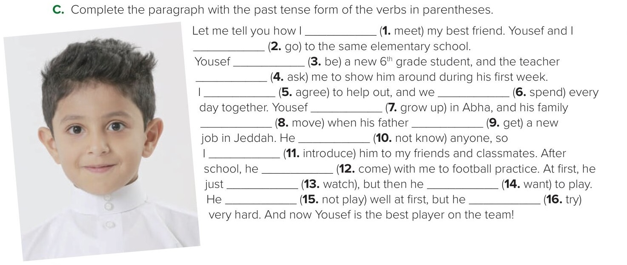
I used to play with toys when I was young.
I didn’t use to take karate classes.
I used to take swimming lessons
I didn’t use to play football
met
went
was
asked
agreed
spent
grew up
moved
got
didn’t know
.introduced
came.
watched
wanted
didn’t play
tried

Slide 12
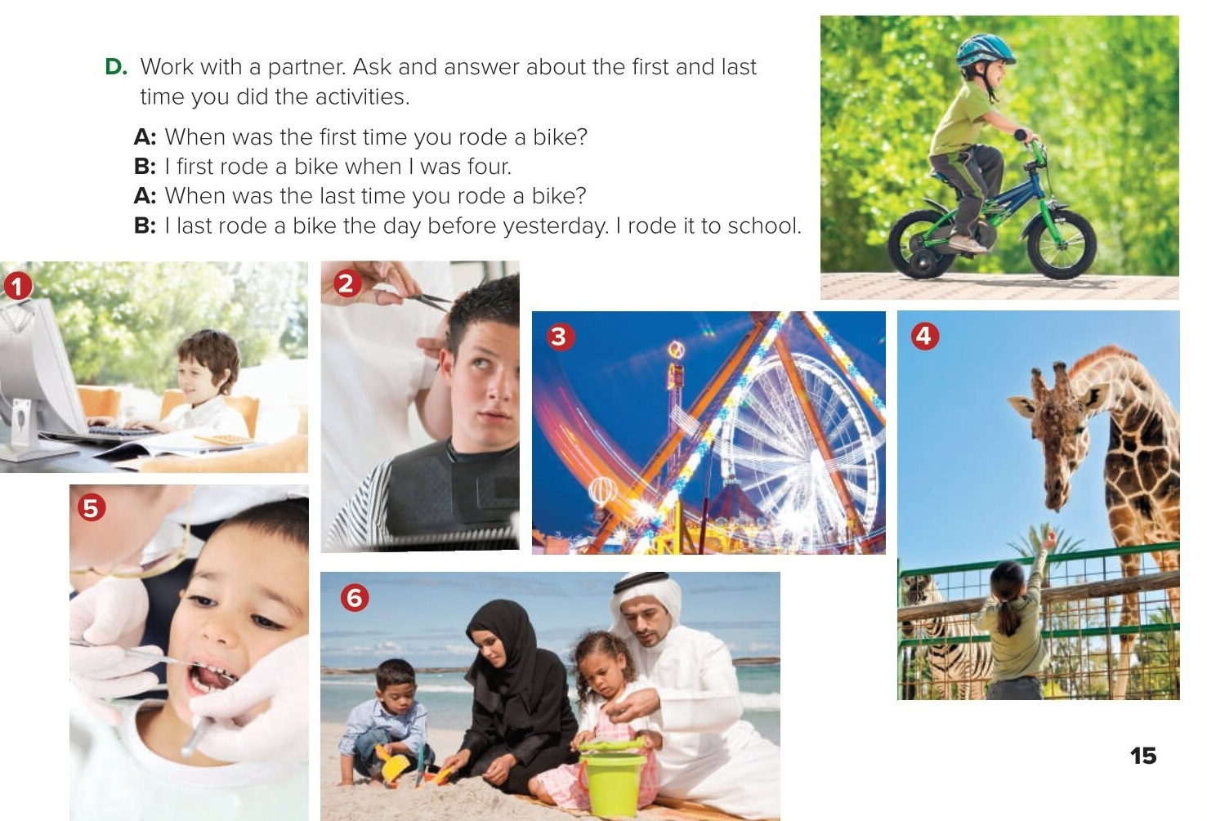

Slide 13
https://youtu.be/j_lLJSO7q2M?si=4ho3zvgI3Po1_5ww

Slide 14
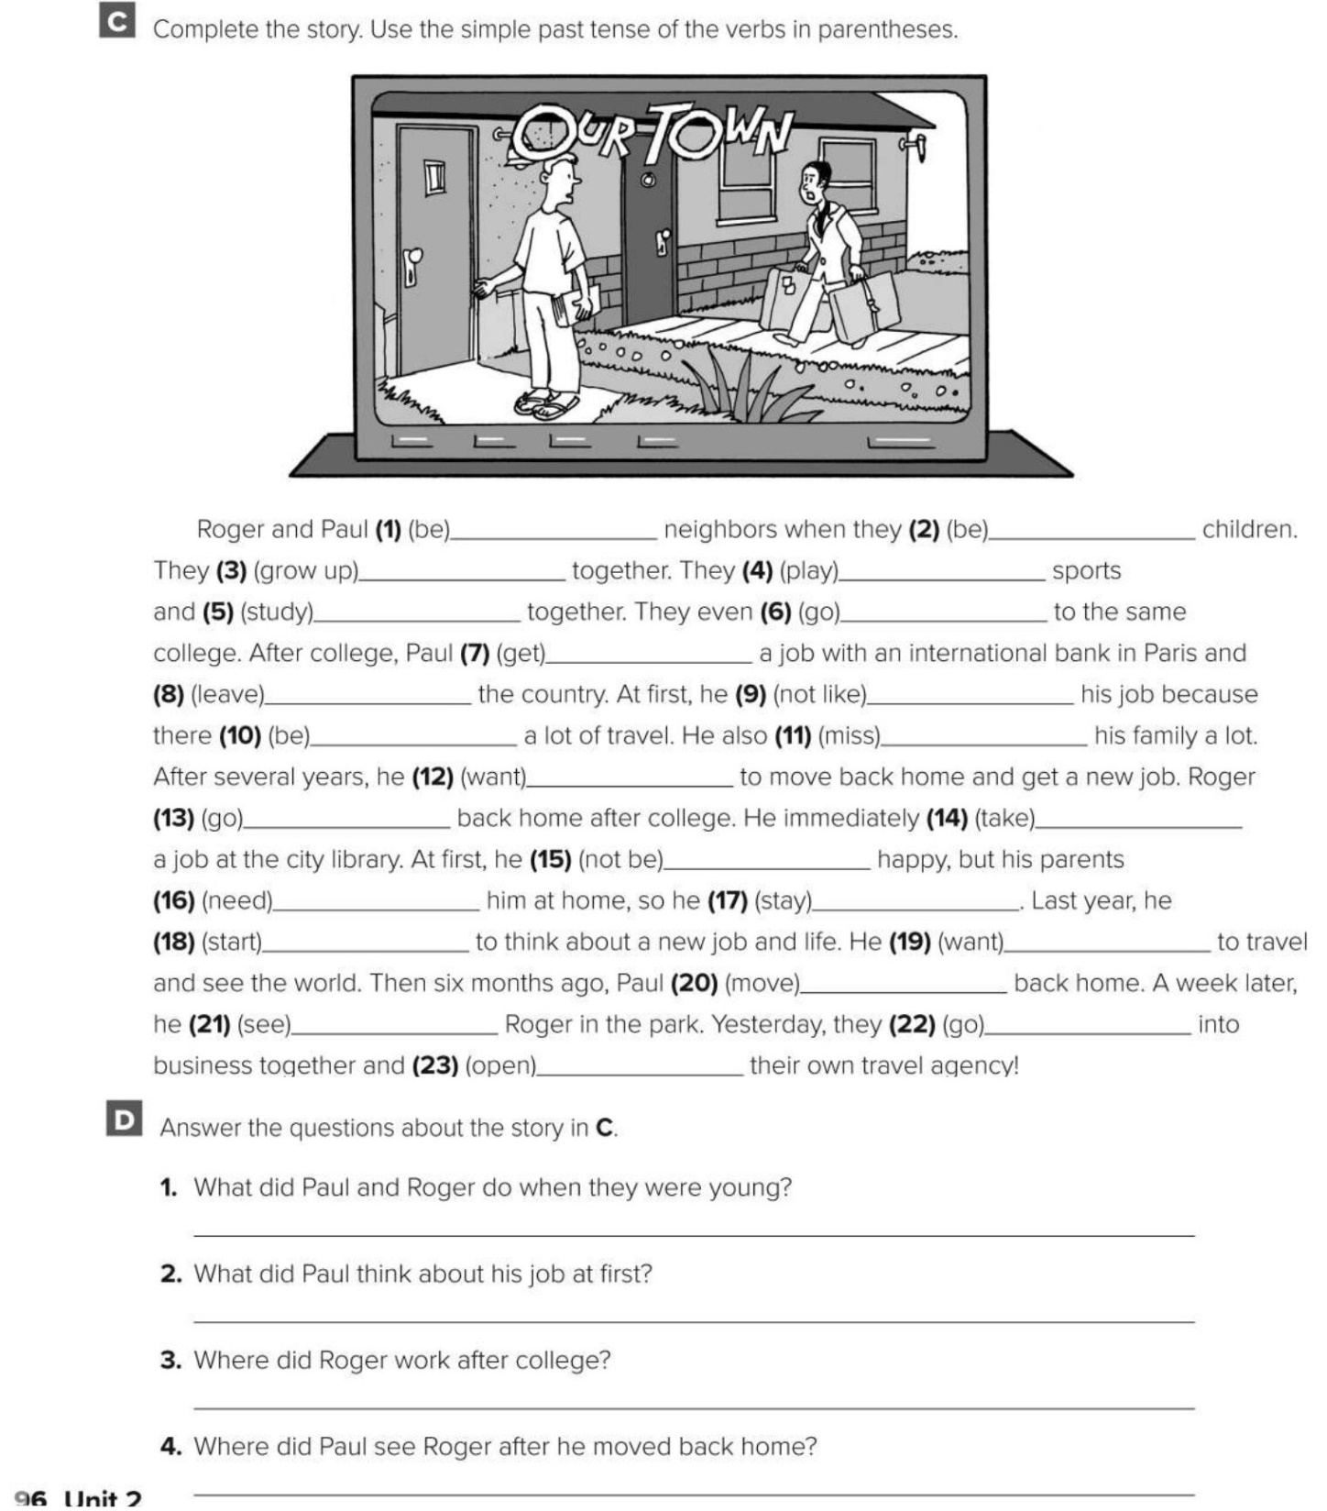
were
were
grew up
played
studied
went
got
didn’t like
left
was
missed
wanted
went
wasn’t
took
needed
stayed
started
wanted
moved
saw
went
opened
They played sports and studied together.
He didn’t like his job at first.
He worked at the city library.
He saw Roger in the park.

Slide 15
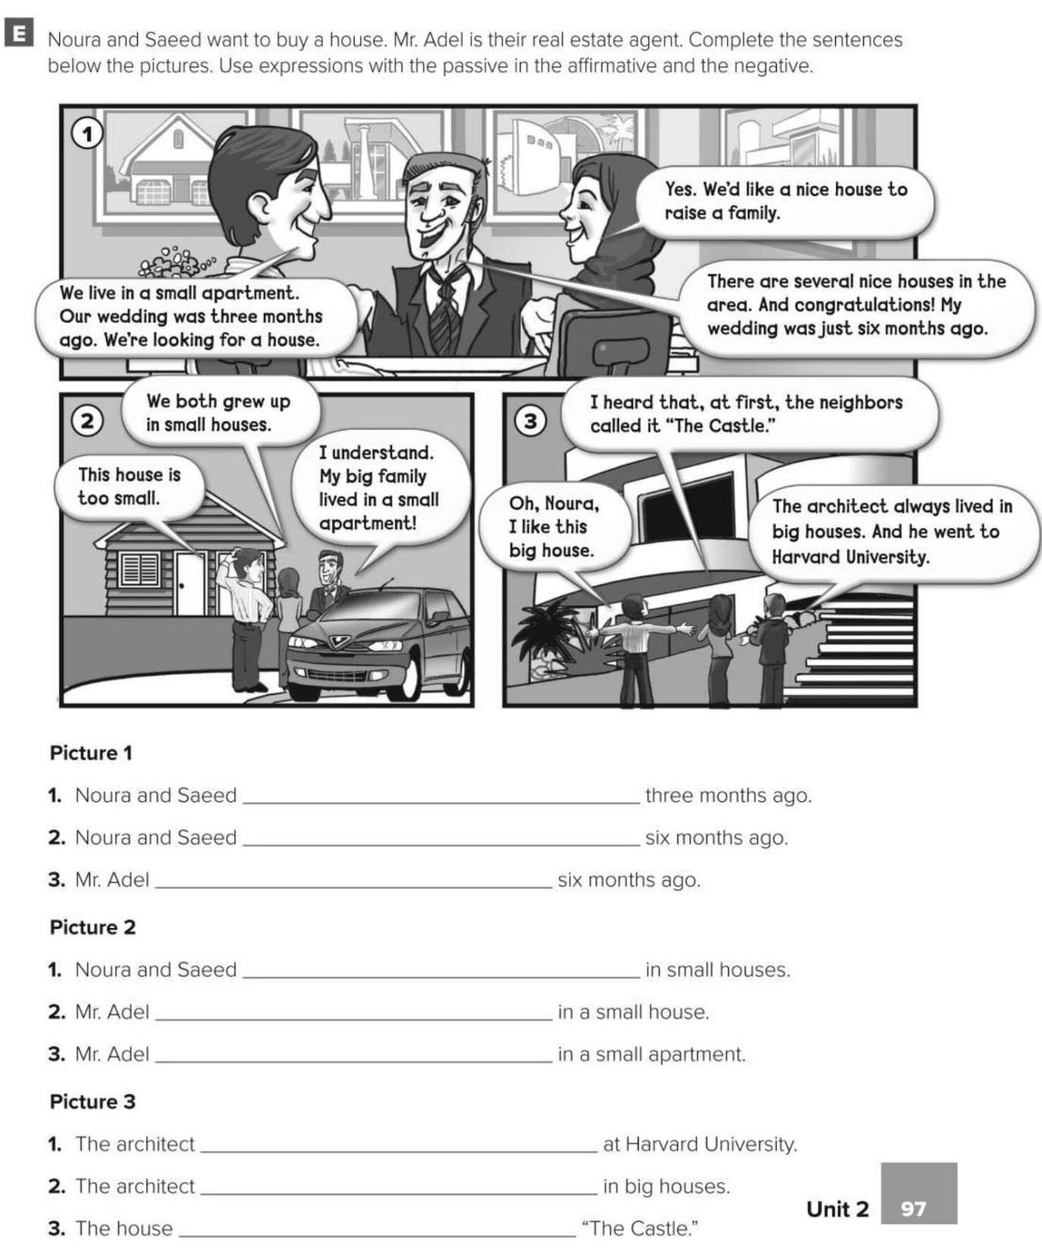
were getting married
wasn’t married
was married
were raised
wasn’t raised
was raised
was educated
was raised
was called

Slide 16
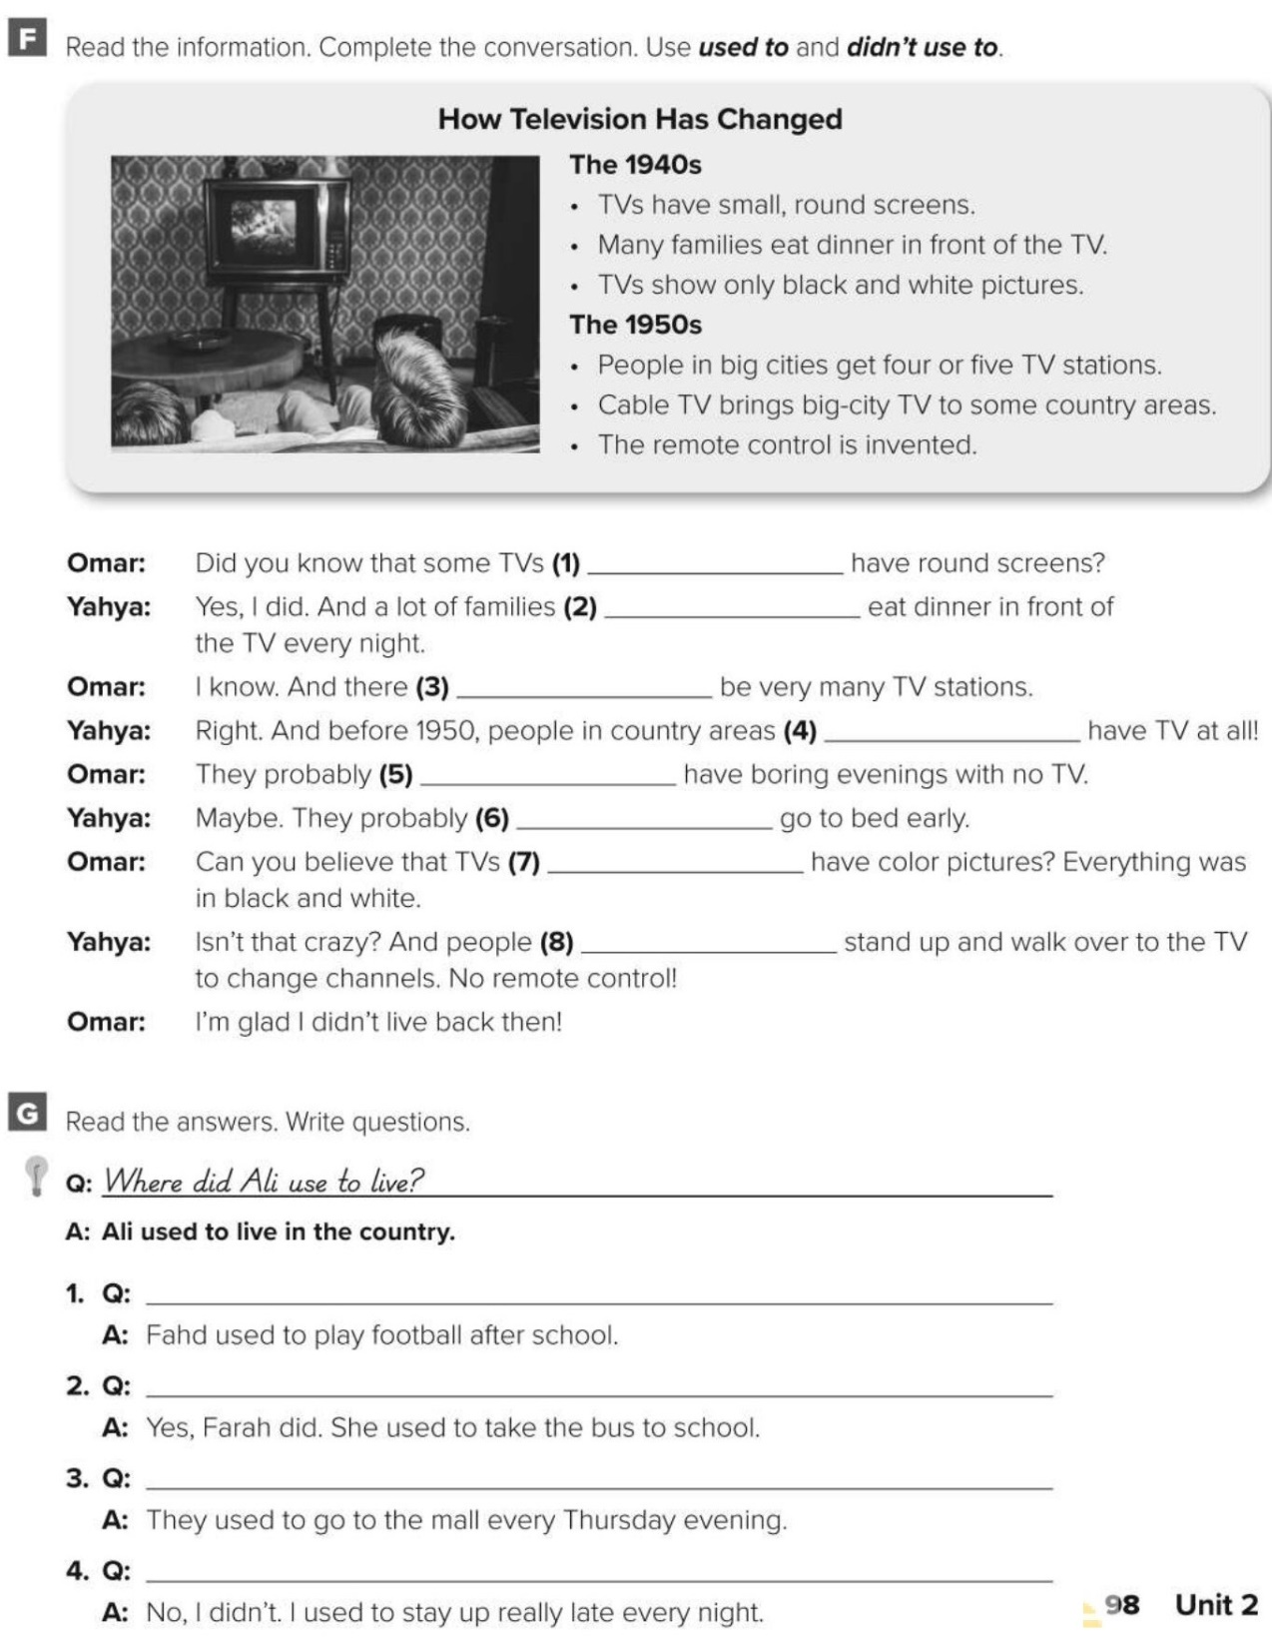
used to
used to
didn’t use to
didn’t use to
used to
used to
didn’t use to
used to
What did Fahd use to do after school?
Did Farah use to take the bus to school?
Where did they use to go every Thursday evening?
Did you use to go to bed early every night?

Slide 17


Choose the correct answer :
1-
Mr. Adel was …… 5 months ago
boarded
born
2-
Where did you live ?
I live in Riyadh
I lived in Riyadh
3-
4-
Parents
Young
Twins
Infants

Slide 18


Slide 19

Back

Slide 20


Back

