Slide 1
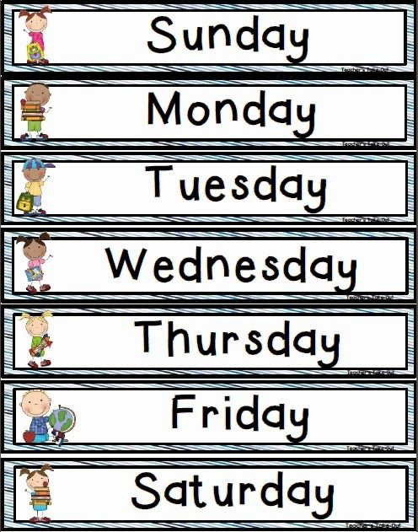
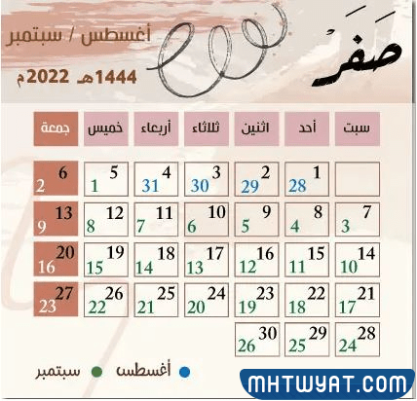

Slide 2

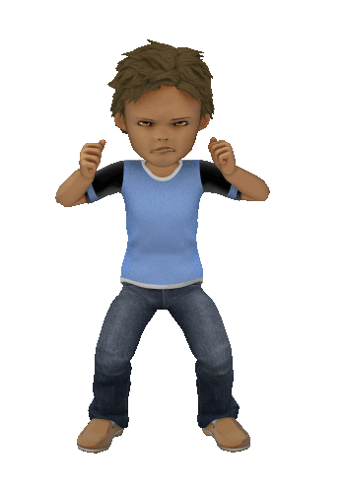


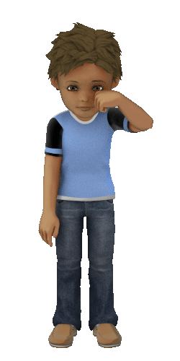
Unit 1
Feelings lesson 3
Notes:
Unit 1 lesson 3
[afterclick]
feelings

Slide 3

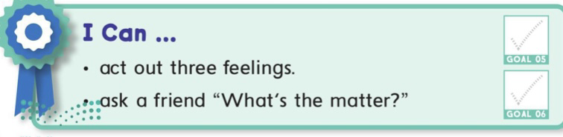

Student will be able to

Slide 4

Religious goal
To be a good citizen who presents
his country in the best way
National goal

Slide 5

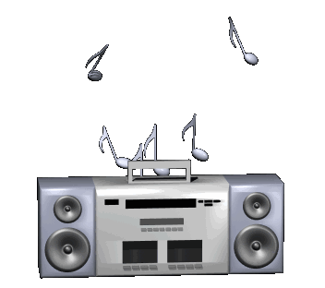
Let`s chant

Slide 6


Slide 7

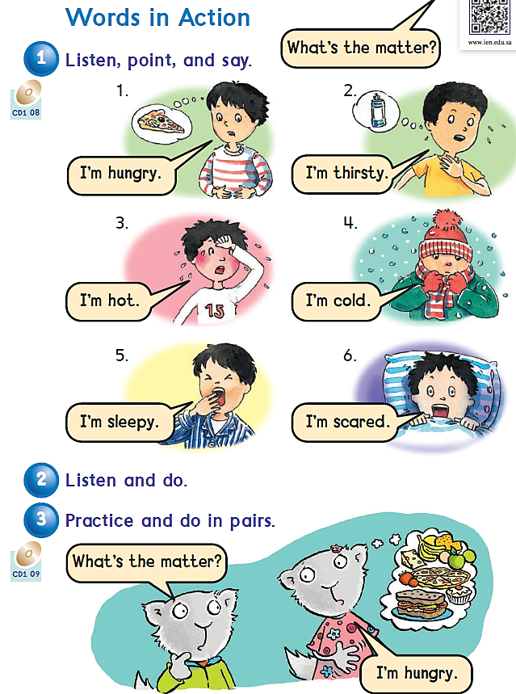



Page 8
Notes:
Words in actions page 8

Slide 8
What`s the matter?
scared
angry
He is scared.
He is angry.
sad
He is sad.
Notes:
[afterclick]
Whats the matter
[afterclick]
Scared
[afterclick]
He is scared
[afterclick]
Angry
[afterclick]
He is angry
[afterclick]
Sad
[afterclick]
He is sad
[afterclick]
Happy
[afterclick]
He is happy

Slide 9
happy
I’m happy.

Slide 10


Slide 11
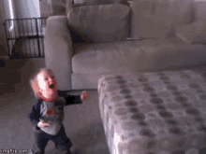
He is happy.

Slide 12

They are happy.

Slide 13
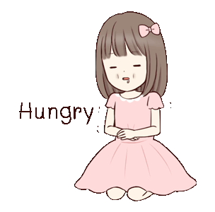
What`s the matter?
I’m hungry.

Slide 14
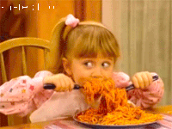
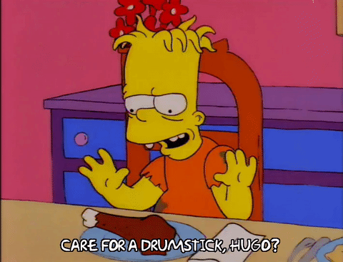
She is hungry.
He is hungry.

Slide 15
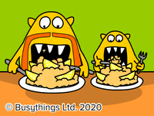
They are hungry.

Slide 16

What`s the matter?
He is thirsty.

Slide 17
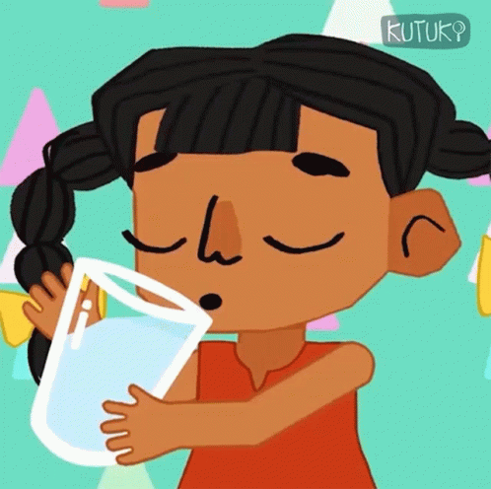
She is thirsty.

Slide 18
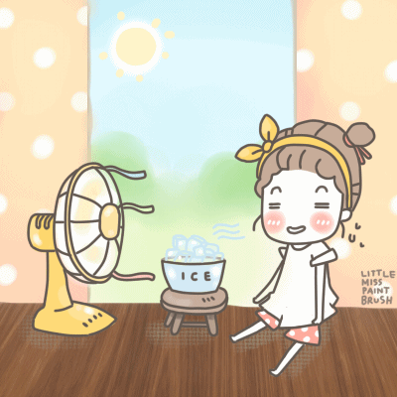
What`s the matter?
She is hot.

Slide 19
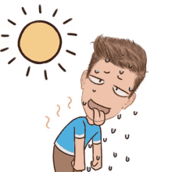
He is hot.

Slide 20
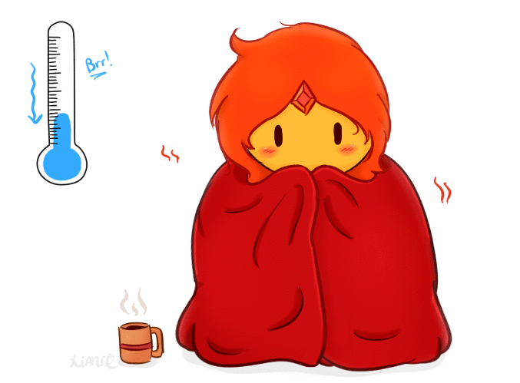
What`s the matter?
She is cold.

Slide 21
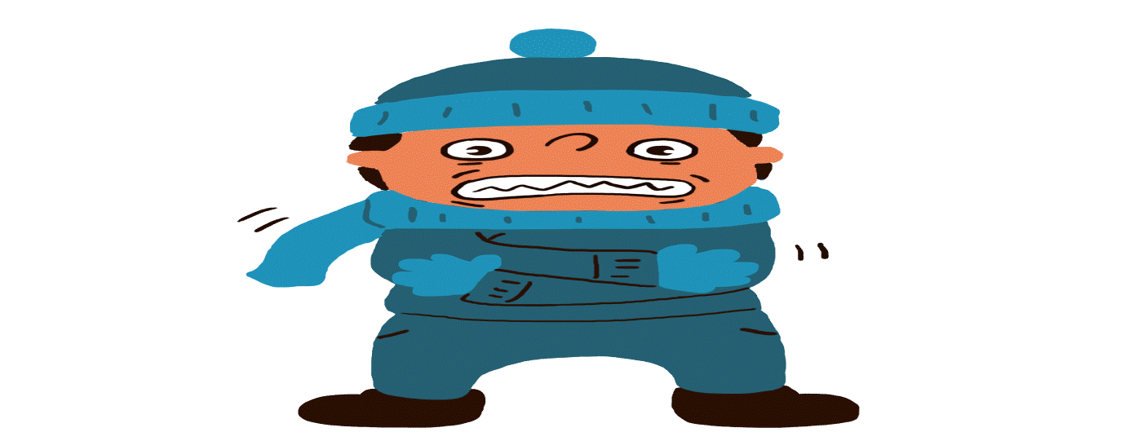
He is cold.

Slide 22
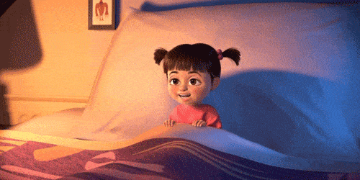
What`s the matter?
She is sleepy.

Slide 23
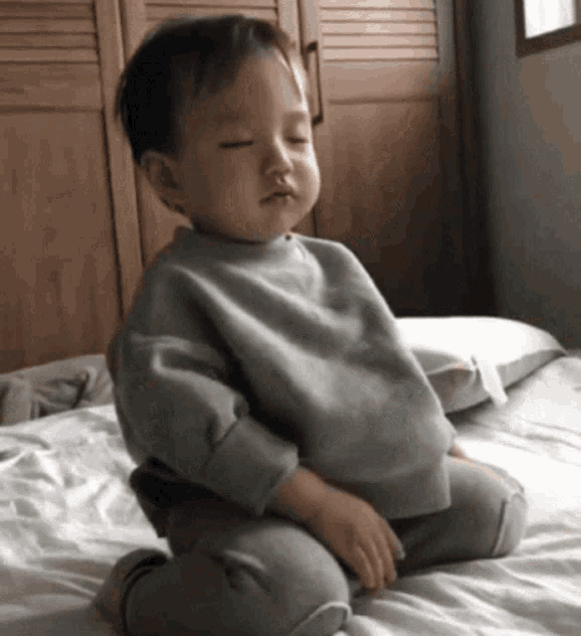
He is sleepy.

Slide 24
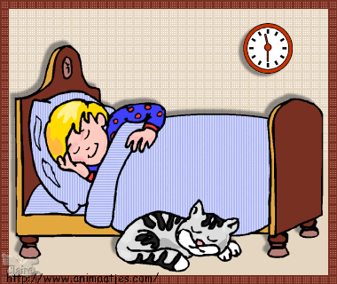
They are sleepy.

Slide 25
What`s the matter?
I’m scared.

Slide 26
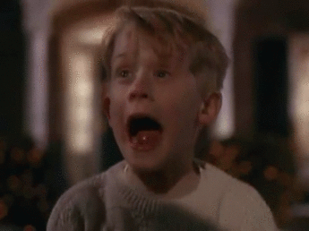
He is
scared.

Slide 27
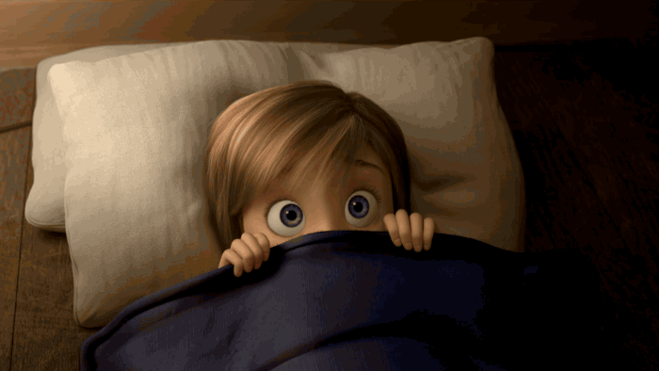
She is
scared.

Slide 28
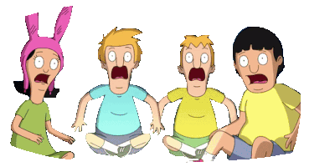
They are scared.

Slide 29


Good luck smart students!
Notes:
Read more

Slide 30






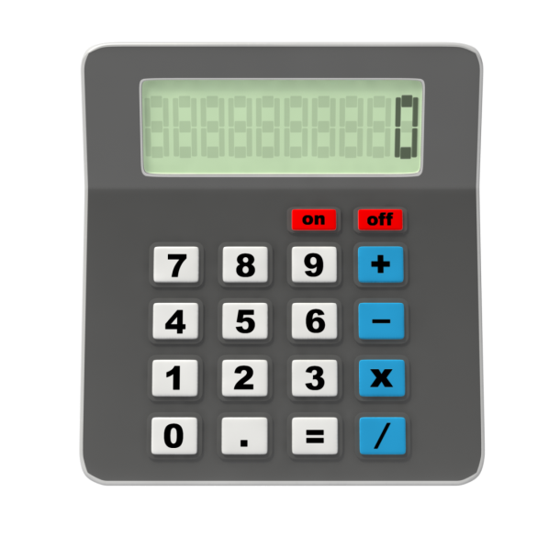





Fun
Time
Let`s play

Slide 31


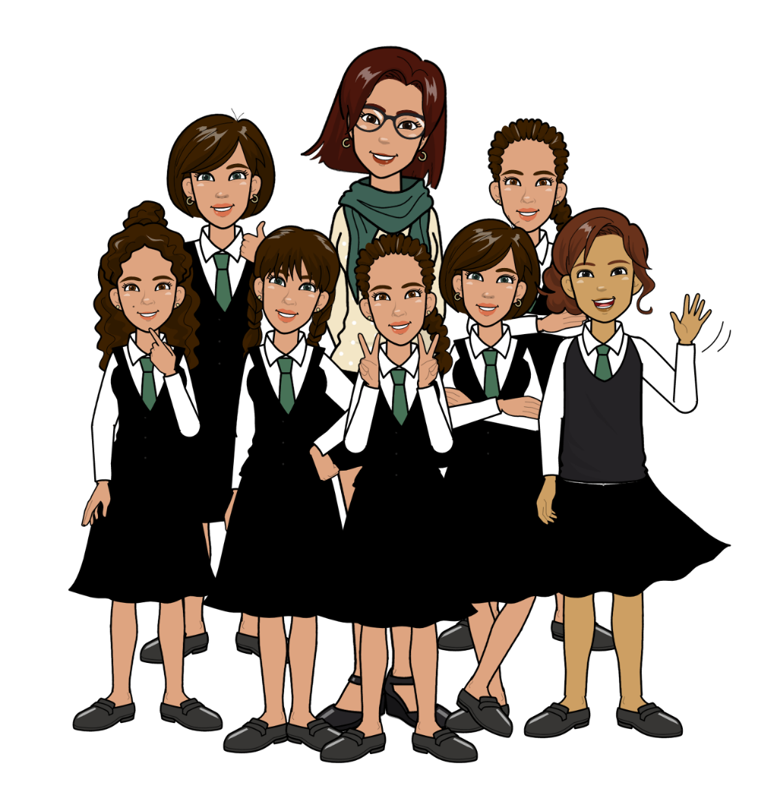

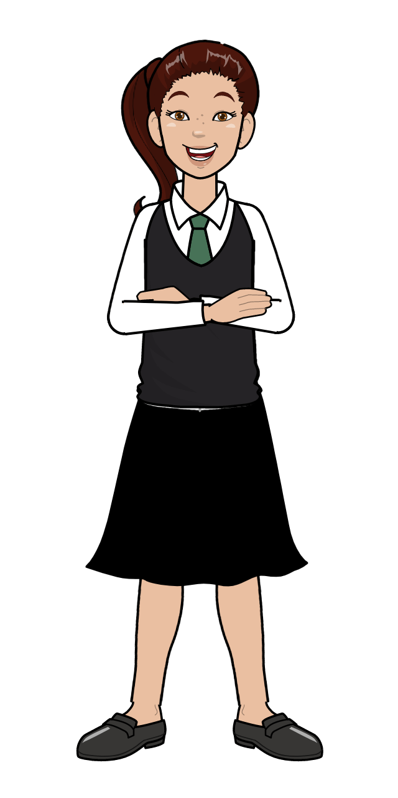



Slide 32


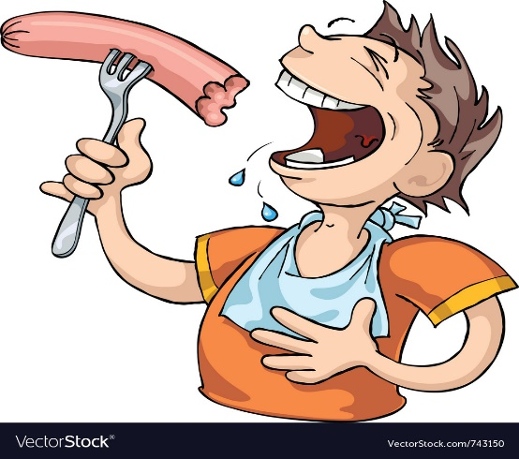



What`s the matter ?
I am hot.
I am hungry.
I am cold.

Slide 33


Excellent

Slide 34

Try again

Slide 35

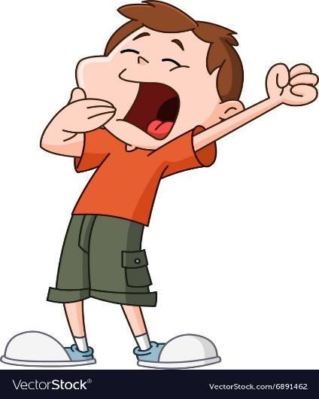
What`s the matter ?
I am sleepy.
I am thirsty.
I am cold.

Slide 36
Excellent

Slide 37
Try again

Slide 38
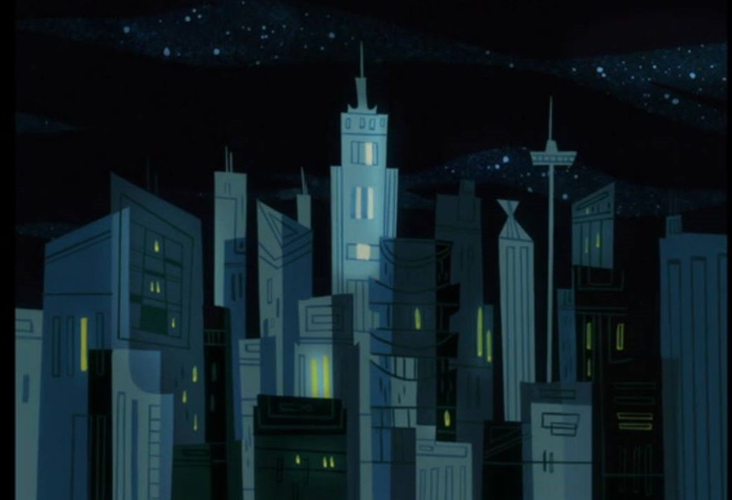
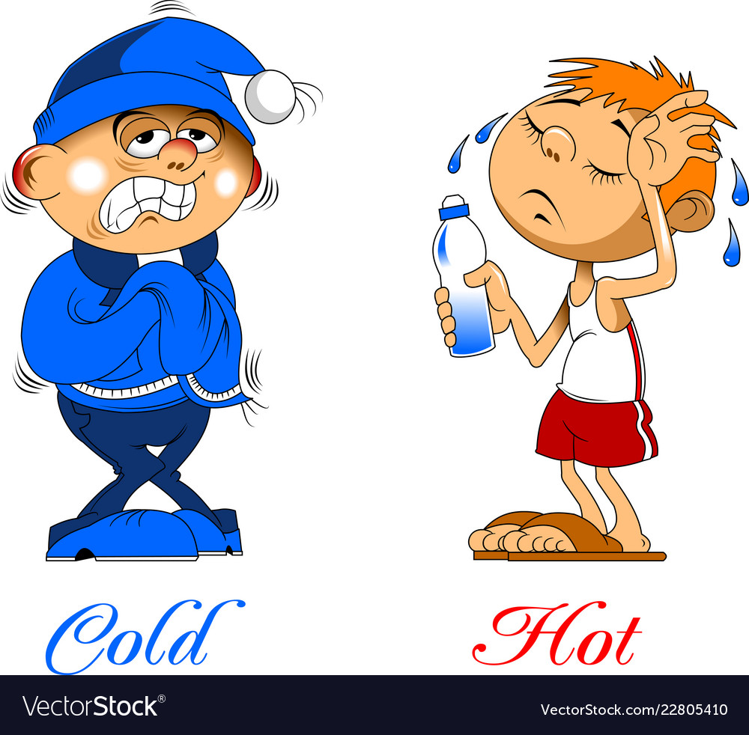
What`s the matter ?
I am hot.
I am scared.
I am cold.

Slide 39
Excellent

Slide 40
Try again

Slide 41
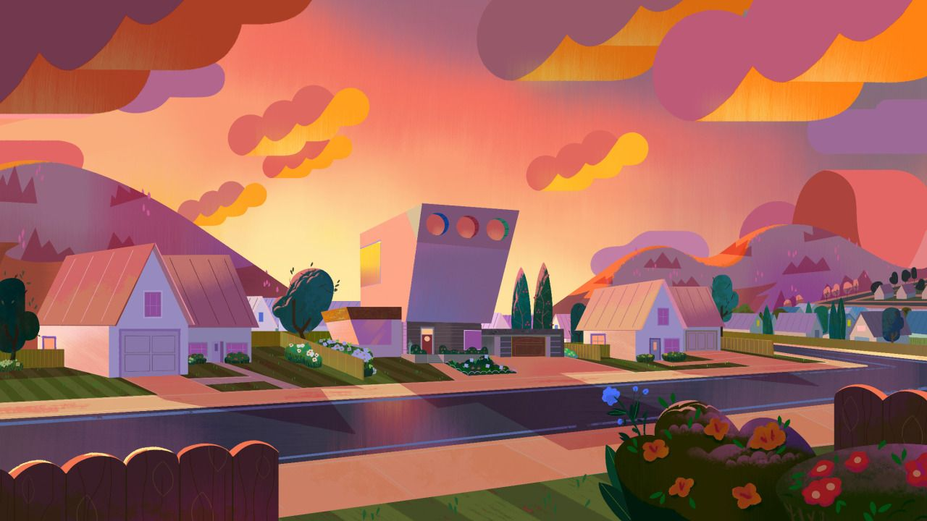
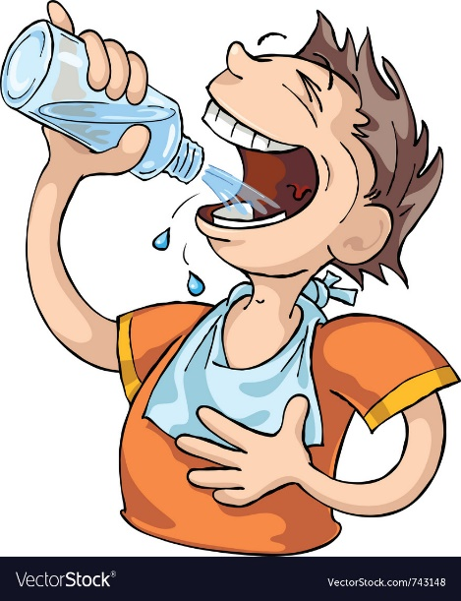
What`s the matter ?
هنا نكتب السؤال:
I am cold.
I am hot.
I am thirsty.

Slide 42
Excellent

Slide 43
Try again

Slide 44

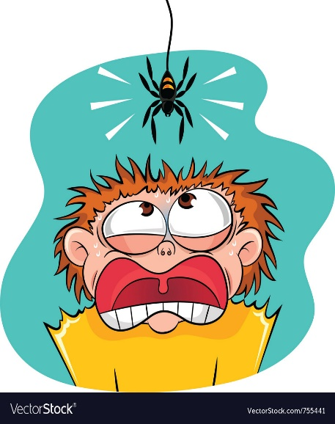
What`s the matter ?
I am scared.
I am hot.
I am sleepy.

Slide 45
Excellent

Slide 46
Try again

Slide 47


What`s the matter ?
I am hungry.
I am hot.
I am sleepy.

Slide 48
Excellent

Slide 49
Try again

Slide 50

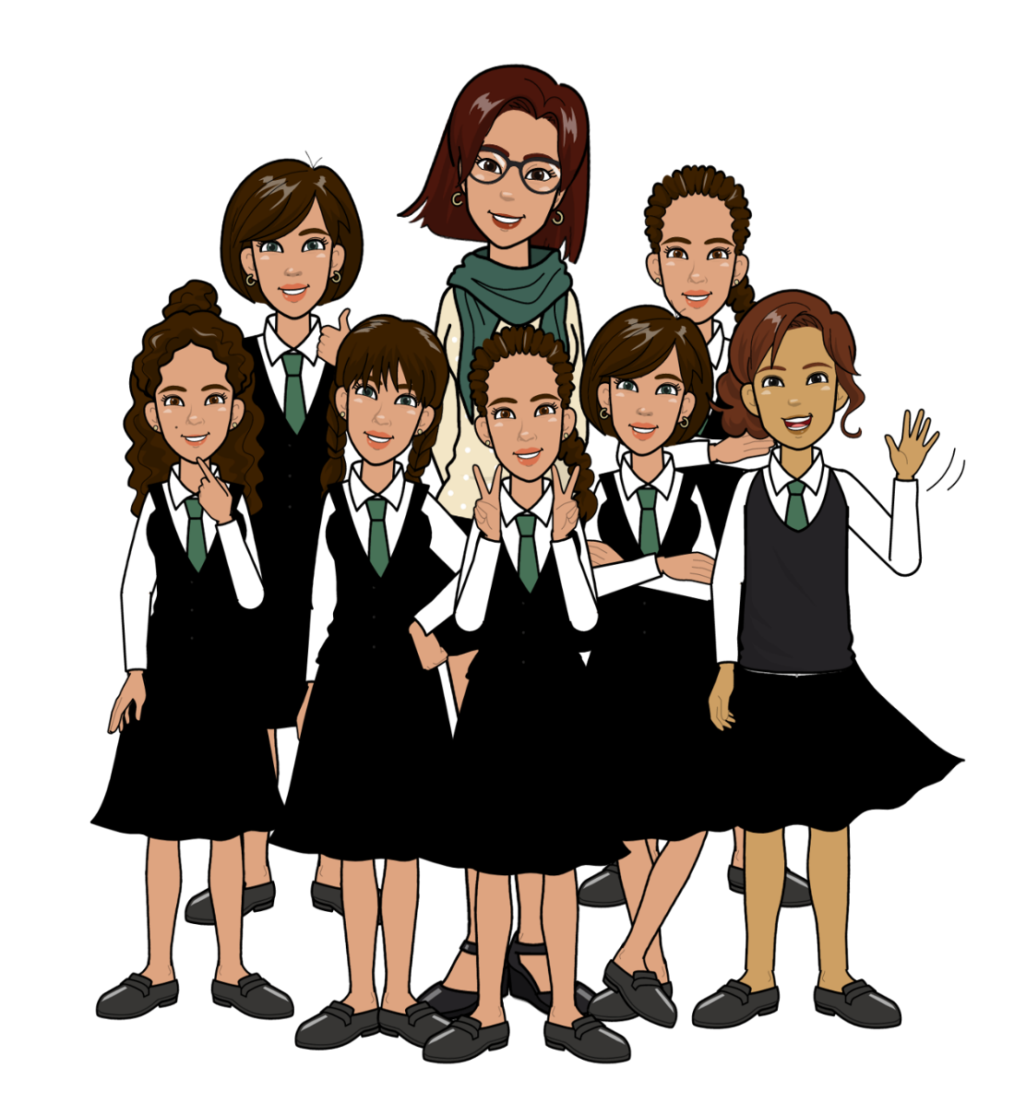




Slide 51
Fun
Time
Let`s play

Slide 52
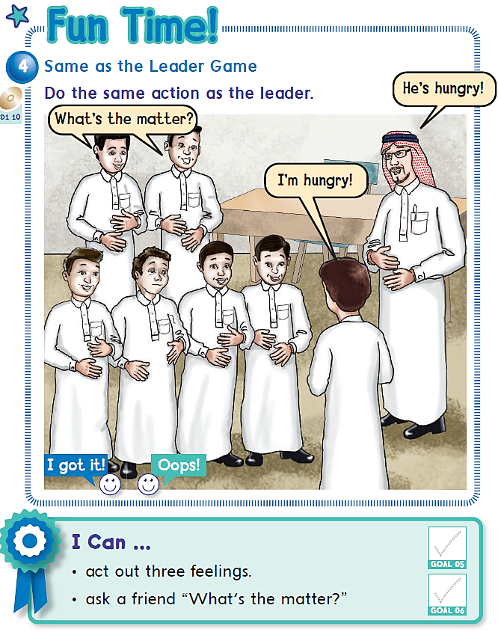

Page 9
Notes:
Fun time page 9

Slide 53


Slide 54


Slide 55
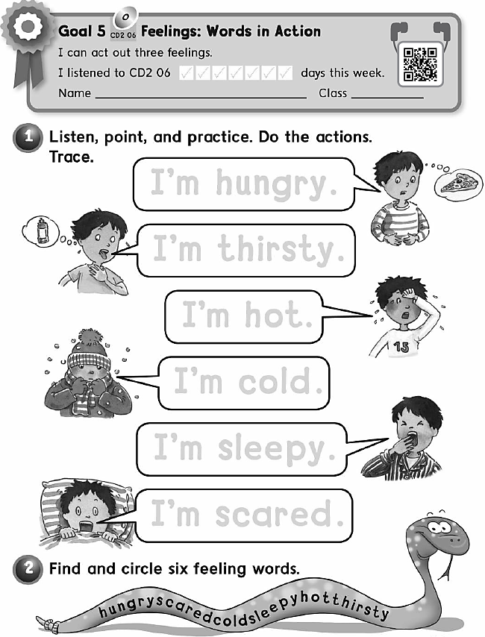


Slide 56
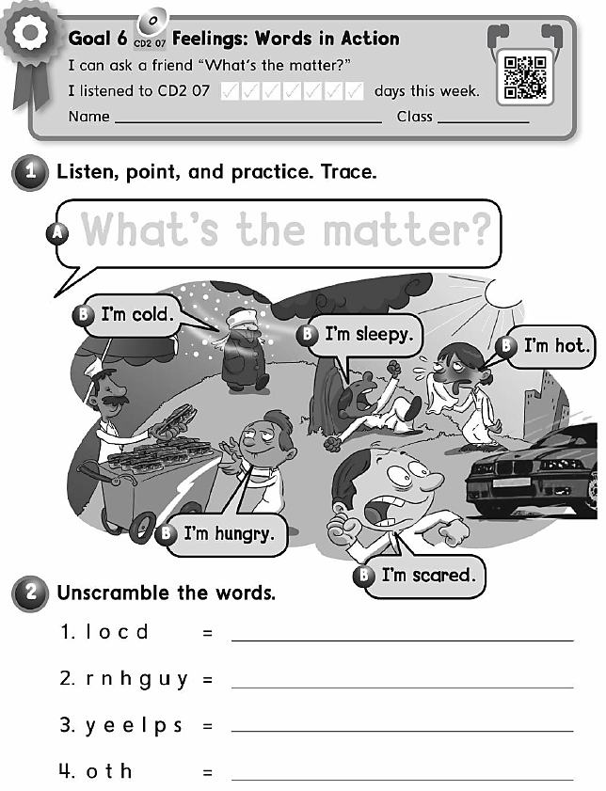
cold
hungry
sleepy
hot

Slide 57


Notes:
Good bye

