Slide 1




Classroom rules
Use the “raise hand” button when you want to ask a question.
“Mute your mics” unless your teacher ask you to do otherwise.
Do not chat with your friends when the teacher is explaining.
Answer the questions your teacher ask you so that you don’t lose marks.

Slide 2
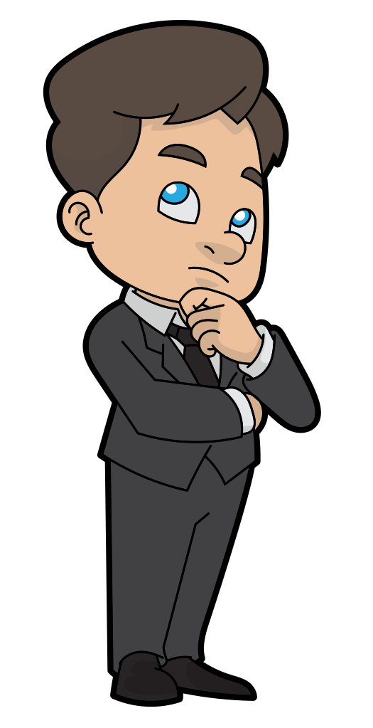
What’s That ?
1-Listen and discuss
هذه الصورة بواسطة كاتب غير معروف مرخصة بالاسم CC BY-SA

Slide 3
Our lesson objectives for today:
1-Identify different words related to a museum
2-Discuss some questions about museums.
3-Mention some instructions of museums.
4-Make sentences about some museum vocabulary

Slide 4
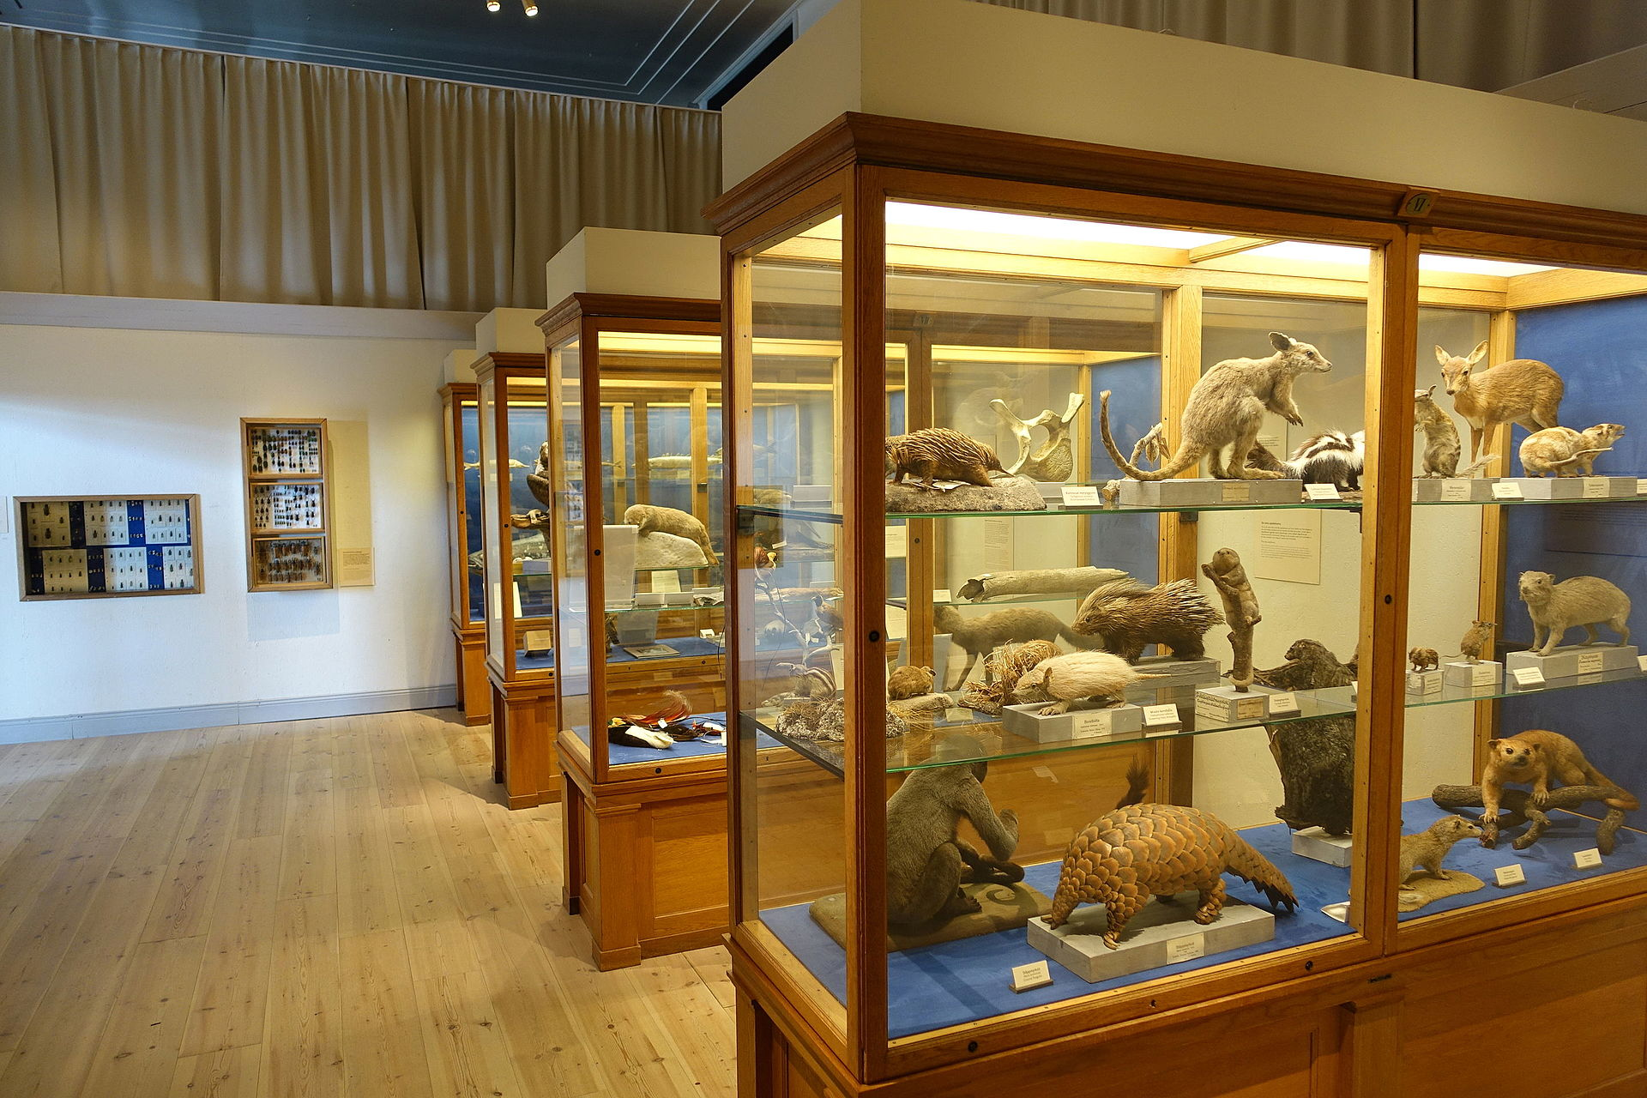
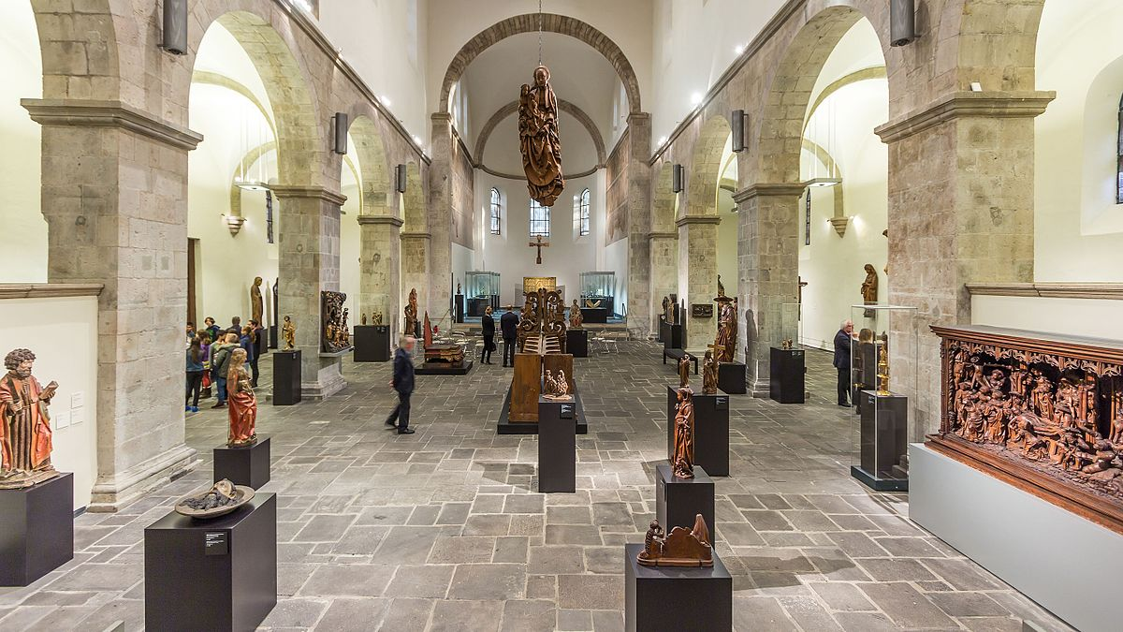
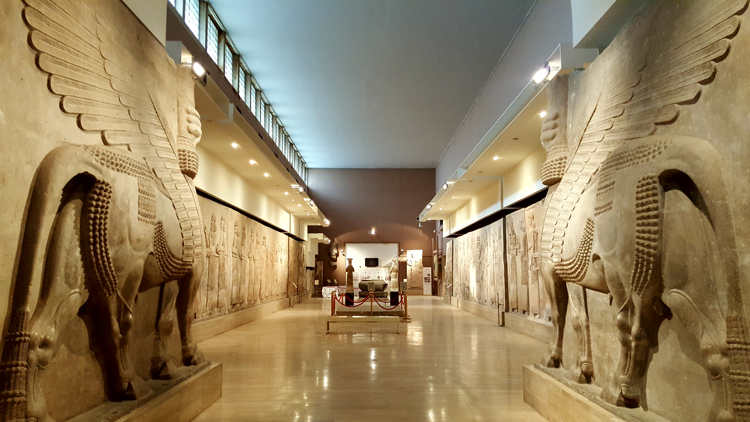
museum
هذه الصورة بواسطة كاتب غير معروف مرخصة بالاسم CC BY-SA
هذه الصورة بواسطة كاتب غير معروف مرخصة بالاسم CC BY-SA

Slide 5
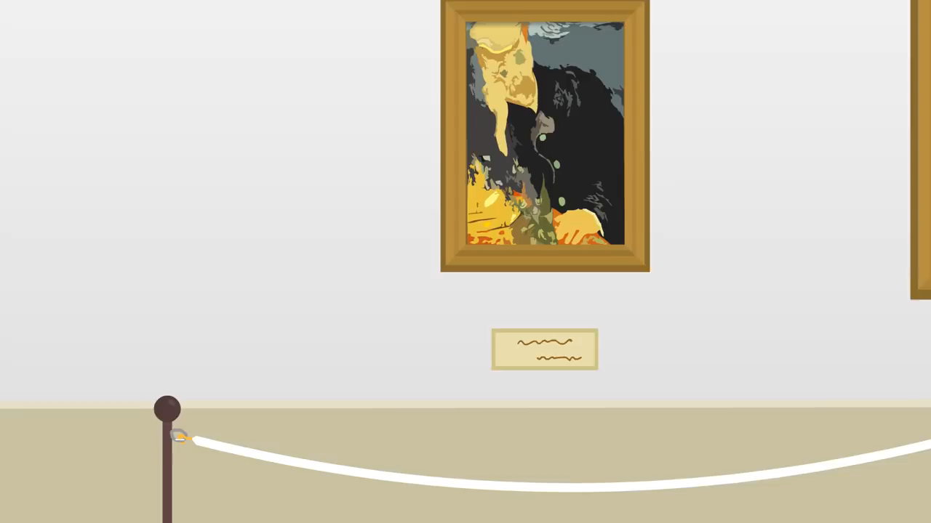
At the museum

Slide 6


After watching the video answer this question.
What are the rules/ instructions of a museum?

Slide 7
Discussion:
Have you been to a museum ? Do you like it ?
Mention some museums in Saudi Arabia.
Do you think museums are important ? Why?

Slide 8
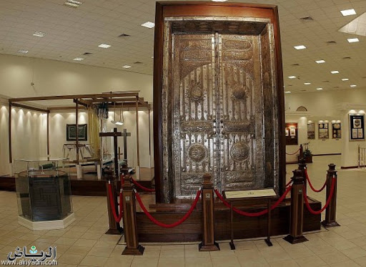
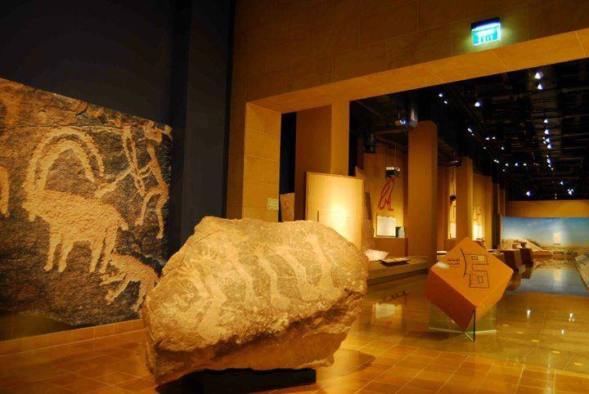
The two holly mosques museum in Makkah
The national museum in
Riyadh

Slide 9
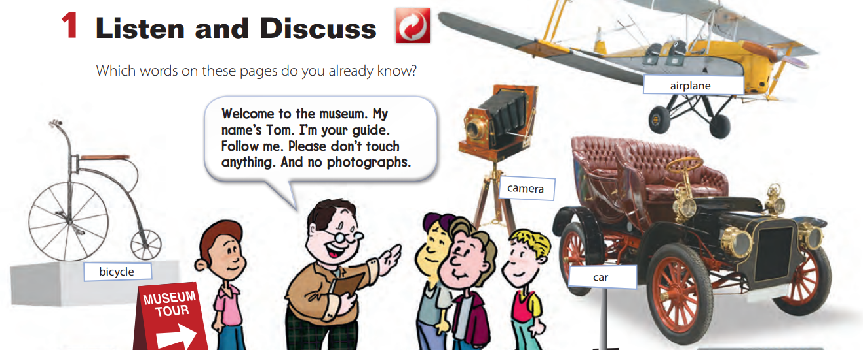
A tour guide is:
A person who can guide people and show them different places.

Slide 10
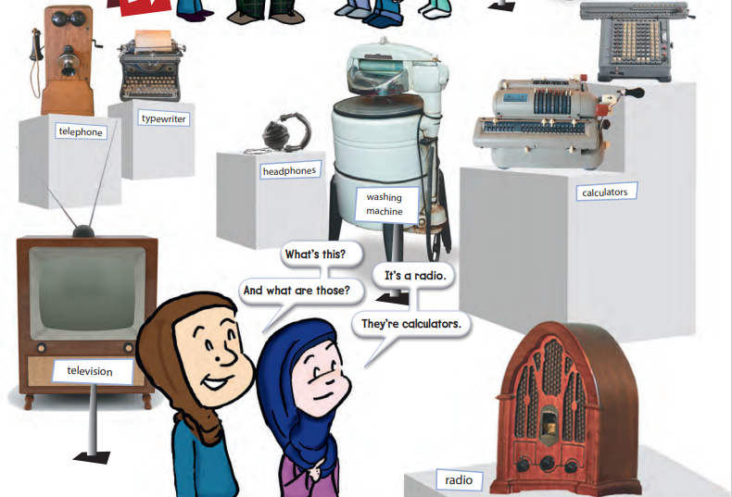

Slide 11
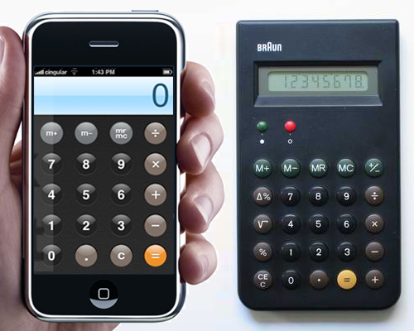
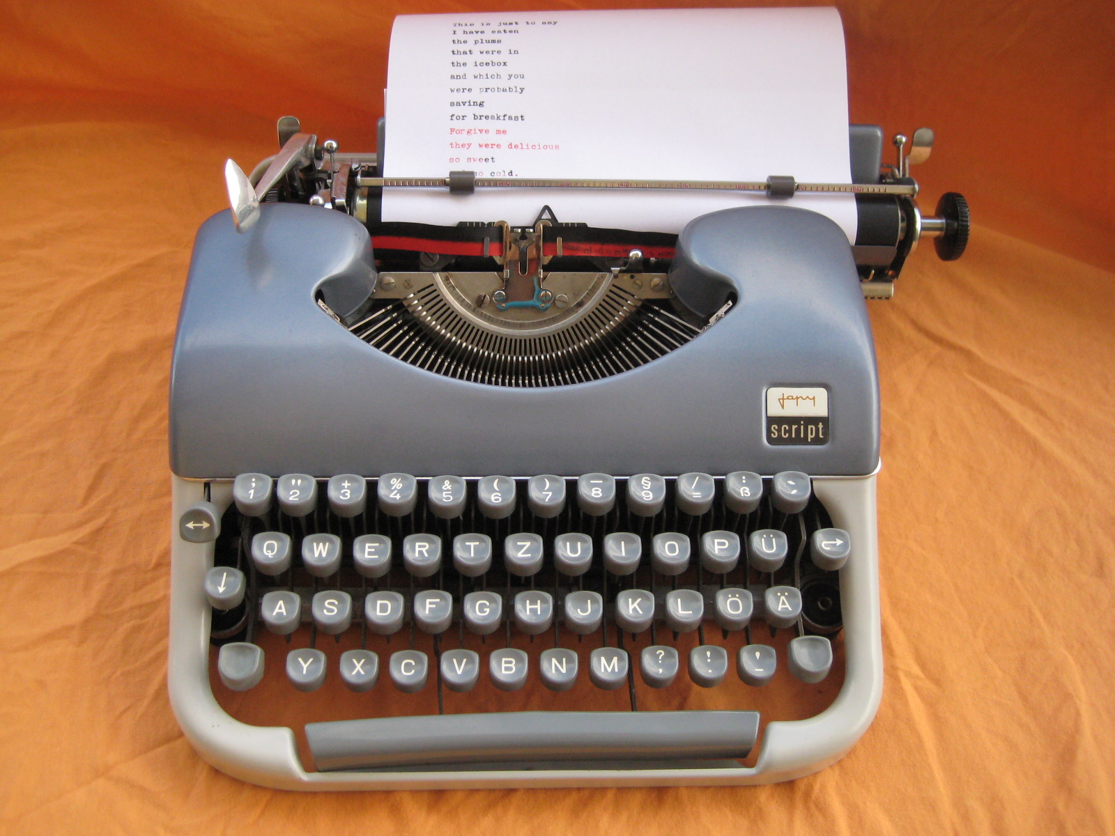
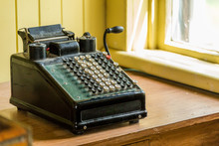
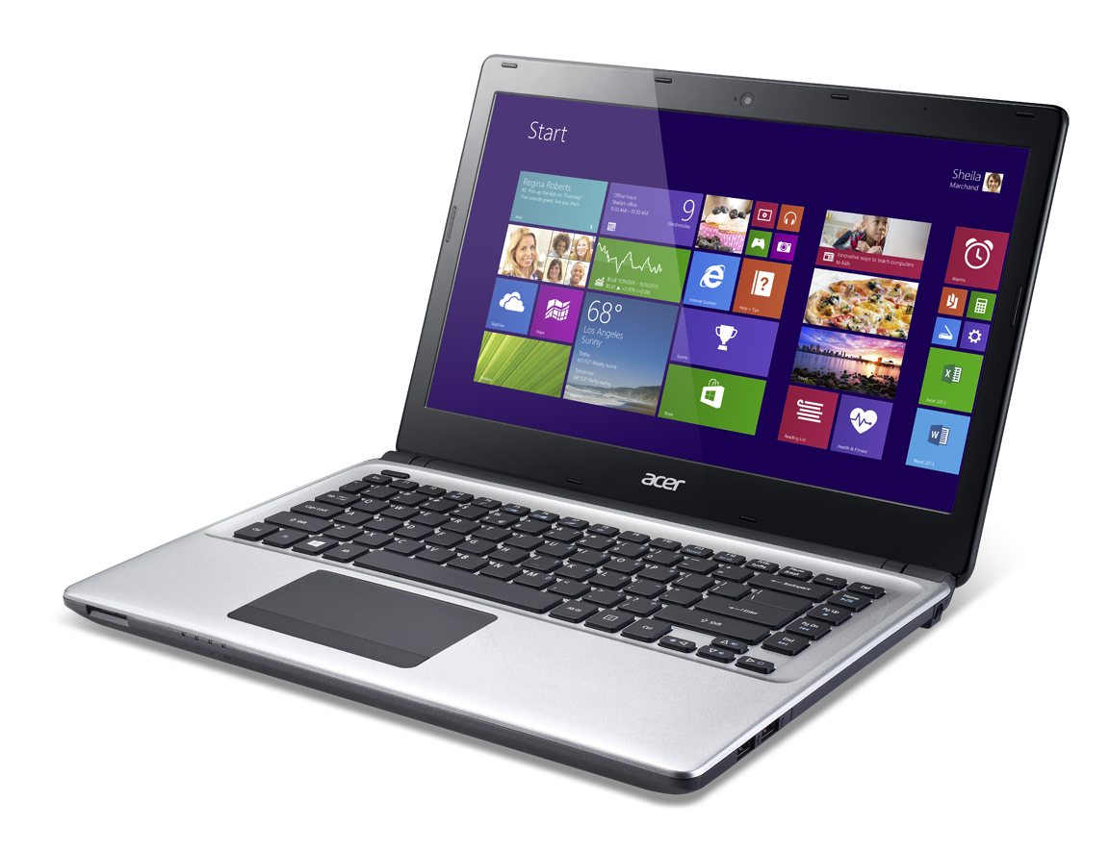

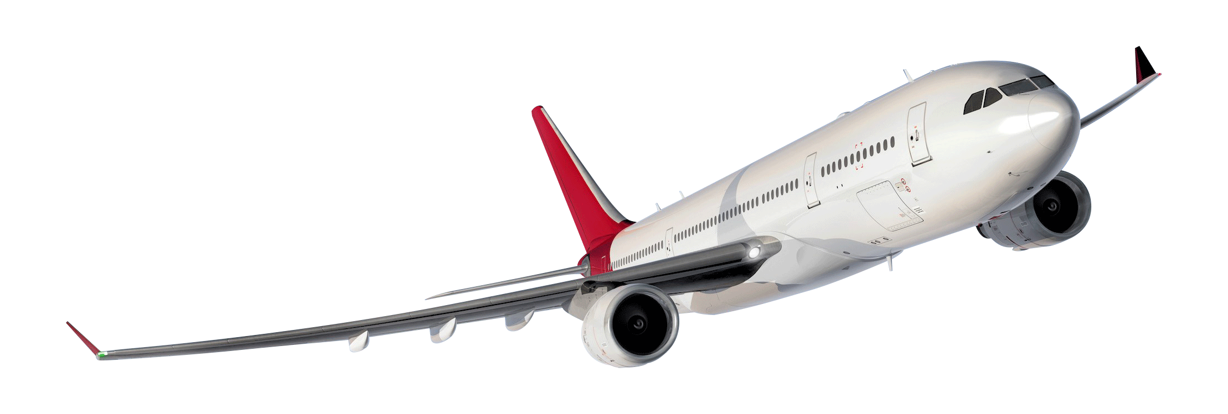
Things you can find in a museum
NOW AND THEN
calculator
typewriter
airplane
هذه الصورة بواسطة كاتب غير معروف مرخصة بالاسم CC BY-NC
هذه الصورة بواسطة كاتب غير معروف مرخصة بالاسم CC BY-NC

Slide 12
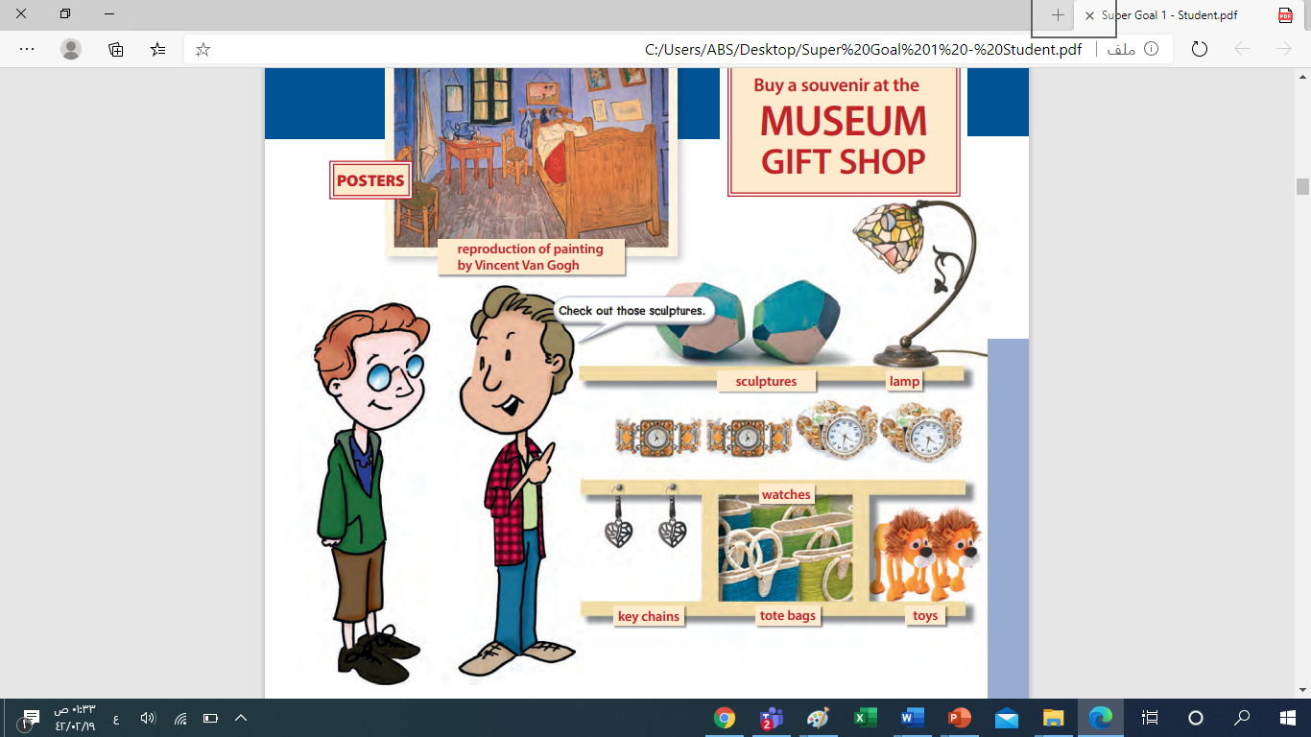

A gift shop:
It's a shop that sells souvenirs

Slide 13
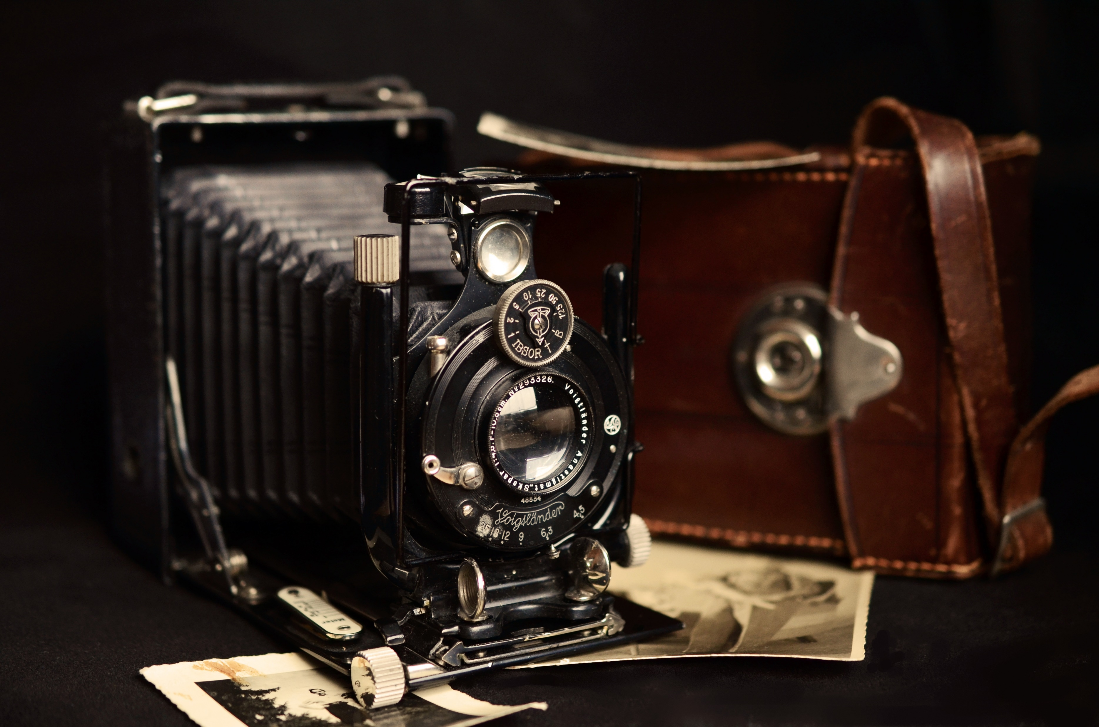
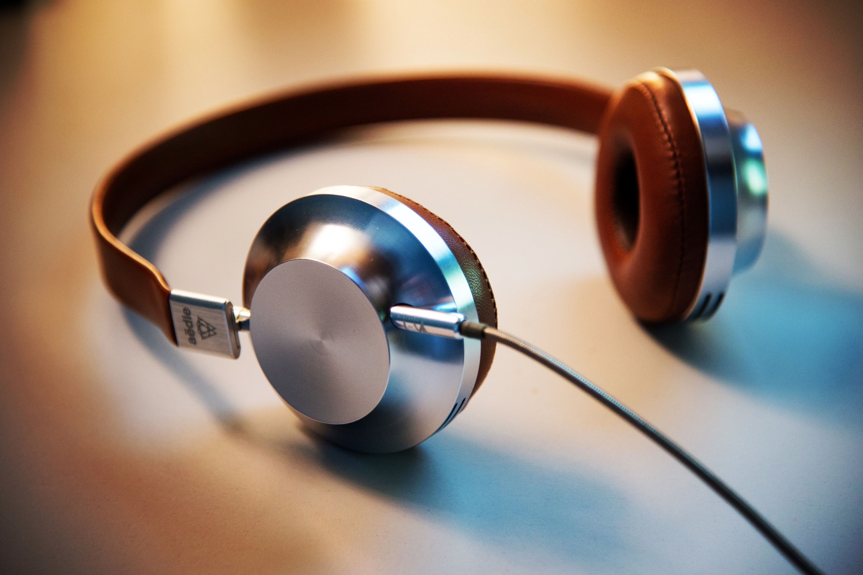
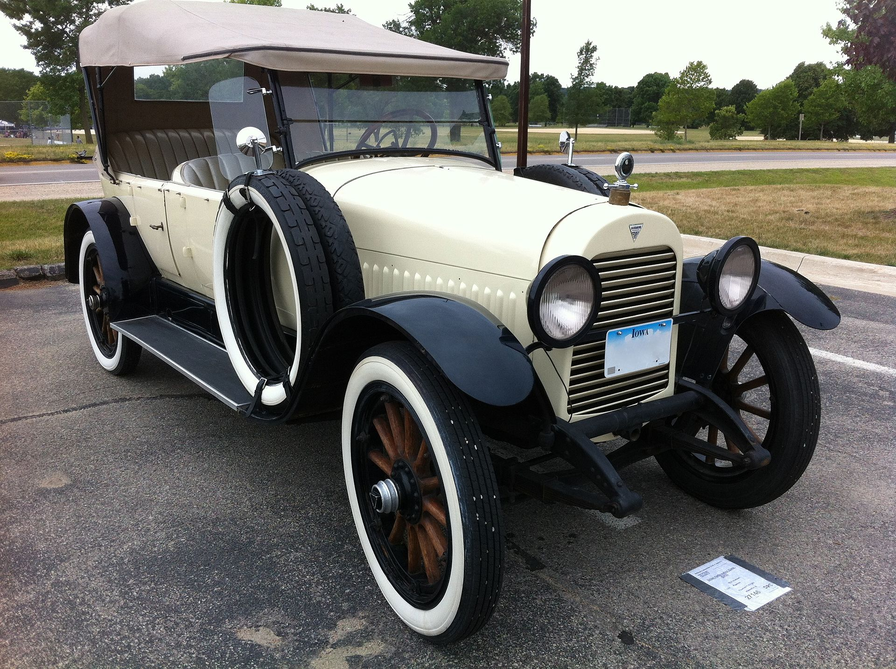
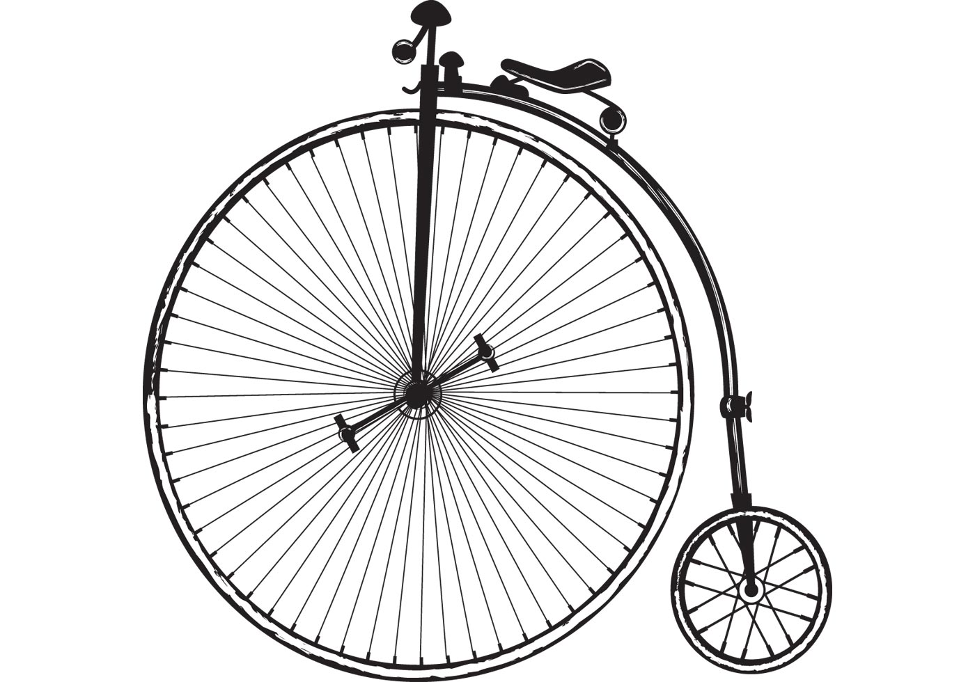
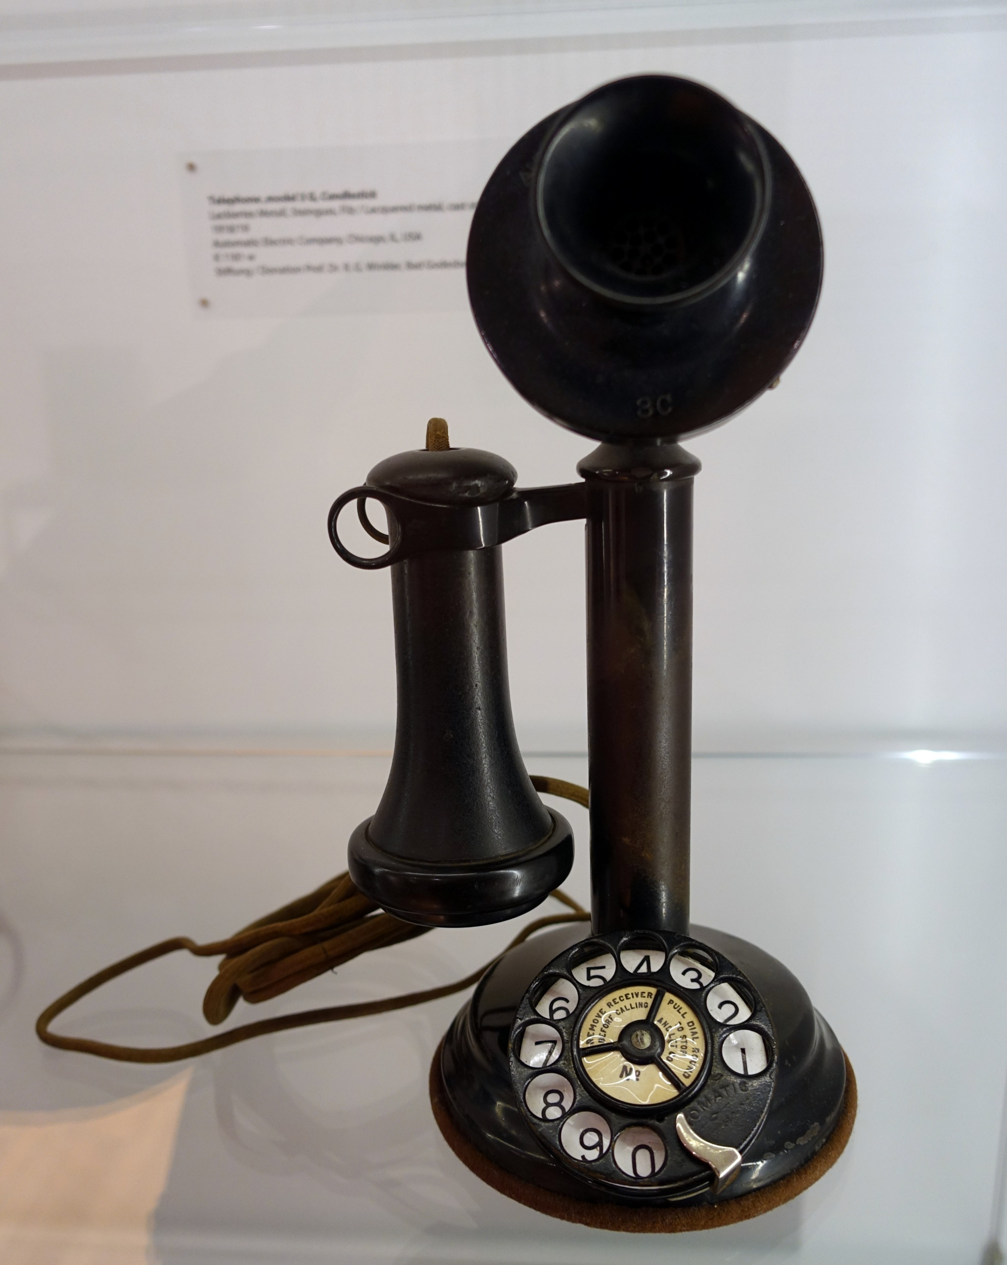
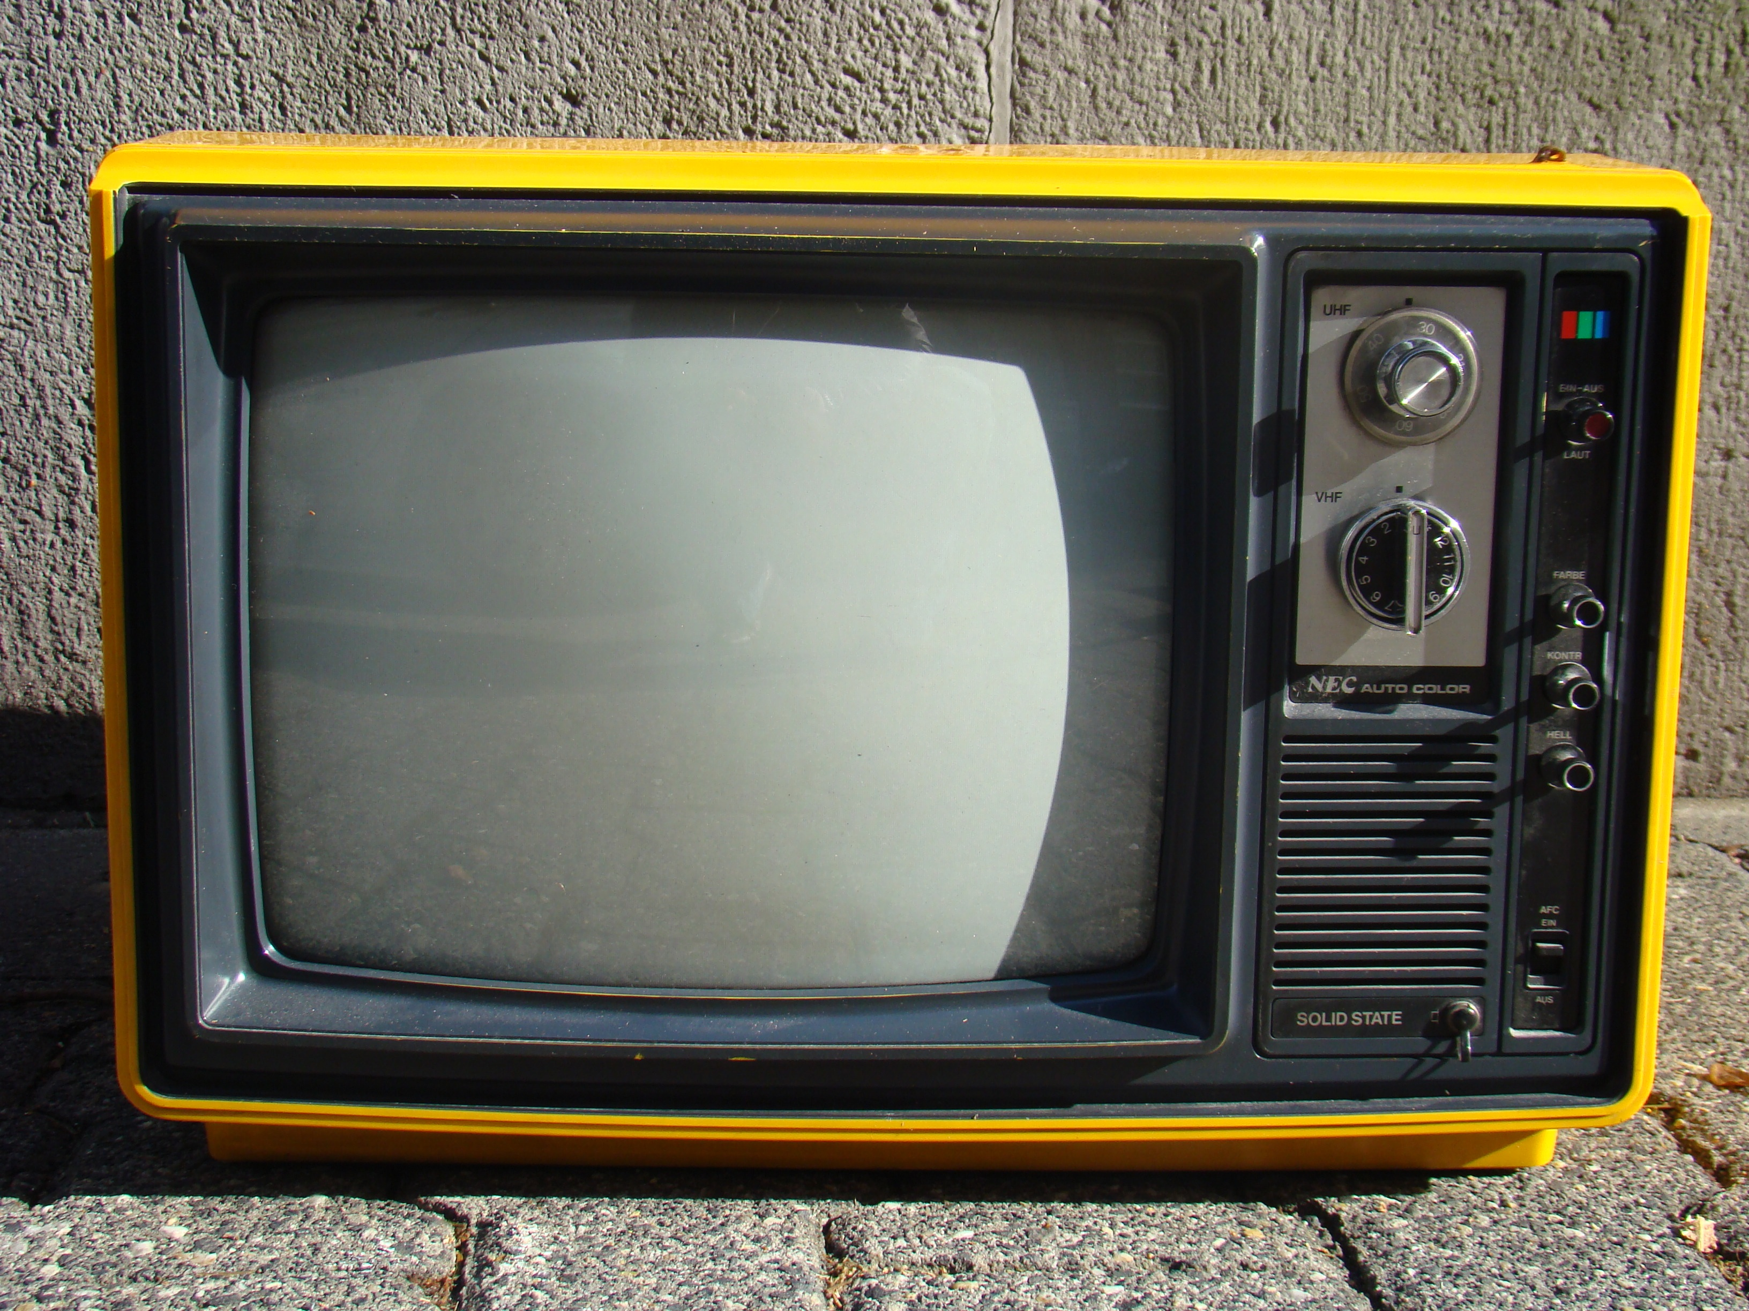
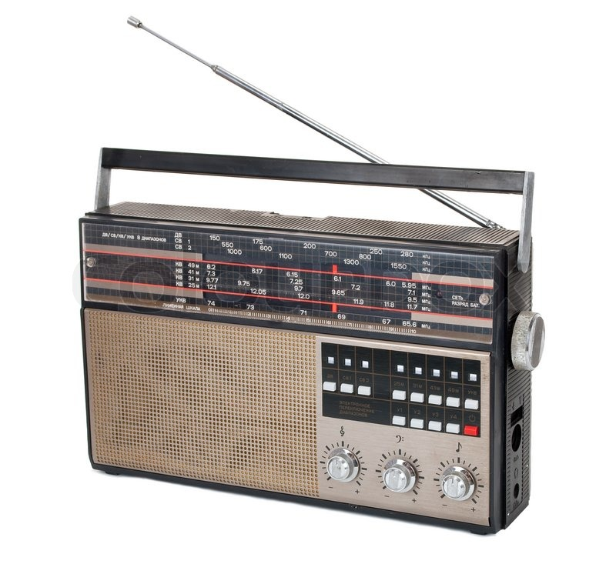
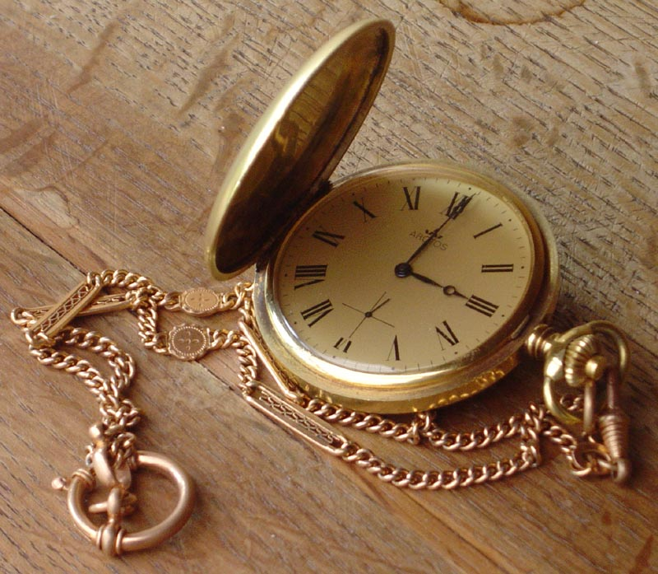

car
camera
headphones
bicycle
telephone
television
radio
watch
Key chains
هذه الصورة بواسطة كاتب غير معروف مرخصة بالاسم CC BY-SA
Notes:
Click on a numbered square to make the square disappear.
Click on the image to reveal it. All the squares will disappear.

Slide 14

zoo
Gift shop
museum
Toys shop
It's a shop that sells souvenirs
hospital
bookstore
library
school
Choose one match
tekhnologic

Slide 15
Zookeeper
nurse
Police officer
builder
A person who can guide people and show them different places.
Teacher
Housewife
Tour guide
Doctor
Choose one match
tekhnologic

Slide 16
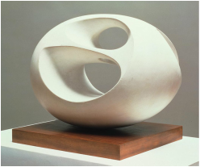
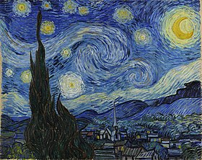
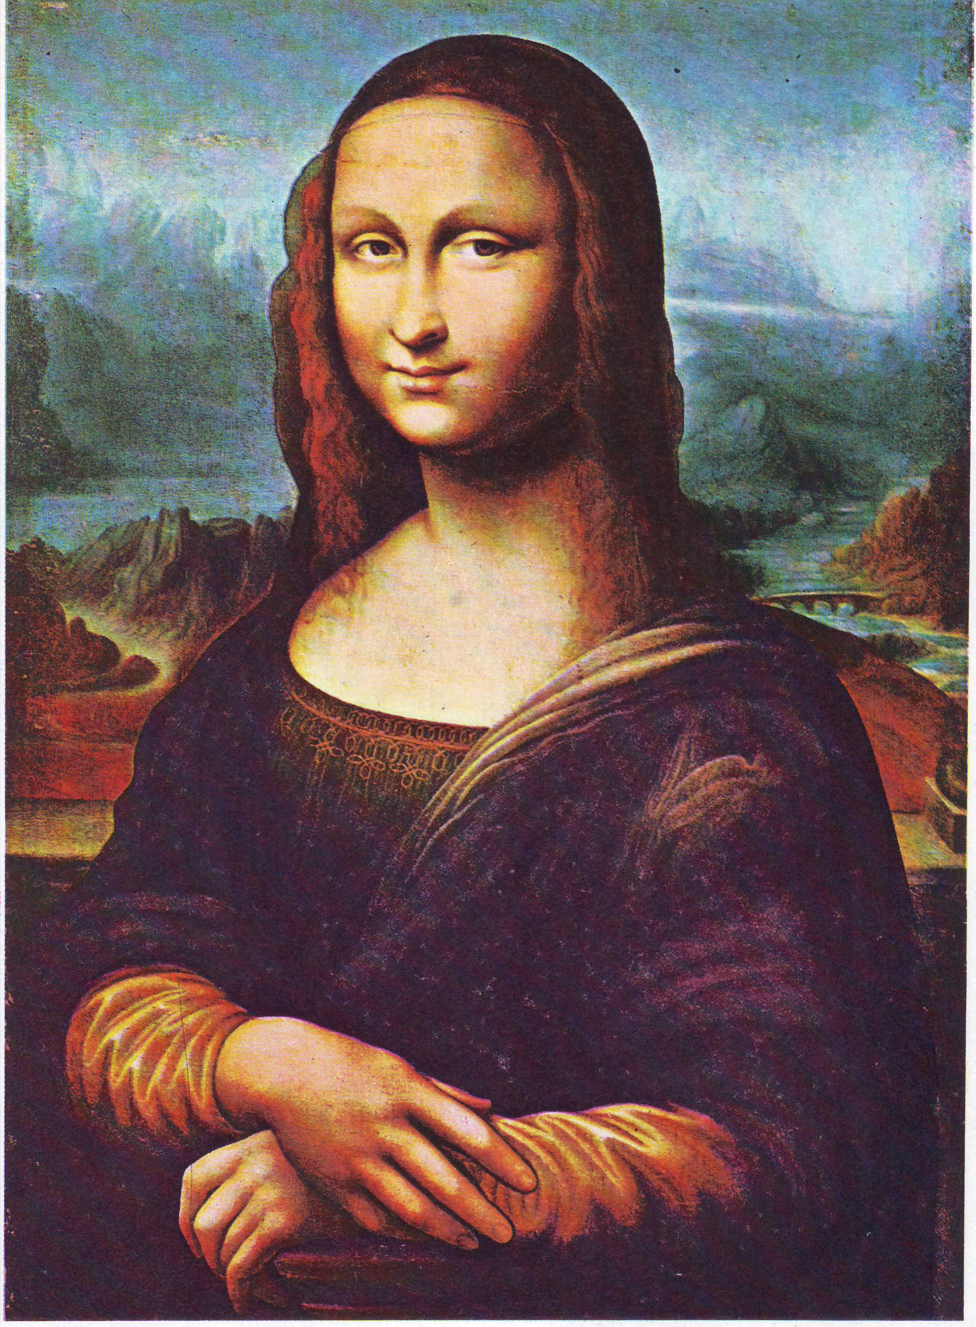
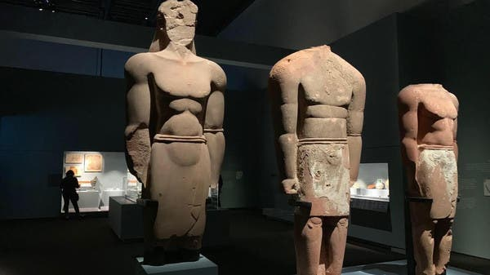
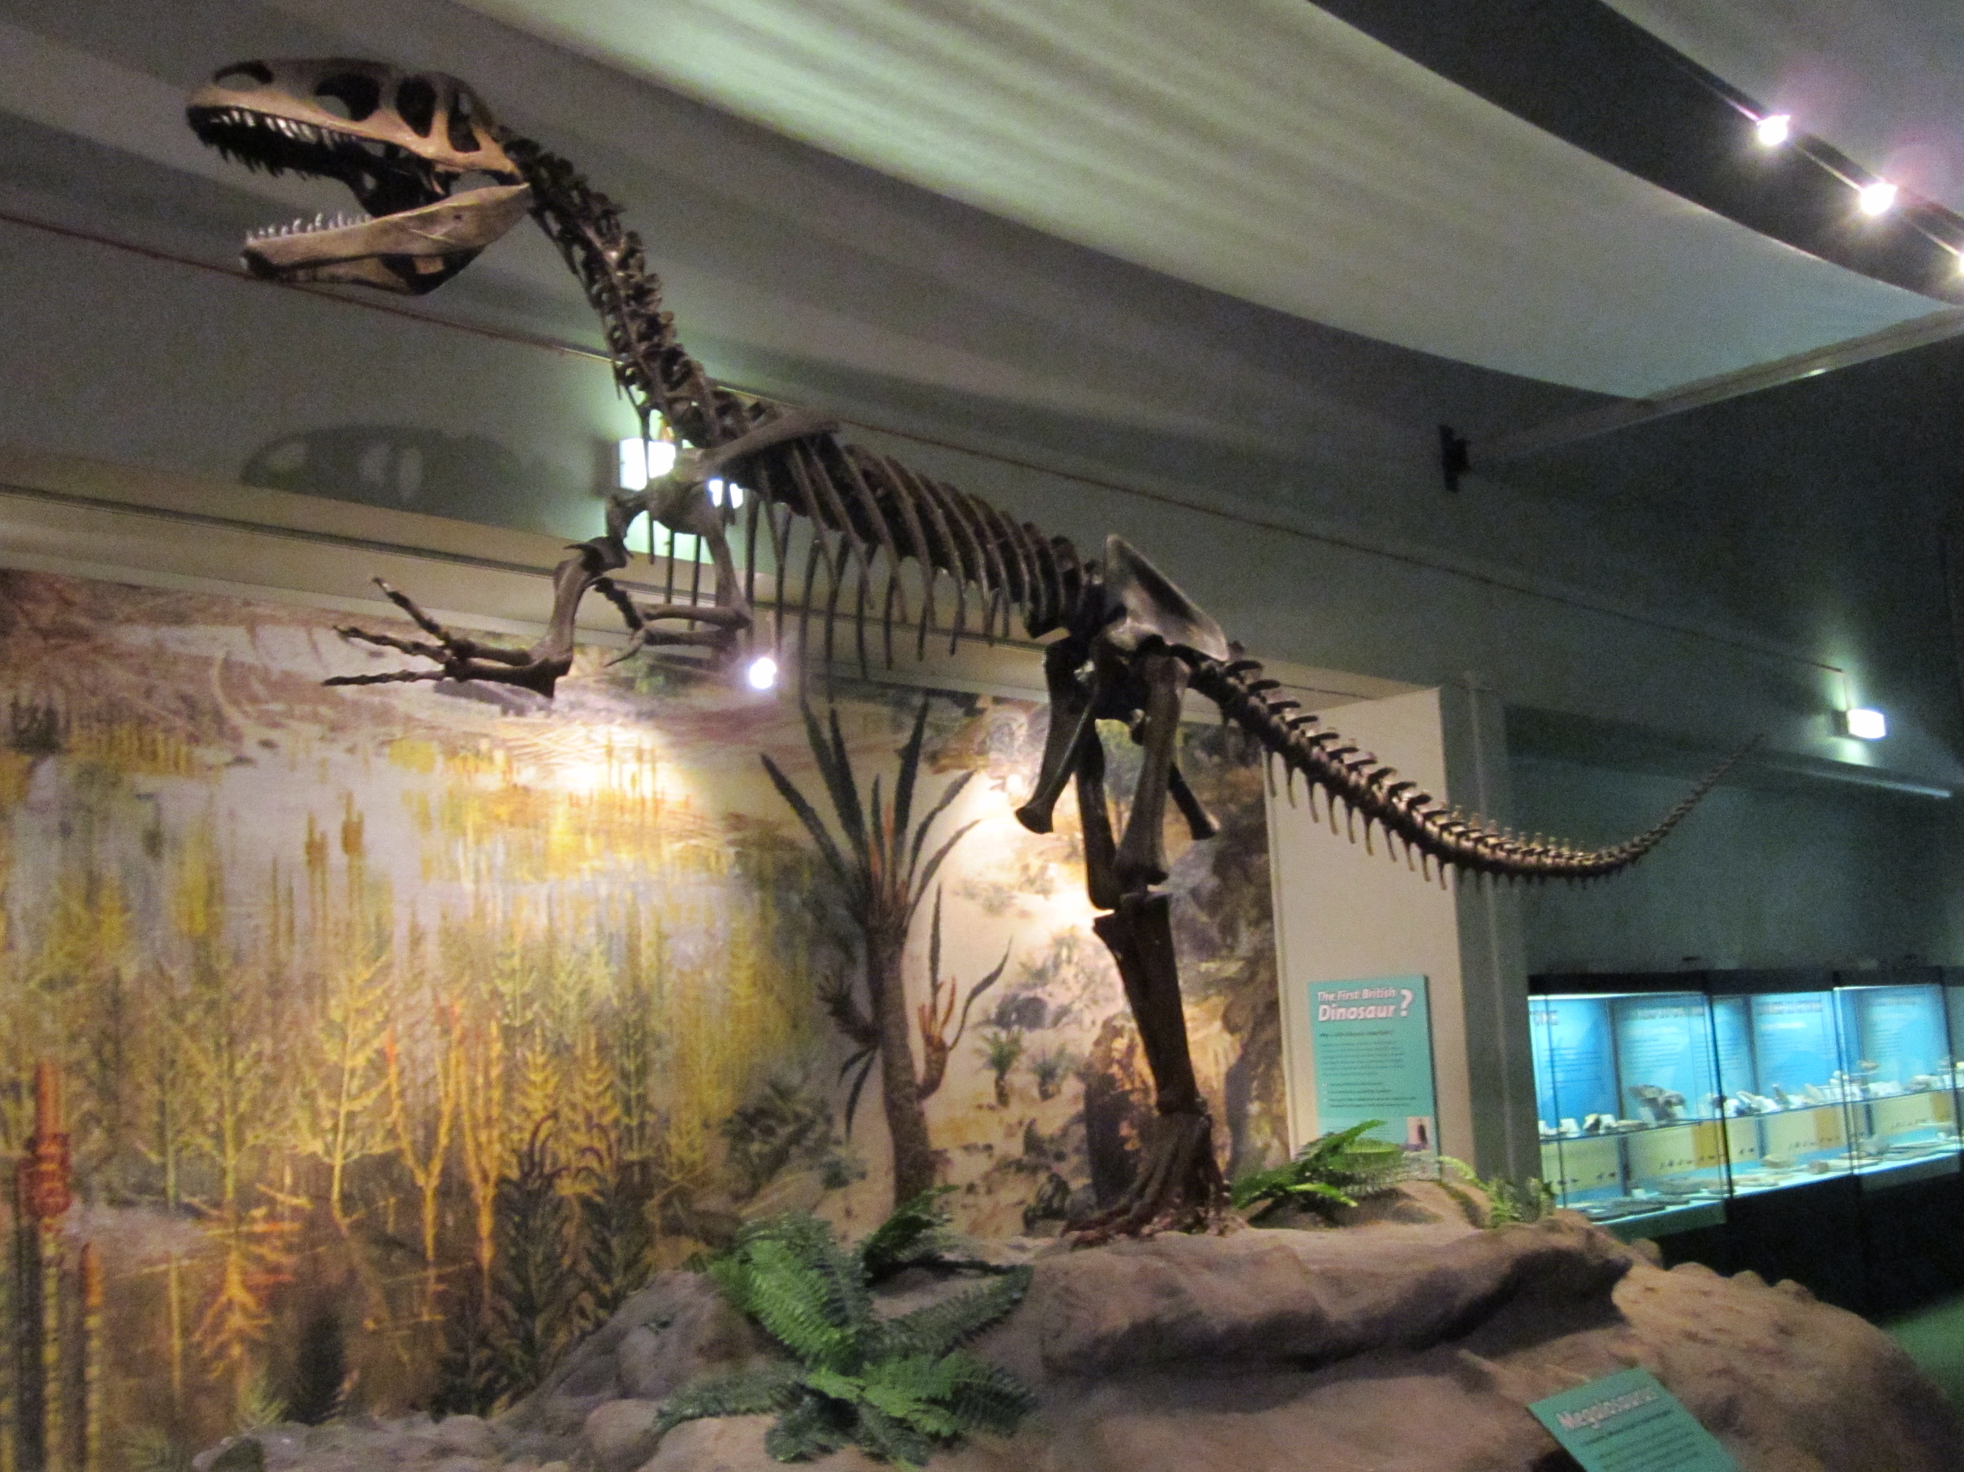
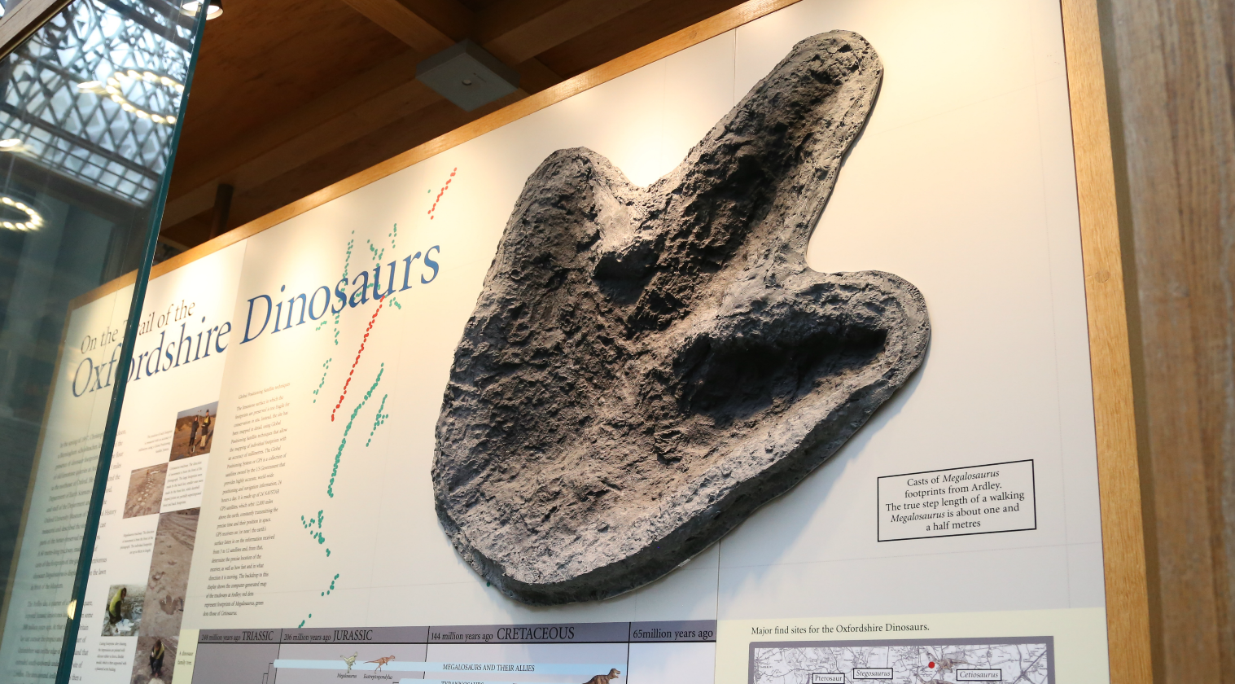
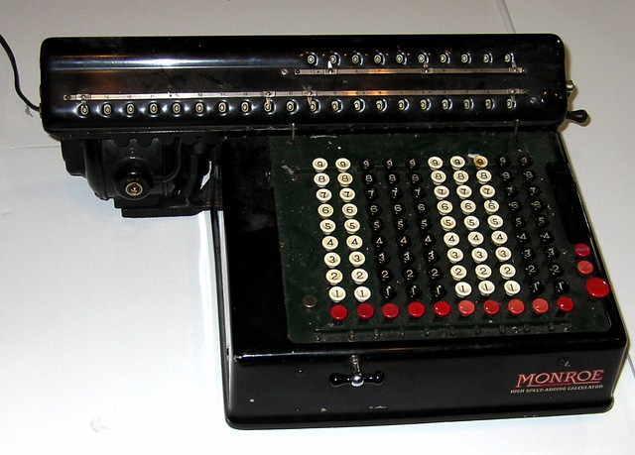
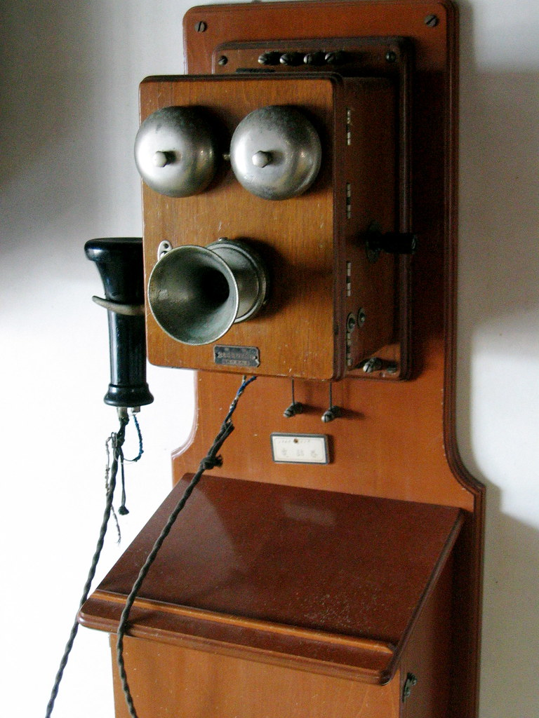
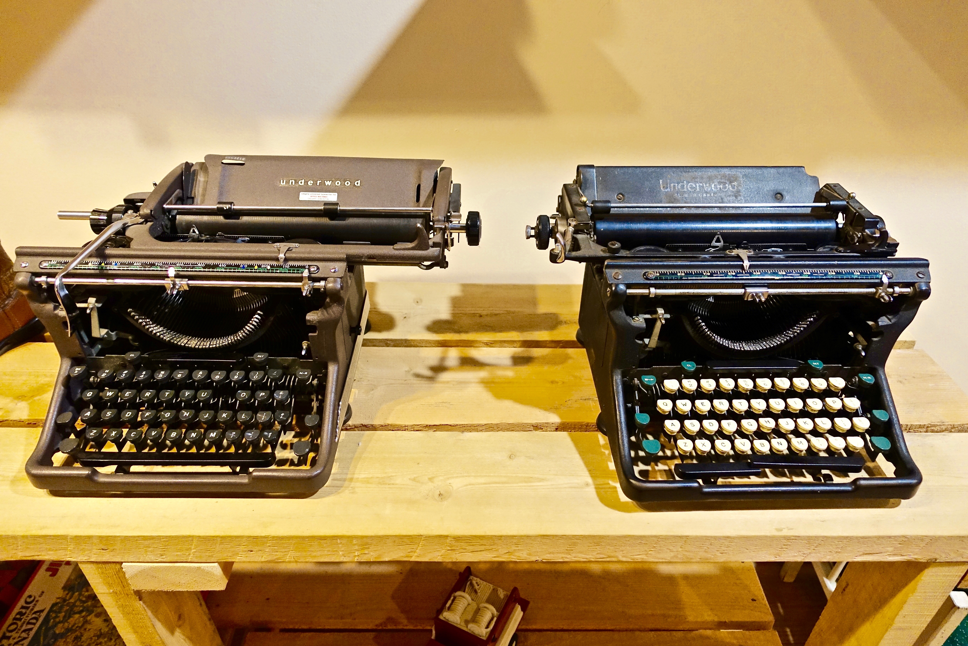
What can I find in a museum?
Paintings
Museum
Sculptures
Fossils
Science and technology gallery
هذه الصورة بواسطة كاتب غير معروف مرخصة بالاسم CC BY-SA
هذه الصورة بواسطة كاتب غير معروف مرخصة بالاسم CC BY-SA-NC

Slide 17

Unscramble the following words
1-seuumm
2-rwtrypeie
3-caltorcula
4-Spturcule
Use the chat box to write your answer

Slide 18
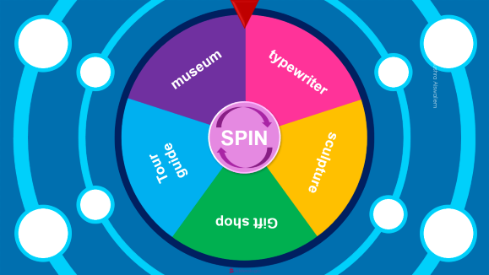

Spin the wheel then make
a sentence

Slide 19


museum
typewriter
SPIN
Tour guide
sculpture
Gift shop
tekhnologic
Notes:
5 Segments

