Slide 1







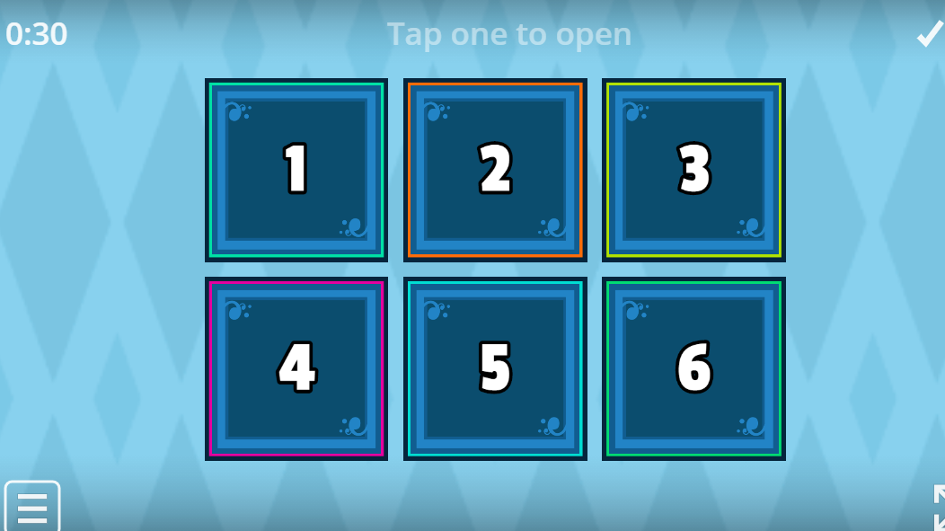



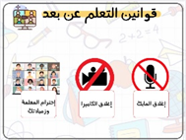
Revision
} وقل رب زدني علما {
هذه الصورة بواسطة كاتب غير معروف مرخصة بالاسم CC BY-NC

Slide 2
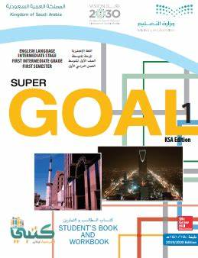


Unit : 4
Around The World
Grammar

Slide 3

Objectives
The student will be able to :
*use verb to be in negative and in questions .
*makequestions using Where .
*use preposition in sentences .

Slide 4


Slide 5


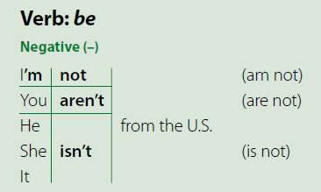
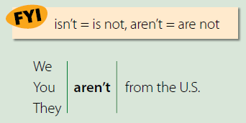
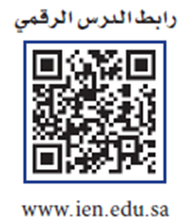
Page 28
What’s the contraction for is not?
isn’t
What’s the contraction for are not?
aren’t
☺☺ the apostrophe replaces the omitted letter o.
For example,
Paris isn’t the capital of Spain, or I’m not from ………country

Slide 6

Example:
-
He is from Saudi Arabia .
……………….from Saudi Arabia? ( Yes\No Questions )
Yes,………...
No,……………...
She isn’t from Oman.
……………………………..from? ( Wh. Questions )

Slide 7
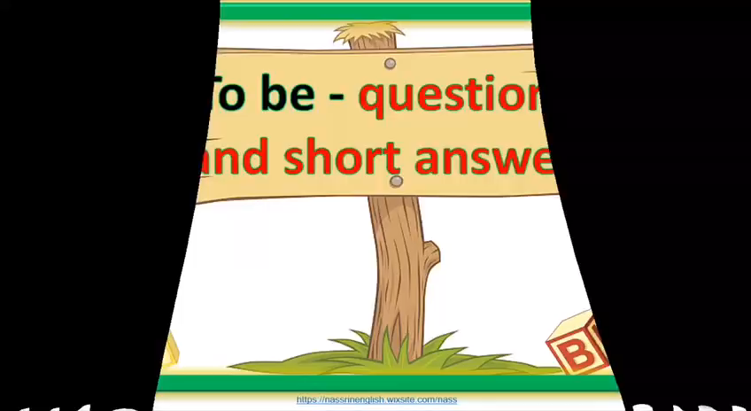

Slide 8
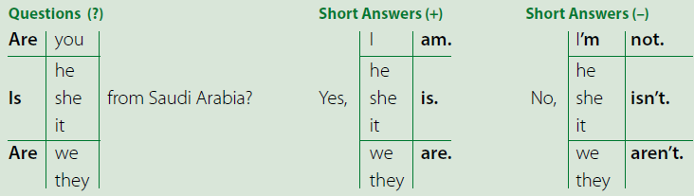
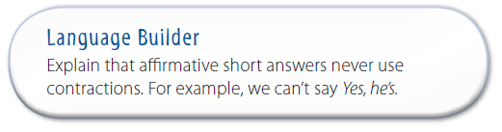
affirmative sentence
He’s from China.
Is he from China?
Yes, he is. and No, he isn’t.

Slide 9
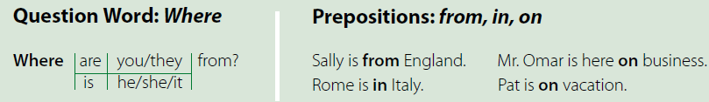
Questions with Where and other question words use the same inversion of subject and verb as the yes/no questions.

Slide 11
https://whiteboard.fi/n22ty

Slide 12
Evaluation

Slide 13





Assign pages 102–103 for practice with the grammar of
the unit.

