Slide 1

Super Goal 1

Slide 2

What animal that is not exist in our planet any more?

Slide 3
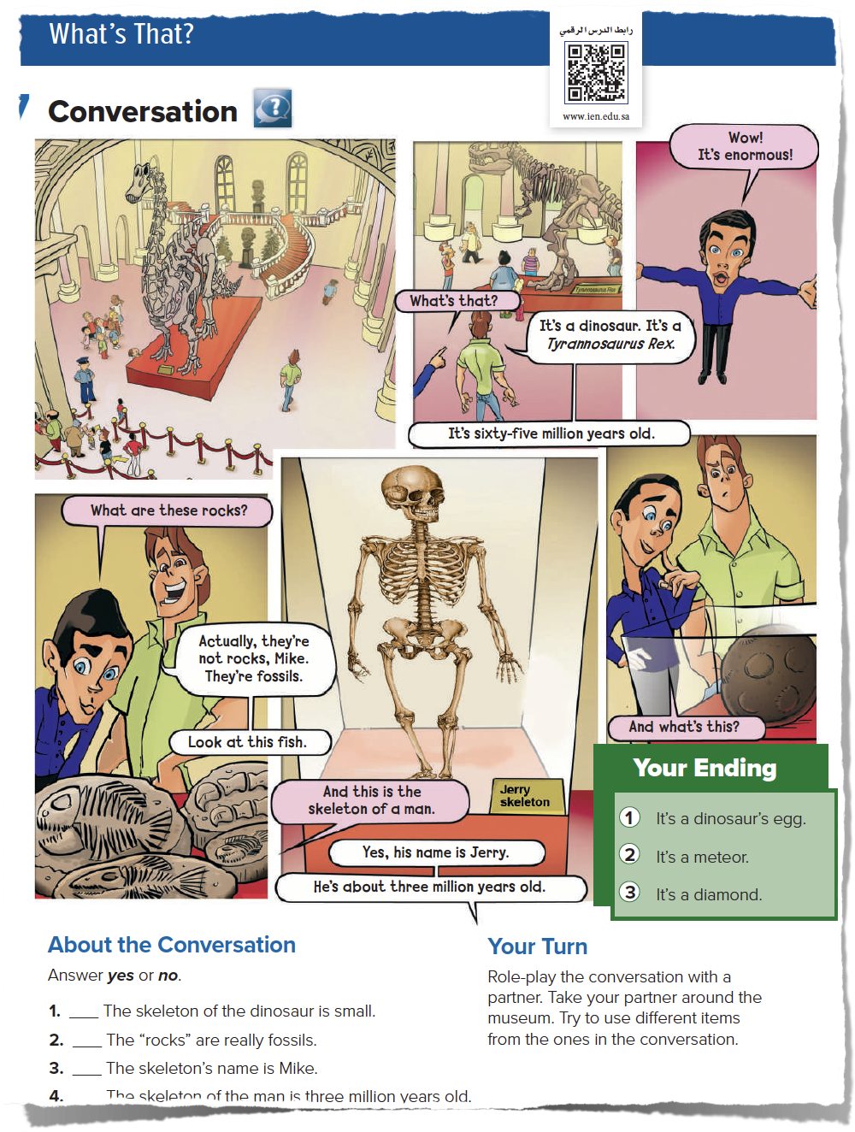
Page 22
Lesson’s Objectives

Slide 4
  -Read and Listen to a conversation.
  -Identify new vocabulary.
  -Role-play a conversation with classmates.
  - Discuss and answer questions.
Lesson’s Objectives

Slide 5
Today’s strategies
  Picture Reading
  Role play
  Brainstorming

Slide 6
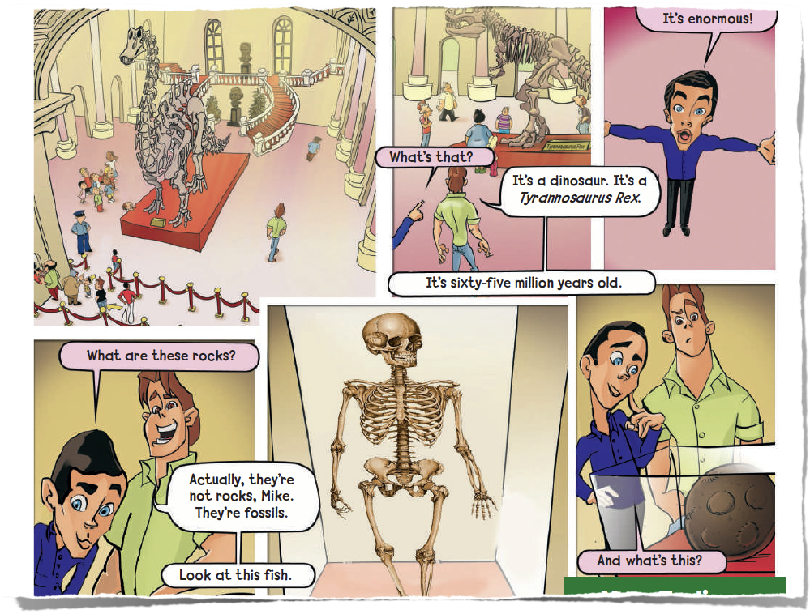
What do you see?
How many characters are there?
Where are these people?
Now listen to the conversation

Slide 8
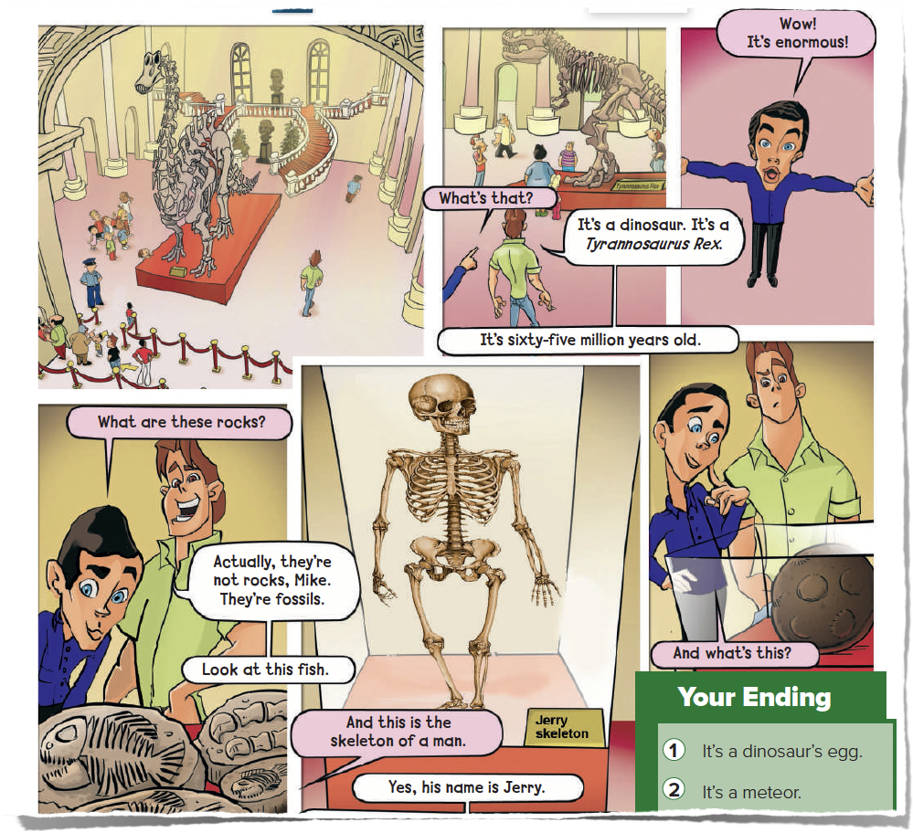
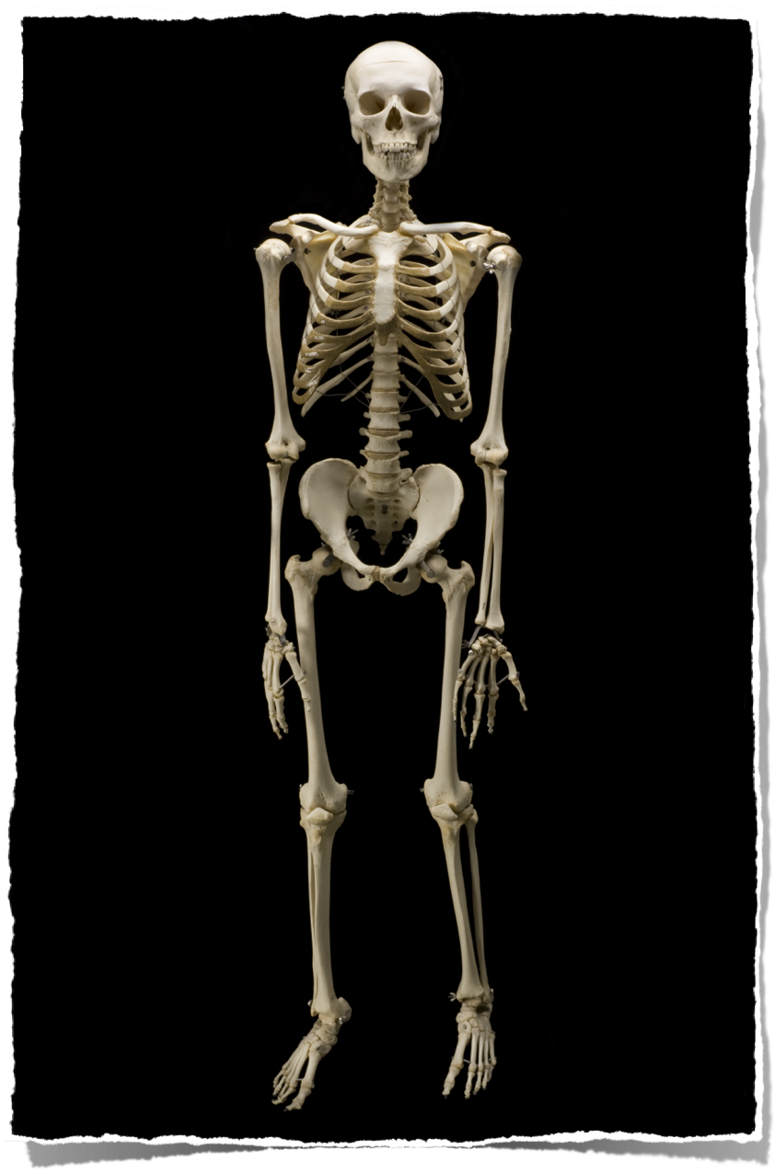




Slide 9
How many bones in your body?
206 bones

Slide 10
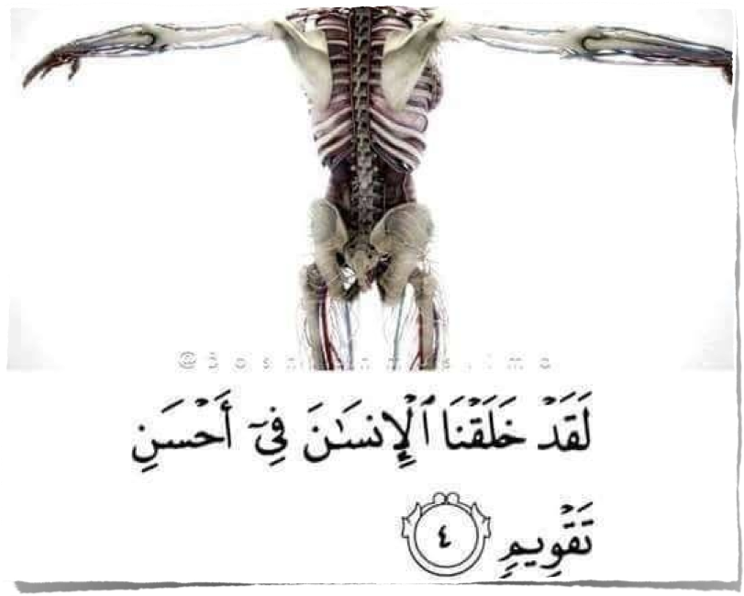

Slide 11
Do you know that there are fossils in Saudi Arabia?!

Slide 12
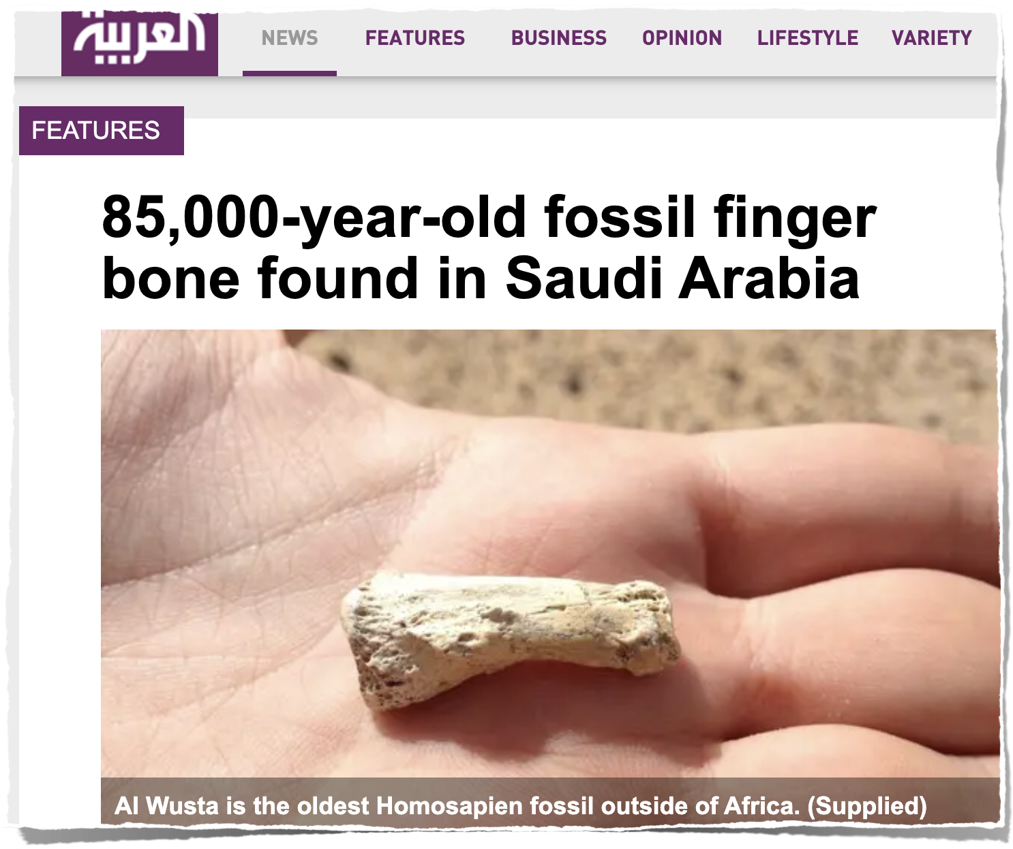

Slide 13
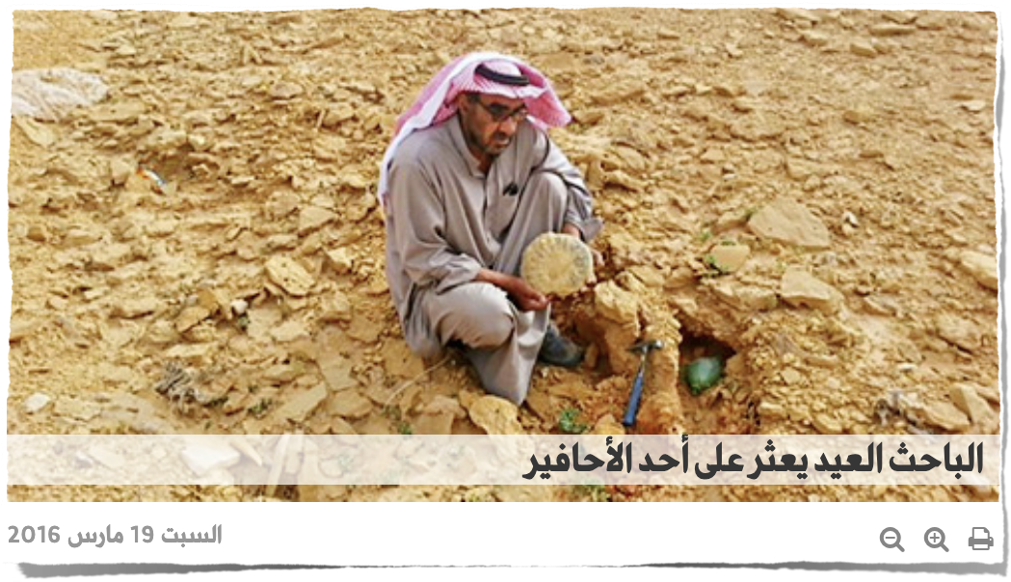

Slide 14
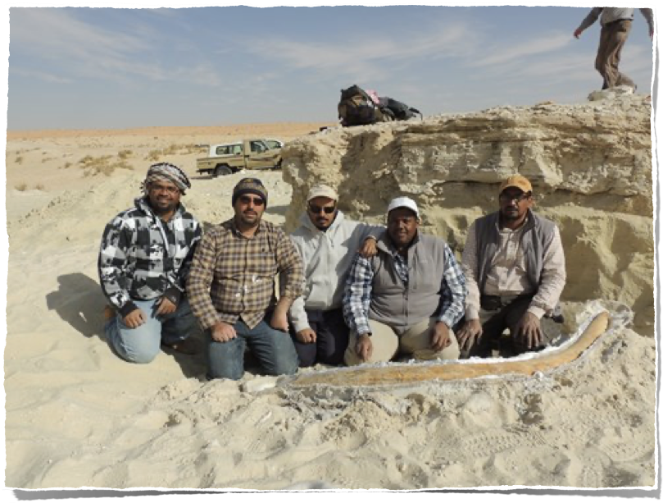

Slide 15
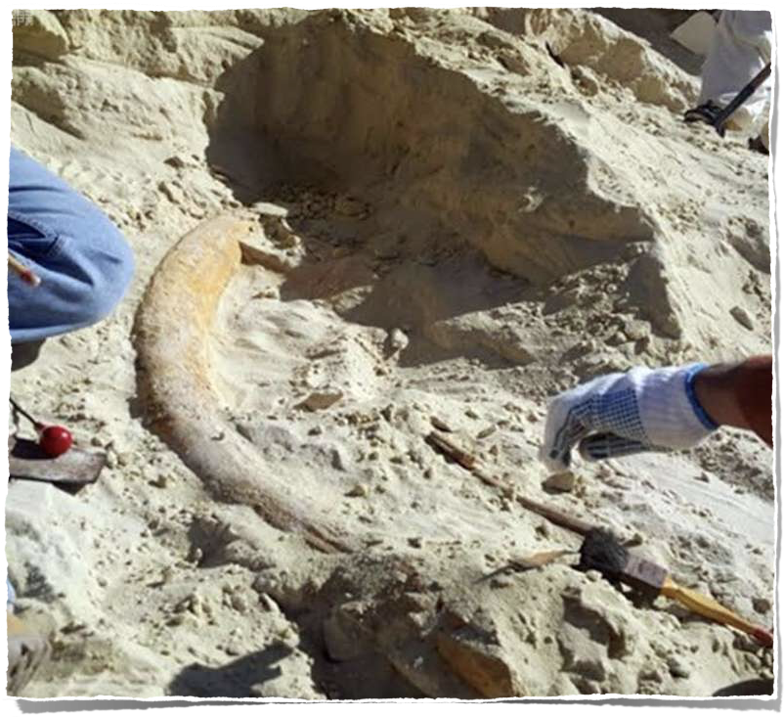
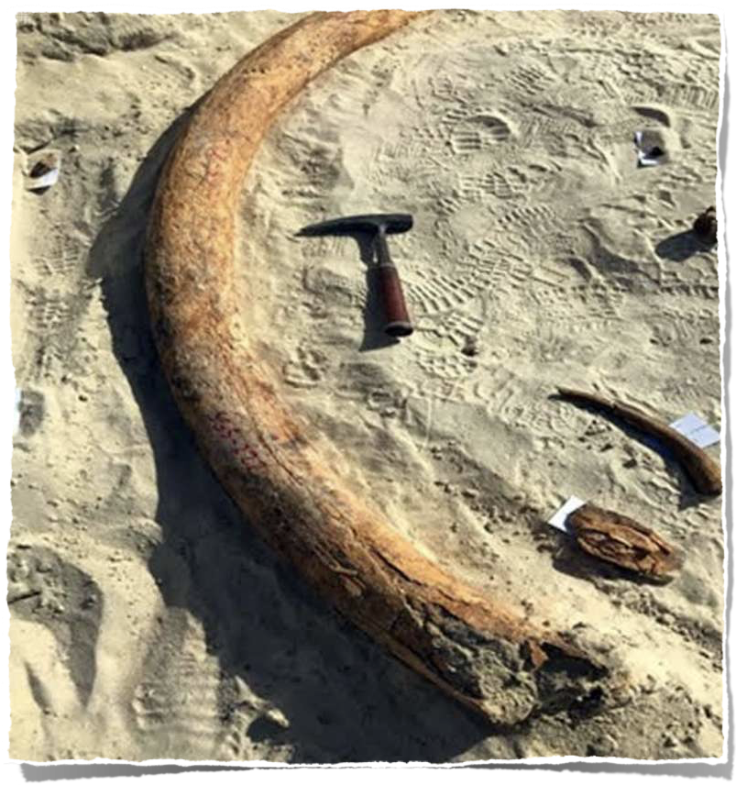

Slide 16
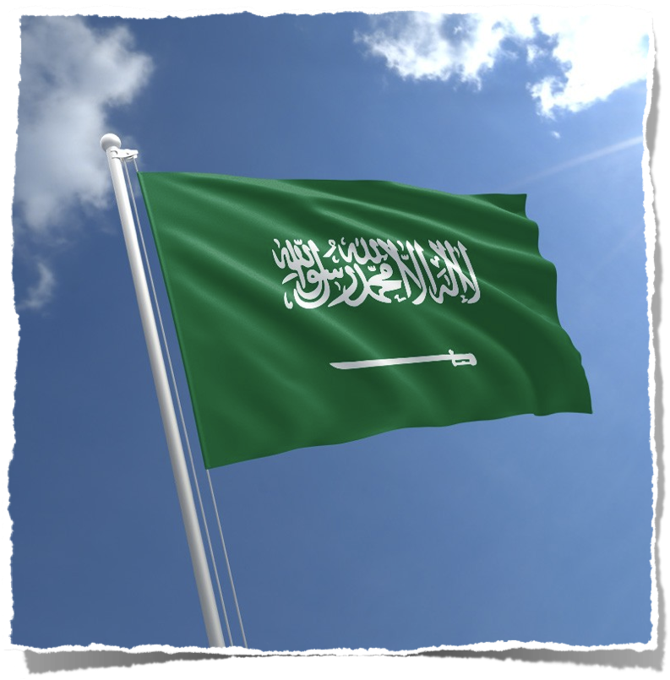
By opening the Kingdom of Saudi Arabia its doors to tourism within the Vision of 2030, Fossils have very important historic value.

Slide 17
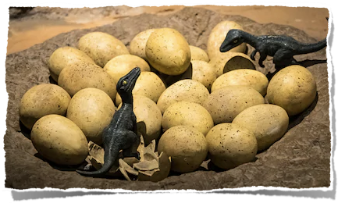
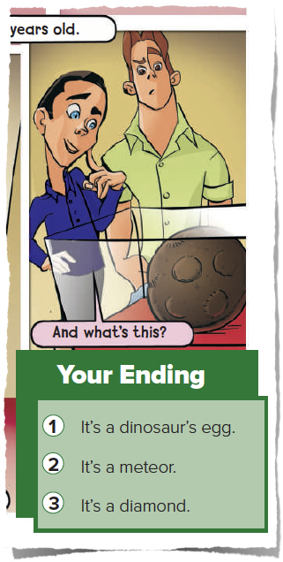
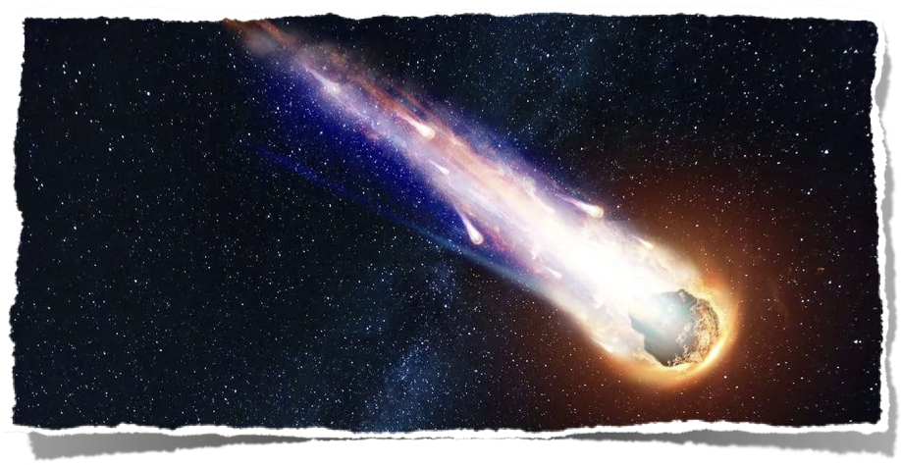

Which ending do you agree with?

Slide 18
It is time to read

Slide 19
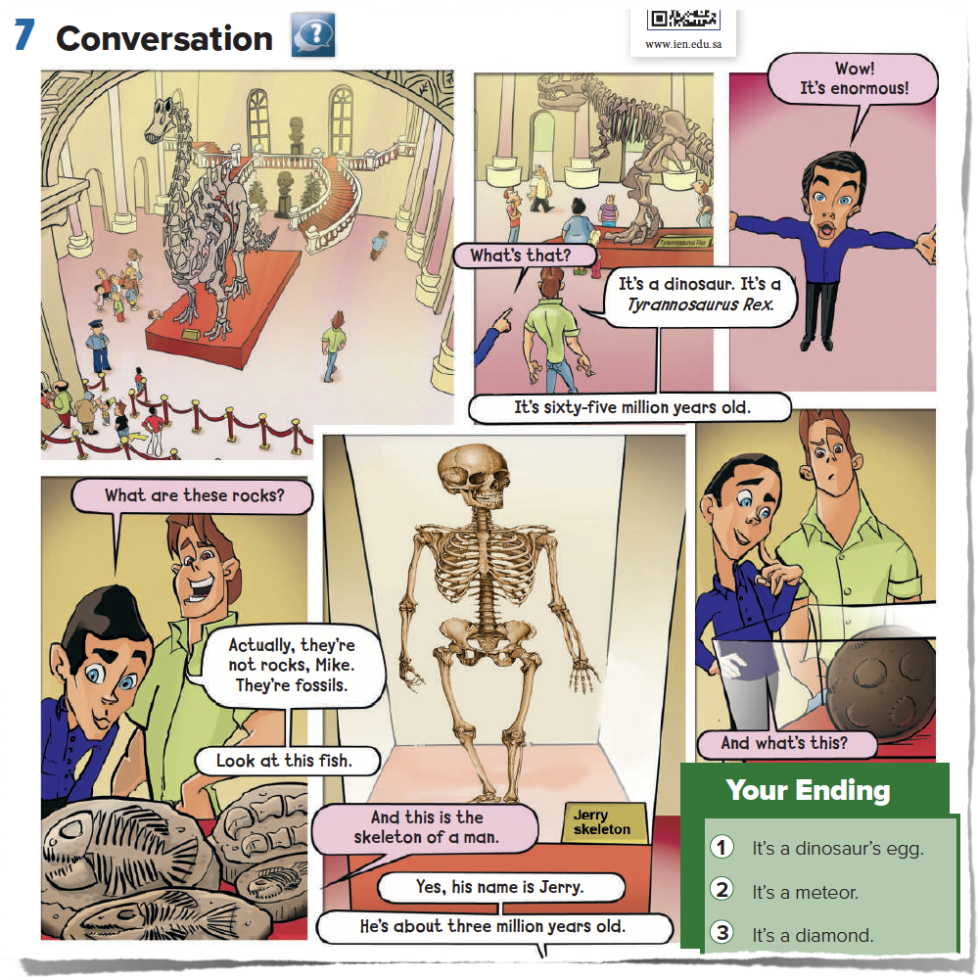

Slide 20

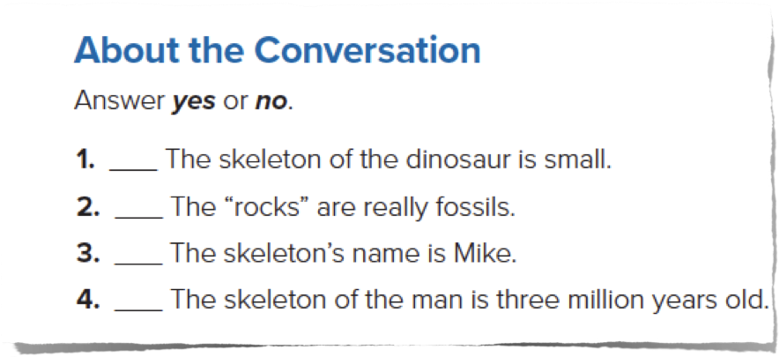
Page 22
No
Yes
No
Yes

Slide 21
The name of the dinosaur is : Tyrannosaurus Rex
True
False

Slide 22
What is this?
Skeleton

Slide 23
The skeleton's name is
Mike
Jerry

Slide 24
Find the word that means (very big) in the conversation.
Enormous

Slide 25
Ways of Encouraging Learner Autonomy
Collect some pictures of fossils
in Saudi Arabia.

Slide 26
“Homework”
2 Questions in Madrasti

Slide 27
Presented by
Noha Al Jammaz
o

