Slide 1
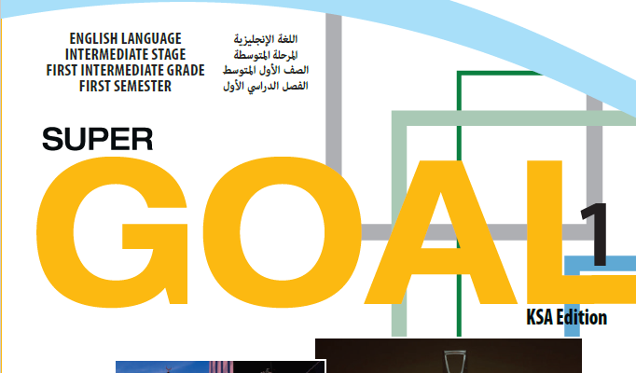

Slide 3
Where are you from?
How old are
you?
SPIN
What’s your
friend’s name?
How do you spell
Your name?
How are you today?
tekhnologic
Notes:
5 Segments

Slide 5
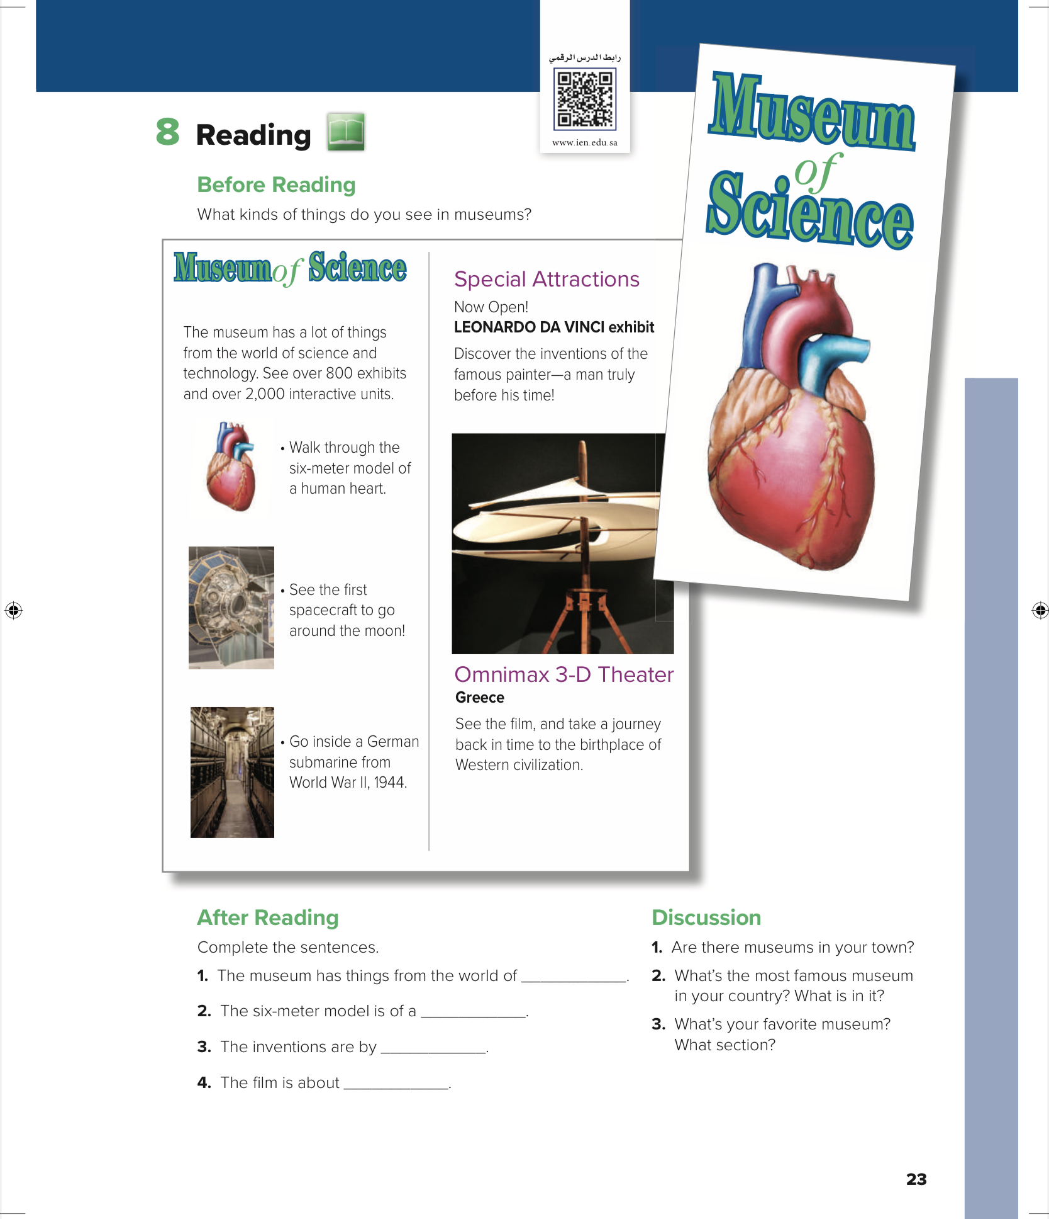
What’s That?
Unit 3
Page 23

Slide 6
SG1
Unit:3
Reading

Slide 7
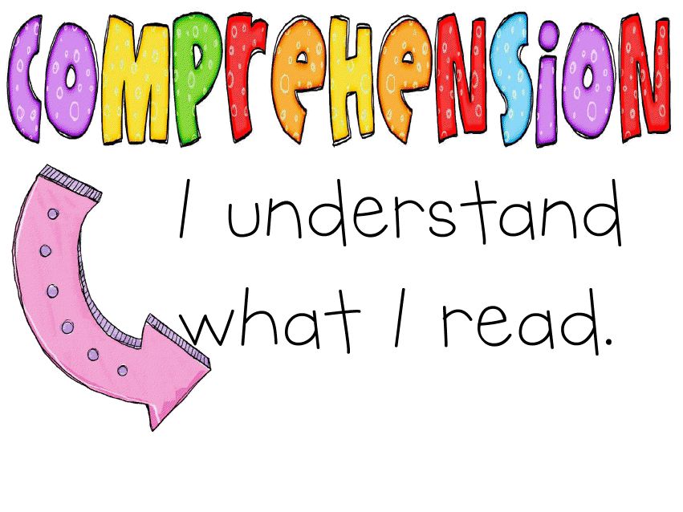
Page 23
Before reading
While reading
After reading

Slide 8
Objectives:
At the end of this session, the students will be able to:
complete sentences from the passage
design a brochure for a museum
answer questions from a passage.

Slide 9
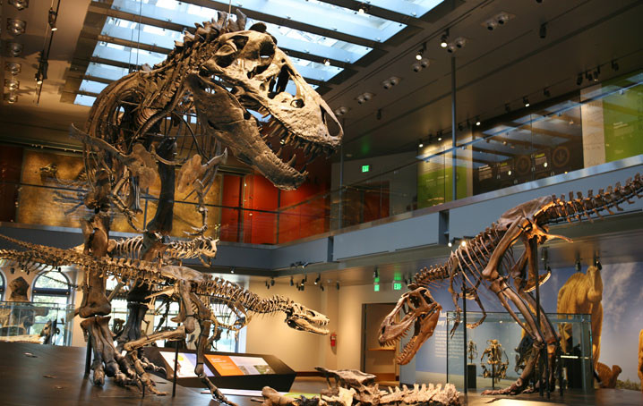
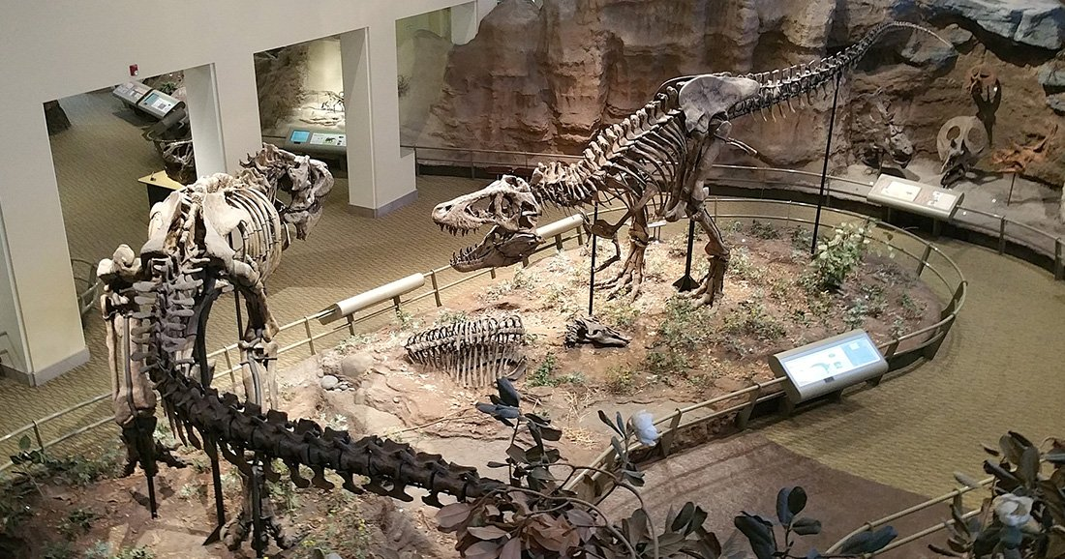
Science Museum

Slide 10
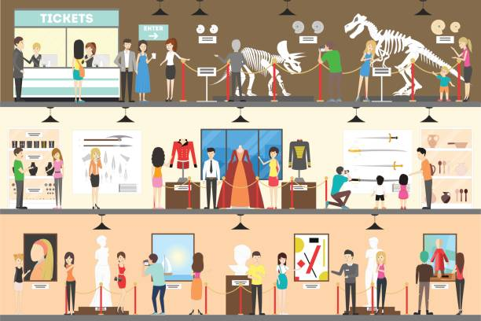
Page 23

Slide 11
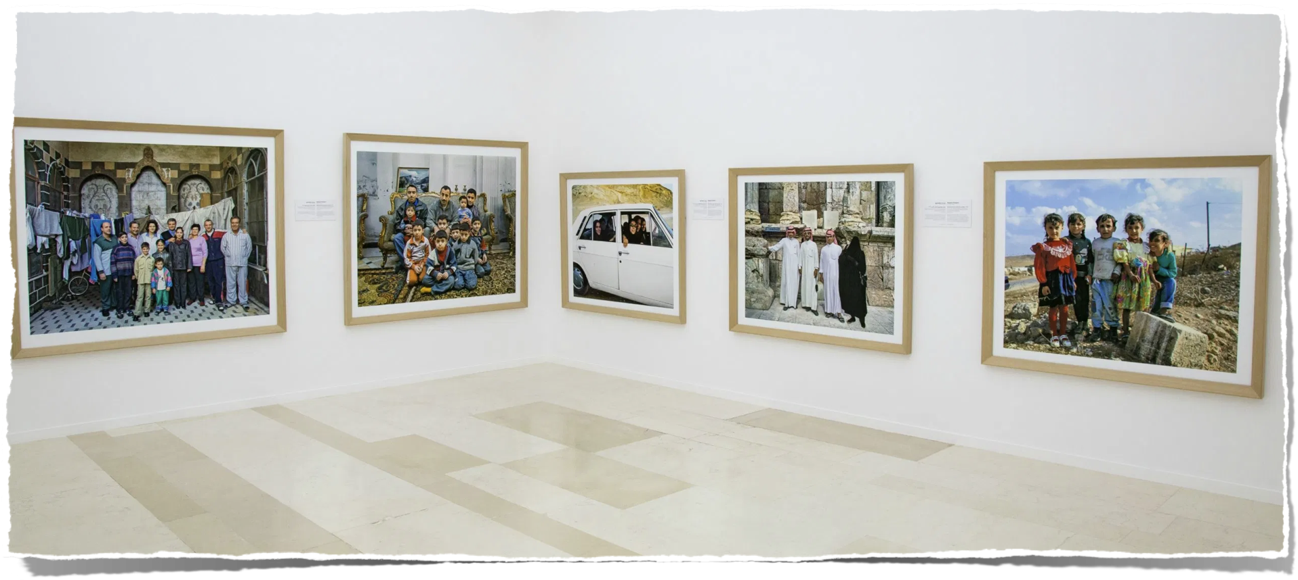
What kind of things do you see in museums?

Slide 12
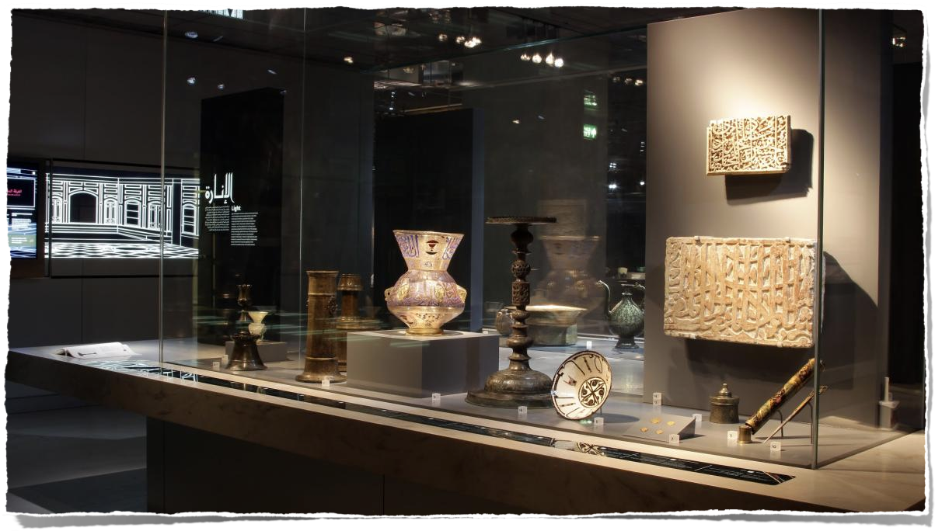

Slide 13
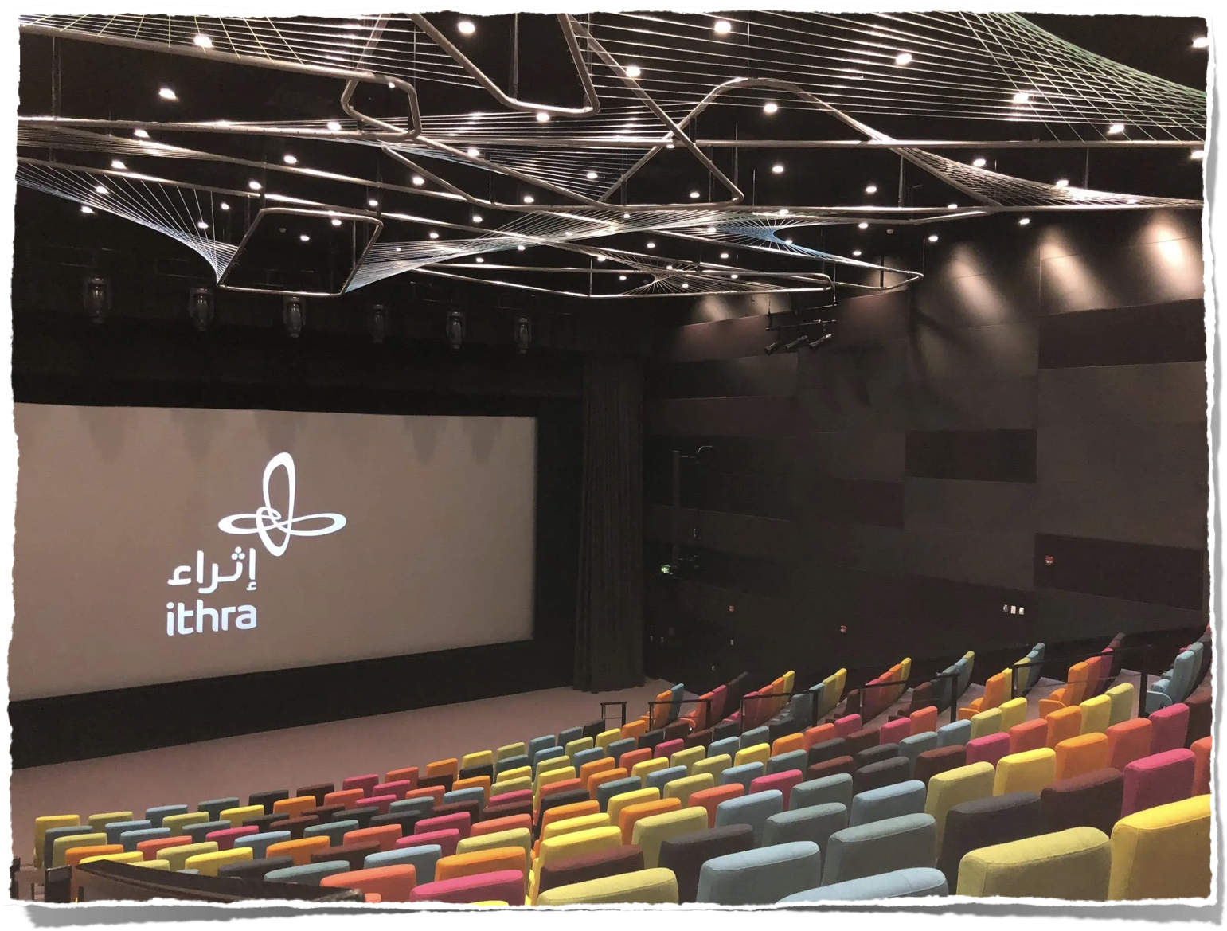

Slide 14
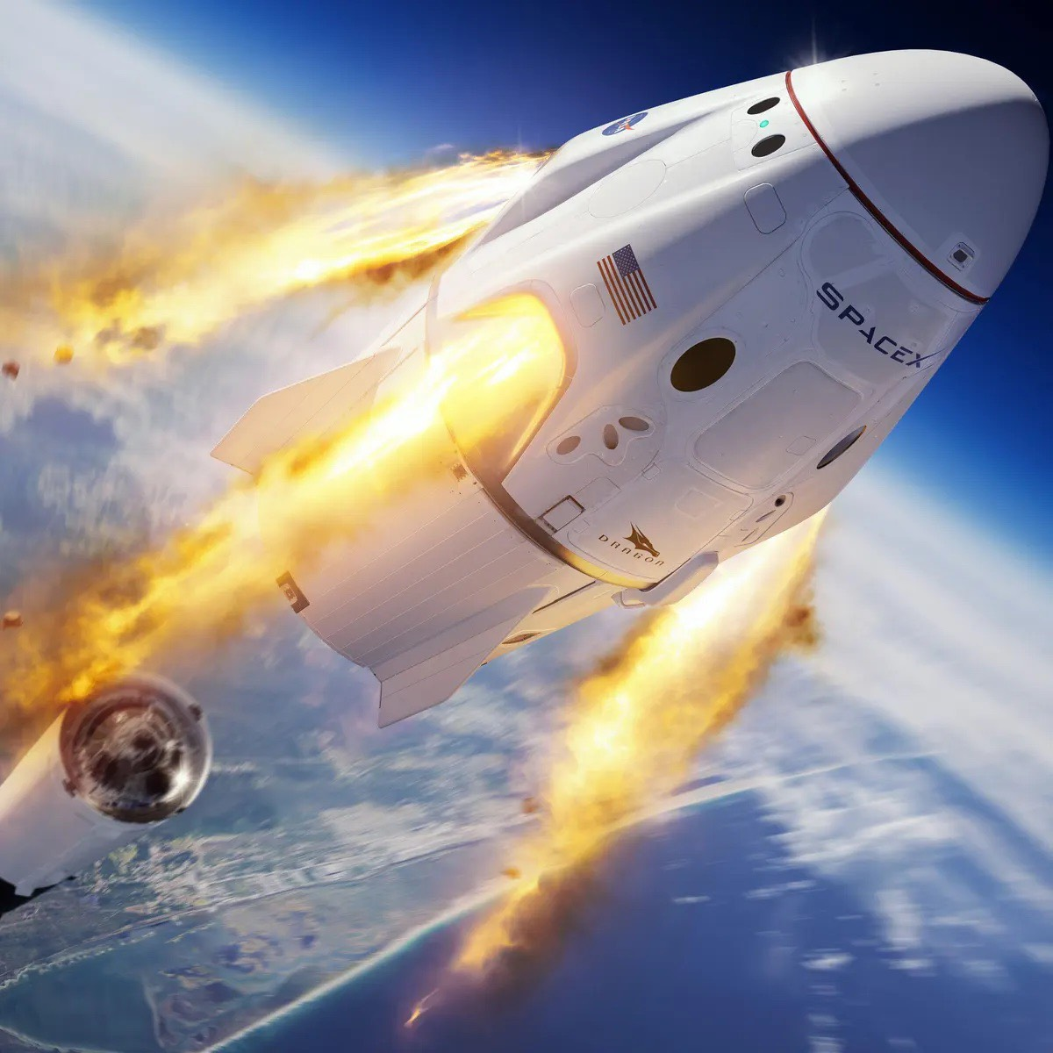
Spacecraft

Slide 15
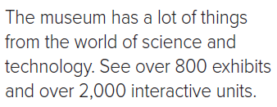
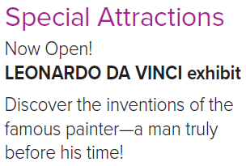
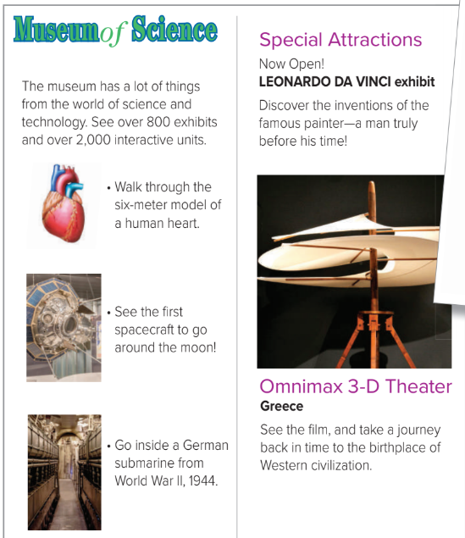
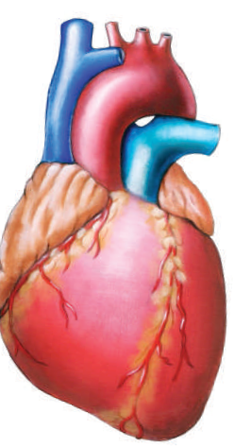
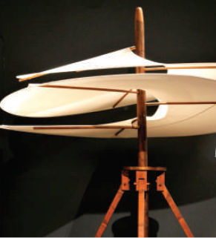
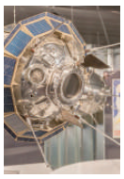
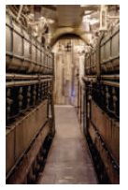
What is the title?
How many paragraphs?
How many lines?
Find numbers
Page 23

Slide 16
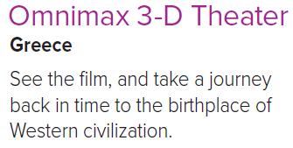
Page 23

Slide 17
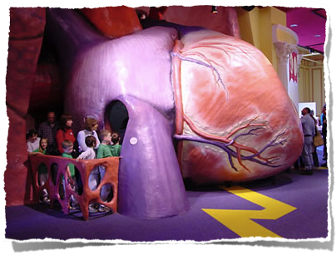
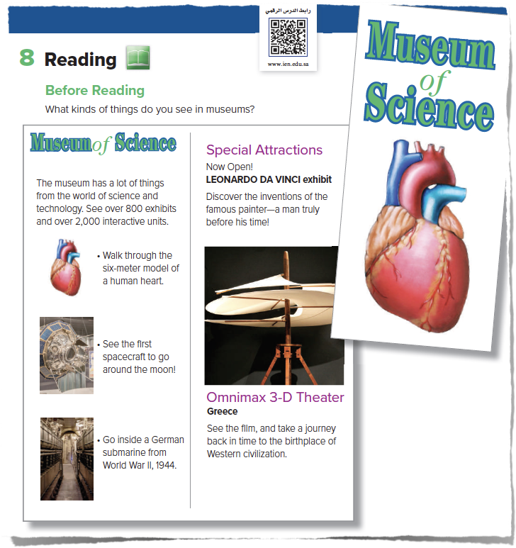
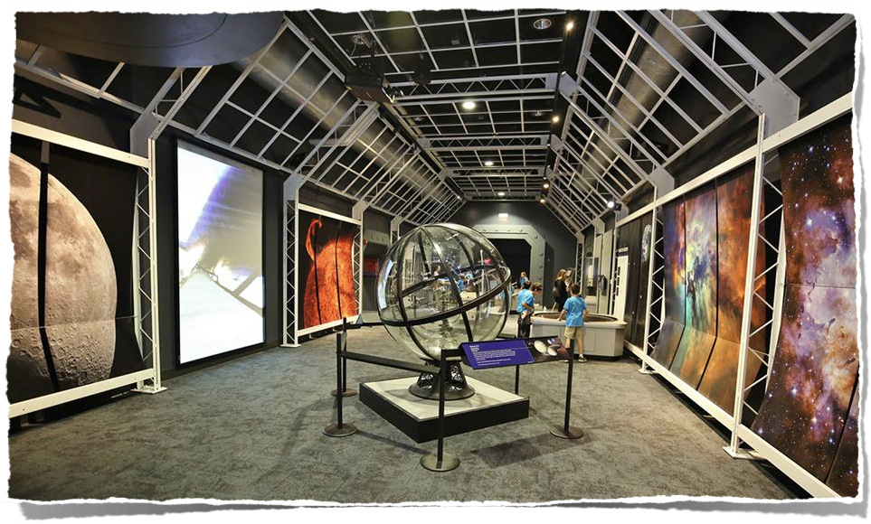
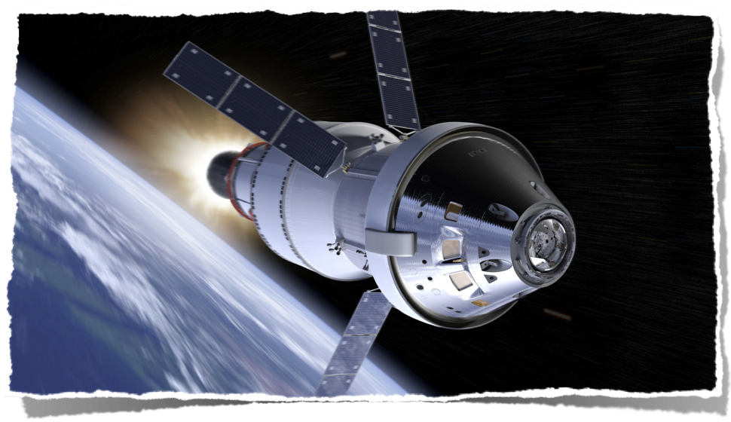
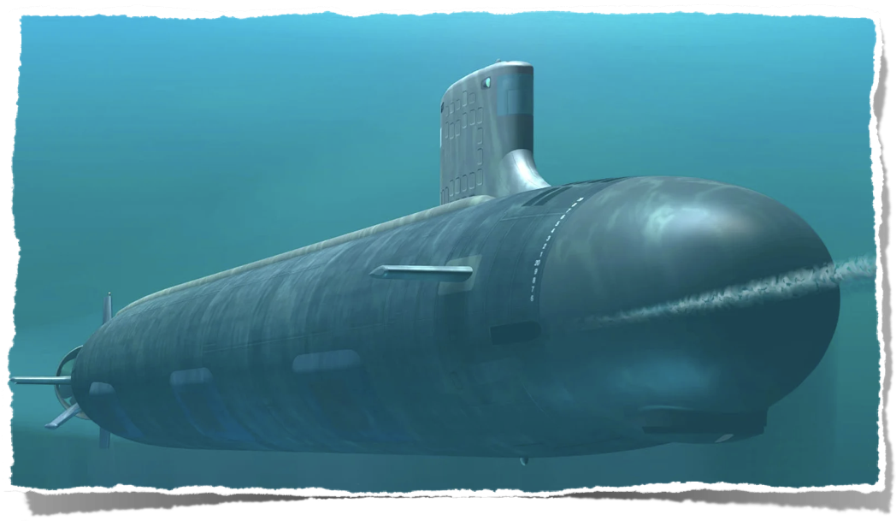
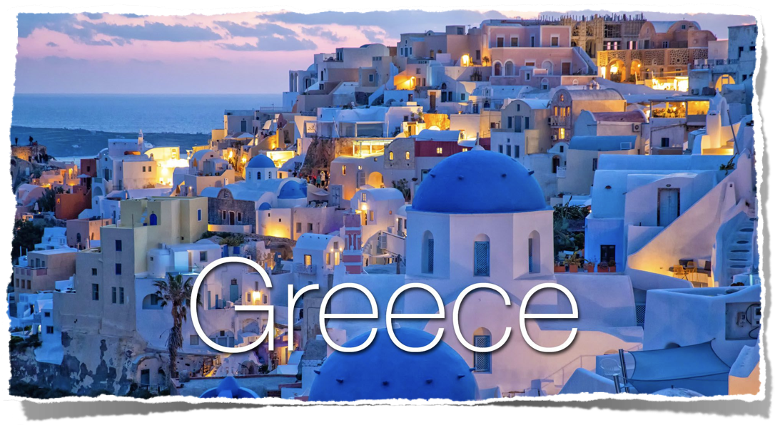
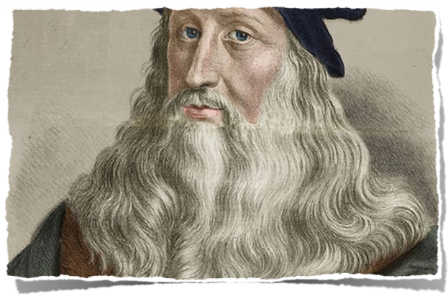
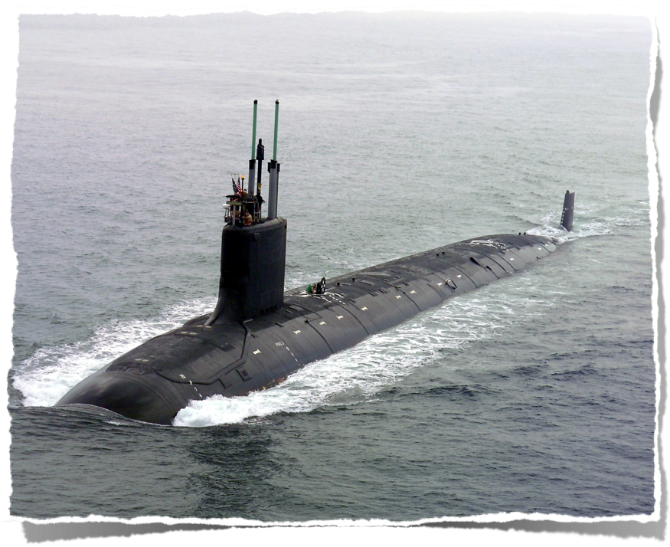

Slide 18
What can you see in the museum of science ?
Page 23
How many exhibits are there?
Who is Leonardo?
How long is the human heart model?
Is the submarine German?
Can you see a film in this museum?

Slide 19
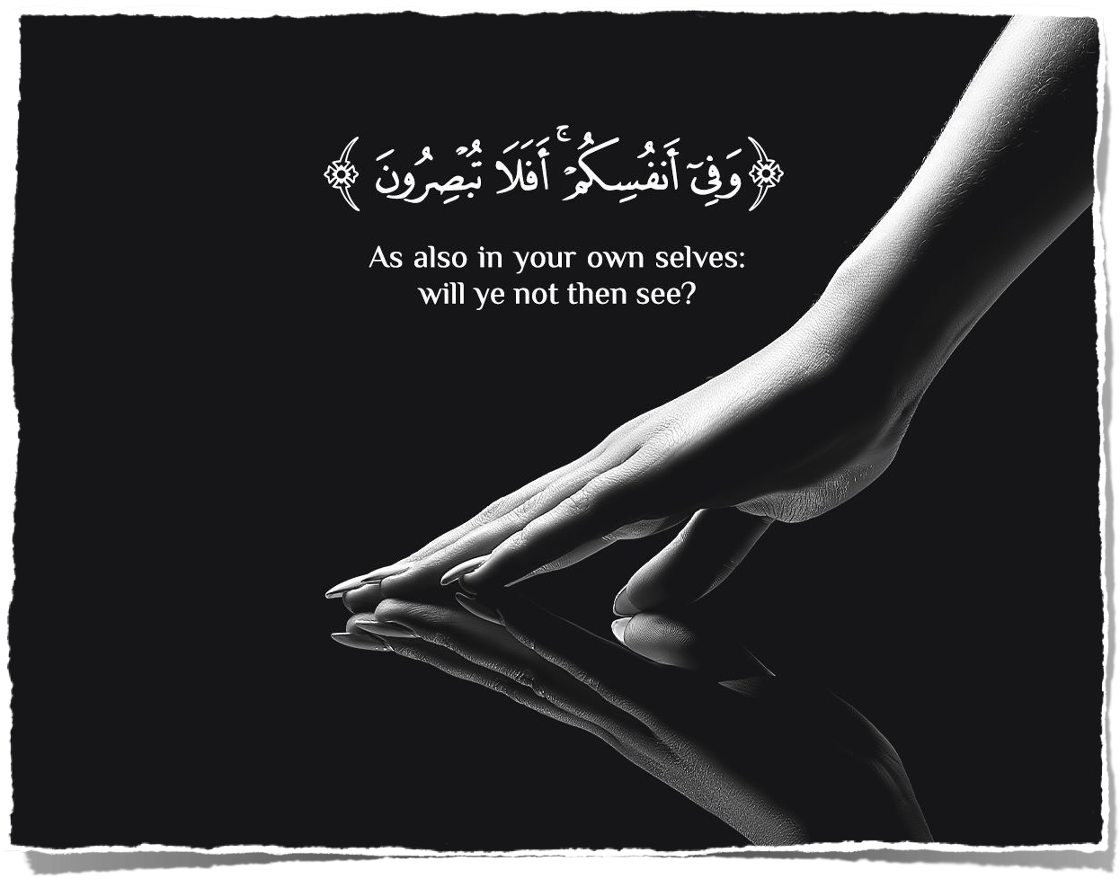
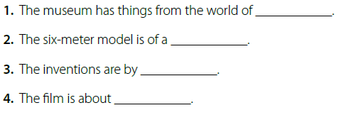
Page 23
science and technology
human heart
Leonardo da Vinci
Greece

Slide 20
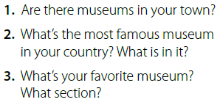
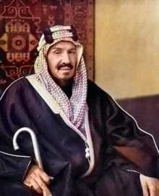
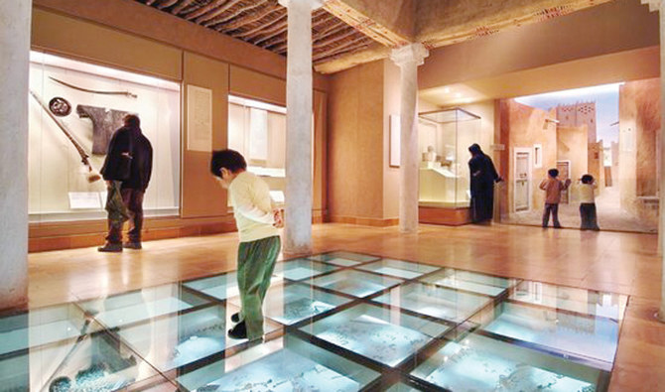
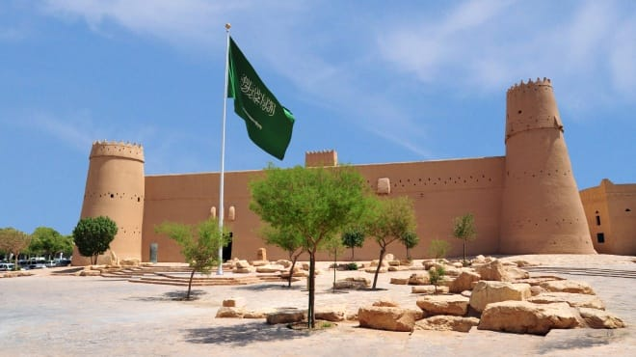
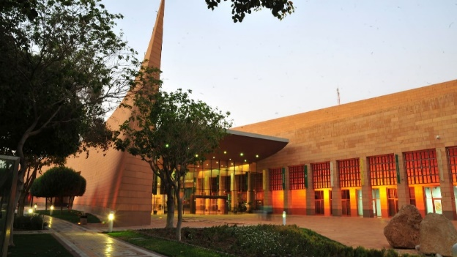
Page 23
Yes, there are.
In Riyadh, there is National History Museum.
In it you can find fossils, skeleton and things from old civilization.
My favorite museum is Al Masmak Museum
I love the section about King Abdul Aziz.
https://www.urtrips.com/jeddah-museums/

Slide 21
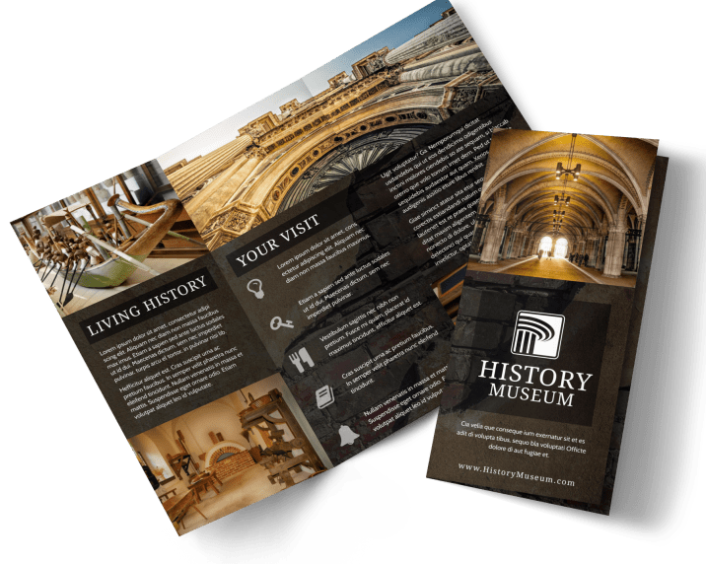
Page 24
Make your brochure. You can use the Reading as a model.

Slide 22
Homework:
G
Page 198

Slide 24
