Slide 1

Unit 3
When Are You Travelling?
Conversation

Slide 2
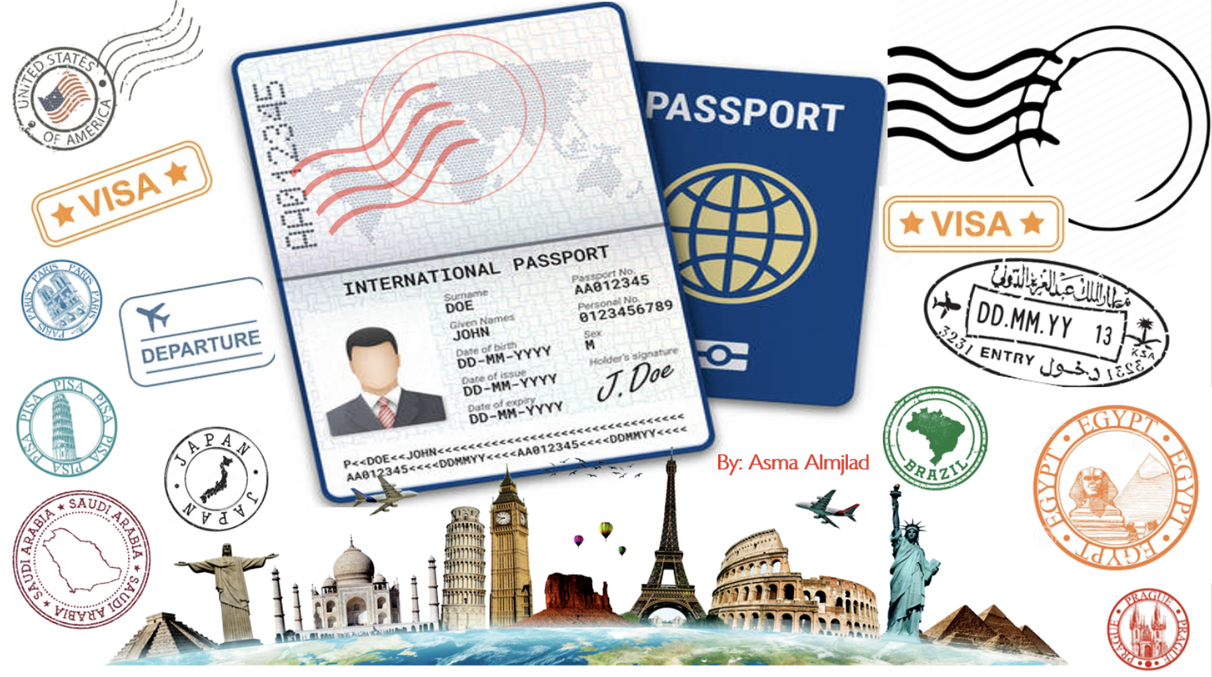

Slide 3
بسم الله الرحمن الرحيم
Day:
Date:

Slide 4


Learning Objectives
Practice conversation correctly
answer questions about the conversation correctly
role play a conversation with someone on a plane
practice using real talk phrases

Slide 5
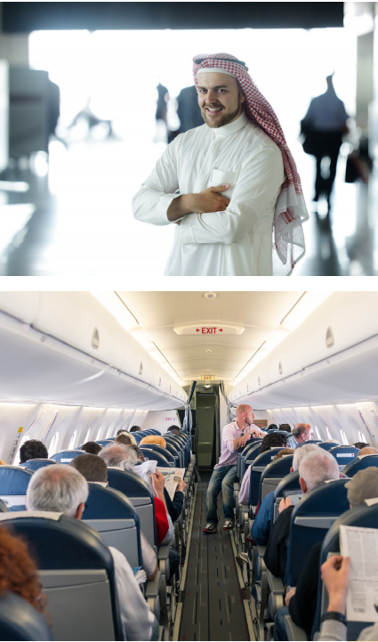
Page:27
What is the connection between the pictures?
Where do you think the people on the plane are going?
What do strangers on planes often talk about?
Do you like to talk to strangers on planes? Why or why not?

Slide 6
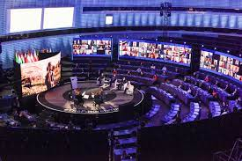
Vocabulary
conference

Slide 7
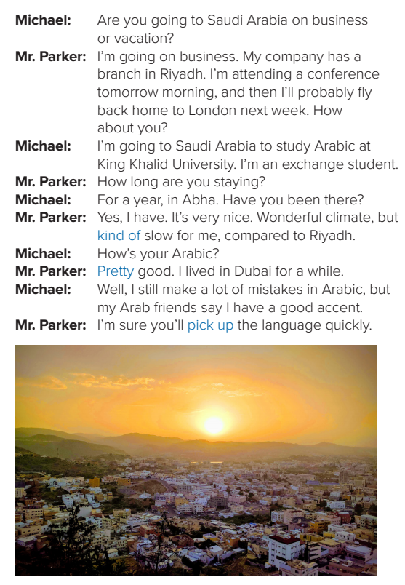

Page:27
Where is the plane going?
(Saudi Arabia)
Do the two people in the conversation know each other?
(no)

Slide 8
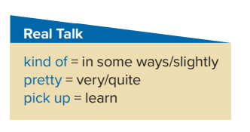
Page:27

Slide 9
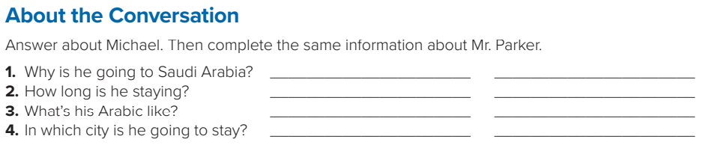
Page:27
Michael
1.He’s going to Saudi Arabia
to study Arabic.
2. He’s staying for a year.
3. He still makes mistakes
in Arabic.
4. He’s going to stay in Abha.
Mr. Parker
He’s going to Saudi Arabia on business.
2. He’s staying for a few days.
3. His Arabic is pretty good.
4. He’s going to stay in Riyadh.

Slide 10
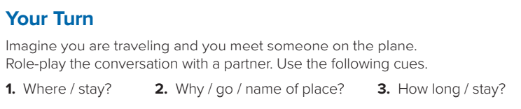
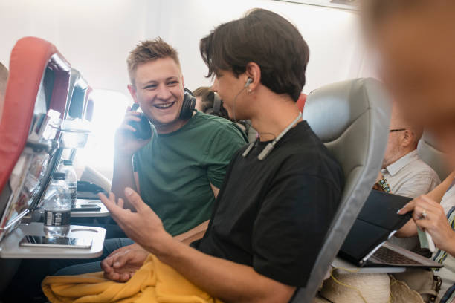
A:Why are you going to Egypt?
B:I’m going to Egypt on a vacation
A:How long are you staying?
B:for two weeks.
A:What’re your Arabic like?
B:not good but it isn’t a big problem since most people there understand English.
A:In which city are you going to stay?
B:I’m going to stay in Alexandria.

Slide 11

Homework
Workbook
Page 182
( SINGLE LARGE HEADER )

Slide 12
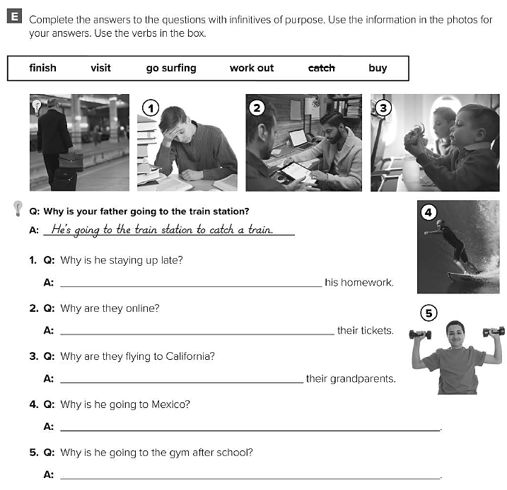
He’s staying up late to finish
They are online to check on
They are flying to visit
He’s going to Mexico to go surfing .
He’s going to the gym to work out .

Slide 13
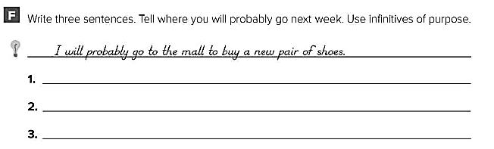
I will probably go to the park to play football .
I will probably go to my friend’s house to play video games .
I will probably go to the mall to hang out with my friends .

