Slide 1

Unit 3
When Are You Travelling?
Writing

Slide 2
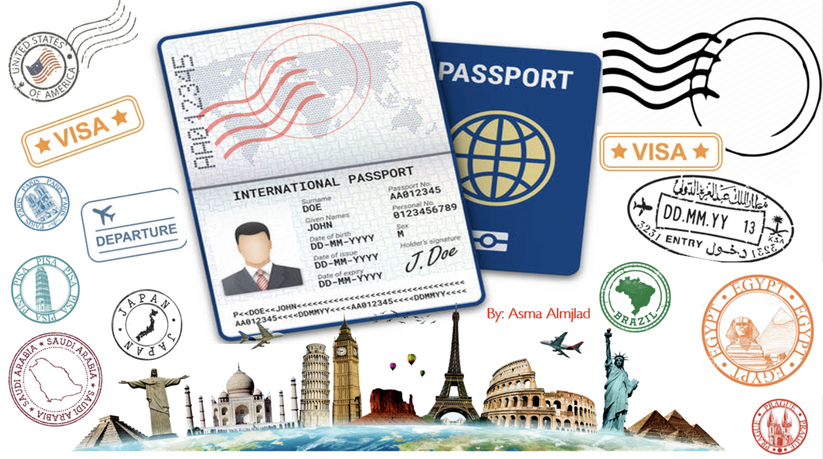

Slide 3
بسم الله الرحمن الرحيم
Day:
Date:

Slide 4


Learning Objectives
Identify the main idea of an e-mail
Use intensifiers to make the adjectives stronger
write an e-mail for a friend.
Write key information for an email

Slide 5


Slide 6
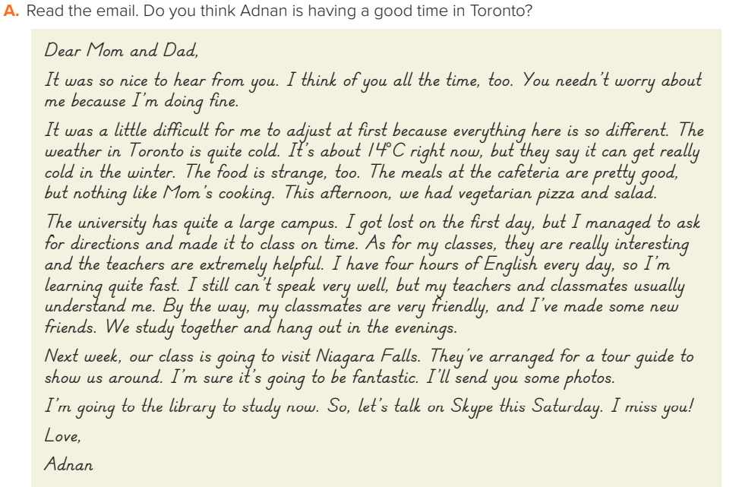
Page:30
In general, he is having a good time. He has made new friends and he is looking forward to a tour of Niagara Falls. He thinks his classes are interesting, and he is learning English quickly. However, he has had some difficulties adjusting to the weather and the food. He also misses his family

Slide 7
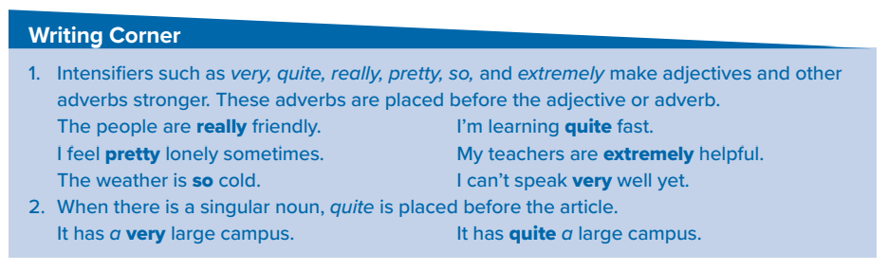
The test was quite difficult.
It was quite… (a difficult test.)
The lesson was quite interesting.
(It was quite an interesting lesson.)
That boy is quite tall.
(He is quite a tall boy)

Slide 8
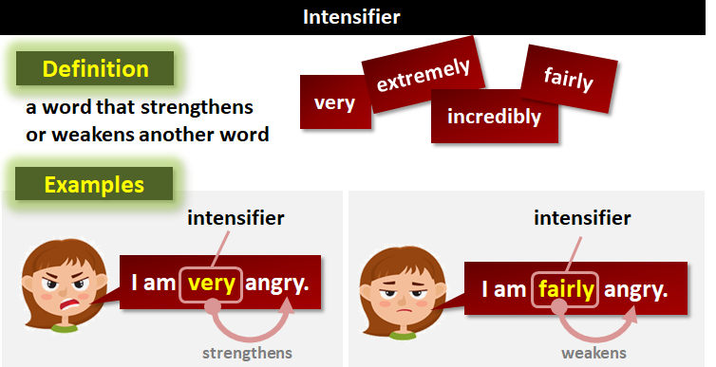

Slide 9
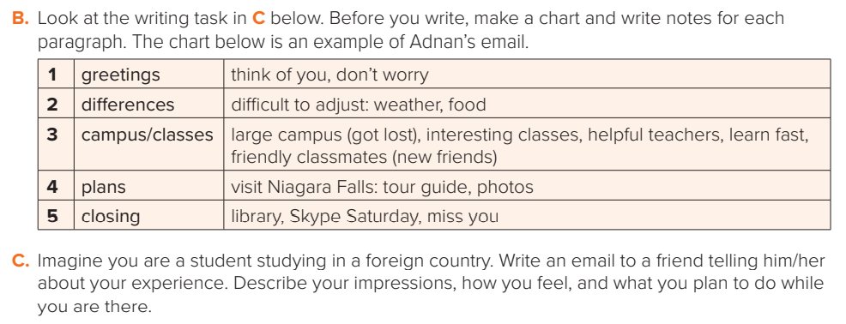

Slide 10
Dear Sara,
It was so nice to hear from you. I think of you all the time, too. You needn’t worry about me because I’m doing fine. It was a little difficult for me to adjust at first because everything here is so different. The weather in Tokyo is very cold specially in winter it’s below 0°C most of the time . The food is strange, too but not bad The university has quite a large campus.. As for my classes, they are really interesting
and the teachers are extremely helpful. I have four hours of Japanese every day, so I’m learning quite fast. I still can’t speak Japanese very well, so I live with a Japanese family to improve my language. I’ve made some new friends. We study together and hang out in the evenings. Next week, our class is going to visit the Japanese national museum . I’ll send you some photos. I’m going to the Cafeteria now. So, let’s talk on Skype this Saturday. I miss you!
Love,
Noura

Slide 11

Homework
Workbook
Page
184
( SINGLE LARGE HEADER )

Slide 12
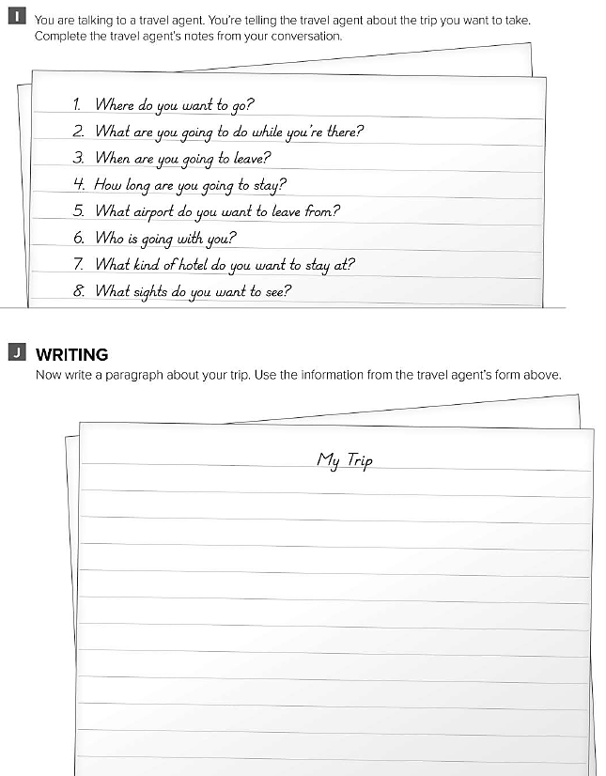
1-I want to go to Paris.
2-I’m going to go sightseeing.
3-On May 20
4-I’m staying there for 2 weeks
5-King Khalid international airport in Riyadh
6-My friends.
7-not too expensive a 3 star hotel will be fine
8-Eiffel Tower / Louvre Museum/ Champs de alysee street

