Slide 1




Slide 2
Mega Goal 1.1
Unit 2 - Careers
4 Language in Context
5 Listening
6 Pronunciation
By: Essa Al Hussaini

Slide 3



Slide 4


Objectives
Create
a job profile
Complete
a chart from a job interview
Differentiate
the sounds /m/ ; /n/ ; /ŋ/

Slide 5
4
Language in context

Slide 6




What is it?
Job profile
What is it for?
Qualifications
What does it highlight?
Special Skills
Personality
Notes:
Meaning of job profile in English
a description of the skills, experience, and personality a person would need in order to do the job:
The job profile outlines the details of an employee's job
CV = Resume

Slide 7

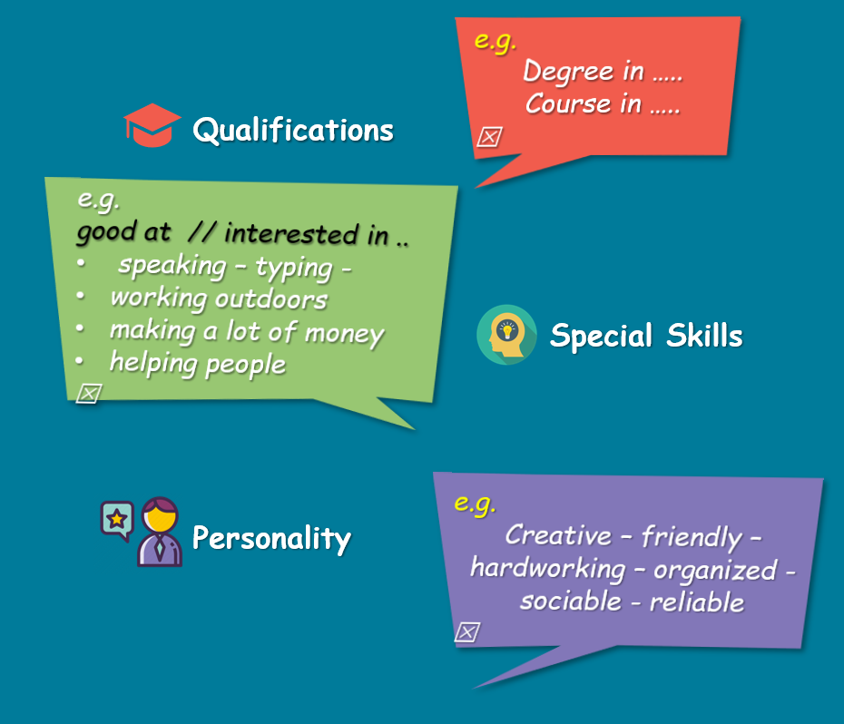
e.g.
Degree in …..
Course in …..
Majored in …

Job profile
Qualifications
e.g.
good at // interested in ..
speaking – typing -
working outdoors
making a lot of money
helping people

Special Skills
Qualifications
e.g.
Creative – friendly – hardworking – organized - sociable - reliable

Special Skills
Personality
Personality

Slide 8

Create yours
Job profile
Qualifications
Special Skills
Personality

Slide 9

Job profile
Possible job for you is
Qualifications
Special Skills
Personality

Slide 10

Job profile
Read & say
Your suggestion??
Possible job
* TV reporter
A TV reporter needs to be confident and has to be comfortable in front of the cameras, and should be interested in following news
events.
Qualifications
Degree in journalism
Special Skills
good at speaking in public
interested in following news
events
Personality
TV reporter
confident

Slide 11

* Secretary
A secretary has to have skill in typing, needs to be creative and organized, and should know how to deal with people.
Job profile
Read & say
Your suggestion??
Possible job
Qualifications
degree in secretarial studies,
Course in typing
Special Skills
Secretary
good at using computer, interpersonal skills
Personality
Creative, organized, hardworking

Slide 12

5
Listening

Slide 13






BOOKS CLOSED
You are going to
listen to a job interview
Listen and answer
Candidate’s name
Education
Skills
Experience
Working hours
Salary
job description
Notes:
Candidate: a person who applies for a job

Slide 14
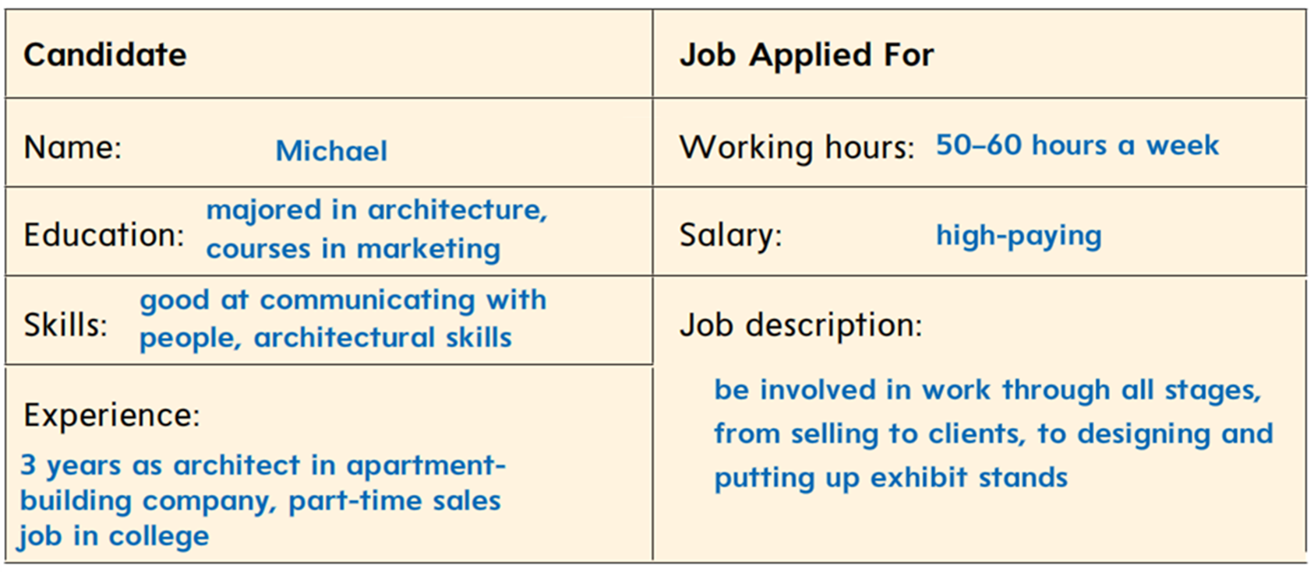

Listen & Complete
Student’s book
24

Slide 15
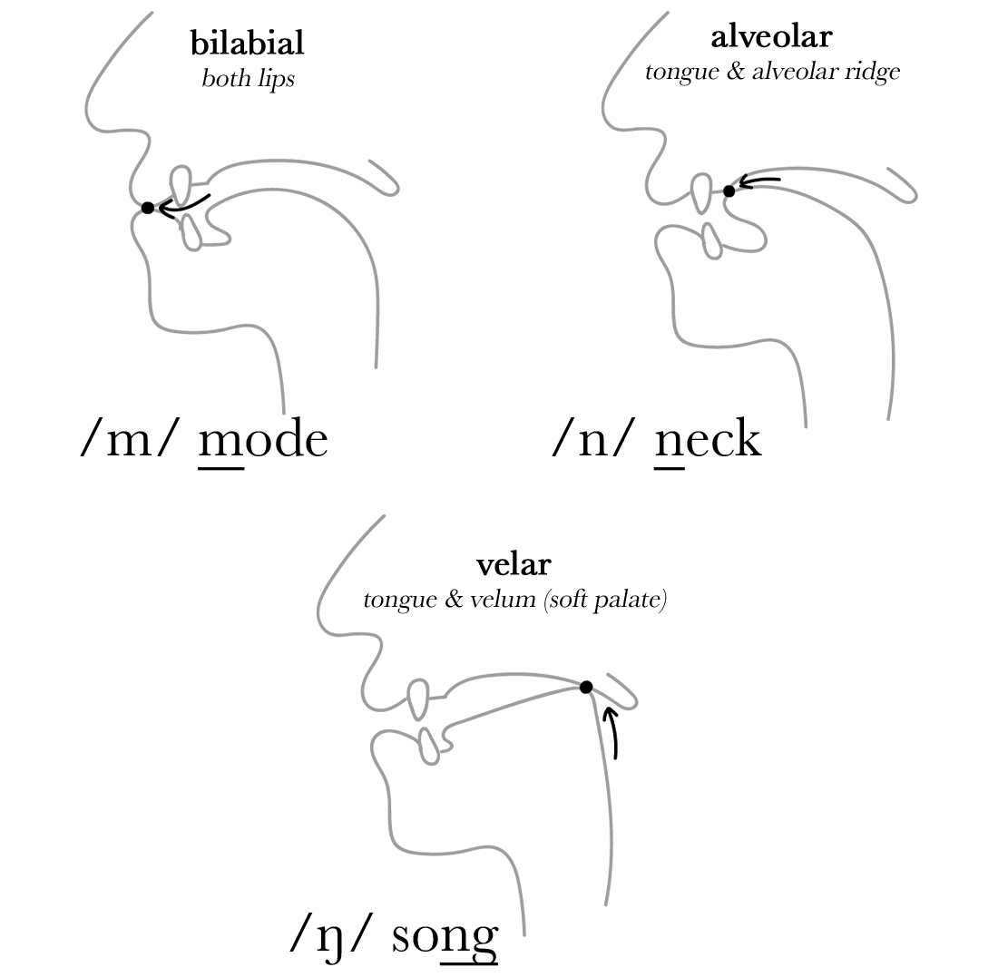

6
Pronunciation
sounds
/m/ ; /n/ ; /ŋ/

Slide 16
The sounds
/m/ - /n/ - /ŋ/
Notes:
/m/ Bilabial = using both the upper and lower lips
/n/ Alveolar = pronounced with the tip of the tongue touching teeth ridge
/ŋ/ Velar = sound produced with the tongue up or near the soft plate

Slide 17
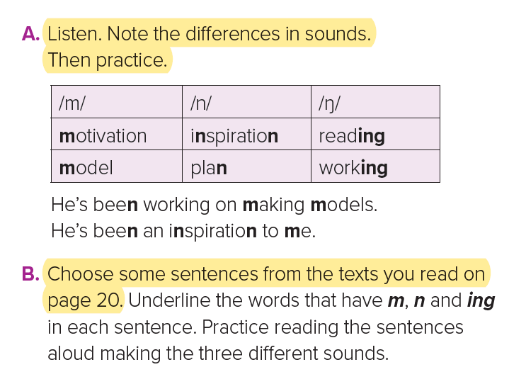
The sounds
/m/ - /n/ - /ŋ/
Notes:
/m/ Bilabial = using both the upper and lower lips
/n/ Alveolar = pronounced with the tip of the tongue touching teeth ridge
/ŋ/ Velar = sound produced with the tongue up or near the soft plate

Slide 18
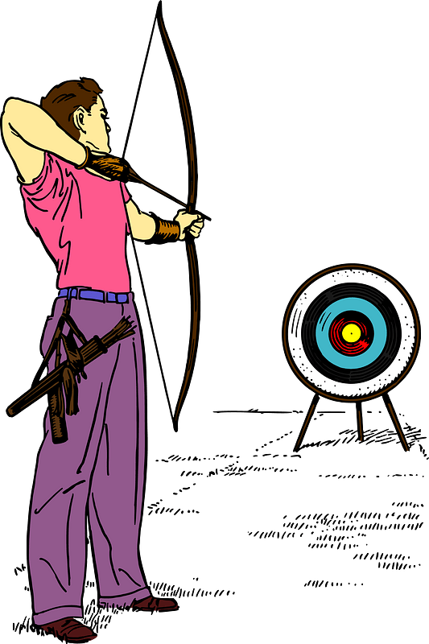

The sounds
/m/ - /n/ - /ŋ/
Notes:
/m/ Bilabial = using both the upper and lower lips
/n/ Alveolar = pronounced with the tip of the tongue touching teeth ridge
/ŋ/ Velar = sound produced with the tongue up or near the soft plate

Slide 19

7
About You

Slide 20
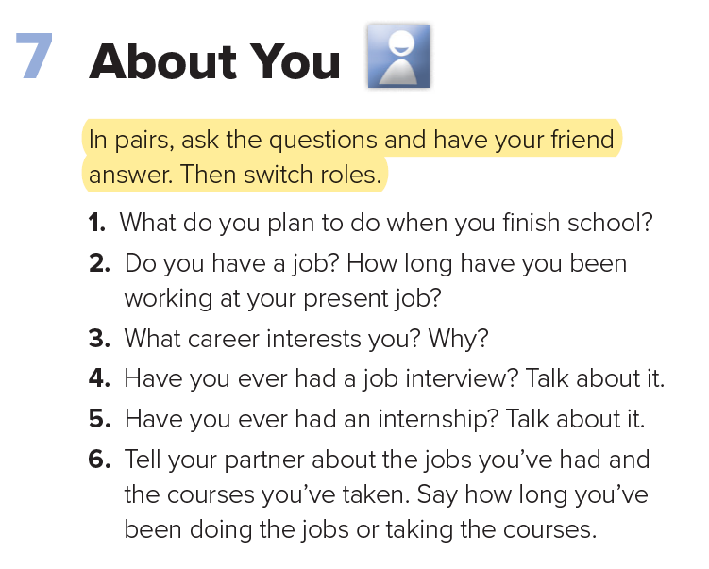
in pairs

Slide 21


