Slide 1
My body
We can 1
Unit : 2
Lesson:1
Tr: Kholoud AlGhamdi

Slide 2
Have you celebrated Saudi national day?

Slide 3
Say hi to Safroot…
Hello,,
How are you?
Hi Safroot,,
I’m fine thanks

Slide 4
Name some colors you took last unit
What is your favorite color?

Slide 5
Objectives:
1- to introduce the body parts..
2- to listen and do the body actions
3- practice saying close and open your eyes..
4- to write letters I and j .

Slide 6
..

Slide 7
My body
body

Slide 8
eyes
eye

Slide 9
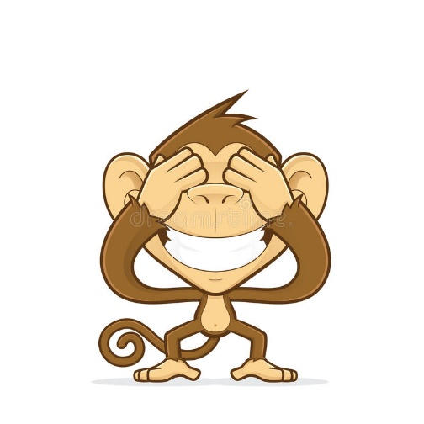
Close your eyes !!

Slide 10
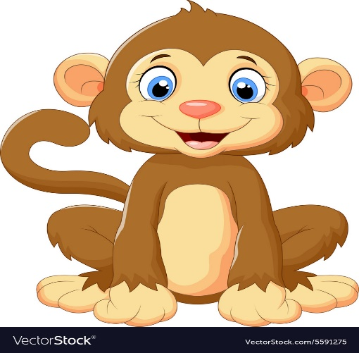
Open your eyes !!

Slide 11
Mouth
قال الله (ولا يغتب بعضكم بعضا)

Slide 12
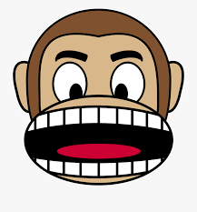
Open your mouth !!!

Slide 13
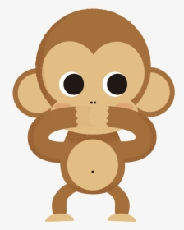
Close your mouth !!

Slide 14
Head
head

Slide 15
Touch your head !!

Slide 16
Nose

Slide 17
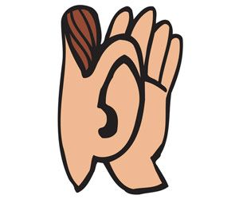
ears
How many ears do you have ??
ear

Slide 18
hand
How many hands do you have ??

Slide 19
Raise your hands!!
hands

Slide 20
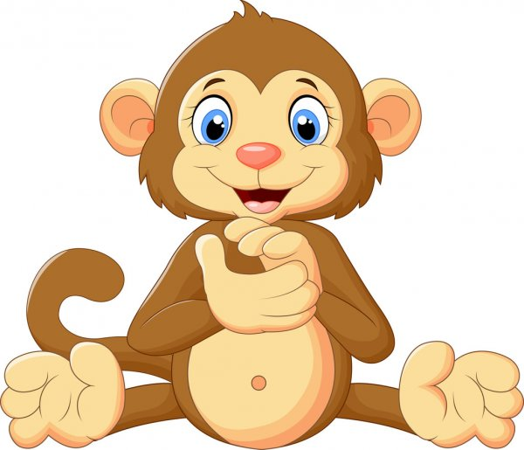
Clap your hands !!

Slide 21
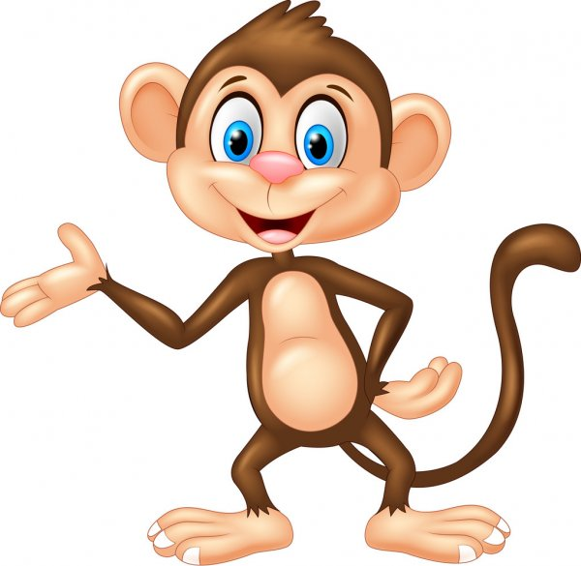
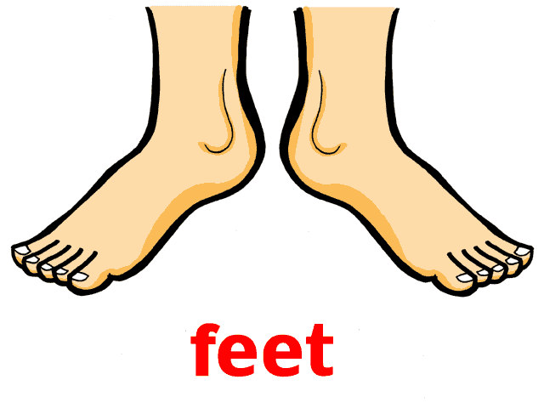
foot
Do you have three feet ?

Slide 22
shoulders

Slide 23
Let’s chant ..

Slide 24
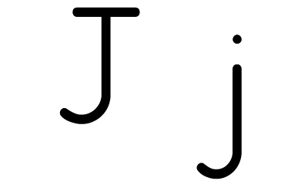
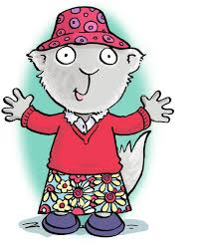
..

Slide 25
Open your books.. P12

Slide 26
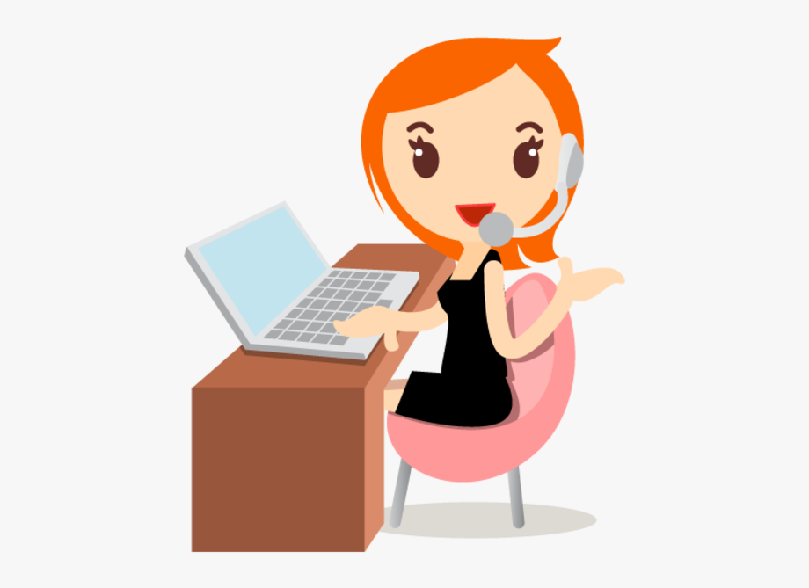
Have a nice day Good bye..
Tr : Kholoud Al Ghamdi

