Slide 1

Good Morning
Mega Goal 2.1

Slide 2
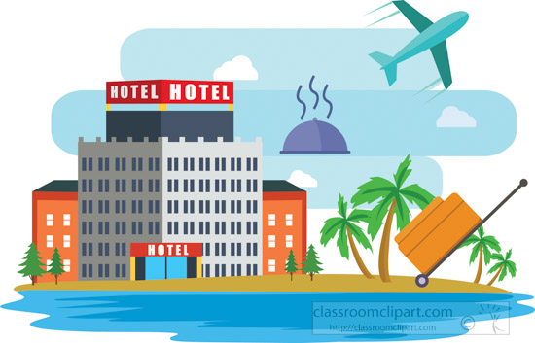
Good Morning
Mega Goal 2.1
Unit -3-
Far and Away
Conversation
Conversation

Slide 3

Unit -3-
Far and Away
Conversation
Good Morning
Mega Goal 2.1

Slide 4




Objectives:
1
2
3
Name stuff to take along when traveling
Use the new words in a conversation .
Use the “ real talk " phrases in new sentences
4
5
Declining special requests.
Make special requests

Slide 5
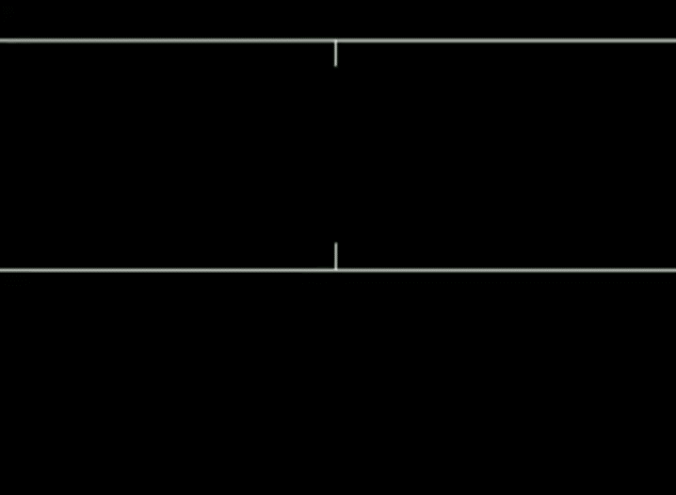

Slide 6
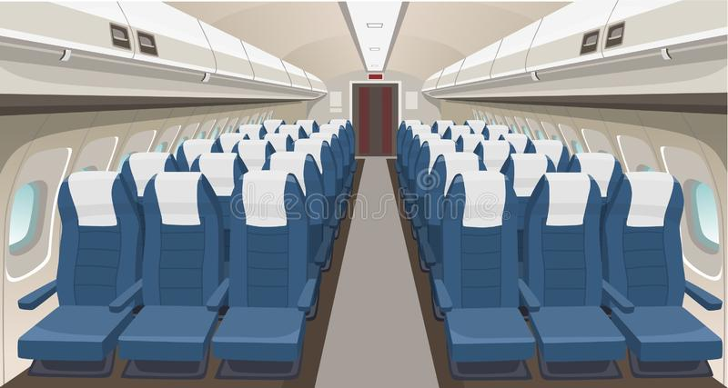
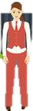
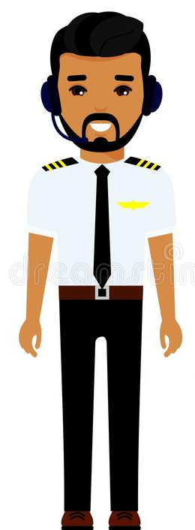
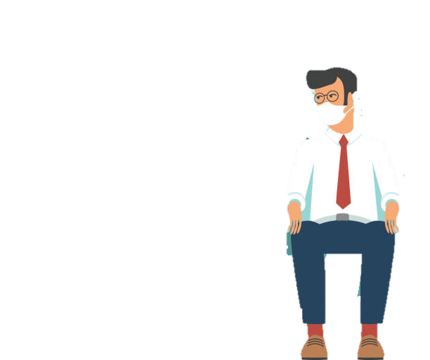
Warm Up
attendant
seat
Passenger
Aisle

Slide 7
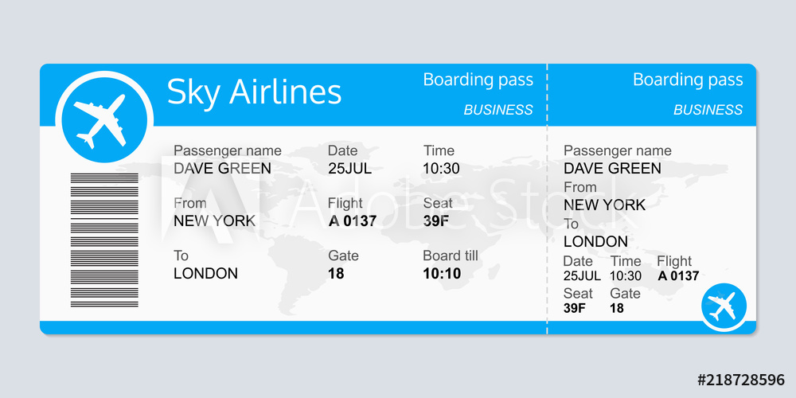
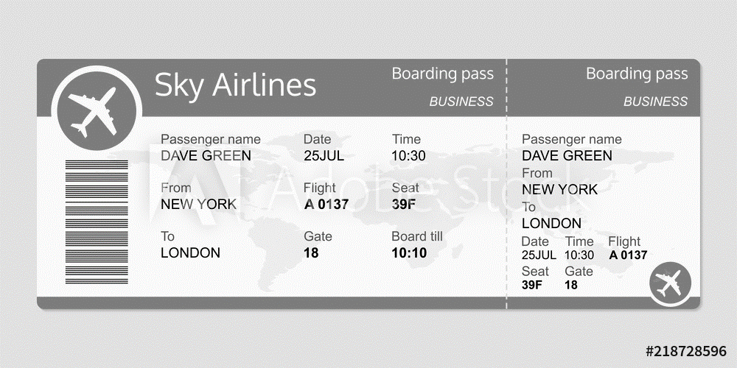

Warm Up
Boarding pass
What do you do when you board a plane?
Do you have to sit in your assigned seat?
Where do you like to sit—by a window or on the aisle?

Slide 8
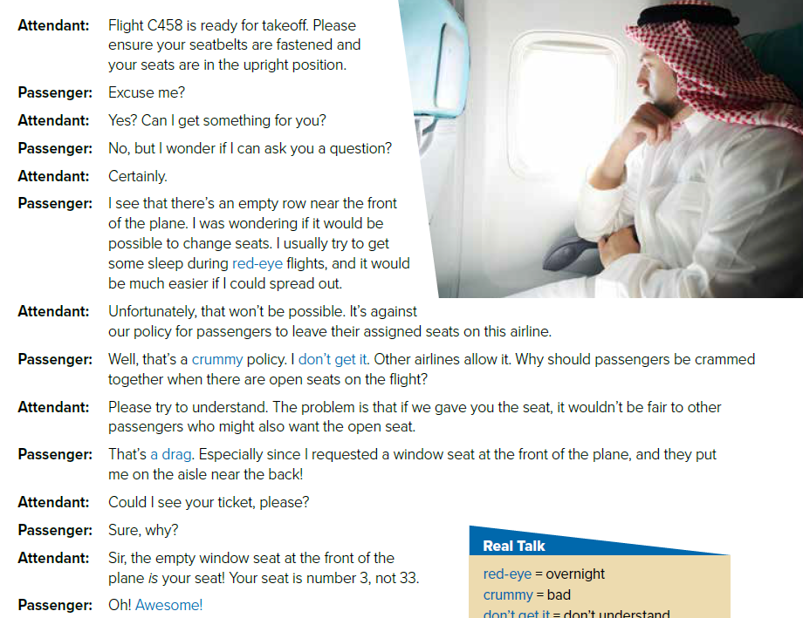



Listen & read
Listen

Slide 9
What is your opinion of the man’s request?
What is your opinion of the man’s request?
What is your opinion of the man’s request?
What if you have seen problems with seating.
Was it OK to ask for the seat change?
What is your opinion of the man’s request?
What is your opinion of the man’s request?
What do you think of the airline policy?

Slide 10
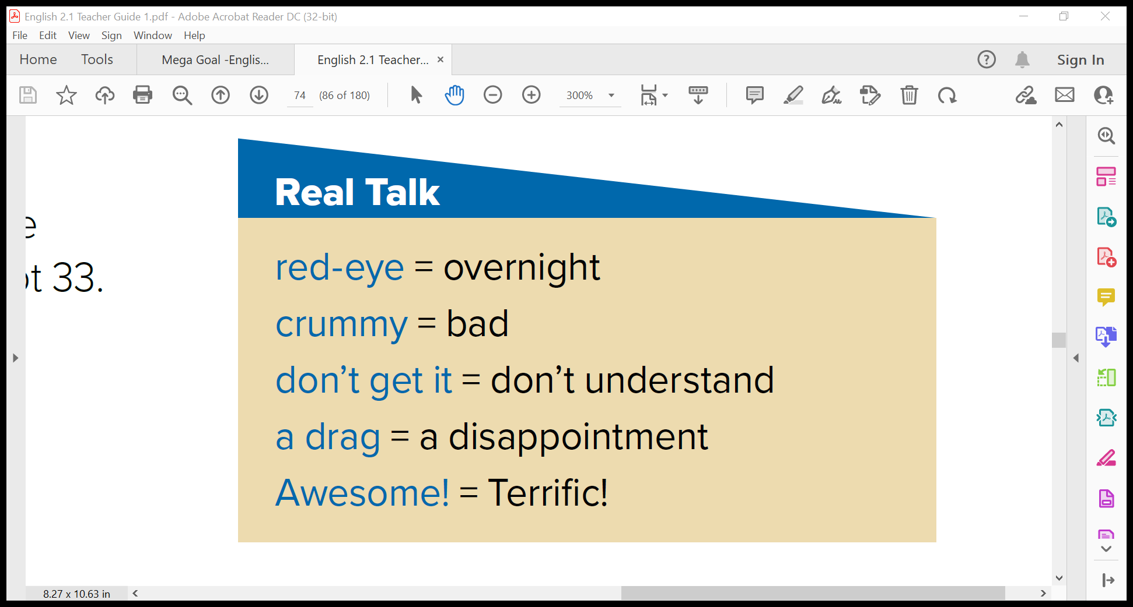






Slide 11
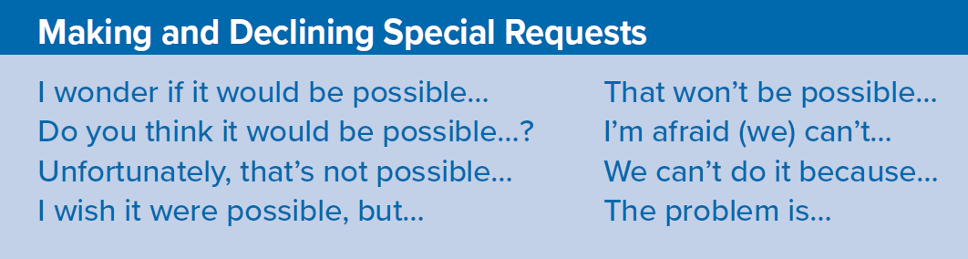
About the Conversation
1. What request does the passenger make?
2. How does the flight attendant respond? What reasons does he give?
3. How does the passenger end up getting what he wants?
1- He would like to change seats .
2- He says that changing seats won’t be possible because it wouldn’t be fair to other passengers. It’s also against the policy of the airline .
3- The passenger was in the wrong seat to begin with. He moves to his assigned seat, which is the one that he wanted .

Slide 12
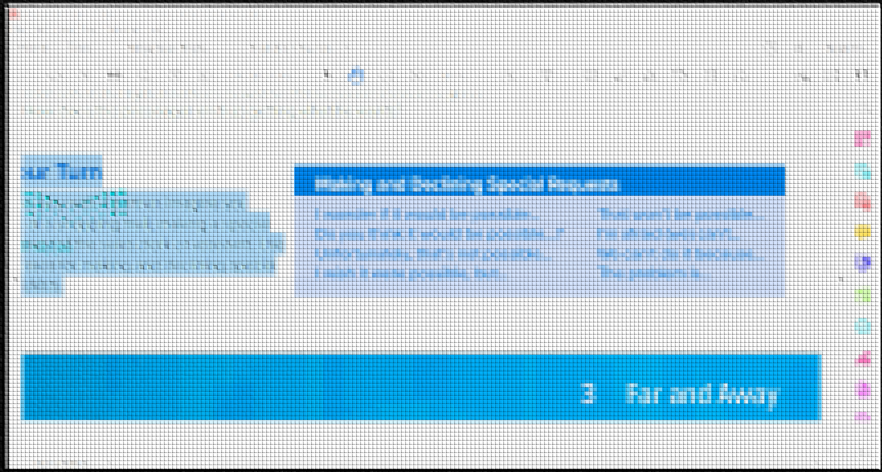

Slide 14

Your Turn
Role-play with a partner. Imagine you
are at a shopping mall, making a special
request of the sales clerk or assistant. Use
phrases for making and declining special
requests.

Slide 15


