Slide 1
Unit 4
What’s that?
Lesson 5

Slide 2
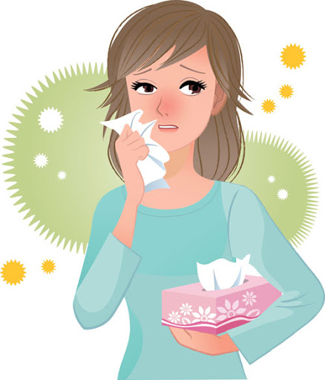
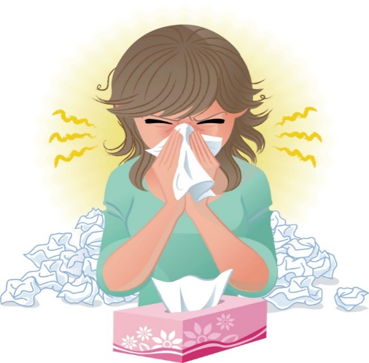
☺Avoid gathering !
Covid 19
☺wear a mask before going out.
☺Social distancing is not a choice, it is a must!
☺Keep a distance of 2 meters to avoid accountability
☺wash hands constantly.

Slide 3
بسم الله الرحمن الرحيم
Day:
Date:

Slide 4
Learning Objectives
use can & will to make an offer correctly
use can & will to make a request correctly
use please to make a polite request
Differentiate between requests and offers

Slide 5
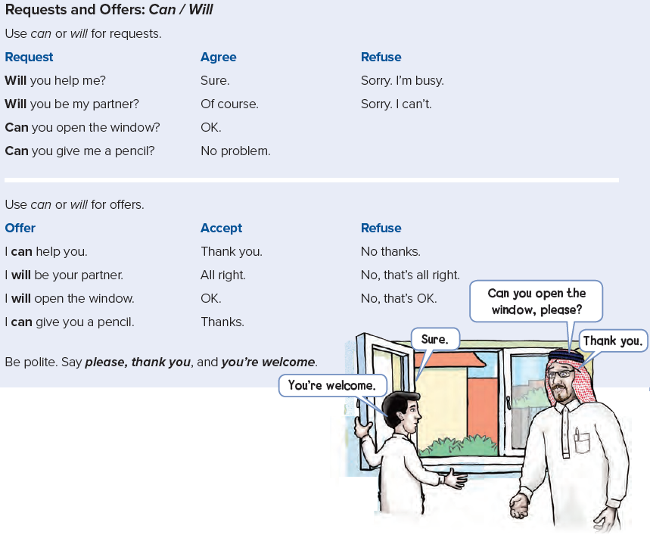

Slide 7
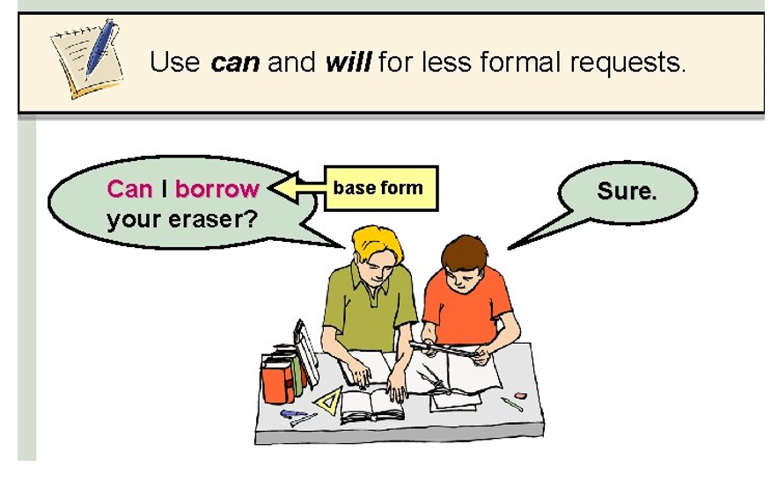

Slide 8
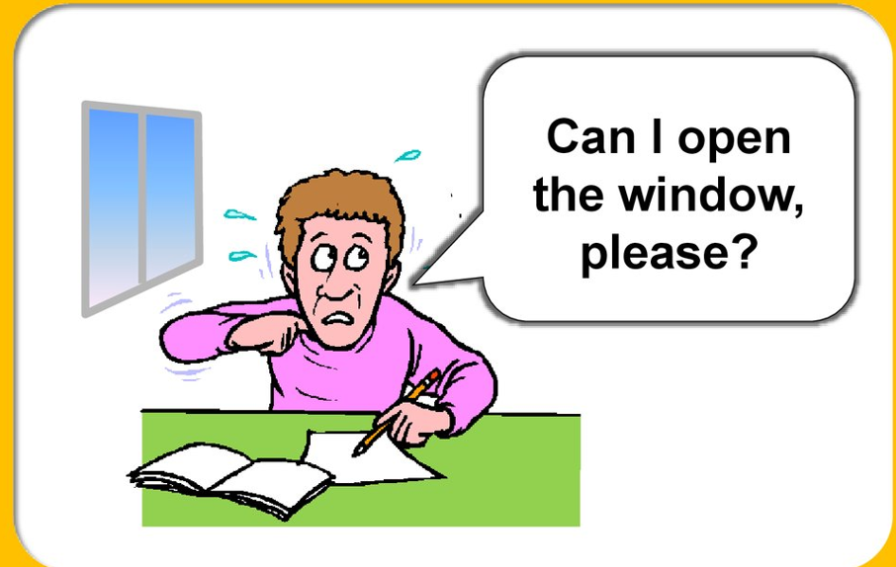
Request
offer
I will open the window.

Slide 9
Practice

Slide 10
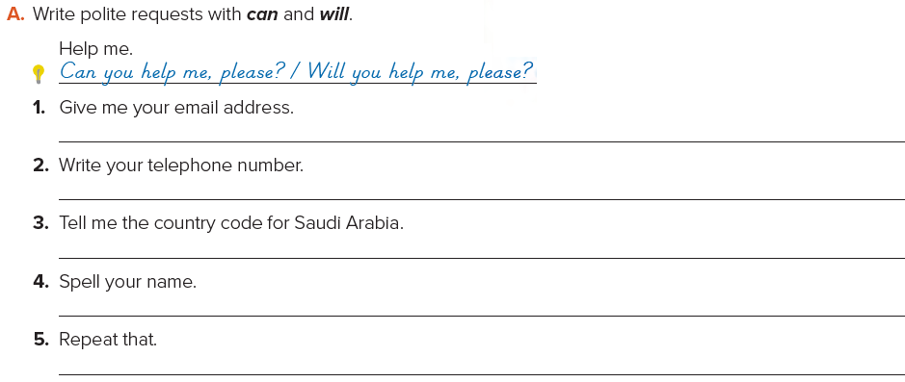
Can you please give me an eraser?
Will you close the door, please?
Can you please be my partner?
Will you open your books, please?
Can you please repeat that?

Slide 12
Home Work

Slide 13
USA
PERU
EUROPE
AUSTRALIA

