Slide 1
Families ,families
1-Listen and discuss

Slide 2
What do you see in page 40-41
What do you think the objectives are for our lesson today?

Slide 3
Objectives for our lesson today:
1-Talk about types of families.
2-Use possessive case.
3-Identify more members of a family.
4-Mark cities on the kingdom of Saudi Arabia map.

Slide 4
What’s the title ?

Slide 5
Discussion:

Slide 6
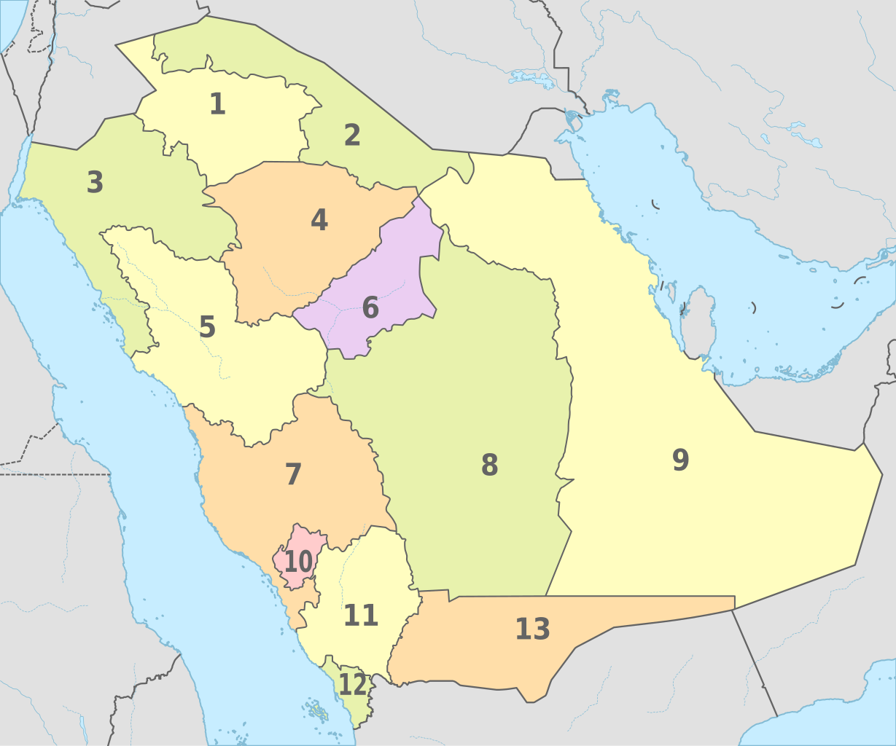
Where are the cities? Mark them on the map
Jeddah –Dammam –Riyadh -Abha
Damma
Riyadh
Jeddah
Abha
This Photo by Unknown Author is licensed under CC BY-SA

Slide 7
Listen then underline new vocabulary:

Slide 8
Possessive case (’s):Mark them on this passage

Slide 9
Comprehension:
1-He has two children.
2-She is Asma.
3-She has one brother.
4-He is Hameed.

Slide 10
Identify the family members
grandpa
grandma
mom
dad
aunt
uncle
uncle
brother
sister
cousin
cousin
Me

Slide 11
Grandfather-Grand mother
Mother-Father
Me
Baby son
Teenage daughter
Grand parents
Parents
Wife - Husband
aunt
uncle
Wife - Husband
sister
siblings
siblings
grandchildren
cousins

Slide 12
Who am I?
My aunt
My grandfather
My uncle
My cousin

Slide 13
Live worksheets
عن أبي هريرة رضي الله تعالى عنه قال: قال رسول الله صلى الله عليه وسلم: «من كان يؤمن بالله واليومِ الآخر فليُكرِم ضيفَه، ومن كان يؤمن بالله واليومِ الآخر فليصِل رحمه، ومن كان يؤمن بالله واليومِ الآخر فليقل خيرًا أو ليصمت»؛ (البخاري) رابط المادة: http://iswy.co/e18gcu
HOMEWORK
https://www.liveworksheets.com/tx810534xd

