Slide 1

EXPANSION
Units 1–4
(part 1)

Slide 2
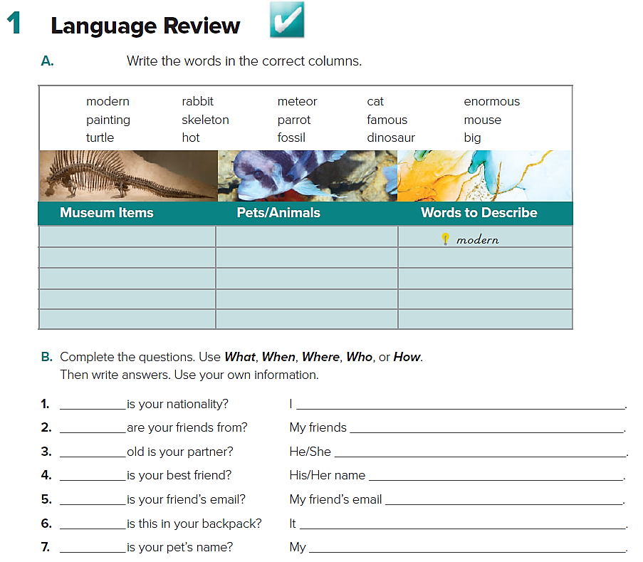
meteor
painting
skeleton
fossil
dinosaur
rabbit
cat
Parrot
mouse
turtle
enormous
famous
hot
big
What
Where
How
Who
What
What
What

Slide 3
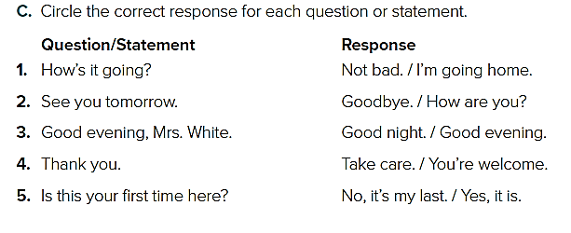

Slide 4
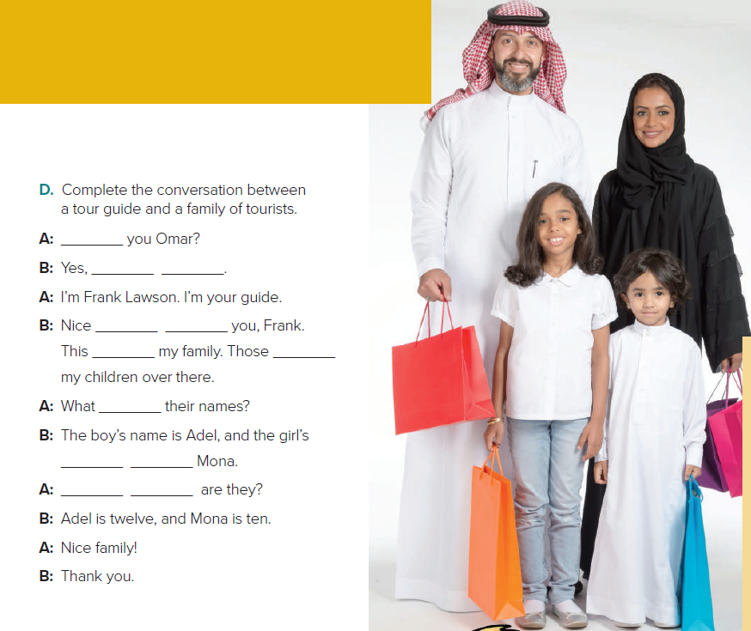
Are
I am
to meet
is are
are
name is
How old

Slide 5
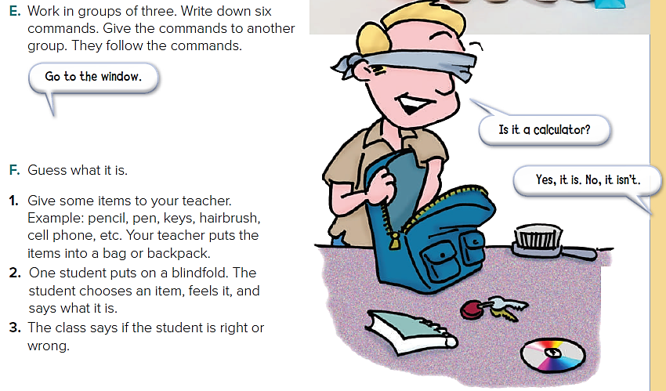

Slide 6
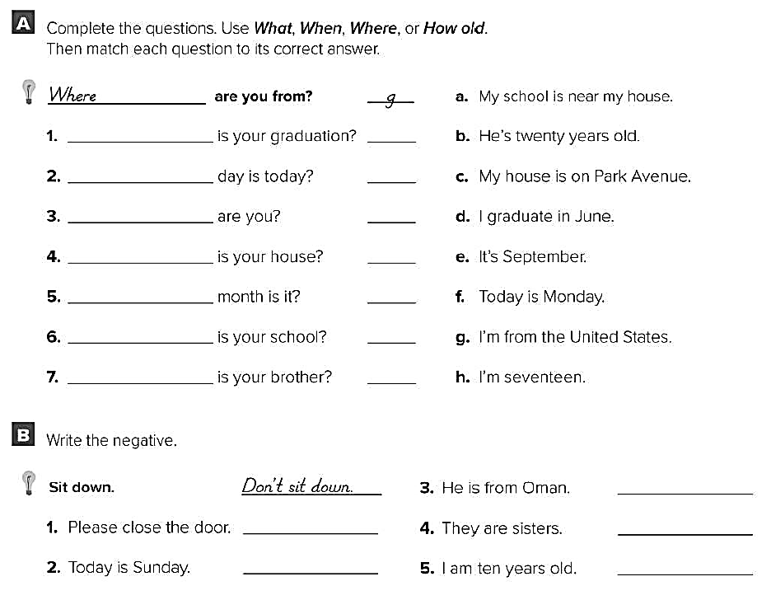
When
What
How old
Where
What
Where
How old
d
f
h
c
e
a
b
He isn’t from Oman
Don’t close the door
They aren’t sisters
Today isn’t Sunday
I’m not ten years old

Slide 7
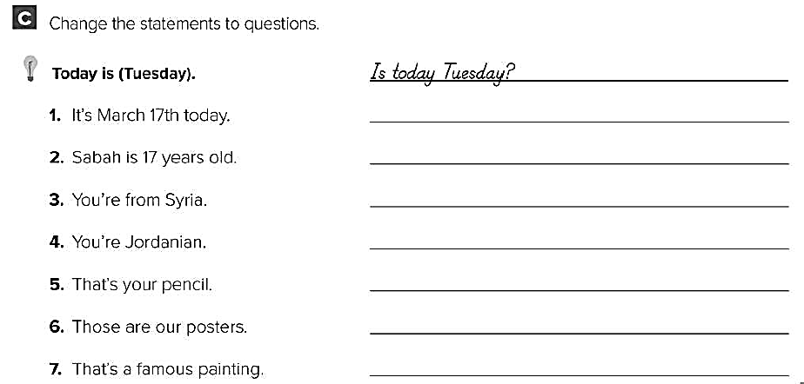
What day is today?
How old is Sabah?
Where are you from?
What’s your nationality ?
What’s that?
What’re those?
What’s that?

